Slide 1

Full day programe on Audit
Clause by clause analysis of Tax Audit Report
CA Kusai Goawala
Presented for
WICASA – Pune Branch of ICAI
3rd September 2023

Slide 2
Applicability of Tax Audit
Every person carrying on Business whose Gross Turnover/Receipt > 1 Cr.
Every person carrying on Profession whose Gross receipt > 50 Lakh
Where profits & gains of person from business are taxable on estimated basis u/ss. 44AD, 44AE, 44BB or 44BBB & such person claims his income to be lower than profits & gains so estimated (Refer Section 44AD(4)
Tax Audit form 3CA/3CB applicable on the basis of audit applicability under any other law – Audit Format SA700
44AD: An eligible assessee can opt to be assessed on presumptive basis, so long as the sales, turnover or gross receipts from an eligible business do not exceed Rs. 2 crore
44AE: Business of plying, hiring or leasing goods carriages.
44BB: Business of exploration etc. of mineral oil.
44BBB: Business of civil construction etc. in certain turnkey projects.
LLP/Cos not covered in presumptive

Slide 3
Tax Audit -3CD – Important Clauses
There are 44 clauses and 102 sub clauses
Agenda to discuss important clauses with issues
Audit Process and Documentation

Slide 4
Clause 4 : Registration under various indirect taxes
Clause 4 : Whether the assessee is liable to pay indirect tax like excise duty, service tax, sales tax, customs duty, etc. if yes, please furnish the registration number or any other identification number allotted for the same
Relevant Issue :
If the assessee is liable to pay indirect taxes, but is not registered, what will be the auditor’s Duty in such an event?

Slide 5
Clause 9 : Details of Partnership
Clause 9: Is applicable to Firms & Association of Persons
[Sub-Clause (a)] : Names of partners / members & their profit-sharing ratios
[Sub-Clause (b)] : If there is Changes in the constitution, or profit-sharing, of Partnership / Association since the last day of preceding year, the particulars of such change
Relevant Issue :
  Will change in remuneration paid to partners, without change in profit-sharing ratio, require any disclosure in tax audit report?
  When partner in representative capacity retires & is admitted as partner in individual capacity, will it amount to change in partnership?
  When the shares of members of AOP are not ascertainable, what is reporting requirement by auditor?

Slide 6
Clause 11: Maintenance of BOA
Clause 11(a): Whether books of accounts are prescribed as per Sec. 44AA, if yes list of books so prescribed?
Clause 11(b): Books of Accounts (BOA) maintained and the address at which BOA are maintained. (In case of computerized system of accounting, mention BOA generated by such system. If the BOA are not kept at one location, furnish the addresses of locations along with the details of BOA maintained at each location)
Clause 11(C): List of BOA examined

Slide 7
Clause : 11 : Detailed Analysis
Section 44AA :
Person Liable to maintain BOA as per this section are – Person carrying on business or profession of
  legal, medical, engineering or architectural profession or
  the profession of accountancy or
  technical consultancy or
  interior decoration
  any other profession as is notified by the Board
Every person carrying on business or profession if his income from business or profession > 1,20,000 (for Indl or HUF Rs.250000) or Total Sales/Gross receipts > 10,00,000 (for Indl or HUF Rs.25 lacs) in any one of the three preceding FY.
Where Business/profession is newly setup - if income is likely to > 1,20,000 (for Indl or HUF Rs.250000) or Sales/Gross receipt likely to > 10,00,000 (for Indl or HUF Rs.25 lacs) during the PY
When PGBP are deemed to be Profit and gain from Sec. 44AE, 44BB, 44BBB, and the asseessee claimed his income lower than so deemed income
where Provision of 44AD(4) is applicable and his income > basic exemption limit.

Slide 8
Clause 11: Relevant Issues
Where stock records are not maintained due to high volume of transactions, what is auditor’s stand?
If multiple location accounting is there like SAP, ERP etc. then how will the same be reported?
In case where stock records are not properly maintained by the assessee due to the nature, level, volume and variety of items/ transactions, What is the call of Tax auditors?

Slide 9
Clause 12: Presumptive profit
Clause 12 : Whether the profit and loss account includes any profits and gains assessable on presumptive basis, if yes, indicate the amount and the relevant sections (44AD, 44AE, 44AF, 44B, 44BB, 44BBA, 44BBB Chapter XII-G, First Schedule or any other relevant section)
SR No. | Section | Business Covered
1 | 44AD | Eligible Business
2 | 44AE | Transport business
3 | 44B | Shipping business of a non-resident
4 | 44BB | Providing service or facilities in connection with, or supplying plant and machinery on hire used, or to be used, in the prospecting for, or extraction or production of, mineral oils
5 | 44BBA | Operation of aircraft by non-resident

Slide 10
Clause 12 : Continued …
SR No. | Section | Business Covered
6 | 44ADA | Professional Income – Doctors/CA/Lawyers/Engineers
7 | 44BBB | Civil construction etc. in certain turnkey power project by non-residents
8 | Chapter XII-G | Special provisions relating to Shipping Companies (Section 115V to 115VT)
9 | First Schedule | Insurance Business
10 | Any other relevant section | This refers to the sections not listed above under which income may be assessable on presumptive basis like section 44D and section 115A(1)(b) and will include any other section that may be enacted in future for presumptive taxation

Slide 11
Clause 13: Method of accounting
Clause 13 :
13(a): Method of Accounting followed in P.Y.
13(b): Any change in method of accounting in relation to P.Y.
13(c): Details of such change and its effect on profit / loss
13(d): Any adjustment is required to be made to the profit or loss for complying the provisions of ICDS notified u/s. 145(2)
13(e): If ans. To (d) above is affirmative, Details of such adjustment, and its effect on profit /loss
13(f): Disclosure as per ICDS.

Slide 12
Clause 13 : Relevant issue:
Relevant Issue : with regards to ICDS :
  Whether ICDS apply to the assessee following cash method of accounting?
  ICDS III - relating to Construction Contracts - whether the contractor is to be taxed in the year in which the work is completed or proportionately over all the years?
  Maintaining audit trail in excel of ICDS adjustments for future
  Accounts vs Tax computation – Deferred Tax impact

Slide 13
Why ICDS?
Reasons for a need to introduce ICDS :
  There is flexibility in the standards issued by the ICAI)
  This leads to avoidance of the payment of correct taxes by following a particular system.
  There is an urgent need to standardize one or more of the alternatives in various standards
  That income for tax purpose can be computed precisely and objectively

Slide 14
ICD Standards
  Applicability
  With effect from 1.4.2017 (AY 2017-18)
  Entities :
    All entities
    Having
      Business/Professional Income
      Income from Other Sources
    Following Mercantile System of Accounting
    Except Individual and HUF who are not required to get its accounts audited u/s 44AB
  - Only for computation and not for maintaining books

Slide 15
Clause 16: Items not credited to P&L
Clause 16 : Amounts not credited to Profit / Loss Account, being –
  [Sub-Clause (a)] items falling within scope of S.28
  [Sub-Clause (b)] pro forma credits, drawbacks, refunds of customs or excise duties or service tax, sales tax or VAT, where same are admitted as due by concerned authorities
  [Sub-Clause (c)] escalation claims accepted during P.Y
  [Sub-Clause (d)] any other items of income
  [Sub-Clause (e)] capital receipt

Slide 16
Clause 16: Relevant Issue:
Does phrase ‘Capital Receipts, if any’ cover capital contribution like gifts, share capital, etc?
What types of Capital Receipts be indicated under this clause?
Should Interest on FDs or Other Incomes like rentals etc be mentioned, if reduced from cost of Fixed Assets / CWIP? Where assessee follows cash method of accounting, is it necessary to give details of escalation claims accepted during P.Y?

Slide 17
Clause 17 : Section 43CA/50C
Clause 17 : Where any land or building or both is transferred during the previous year for a consideration less than value adopted or assessed or assessable by any authority of a State Government referred to in section 43CA or 50C. Provide the following Details:
Details of Property | Consideration received or accrued | Value adopted or assessed or assessable | Whether provisions of second proviso to section 43CA(1) or fourth proviso to clause (x) of section 56(2) applicable? [Yes/No]
 |  |  | Second Proviso to Sec. 43CA(1) is not applicable for audit of AY 2023-24 Permissible margin – 20% for certain period only

Slide 18
Clause 17: Relevant Issue:
Whether leasehold right / development rights / TDR / FSI etc. would fall under these provisions or not?
When the assessee is following any one of following two different method of accounting, when is the reporting requirement arise?
  Project Completion method for revenue recognition
  Percentage completion method for revenue recognition
Which details needs to be furnished 1. all the transaction where consideration is less than stamp duty value or 2. only the transaction in which deviation of consideration to stamp duty value is not permissible?
Deviation is permissible to the extent of 10% Actual consideration that means if consideration is Rs.100 Stamp Duty value can be Rs.110
In other words if Stamp Duty Value is Rs.100 Consideration can be Rs.90.91

Slide 19
Clause 18:Depreciation
Clause 18 : Particulars of depreciation as per Income Tax Act, 1961 for each block of assets in following form-
[Sub-Clause (a)] Description of asset / block of assets
[Sub-Clause (b)] Rate of Depreciation
[Sub-Clause (c)] Actual Cost/WDV
[Sub-Clause (d)] Additions (along with date of asset being put to use) /deductions made to block along with following adjustments
  CENVAT claimed & allowed
  Change in exchange rates
  Subsidy, grant or reimbursement
[Sub-Clause (e)] Depreciation allowable
[Sub-Clause (f)] WDV at end of the year

Slide 20
Clause 18 : Relevant Issue
Whether Goodwill qualify for Depreciation?
Where companies are exempt from Income Tax u/s. 10, 10A or 10B should tax auditor give details of depreciation allowable under I T Act?
In cases where depreciation is not provided for & same is not claimed in return of income, should TA state particulars of depreciation under this clause?
Does assessee have option of charging less depreciation than rates prescribed under I T Act? What is TA’s duty in this regard?
In case subsidy is received in excess of WDV, how should same be accounted for?
In case subsidy sanctioned is not received, should same be deducted to arrive at actual cost of asset?
How should TA ascertain date of asset being put to use?

Slide 21
Clause 19 : Certain deductions
Clause 19 :
  Amounts admissible u/s. 32AC, 32AD, 33AB, 33ABA, 35(1)(i), (ii), (iia), (iii) (iv), 35(2AA), (2AB), 35ABB, 35AC, 35AD, 35CCA, 35CCB, 35CCC, 35CCD, 35D, 35DD, 35DDA & 35E-
[Sub-Clause (a)]
  Debited to Profit / Loss Account (showing amount debited & deduction allowable under each section)
[Sub-Clause (b)]
  Not Debited to Profit / Loss Account

Slide 22
Clause 19 : Certain deductions
Clause | Investment/Deposit/Amount Paid to
32AC | New Plant and Machinery
32AB | Tea/Coffee/Rubber Development Account
32ABA | Petroleum and Natural Gas for the purpose of prospecting or extraction etc. of petroleum or natural gas.
35(1)(ii) | Research association/ University/College to be used for scientific research
35(1)(iia) | Company registered in India with object carrying out of scientific research and development
35(1)(iii) | Research association / university, college object the undertaking of research in social science or statistical research
35(1)(iv) | Expenditure of capital nature on scientific research
35(2AA) | National Laboratory; or a University; or Indian Institute of Technology or specified person
35(2AB) | company engaged in the business of Bio Technology or manufacture or production of any article or thing,. Or business of manufacture or production of any drugs, or any other article or thing notified by the Board.

Slide 23
Clause 19 : Certain deductions
Clause | Investment/Deposit/Amount Paid to
35ABB | Acquiring right to operate telecommunication services
35AC | Payment to public sector company or a local authority or to an association or institution
35AD | Expenditure of capital nature incurred wholly & exclusively for any specified business.
35CCA | Association and institutions for carrying out rural development programmes
35CCB | Associations and institutions for carrying out programmes of conservation of natural resources
35CCC | Expenditure on agricultural extension project notified by the Board
35CCD | Skill development project notified by the Board
35D | Expenditure incurred by an Indian Company or a person who is resident in India on amortization of certain preliminary expenses.
35DD | Amortization of Expenditure incurred by an Indian Company for the purpose of amalgamation or demerger
35DDA | Payment of sum to an employee in connection with his voluntary retirement
35E | Prospecting or extraction or production of certain minerals

Slide 24
Clause 20 Employee payments
Clause 20 :
  [Sub-Clause (a)] Sum paid to employee as bonus or commission, where same was payable as profits or dividend u/s. 36(1)(ii)
  [Sub-Clause (b)] Sums received from employees as contributions to any provident or superannuation funds or any other fund u/s. 2(24)(x); due date for payment & actual date of payment to concerned authorities u/s. 36(1)(va)
Relevant Issue :
Is it mandatory to disclose that employers have not deducted / collected Provident Fund, etc. from employees?

Slide 25
Clause 21 : Certain disallowances
Clause 21 :
(a) Please furnish the details of amounts debited to the Profit & loss account, being in the nature of capital, personal, advertisement expenditure etc.
(b) Amount inadmissible under section 40(a)
  (i) As payment to non-resident referred to in sub clause (i)
  (ii) As payment to resident referred to in sub clause (ia)
  (iii) under sub-clause (ic): sum paid on account of FBT
  (iv) under sub-clause (iia): sum paid on account of Wealth tax
  (v) under sub-clause (iib): amount paid by way of royalty, license fee, service fee, privilege fee, service charge or any other fee or charge, by whatever name called, which is levied exclusively on or which is appropriated, directly or; indirectly, from a SG undertaking by the SG.

Slide 26
Clause 21 Certain disallowances:
Clause 21 : (b) Amount inadmissible under section 40(a)
  (vi) under sub-clause (iii): amount chargeable under the head “Salaries” payable outside India or to a non-resident
  (vii) under sub-clause (iv): payment to a provident or any other fund established for the benefit of employees of the assessee, unless the assessee has made effective arrangements to secure that tax shall be deducted at source from any payments made from the fund which are chargeable to tax under the head “Salaries”
  (viii) under sub-clause (v): any tax actually paid by an employer referred to in clause (10CC) of Section 10.
  Amounts debited to Profit / Loss, being- Amounts inadmissible u/s. 40(b) / 40(ba) & computation thereof, by way of [Sub-Clause (g)]- Interest, Salary, Bonus, Commission or remuneration
  Disallowance/deemed income u/s 40A(3)

Slide 27
Clause 21 Certain disallowances:
Clause 21 :
  Provision for gratuity not allowable u/s. 40A(7) [Sub-Clause (i)]
  Any sum paid as employer not allowable u/s. 40A(9) [Sub-clause (j)]
  Particulars of contingent liability [Sub-Clause (k)]
  Deduction inadmissible as per S. 14A relating to expenditure pertaining to income not forming part of total income [Sub-Clause (l)]
  Amount inadmissible under proviso to S. 36(1)(iii) [Sub-Clause (m)]

Slide 28
Clause 21 Relevant Issues:
Relevant Issue : Clause 21 :
Whether the provisions of sec. 40(a)(ia) can be invoked only in event of non-deduction of tax at source but not for lesser deduction of tax at source. DCIT vs. Chandabhoy & Jassobhoy, 17 taxmann.com 158 (Mum. ITAT)
TDS U/s 194R – a wide scope, where need to identify and scrutinize each ledgers for incentives/Value provided to any resident person.
TDS U/s 194R – at which value TDS to be deducted and amount to be disallowed u/s 40(a)(ia) if TDS not deducted.
Where Capital borrowed for acquisition of an asset is admissible u/s 36(1)(iii) in computing income?

Slide 29
Clause 21 : Relevant issues
Relevant Issue : Clause 21 :
What if amount of TDS is not deducted as per DTAA u/s 40(a)(i)?
Whether TDS applicable on Import of Goods? (Section 9 Expl 2A : Significant Economic Presence)
TDS on Import of Goods along with installation
TDS on separate contract for Installation
Whether for payment more than limit specified u/s 40(A)(3) by other than mode specified there, assertion obtaining certificate required or only to obtained in MRL?

Slide 30
23 Clause: Related party 40A2b
Clause 23 : Particulars of payments made to persons specified u/s. 40A(2)(b)
Where payment made to related parties, whether is it at arms length price ?
Parties covered under this sections are as per below chart;

Slide 31
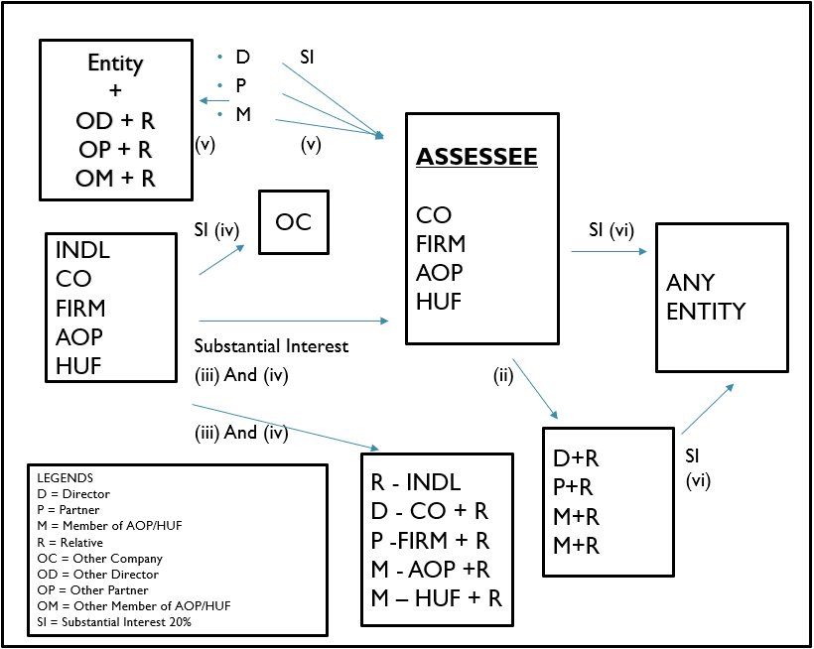
23 Clause: Related party 40A2b

Slide 32
Clause 23: Relevant issues
Relevant Issue : Clause : 23
Are payments made of capital nature to persons covered u/s. 40A(2)(b) to be reported under this clause? (Refer Section 40A(2)(a) read with Section 40A(2)(b)
How can TA ascertain details regarding persons covered u/s. 40A(2)(b) & how can transactions with such persons be verified?

Slide 33
Clause 24 : Deem income
Clause 24 : Amounts deemed to be profits and gains under section
32AC : Deduction of 15% of investment in new plant & machinery exceeding Rs.100 crore
33AB : Profit from tea, coffee and rubber business
33ABA : Profit from business of extraction or production of petroleum or natural gas
33AC : Profit from business of operating ships

Slide 34
Clause 26 :Deduction on payment basis – Section 43B
Clause 26 : In respect of any sum referred to in Clauses (a), (b), (c), (d), (e), (f) , (g) or (h) of S. 43B, liability for which-
  [Sub-Clause (i A)] : Pre-existed on first day of P.Y but was not allowed in assessment of preceding P.Y & was-
  Paid during P.Y
  Not paid during P.Y
  [Sub-Clause (i B)] : Was incurred in P.Y & was-
  Paid on or before due date for furnishing returns of P.Y u/s. 139 (1)
  Not paid on or before due date
State whether sales tax, customs duty, excise duty or any other indirect tax, levy, cess, impost etc. is passed through profit / loss account

Slide 35
Clause 26 Relevant issues
Clause 26 : Relevant Issues :
Where taxes, duties, etc. referred to in S. 43B are paid after tax audit is completed but before due date of filing returns, how should same be dealt with by TA?
Advance deposit of duty (like custom duty, Taxes) is within the meaning of Section 43B or not? Whether the same is entitled for benefit of deduction?
MSME payments after due date of 45 days applicable for AY 24 25 onwards – In this case even if payment before due date of return allowable in subsequent year
Interest paid to Systematically Important Non Deposit Taking Non Banking Finance Company

Slide 36
Clause 28 : Deem Gift – 56(2)(viia)
Transfer of shares of Closely held Company
Without consideration or for inadequate consideration
Relevant to Company & Firms
But This section is applicable till 31.03.2017.
Hence for AY 2022-23 and onwards this clause is not applicable.

Slide 37
Clause 29 : Deem Gift – 56(2)(viib)
Allotment of Shares by a Closely held companies
To person other than Non Resident (From AY 24-25 even Non resident covered)
  If at par the provision is not applicable
  If at a premium then if the share value is higher than value as per DCF method or other method as may be prescribed.
EXAMPLE
  Suppose Co A allots Shares to B at Rs.100 (FV Rs.10)
  Value as per 11UA = 150
  Value as per DCF = 80
  Company will have option to select method u/s 11UA (book value or DCF)
  A will be taxed at Rs.50 (150-100)

Slide 38
Clause 29A : Forfeiture 56(2)(ix)
Amount received as advance or in course of negotiation for transfer of capital asset
  the sum is forfeited
  Negotiation do not result in transfer of capital asset
Details to be furnished :
  Nature of Income
  Amount thereof

Slide 39
Clause 29B : Deem Gift – 56(2)(x)
Aggregate of Money received without consideration > 50,000
Any immovable property received
  Without consideration for which Stamp duty value > 50,000
  For a consideration less than stamp duty value for which Stamp duty value – Less – consideration exceeds higher of following:
    50,000 and
    10% of the Consideration

Slide 40
Clause 29B : Deem Gift – 56(2)(x)
Any Property other than immovable property received
  Without consideration for which Fair market value > 50,000
  For a consideration for less than fair market value for which Fair market value – Less – consideration > 50,000
  Proviso : this section not applicable to any sum received :
  from any relative; or (Relative to be seen from recipients side – A can be relative of B but B cannot be relative of A – example Uncle and nephew
  on the occasion of the marriage of the individual; or
  under a will or by way of inheritance; or
  in contemplation of death of the payer or donor, as the case may be; or
  from any local authority as defined in the Explanation to clause (20) of section 10; or

Slide 41
Clause 29B : Deem Gift – 56(2)(x)- Proviso
  Proviso : this section not applicable to any sum received : ……. Continued
from any fund or foundation or university or other educational institution or hospital or other medical institution or any trust or institution referred to in clause (23C) of section 10; or
from or by any trust or institution registered under section 12A or section 12AA or section 12AB; or
by any fund or trust or institution or any university or other educational institution or any hospital or other medical institution referred to in sub-clause (iv) or sub-clause (v) or sub-clause (vi) or sub-clause (via) of clause (23C) of section 10; or
by way of transaction not regarded as transfer under clause (i) or clause (iv) or clause (v) or clause (vi) or clause (via) or clause (viaa) or clause (vib) or clause (vic) or clause (vica) or clause (vicb) or clause (vid) or clause (vii) ³⁰[or clause (viiac) or clause (viiad) or clause (viiae) or clause (viiaf)] of section 47; or
from an individual by a trust created or established solely for the benefit of relative of the individual

Slide 42
Clause 29B: Deem Gift – 56(2)(x)- Proviso
  Proviso : this section not applicable to any sum received : ……. Continued
from such class of persons and subject to such conditions, as may be prescribed³¹;
by an individual, from any person, in respect of any expenditure actually incurred by him on his medical treatment or treatment of any member of his family, for any illness related to COVID-19 subject to such conditions, as the Central Government may, by notification in the Official Gazette, specify in this behalf;
by a member of the family of a deceased person,—
  from the employer of the deceased person; or
  from any other person or persons to the extent that such sum or aggregate of such sums does not exceed ten lakh rupees,
where the cause of death of such person is illness related to COVID-19 and the payment is—
  received within twelve months from the date of death of such person; and
  subject to such other conditions, as the Central Government may, by notification in the Official Gazette, specify in this behalf.

Slide 43
Clause 30A : Adjustment to 92CE
(a) Whether primary adjustment (suo moto by assessee) to transfer price, as referred to in sub-section (1) of section 92CE, has been made during the previous year? (Yes/No)
(b) If yes, please furnish the following details:-
  (i) Under which clause of sub-section (1) of section 92CE primary adjustment is made?
  (ii) Amount (in Rs.) of primary adjustment:
  (iii) Whether the excess money available with the associated enterprise is required to be repatriated to India as per the provisions of sub-section (2) of section 92CE? (Yes/No)
  (iv) If yes, whether the excess money has been repatriated within the prescribed time (Yes/No)
(v) If no, the amount (in Rs.) of imputed interest income on such excess money which has not been repatriated within the prescribed time.

Slide 44
Clause 30B : Limitation on interest deduction u/s 94B(1)
Company borrows money from non resident being associated enterprise
Interest or similar nature expense of such debt > 1 Crore
Such interest or similar nature expense shall not be deductible as expense, to the extent in excess of amount of lower of following two:
  EBITDA * 30%
  Interest paid /payable to associated enterprise in PY
Relevant Issue :
If the debt issued by the AE is engaged in the business of banking, whether section applies to the same?
If the debt issued by the AE is NBFC, whether section applies to the same?

Slide 45
Clause 30C : GAAR
Whether Company entered into Impermissible avoidance agreement, as referred to in section 96 during PY?
Details to provide :
  Nature of the impermissible avoidance arrangement:
  Amount (in Rs.) of tax benefit in the previous year arising, in aggregate, to all the parties to the arrangement

Slide 46
Clause 30C : GAAR
Additional Test provided u/s 96 :
(i) Arrangement creates rights/ obligations which are not ordinarily created between persons dealing at arm’s length, (which may also be referred to as “Abnormal Rights/Obligations”);
(ii) Arrangement results, directly or indirectly, in misuse or abuse of the provisions of the Act, (which may also be referred to as “Misuse Test”);
(iii) Arrangement lacks commercial substance or is deemed to lack commercial substance, by virtue of fiction created by section 97(which may also be referred to as “Lack of Commercial Substance’ Test”), or
(iv) Arrangement entered into or is carried out, by means, or in a manner, which not ordinarily employed for bonafide purposes (which may also be referred to as “Abnormal Manner’ Test”).

Slide 47
Clause 30C : Issues - GAAR
The provision requires to verify whether GAAR applies if the benefit to all parties put together is Rs.3 crore or more – how can one find about the benefits to other parties to the agreement
Disclaimer by Auditors
GAAR is subjective
Examples :
  Merger of two entities for tax benefits
  Reconstitution of partnership to avoid the rigours of Section 56
  Avoiding tax on dividend by acquiring a company

Slide 48
Pre cursor to GAAR
Every man entitled if he can to order his affairs so as that the tax attaching under the appropriate Acts is less than it otherwise would be [Duke of Westminster (1935) AC 1 (UK H.L.)]
Tax planning may be legitimate provided it is within the framework of law [McDowell & Co. Ltd [154 ITR 148 (SC)]
Revenue cannot tax a subject without a statute to support and every taxpayer is entitled to arrange his affairs so that his taxes shall be as low as possible and that he is not bound to choose that pattern which will replenish the treasury [Vodafone (341 ITR 1)]

Slide 49
Consequences of GAAR
Section | Consequences
98(1)(a) | Disregarding any step or part or whole
98(1)(a) | Combining or re-characterising any step or part or whole
98(1)(b) | Treat as if IAA not entered into
98(1)(c) | Disregard / treat any accommodating party and another as one and same
98(1)(d) | Deeming connected persons to be one and the same
98(1)(e) | Reallocate income/ expense/ relief
98(1)(f) | Treat place of residence, situs of asset or transaction at different place
98(1)(g) | Disregard/ look through any corporate structure

Slide 50
CBDT clarifications (Circular 7/2017)
GAAR VS SAAR
  SAAR may not address all situations of abuse
  GAAR and SAAR can coexist
GAAR v/s LOB
  Limitation of Benefits (LOB) may not be sufficient to address all tax avoidance strategies and same may be required to tackle through GAAR
  If avoidance is sufficiently addressed by LOB in tax treaty, there shall not be an occasion to invoke GAAR
  Treaty Shopping
Principle of Choice
  GAAR will not interplay with right of the taxpayer to select or choose method of implementing a transaction
Choice of jurisdiction
  If jurisdiction is finalized based on non-tax commercial considerations and main purpose of the arrangement is not to obtain tax benefit, GAAR will not apply

Slide 51
Clause 31: Loan/specified sum Taken U/s 269SS & 269T
Clause | Nature & Transaction | Type
(a) | loan or deposit in an amount exceeding the limit specified in sec 269SS taken or accepted during the P.Y | Cheque or Bank Draft or Electronic Clearing System
(b) | Specified sum in an amount exceeding limit specified in sec 269SS taken or accepted during P.Y
b (a) | Particulars of each receipt (exceeding limit u/s 269ST) | Otherwise than a bank draft, or use of ECS.
b (b) | Particulars of each receipt (exceeding limit u/s 269ST) | Cheque or a bank draft not being an account payee cheque
b (c) | Particulars of each payment (exceeding limit u/s 269ST) | Otherwise than a bank draft, or use of ECS.
b (d) | Particulars of each payment (exceeding limit u/s 269ST) | Cheque or a bank draft not being an account payee cheque

Slide 52
Clause 31: Loan/specified sum Taken U/s 269SS & 269T
Clause | Nature & Transaction | Type
(c) | Particulars of each repayment of loan or deposit or any specified advance (exceeding limit u/s 269ST)
(d) | Particulars of each repayment of loan or deposit or any specified advance (exceeding limit u/s 269ST) which at the time of its receipt (mode was as per next column) | Otherwise than a bank draft, or use of ECS.
(e) | Particulars of each repayment of loan or deposit or any specified advance (exceeding limit u/s 269ST) which at the time of its receipt (mode was as per next column) | Cheque or a bank draft not being a account payee cheque

Slide 53
Clause 32 : Change in share holding
There is change in share holding of company
due to which loss incurred prior to the previous year can not be allowed to be carried forward in terms of section 79.
Change in shareholding : holding 51% of voting power were hold be the same persons compared to the last date of the PY in which loss is incurred. To check the shareholding on the first day and last day only – in between transactions are not relevant

Slide 54
Clause 34: TDS Compliance
Stringent Reporting requirement
TCS also covered
Total payment – nature of payment wise
Amount on which tax deductible out of above
Tax deducted at specified rates
Tax deducted at less than specified rates
Tax deducted but not paid
If return is not filed within time limit – then report details of delay.
statement to be given whether all items of deduction have been considered in return.
Interest payable on delayed payment of tds and date of payment

Slide 55
Clause 34: TDS Compliance
New Section introduced – 194R – wide scope – TDS on benefits or perquisites provided in the course of business or profession
Clause 34(a) : TDS compliance information
Clause 34(b) :
  Timely filing of TDS Return
  Whether assessee has reported all the transactions in TDS return which is required to report, if not, furnish the details
Clause 34(c) : Interest payable u/s 201(1A) or 206C(7)
Section 194Q – Shares purchased by an entity attracts TDS as shares considered as goods
Section 194IA and 194IC – difference – Tax rate 1% and 10%

Slide 56
Applicability of Section 194R:
Any person responsible for providing any benefit or perquisite (in cash or in kind) to a resident;
Such benefit or perquisite is arising from business or profession
In such a case, TDS is deductible under section 194R
Effective from 1st July, 2022
Rate of TDS
10% of Value or aggregate of value of such benefit / perquisites
No option for certificate of lower Deduction or no Deduction under this provision
If no PAN – Rate as per Section 206AA,
If deductee has not furnished ROI for specified period, TDS Rate as per sec. 206AB
If both Section 206AA and 206AB applies, TDS at rate –whichever is higher

Slide 57
Time of Payment of TDS u/s 194R :
When Benefit/perquisites is in Cash/ Partly in Cash partly in kind where such part of cash is sufficient to meet liability of TDS in respect of whole benefit/perquisites:
  TDS is to be deducted at time of providing benefit/perquisites
When Benefit/perquisites is in Kind/ Partly in Cash partly in kind where such part of cash is not sufficient to meet liability of TDS in respect of whole benefit/perquisites
  TDS is to be deducted at time of providing benefit/perquisites
  TDS is to be paid before providing benefit/perquisites to receipient either by Benefit/service provider in form of TDS or by receipient in form of advance tax and provider will report in Form 26Q
  (Ref. Section 194R read with Circular No. 12/2022 dated 16th June, 2022 Que. 2

Slide 58
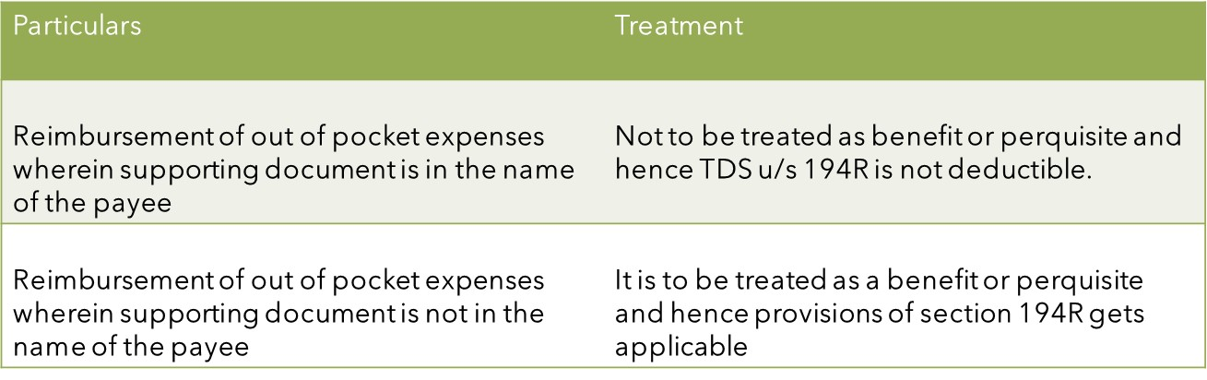
Treatment of Out of pocket expenses :

Slide 59
Clause 36A : Deemed dividend u/s 2(22)(e)
When Assessee received any amount in the nature of dividend u/s 2(22)(e)
Details to report :
  Amount received
  Date if receipt
  Applicable to Company in which public are not substantially interested (Private Limited Company)
  Payment by way of advance or loan or payment by such company on behalf of any specified share holders
  Specified Share Holders : Beneficial owner of shares holding not less than 10% of voting power.
  Share holding of assessee’s relative is not required to be considered
  Payment to the shareholder or to any concern in which share holder is a member or a partner in which he has substantial interest.

Slide 60
Clause 43 : Parent company furnishes report u/s 286(2)
Whether the assessee or its parent entity or alternate reporting entity
liable to furnish the report u/s 286(2) only if the Consolidated Group Turnover is Rs.5500 crore or more
Details to furnish :
  Whether report has been furnished by the assessee/ its parent company/ alternate reporting entity
  Name of Parent entity
  Name of Alternate reporting entity
  Date of furnishing report

Slide 61
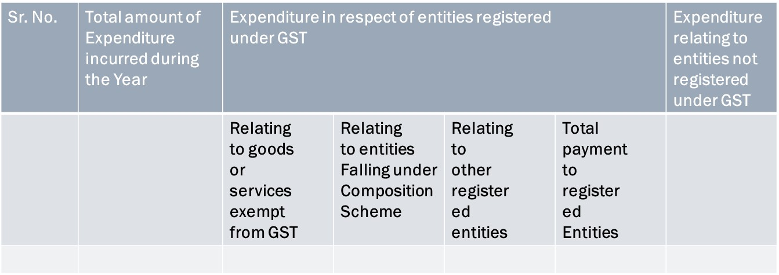
Clause 44 : Breakup of Expenditure
Breakup of Total expenditure of entities registered or not registered under GST :

Slide 62
Audit Process and Trust
Follow Auditing Standards
What is not documented is not done
True and Correct – accuracy is important
High responsibility and trust reposed in the Auditor by the Income tax Department

Slide 63
Any Question?

Slide 64
Thank You
Kusai Goawala kusai@gkdj.in
9823140520

