Slide 1


India’s Largest
Insolvency Professional
Entity (IPE) under IBC
Head Office: E10A, Kailash Colony, New Delhi – 110048
Email id: anilgoel@aaainsolvency.com,
Mobile: 9811055148
Mumbai | Kolkata | Bengaluru |
Chennai | Hyderabad | Kochi |
Ahmedabad | Raipur | Ludhiana | Nagpur
| Jaipur | Kanpur | Dhanbad | Noida | Pune | Ranchi
Liquidation Process for Corporate Debtor
PRESENTED BY
CA. ANIL GOEL
FOUNDER CHAIRMAN
AAA INSOLVENCY PROFESSIONALS LLP

Slide 2


Slide 3
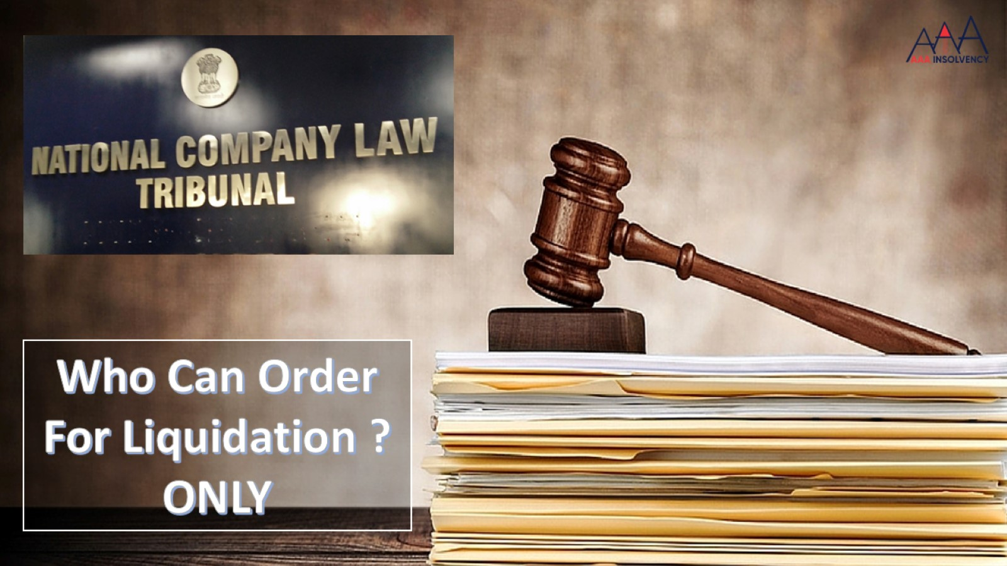

Slide 4
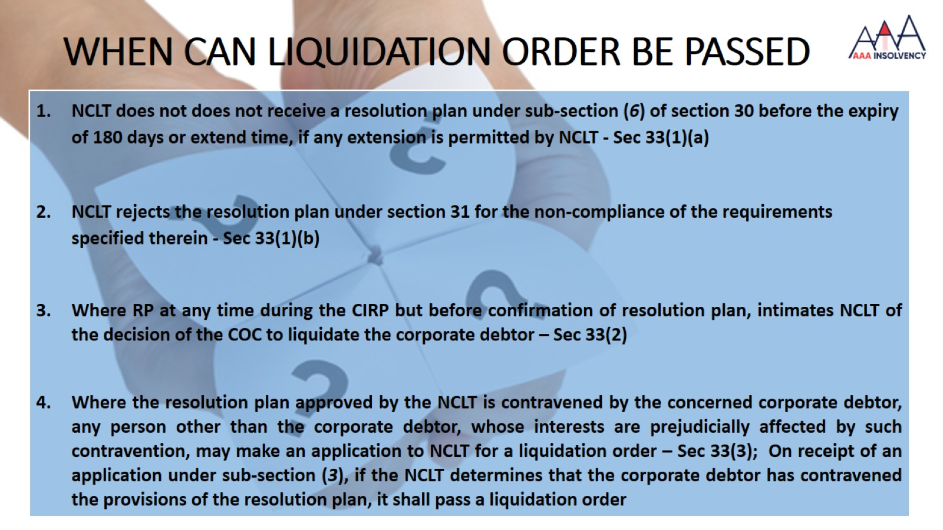
WHEN CAN LIQUIDATION ORDER BE PASSED

Slide 5
COC CAN DECIDE TO LIQUIDATE THE CORPORATE DEBTOR ANY TIME
An Explanation was added to section 33(2) w.e.f. 16/08/2019
Explanation. – For the purpose of this sub-section, it is hereby declared that the committee of creditors may take the decision to liquidate the corporate debtor, any time after its constitution under sub-section (1) of section 21 and before the confirmation of the resolution plan, including at any time before the preparation of the information memorandum.
Mr. Gulabchand Jain v. Mr. Ramchandra D. Choudhary, Resolution Professional of Vijay Timber Industries Pvt. Ltd. Company Appeal (AT) (Insolvency) No. 142 of 2021 – 02.03.2021 -
“the COC is empowered to take a decision in regard to liquidation of the Corporate Debtor even after an application has been filed by the Resolution Professional placing the Resolution Plan approved by the COC before the Adjudicating Authority for approval”

Slide 6
VELU CHAIRMAN, MONITORING COMMITTEE RESOLUTION PROFESSIONAL FOR PALM LAGOON BACKWATER RESORTS PRIVATE LIMITED VS. INVENT ASSETS SECURITIZATION AND RECONSTRUCTION PRIVATE LIMITED
(NCLAT, Chennai Bench, Comp Appl. (AT) (CH) (INS) No. 38 of 202 dated 21. 09.2021)
JUDGEMENT/OBSERVATIONS:
In case a Resolution Plan is not passed within 330 days, the AA must pass the Liquidation order as per provisions of the Code.
Any person other than the Corporate Debtor may make the application for a Liquidation Order to the AA.
In a case where maximum CIRP period (i.e. 330 days) has expired and the Corporate Debtor has failed to implement resolution plan, liquidation orders can be passed by AA u/s 33 read with Section 60(5) of the Code.
EBIX SINGAPORE PTE LTD. VS COMMITTEE OF CREDITORS OF EDUCOMP
(Hon’ble Supreme Court, CA. No. 3224 of 2020, 13.09.2021 )
JUDGEMENT/OBSERVATIONS:
Section 12 (3) mandates the CIRP process, including legal proceedings, must be concluded within 330 days.
This 330 period can be extended only in exceptional circumstances, if the process is at near conclusion and serves the object of the IBC.

Slide 7
RATIONALE FOR AMENDMENT THAT AT ANY POINT LIQUIDATION RESOLUTION CAN BE PASSED
In VIP Finvest Consultancy Private Limited v. Bhupen Electronics – Held that it is prudent for the company to go for liquidation, as the company had not been operational for decades and had no employee on its payroll
Chivas Trading Private Limited v. Abhayam Trading Limited (NCLT Chennai Bench), wherein the corporate debtor was liquidated as there was lack of business opportunity, and the creditors felt there was no point putting good money to recover bad money
Best Deal TV Pvt. Ltd. (NCLT Mumbai Bench), the committee of creditors recommended liquidation since the business activities were already closed down and all employees had left the corporate debtor
Esskay Motors Pvt. Ltd. contended that the resolution professional did not invite bids from interested parties, however, the committee of creditors noted that inviting bids would only prolong the process of resolution and will not yield any result as the corporate debtor was not a going concern

Slide 8
RATIONALE FOR AMENDMENT THAT AT ANY POINT LIQUIDATION RESOLUTION CAN BE PASSED
There is no business prospects with the company;
There is no substance in chasing the legal suits and cases for recovery;
There is no point in spending good money to make efforts to recover bad money, having very remote chance of recovery;
The assets with the company are not sufficient to repay the amounts of creditors;
The assets in the form of loan and shares are also not easily recoverable.
The business is not feasible and there is lack of business opportunity;
Any resolution plan is not possible, which could enable the company to pay the debts;
There are old and ‘dead’ cases where chances of insolvency resolution are very remote, and liquidation is the only natural outcome
In case of highly stressed businesses, liquidations may be a valid commercial outcome to realise the assets trapped.

Slide 9
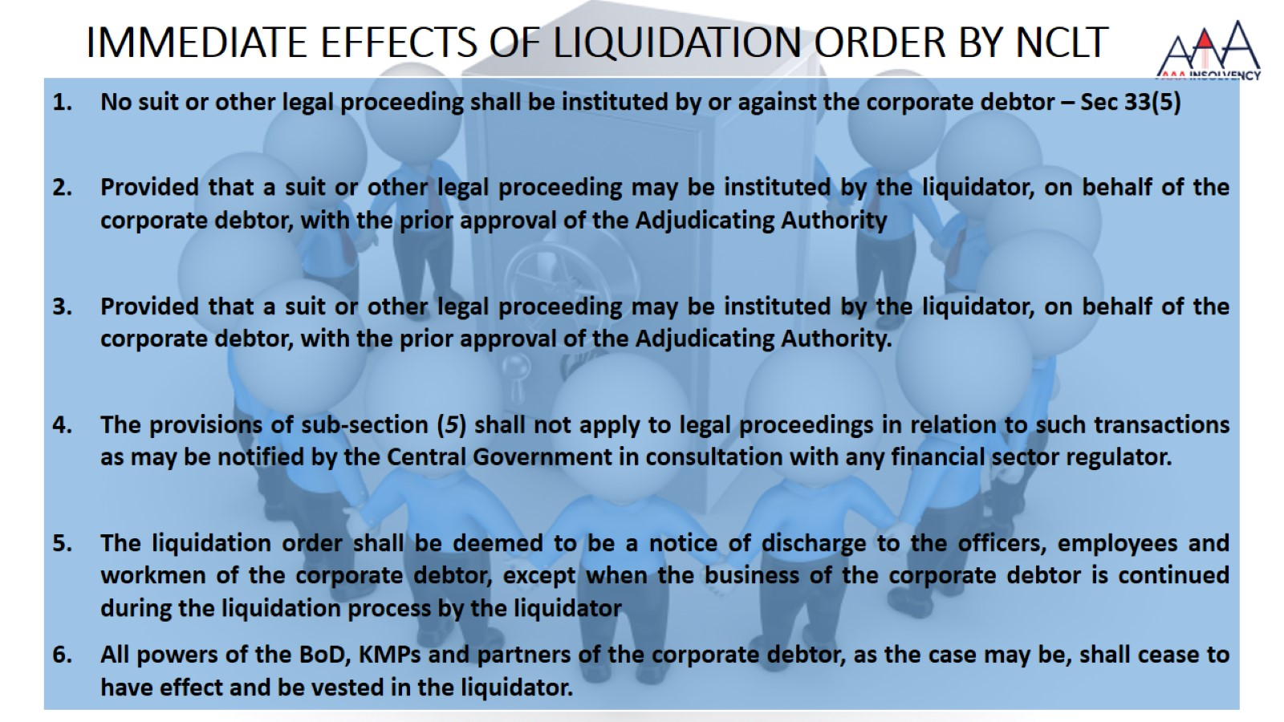
IMMEDIATE EFFECTS OF LIQUIDATION ORDER BY NCLT
Notes:
Section 14 of the Code says “ the institution of the suits or continuation of pending suits or proceedings against the corporate debtor”

Slide 10
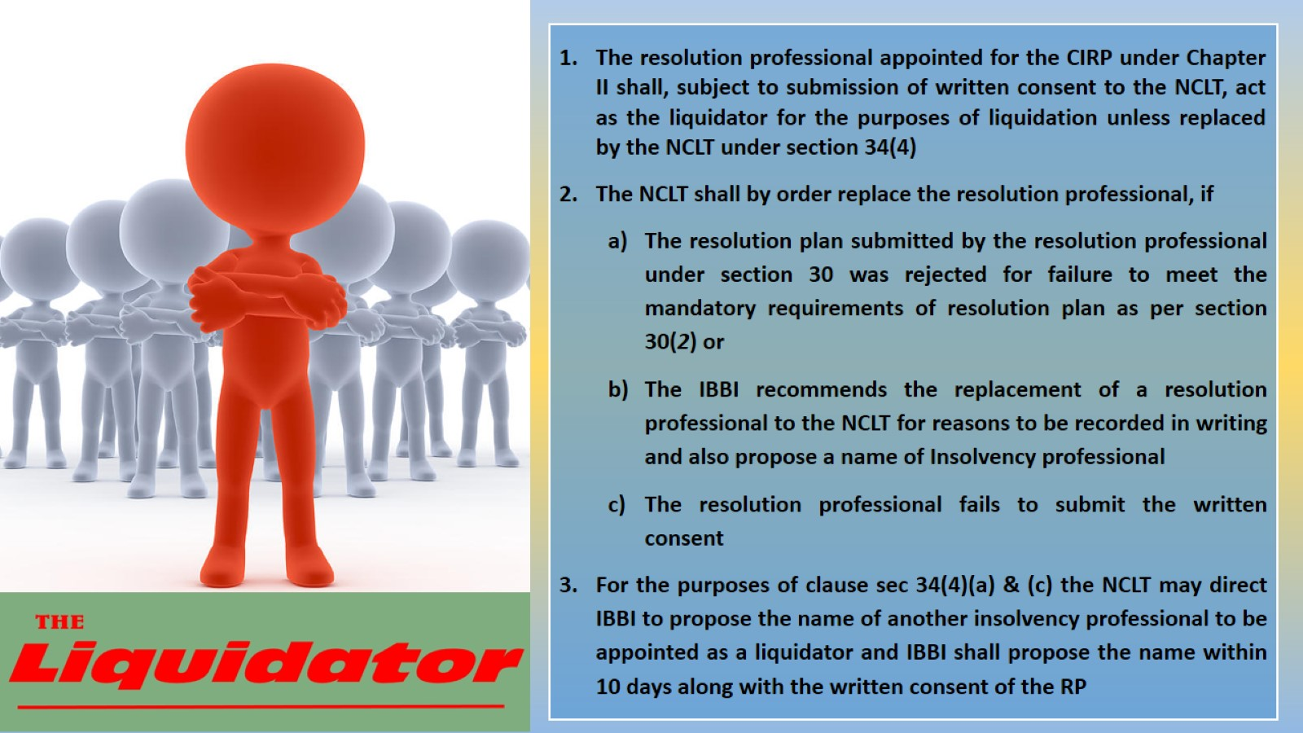

Slide 11
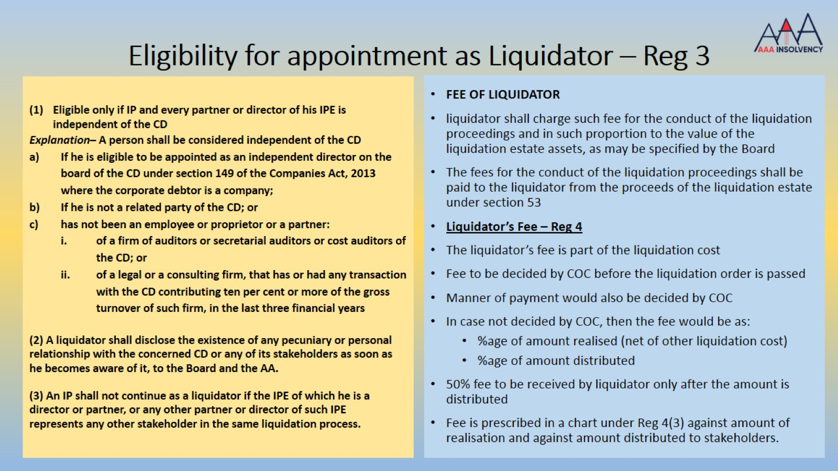
Eligibility for appointment as Liquidator – Reg 3

Slide 12
COC CAN APPOINT A LIQUIDATOR OTHER THAN RP
Reg 39 D of the CIRP Regulations : COC will decided the fee of the liquidator while passing the resolution for liquidating the Corporate Debtor.
How can the fee be negotiated, if COC does not have power to appoint a liquidator other than the Resolution Professional.
COC can decide about the appointment of any other person as liquidator by way of a resolution. It was decided in Keshav Sponge and Energy Pvt Ltd by Kolkata Bench on 14/11/2017 before even the amendment dated 6/6/2018.
Sec 34(1) of IBC : Resolution Professional shall be appointed as liquidator of the Corporate Debtor subject to submission of a written consent by the Resolution Professional to the Adjudicating Authority. (w.e.f. 6/6/2018)
If Resolution Professional’s consent is not filed, then any other IP can file the consent

Slide 13
AA CAN APPOINT A LIQUIDATOR OTHER THAN RP
Sandeep Kumar Gupta, Resolution Professional Vs. Stewarts & Lloyds of India Ltd. & An (NCLAT)
While we hold that the observations made in the impugned order should not be construed to be misconduct on the part of the RP, but as we find that the Adjudicating Authority was not satisfied with the performance of the ‘Resolution Professional’, we hold that the Adjudicating Authority was well within its jurisdiction to engage another person as ’Liquidator’.
Devendra Padamchand Jain, Resolution Professional vs. State Bank of India & Ors (NCLAT)
AA has the power to appoint or replace the RP

Slide 14
LIQUIDATOR CAN NOT BE REMOVED BY COC
Punjab National Bank Vs. Mr. Kiran Shah Liquidator of ORG Informatics Ltd. (21-Jan-20, NCLAT DELHI)
In the CIRP of M/s. ORG Informatics Limited (Corporate Debtor), the CoC of which the ‘Punjab National Bank’ is the lead Bank, decided to move application for liquidation of the Corporate Debtor. The said application has been accepted by the Adjudicating Authority, Ahmedabad Bench by impugned order dated 20.11.2019. The Resolution Professional has been asked to continue as Liquidator. Appeal filed against the appointment of Liquidator.
Held while dismissing the appeal
After the liquidation the ‘Committee of Creditors’ has no role to play and they are simply a claimant whose matters are to be determined by the Liquidator and cannot move an application for removal of Liquidator in absence of any provisions under the law.

Slide 15
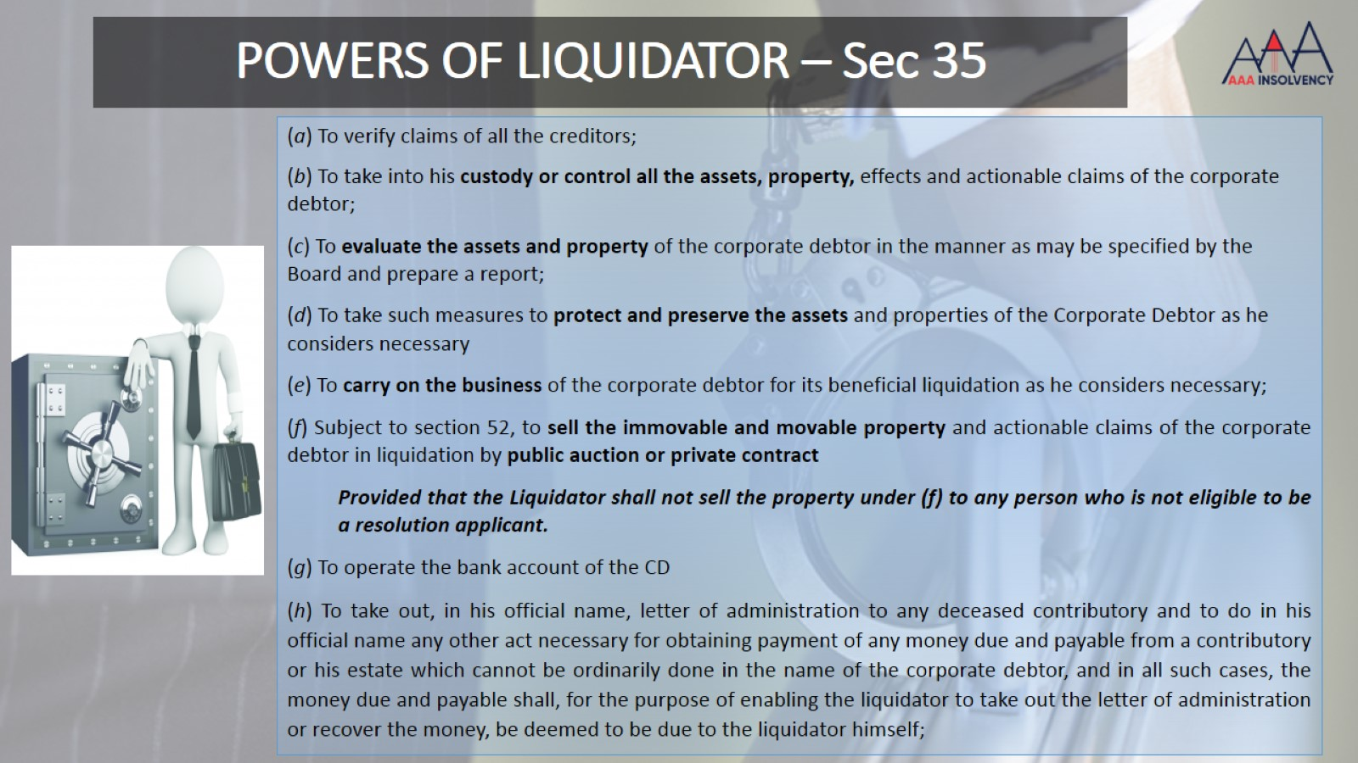
POWERS OF LIQUIDATOR – Sec 35

Slide 16
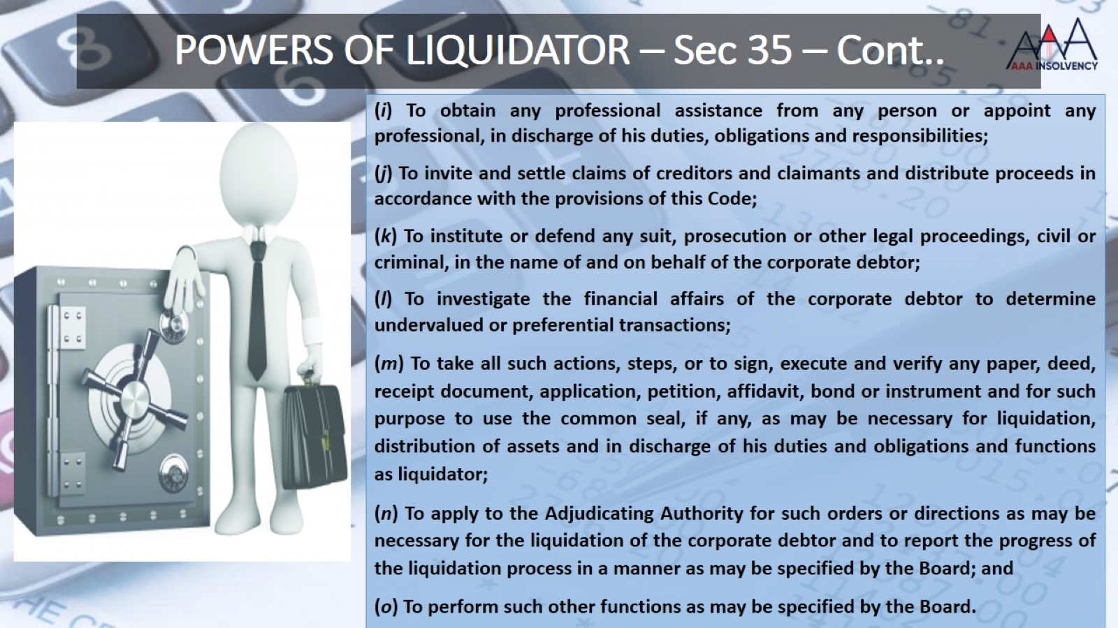
POWERS OF LIQUIDATOR – Sec 35 – Cont..

Slide 17
JUDGEMENTS ON POWERS OF LIQUIDATOR
Deepak Cables Ltd v. Hubli Eletricity Supply Co., the Karnataka High Court (Dharwad Bench), held that a Liquidator is empowered under S. 35(k) of the Code to institute proceedings on behalf of the Corporate Debtor. For this reason, the High Court concluded that the petition filed by the Liquidator on behalf of the Corporate Debtor under S. 11 of the Arbitration and Conciliation Act, 1996 for appointment of an arbitrator was maintainable.
S. Muthuraju Vs. Commissioner of Police and Another [MA/504/2019 in CP/288/IB/2018]
A group / mob of unknown persons hurled threats with weapons and did not allow the liquidator to enter the premise of the corporate debtor (CD) and carry out his functions. The AA directed the Superintendent of Police to give adequate police protection to the liquidator to enable him to perform his duties.

Slide 18
POWERS OF LIQUIDATOR – Sec 35 – Cont..
PUBLIC ANNOUNCEMENT BY LIQUIDATOR
FILING OF CLAIMS BY STAKEHOLDERS
Public Announcement in Form B of Schedule II within 5 days
For filing of claims or updation of claims in 30 days
One English and one regional language of wide circulation
At Regd office and principal offices or material business
On website of CD
On website of IBBI
Stakeholders can file a fresh claim as on LCD; or
Can update the claim filed during CIRP up to LCD w.e.f 25/07/2019
Liquidator to maintain a register of claims and dividend

Slide 19
FILING OF CLAIMS BY STAKEHOLDERS – Sec & Reg 16
Sec 3(6): “claim” means –
a right to payment, whether or not such right is reduced to judgment, fixed, disputed, undisputed, legal, equitable, secured, or unsecured.
right to remedy for breach of contract under any law for the time being in force, if such breach gives rise to a right to payment, whether or not such right is reduced to judgment, fixed, matured, unmatured, disputed, undisputed, secured or unsecured;
Sec 18(b): Duty of the IRP to receive and collate all the claims submitted by creditors to him, pursuant to the public announcement made under sections 13 and 15
Sec 25(2)(e): Duty of the RP to maintain an updated list of claims.
Reg 13(1) of CIRP: shall verify the claim
Sec 35(1)(a): Powers and duties of the Liquidator to verify claims of all the creditors
Sec 35(1)(j): Powers and duties of the Liquidator to invite and settle claims of creditors and claimants and distribute proceeds in accordance with the provisions of this Code
No claim no distribution under liquidation, unlike CIRP

Slide 20
POWERS OF LIQUIDATOR TO ACCESS INFORMATION
Sec 37(1) the liquidator shall have the power to access any information systems for the purpose of admission and proof of claims and identification of the liquidation estate assets relating to the corporate debtor from the following sources, namely: -
(a) an information utility.
(b) credit information systems regulated under any law for the time being in force.
(c) any agency of the Central, State or Local Government including any registration authorities.
(d) information systems for financial and non-financial liabilities regulated under any law for the time being in force.
(e) information systems for securities and assets posted as security interest regulated under any law for the time being in force.
(f) any database maintained by the Board; and
(g) any other source as may be specified by the Board

Slide 21

SUBMISSION OF PROOF OF CLAIMS TO THE LIQUIDATOR

Slide 22
CLAIMS BY FINANCIAL CREDITORS AND PROOFS OF EXISTENCE OF DEBT – REG 18
Form D of Schedule II in electronic means
records available in an information utility, if any
a financial contract supported by financial statements as evidence of the debt
a record evidencing that the amounts committed by the financial creditor to the corporate debtor under a facility has been drawn by the corporate debtor
financial statements showing that the debt has not been repaid; and
an order of a court or tribunal that has adjudicated upon the non-payment of a debt, if any
other relevant documents which adequately establish the debt
Bill of Exchange, Promissory Note or other Negotiable instrument or security of like nature, then these documents shall be produced before liquidator

Slide 23
CLAIMS BY OPERATIONAL CREDITOR (OTHER THAN WORKMEN AND EMPLOYEES) AND PROOFS OF EXISTENCE OF DEBT – REG 17
Form C of Schedule II in person, by post or by electronic means
records available in an information utility, if any
a contract for the supply of goods and services with corporate debtor
an invoice demanding payment for the goods and services supplied to the corporate debtor
an order of a court or tribunal that has adjudicated upon the non-payment of a debt, if any
financial accounts.
other relevant documents which adequately establish the debt

Slide 24
CLAIMS BY WORKMEN AND EMPLOYEES AND PROOFS OF EXISTENCE OF DEBT – REG 19
Form E of Schedule II in person, by post or by electronic means
Form F of Schedule II on case one claim is submitted by Authorised Representative for numerous workmen or employee
records available in an information utility, if any
a proof of employment such as contract of employment for the period for which such workman or employee is claiming dues;
evidence of notice demanding payment of unpaid amount and any documentary or other proof that payment has not been made; and
an order of a court or tribunal that has adjudicated upon the non-payment of dues, if any
other relevant documents which adequately establish the debt
Liquidator may admit claims on the basis of the books of account of the corporate debtor, if such workman or employee has not made a claim.

Slide 25
DISPUTES WITH REGARD TO WORKMEN DUES, PF, GRATUITY AND SUPERANNUATION FUND
Mr Savan Godiwala(the liquidator of Lanco Infratech Limited ) Vs. Mr. Apalla Siva Kumar (11/02/2020, NCLAT DELHI
NCLAT held that it is the settled position of law, that the provident fund, the pension fund and the gratuity fund, do not come within the purview of liquidation estate for the purpose of distribution of assets under Section 53 of the Code. Based on this, the only inference which can be drawn is that Pension Fund, Gratuity Fund and Provident Fund can‘t be utilised, attached or distributed by the liquidator, to satisfy the claim of other creditors.
In a case, where no fund is created by a company, in violation of the Statutory provision of the Sec 4 of the Payment of Gratuity Act, 1972, then in that situation also, the Liquidator cannot be directed to make the payment of gratuity to the employees
Payment of Gratuity to employees depends on their entitlement of Gratuity, subject to the fulfilment of the conditions laid down under the payment of Gratuity Act, 1972 and also on the availability of the fund in this regard
Based on the judgment of NCLAT in case of the State Bank of India Vs. Moser Baer Karamchari Union and Another (19/3/2019), it is clear that in terms of sub-Section (4)(a)(iii) of Section 36 all sums due to any workman or employees from the Provident Fund, Pension Fund and the Gratuity Fund, do not form part of the liquidation estate/liquidation assets of the Corporate Debtor. It was held that the ‘Provident Fund Dues’, ‘Pension Fund Dues’ and ‘Gratuity Fund Dues’ cannot be part of Section 53 of the Code.

Slide 26
CLAIMS BY OTHER STAKEHOLDERS (OTHER THAN ALL ABOVE) AND PROOFS OF EXISTENCE OF DEBT – REG 20
Form G of Schedule II in person, by post or by electronic means
records available in an information utility, if any
documentary evidence of notice demanding payment of unpaid amount or bank statements of the claimant showing that the claim has not been paid and
an affidavit that the documentary evidence and bank statements are true, valid and genuine;
documentary or electronic evidence of his shareholding; and
an order of a court, tribunal or other authority that has adjudicated upon the non-payment of a claim, if any
other relevant documents which adequately establish the debt

Slide 27
WITHDRAWAL OF CLAIM BY CREDITORS – SECTION 38 (5)
The Creditor may withdraw or vary the Claim submitted under Section 38
The Timeline for withdrawal of the claim by a creditor as provided under Reg. 47 of the Liquidation Regulation is Within 14 days of submission of claim i.e. T +44 days.
The claim may be allowed to be withdrawn even after the timeline provided is expired as it may be considered as statutory right

Slide 28

VERIFICATION OF CLAIMS BY LIQUIDATOR – Sec 39 & Reg 30

Slide 29
POWER TO VERIFY, ADMIT AND REJECT THE CLAIMS AND COST OF VERIFICATION
The liquidator shall verify the claims within 30 days from the last date of submission of claim and can reject, admit or part admit the claims - Sec 39 & Reg 30
The liquidator may ask the creditor or the CD or any other person to produce any other document or evidence for the purpose of verifying the whole or any part of the claim – Sec 39(2) & Reg 23
Cost of substantiation of claim to be borne by claimant and expenses incurred by Liquidator would be part of Liquidation Cost
Cost of verification of false claims can be recovered from claimant and the matter may be reported to IBBI – Reg 24

Slide 30
TREATMENT OF DIFFERENT SCENARIO WHILE VERIFICATION OF CLAIMS
Contingent Claims: where is amount of claim is not precise because of any contingency, then the Liquidator will make best estimate of the claim based on the information available
Debt in Foreign Currency: to be valued in Indian currency based on the Official Exchange rate of RBI
Periodic Payment: The periodic payments e.g. rent, interest, etc may be claimed only up to LCD
Debt Payable at future date: Payment of claim is not due yet as on LCD is entitled to file claim and also get distribution. However, the distribution would be calculate based on due date and Yield rate of G Sec and the date of distribution
Mutual Credits and Set off: Mutual dealings between the CD and other Party can be set off and net amount can be claimed.
Withdrawal of Claim: A creditor may withdraw or vary his claim under this section within fourteen days of its submission – Sec 38(5)
Separate claims: to be filed for each type of credit i.e. operational Creditor. Financial creditor or workmen and employee or other stakeholders in different forms

Slide 31
REJECTION OF CLAIMS BY LIQUIDATOR AND RIGHT OF CLAIMANT TO APPEAL
Admittance of Claim after Verification: Liquidator to communicate to claimant admittance of claim along with amount admitted, priority u/s 53, category and security interest, if any. If provisional admittance then the communication should mention the deficiencies and remedies available with the claimant
Rejection of Claim after Verification: Liquidator to record detailed reasons for rejection of a claim and the process of verification adopted.
Claim admitted Partly or Rejected partly: Liquidator to record detailed reasons for rejection of a claim and the process of verification adopted.
Indian Oil Corporation Ltd. Vs. Mr. Ashish Arjun Kumar Rathi, Liquidator of SBQ Steels Pvt. Ltd. (22-May-20, NCLAT New Delhi)
Not assigning reasons and that too in a rejection order relating to a claim is not a ‘prudent and reasonable course of action’
in respect of ‘Interest’ merely stated that as per contractual agreement there was no provision for an interest and hence not considered, are incorrect and legally untenable in the eye of law

Slide 32
LIQUIDATOR CAN DECIDE ABOUT A CLAIM IRRESPECTIVE OF LITIGATION
Power Grid Corporation of India Vs. Deepak Cables (India) Limited (18-Jul-19, NCLAT DELHI)
The pendency of the case before the Hon’ble High Court is not to come in the way of the liquidator to decide the claim
So far as pendency of the arbitration proceeding is concerned, after liquidation it is open to the Arbitral Tribunal to proceed in the arbitration. However, we are not inclined to express any opinion with regard to the same. We are of the view that if the claim is filed by the ‘Corporate Debtor’- ‘Deepak Cables (India) Limited’, there is no bar to proceed in the arbitration and if it proceeds, its counter claim is to be decided. If the counter claim is awarded in favour of the Appellant and if certain amount is payable to it, it can take advantage of the same
We make it clear that we have not expressed any opinion with regard to the claim of the Appellant, it may be decided by the appropriate authority/ arbitration proceeding

Slide 33
VERIFICATION OF SECURITY INTEREST & PRESUMPTION OF SECURITY INTEREST – Reg 21 & 21A
Sec 3(30) “secured creditor” means a creditor in favour of whom security interest is created
Sec 3(31) “security interest” means
- right, title or interest or a claim to property,
- created in favour of, or provided for a secured creditor by a transaction which secures payment or performance of an obligation;
and includes
- mortgage, charge, hypothecation, assignment and encumbrance or any other agreement or arrangement
- securing payment or performance of any obligation of any person:
Provided that security interest shall not include a performance guarantee

Slide 34
VERIFICATION OF SECURITY INTEREST & PRESUMPTION OF SECURITY INTEREST – Reg 21 & 21A – Contd..
Sec 3(33) “transaction” includes a agreement or arrangement in writing for the transfer of assets, or funds, goods or services, from or to the corporate debtor
Sec 3(34) “transfer” includes sale, purchase, exchange, mortgage, pledge, gift, loan or any other form of transfer of right, title, possession or lien
Sec 3(35) further defines ‘transfer of property’ means transfer of any property and includes a transfer of any interest in the property and creation of any charge upon such property

Slide 35
PROVING SECURITY INTEREST - REG 21
The existence of a security interest may be proved by a secured creditor on the basis of: -
(a) the records available in an information utility, if any;
(b) certificate of registration of charge issued by the Registrar of Companies; or
(c) proof of registration of charge with the Central Registry of Securitisation Asset Reconstruction and Security Interest of India.

Slide 36
PRESUMPTION OF SECURITY INTEREST - REG 21A. – W.E.F. 25/7/2019
Relinquish its security interest to the liquidation estate or realise its security interest, as the case may be, to be filled in Form C or Form D of Schedule II:
Where a secured creditor does not intimate its decision within 30 days from the LCD, the assets covered under the security interest shall be presumed to be part of the liquidation estate.
(2) Where a secured creditor proceeds to realise its security interest, it shall pay –
(a) CIRP Cost and the Liquidation Cost
  (b) Workmen Dues for the period of 24 months preceding the LCD
to the liquidator within ninety days from the LCD (w.e.f. 6/1/2020)
(c) the excess of the realised value of the asset, which is subject to security interest, over the amount of his claims admitted, to the liquidator within 180 days from the LCD
If the amount is not certain then as estimated by the liquidator and difference to be accounted for
(3) Where a secured creditor fails to comply with sub-regulation (2), the asset, which is subject to security interest, shall become part of the liquidation estate.

Slide 37
TREATMENT OF SUBORDINATION AGREEMENTS WITHIN THE LIQUIDATION WATERFALL – FIRST CHARGE OR SECOND CHARGE OR SUBSERVIENT CHARGE
REPORT OF THE INSOLVENCY LAW COMMITTEE New Delhi, the 26 March, 2018 – Para No 21.1 to 21.6
The Phrase “shall rank equally between and among” in section 53(1)(b) to be interpreted to mean that debts inter-se secured creditors in clause (ii) of section 53(1)(b) would also rank equally cannot be excluded
Further, the Committee was appraised of the case of ICICI Bank Limited v. SIDCO Leathers Limited & Ors.109 wherein the Hon'ble Supreme Court interpreted sections 529 and 529A of the CA 1956 which deal with ranking of claims on liquidation. It was held in this case that, “Only because the dues of workmen and debts due to the secured creditors are treated pari passu with each other, the same by itself, in our considered view, would not lead to the conclusion that the concept of inter se priorities amongst the secured creditors had thereby been intended to be given a total go-by.
Section 48 of the Transfer of Property Act, 1882 (“TOPA”) clearly provides that claim of a first charge holder shall prevail over the claim of a second charge holder
Merely because the relevant section did not specifically provide for the rights of priorities over mortgaged assets, it would not mean that the provisions of section 48 of TOPA shall stand obliterated in relation to a company that has undergone liquidation

Slide 38
TREATMENT OF SUBORDINATION AGREEMENTS WITHIN THE LIQUIDATION WATERFALL – FIRST CHARGE OR SECOND CHARGE OR SUBSERVIENT CHARGE
Moreover, this may negatively impact the credit market and discourage banks and other financial creditors to grant big loans which are more often than not granted against property or other valuable collateral as they shall have no protection in case the corporate debtor becomes insolvent
Para 21.6: To conclude, the Committee was of the opinion that it is sufficiently clear from a plain reading of section 53(1)(b) that it intended to rank workmen's dues equally with debts owed to secured creditors who have relinquished their security.
Section 53(1)(b) does not talk about priority inter-se secured creditors.
Thus, valid inter-creditor/subordination agreements would continue to govern their relationship.
Further sub-section (2) of section 53 must also be interpreted accordingly. For instance, applying section 53(2) in the context of section 53(1)(b), any agreements between workmen and secured creditors which disrupts their pari passu rights will be disregarded by the liquidator. However, agreements inter-se secured creditors do not disturb the equal ranking sought to be provided by section 53(1)(b) and therefore do not fall within the ambit of section 53(2).
The Committee felt that there was no requirement for an amendment to the Code required since a plain reading of section 53 was sufficient to establish that valid inter-creditor and subordination provisions are required to be respected in the liquidation waterfall under section 53 of the Code

Slide 39
TREATMENT OF SUBORDINATION AGREEMENTS WITHIN THE LIQUIDATION WATERFALL – FIRST CHARGE OR SECOND CHARGE OR SUBSERVIENT CHARGE
Sec 30(4): The committee of creditors may approve a resolution plan by a vote of not less than [sixty-six] per cent. of voting share of the financial creditors, after considering its feasibility and viability, [the manner of distribution proposed, which may take into account the order of priority amongst creditors as laid down in sub-section (1) of section 53, including the priority and value of the security interest of a secured creditor – w.e.f. 16/8/2019] and such other requirements as may be specified by the Board

Slide 40
LIST OF STAKEHOLDERS – Reg 31
The liquidator shall prepare a list of stakeholders, category-wise of admitted claims with specified details
The liquidator shall file the list of stakeholders with the AA within 45 days from the last date for receipt of claims
The filing of the list shall be announced to the public in the manner specified in Regulation 12(3) i.e. One in English and One in Regional newspaper with wide circulation.
The liquidator may apply to the AA to modify an entry in the list of stakeholders filed with the AA, when he comes across additional information warranting such modification, and shall modify the entry in the manner directed by the AA.
The liquidator shall modify an entry in the list of stakeholders filed with the AA, in the manner directed by the AA while disposing off an appeal preferred under section 42.
The list of stakeholders, as modified from time to time, shall be: -
  (a) available for inspection by the persons who submitted proofs of claim;
  (b) available for inspection by members, partners, directors and guarantors of the corporate debtor;
  (c) displayed on the website, if any, of the corporate debtor

Slide 41
REGULATION 31A- STAKEHOLDERS’ CONSULTATION COMMITTEE
Amendment Notification dated 30.09.2021
PRE AMENDMENT | POST AMENDMENT
31A (1) The liquidator shall constitute a consultation committee within sixty days from the liquidation commencement date, based on the list of stakeholders prepared under regulation 31, to advise him on the matters relating to sale under regulation 32.” | 31A (1) The liquidator shall constitute a consultation committee within sixty days from the liquidation commencement date, based on the list of stakeholders prepared under regulation 31, to advise him on matters relating to– (a) appointment of professionals and their remuneration under regulation 7; (b) sale under regulation 32, including manner of sale, pre-bid qualifications, reserve price, amount of earnest money deposit, and marketing strategy: Provided that the decision(s) taken by the liquidator prior to the constitution of consultation committee shall be placed before the consultation committee for information in its first meeting.”

Slide 42
REGULATION 31A- STAKEHOLDERS’ CONSULTATION COMMITTEE
Amendment Notification dated 30.09.2021…..CONTD
PRE AMENDMENT | POST AMENDMENT
31A (4) If the stakeholders of any class fail to nominate their representatives, the required number of stakeholders with the highest claim amount in that class shall be included in the consultation committee.” | 31A (4) If the stakeholders of any class fail to nominate their representatives, under sub-regulation (3), such representatives shall be selected by a majority of voting share of the class, present and voting.”
31A (10) The advice of the consultation committee shall not be binding on the liquidator: Provided that where the liquidator takes a decision different from the advice given by the consultation committee, he shall record the reasons for the same in writing.” | 31A (10) The advice of the consultation committee shall not be binding on the liquidator: Provided that where the liquidator takes a decision different from the advice given by the consultation committee, he shall record the reasons for the same in writing and mention it in the next progress report.”

Slide 43
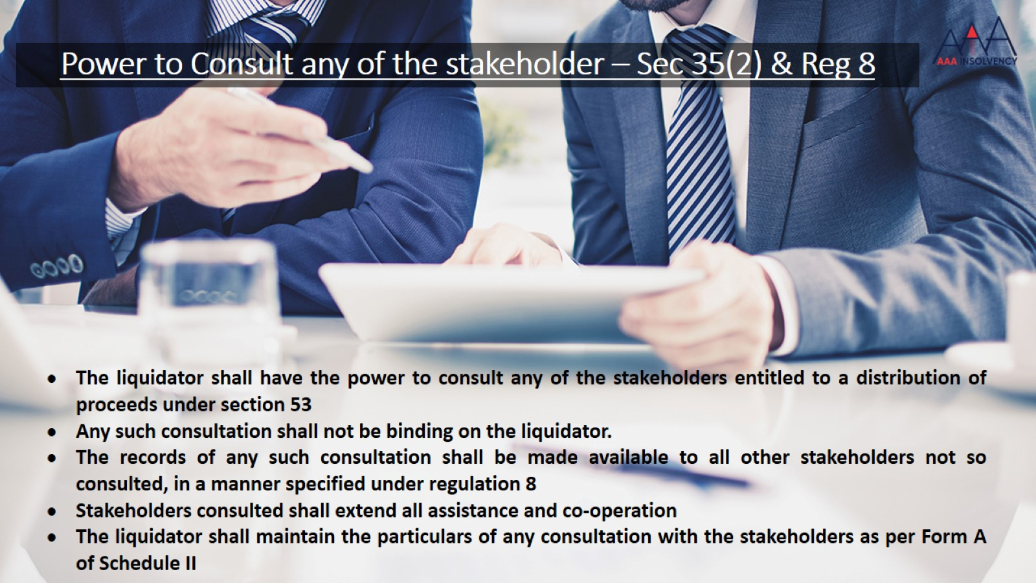
Power to Consult any of the stakeholder – Sec 35(2) & Reg 8
TREATMENT OF DIFFERENT SCENARIO WHILE VERIFICATION OF CLAIMS

Slide 44
STAKEHOLDERS’ CONSULTATION COMMITTEE (SCC), IT ROLE AND POWERS
Reg 2(1)(ba): “consultation committee” means the stakeholders’ consultation committee constituted under sub-regulation (1) of regulation 31A – w.e.f 25/07/2019
liquidator shall constitute a SCC within 60 days from the liquidation commencement date (LCD)
WHO WOULD BE THE MEMBERS?
Only those who relinquish their security interest in favour of liquidator
Liquidator may facilitate the stakeholders of each class to nominate their representatives
If they fail to nominate then, the Liquidator will nominate stakeholders with highest claim

Slide 45
CONSTITUTION OF STAKEHOLDERS’ CONSULTATION COMMITTEE (SCC)
Class of Stakeholders | Description | Number of Representatives
(1) | (2) | (3)
Secured financial creditors | Where claims are less than 50% of LV | Maximum of 2
 | Where claims are at least 50% of LV | Maximum of 4
Unsecured financial creditors | Where claims are less than 25% of LV | Maximum of 1
 | Where claims are at least 25% of LV | Maximum of 2
Workmen and employees | Irrespective of Claims | 1
Governments | Irrespective of Claims | 1
Operational creditors other than Workmen, employees and Governments | Where claims is less than 25% of LV | Maximum of 1
 | Where claims are at least 25% of LV | Maximum of 2
Shareholders or partners, if any |  | 1

Slide 46
MEETINGS OF STAKEHOLDERS' CONSULTATION COMMITTEE
Meeting can be called by the Liquidator when he considers necessary
Meeting can called on the request of at least 50% of the members /representatives
Liquidator to chair the meeting
Recommendations of the COC under regulation 39C of CIRP regulations shall be placed before SCC on its formation – regarding assessment of Sale as a Going Concern.
The liquidator shall maintain the particulars of any consultation with the stakeholders made under this Regulation, as specified in Form A of Schedule II of Liquidation Regulations.
These records are called as Minutes and is part of the Reports u/r 5 can be circulated to all the stakeholders and to be submitted to Adjudicating Authority – practically along with the Progress Reports

Slide 47
ROLE AND POWERS OF SCC
The role is to advise him on the matters relating to sale under regulation 32
SCC shall have access to all relevant records and information as may be required to provide advice to the liquidator for matters relating to sale under regulation 32
SCC shall advise the liquidator, by a vote of not less than 66% of the members, present and voting – not based on amount of claims
The advice of the consultation committee shall not be binding on the liquidator,
Provided that where the liquidator takes a decision different from the advice given by the consultation committee, he shall record the reasons for the same in writing
The stakeholders consulted under section 35(2) shall extend all assistance and cooperation to the liquidator to complete the liquidation of the corporate debtor – Reg 8

Slide 48
MATTERS RELATING TO SALE UNDER REG 32 – SCC ROLE
To decide about the Sale of Assets:
an asset on a standalone basis;
(b) the assets in a slump sale;
(c) a set of assets collectively
(d) the assets in parcels;
(e) the corporate debtor as a going concern; or
(f) the business(s) of the corporate debtor as a going concern:
Even Schedule I is under regulation 33 and not under 32, therefore the process of sale as defined under Schedule I would also not fall under the role of SCC
Marketing strategy, fixation of reserve price, auction process, private sale etc. are all part of Regulation 33
Practice amongst the professionals is to consult on most of the actions – as a matter of transparency

Slide 49


LIQUIDATION COST
AND
CONTRIBUTION TO
LIQUIDATION COST

Slide 50
LIQUIDATION COST AND CONTRIBUTION TO LIQUIDATION COST
Reg 2(1)(ea) “liquidation cost” under clause (16) of section 5 means-
fee payable to the liquidator under regulation 4 – Liquidator fee as per chart;
remuneration payable by the liquidator under sub-regulation (1) of regulation 7 – Professionals appointed by Liquidator – including brokers ;
costs incurred by the liquidator under sub-regulation (2) of regulation 24- verification of claims;
costs incurred by the liquidator for preserving and protecting the assets, properties, effects and actionable claims, including secured assets, of the corporate debtor;
costs incurred by the liquidator in carrying on the business of the corporate debtor as a going concern;
interest on interim finance for a period of twelve months or for the period from the liquidation commencement date till repayment of interim finance, whichever is lower;
the amount repayable to contributories under sub-regulation (3) of regulation 2A;
any other cost incurred by the liquidator which is essential for completing the liquidation process:

Slide 51
AMENDMENT TO LIQUIDATION PROCESS REGULATIONS
30.09.2021
Omission of ‘Contributories’ from Clause (vii) Sub -Regulation (ea) to Regulation 2 Liquidation Process Regulations
Amended Regulation –
(vii) the amount repayable to under sub-regulation (3) of regulation 2A;
Implication –
The said omission has been carried out solely with the intent to make regulation more precise as to any payment under sub-regulation (3) of regulation 2A shall be deemed to be liquidation cost.

Slide 52
LIQUIDATION COST FOR SOME OTHER OBLIGATIONS OF LIQUIDATOR
Cost incurred by the liquidator in relation to compromise or arrangement under section 230 shall not form part of liquidation cost.
Cost of Public Announcement for commencement of Liquidation – Reg 12
Cost of Public Announcement for List of Stakeholders – Reg 31(2)
Watch and ward (estimated for 12 months during liquidation process period) – Reg 2(1)(ea)(iv)
Professional Fee for maintenance of Books of account, registers, etc.. – Reg 6
Fee payable to Registered Valuers- Reg 35
Fee payable to Auditor including filing of TDS returns, GST returns, etc. – Reg 15(5)
Expenses on meetings of SCC – Reg 31A
E-Auction and sale notice publication charges – Schedule I
Advertisement and publicity for sale of assets – Schedule I
Cost of preservation of electronic and physical records of reports, minutes, books and registers for eight years after the dissolution of the CD – Reg 5(2) & 6(2)

Slide 53
COC TO PREPARE A PLAN TO MEET LIQUIDATION COST DURING CIRP – Reg 39B of CIRP – w.e.f 25/07/2019
While approving a Resolution Plan or deciding to liquidate the Corporate Debtor, the COC is required to do as under :-
  Prepare a best estimate of the Liquidation Cost along with RP
  Make best estimate of the liquid assets of the CD
  In case the Liquid Assets are less than the estimated Liquidation Cost, then prepare a plan providing for the contribution for meeting the difference
  The plan as approved by COC shall be submitted by RP to AA while submitting the application for approval of Resolution Plan or for liquidating the Corporate Debtor

Slide 54
CONTRIBUTION OF LIQUIDATION COST – REG 2A – w.e.f 25/07/2019
Where the COC did not approve a plan for estimated liquidation cost, value of liquid assets and contribution for meeting the difference under regulation 39B of CIRP Regulations
The liquidator shall call upon the financial creditors, being financial institutions, to contribute the excess of the liquidation costs over the liquid assets of the corporate debtor,
as estimated by Liquidator
in proportion to the financial debts owed to them by the corporate debtor
The funds required need not be contributed by non-financial institutions
Where the COC approved the plan of contribution under Reg 39B of CIRP Regulations, the contribution shall be deposited in 7 days from the liquidation order in an Escrow Account to be maintained in a scheduled bank
The contribution made shall be repaid along with interest at Bank rate – 4.25%

Slide 55
LIQUIDATOR’S FEE – Reg 4
Fee of the Liquidator would be decided by the COC under Reg 39D of CIRP Regulations:-
  For the period of compromise or arrangement u/s 230 of Companies Act
  For the period used for sale of business or company as a going concern under clause (e) or (f) of Reg 32
  For the balance period
Where COC has not decided the fee as per Reg 39, the liquidator will be entitled to fee as per chart
Liquidator will be entitled to fee equivalent of RP fee for the period of scheme u/s 230
Liquidator will be entitled to fee as decided by SCC for the period of keeping the Company as a going concern – SCC will decide if the company need to be kept as a going concern or not
%age as per chart to be calculation on Amount of Realisation in the first 6 months, next 6 months and thereafter
%age as per chart to be calculation on Amount of distribution in the first 6 months, next 6 months and thereafter

Slide 56
LIQUIDATOR’S FEE – Reg 4 – CONTD…
50% fee on amount of realisation would be taken on distribution of amount to stakeholders
Both charts are applicable for calculation of fee as clarified by IBBI
Reg 2(1)(k): “stakeholders” means the stakeholders entitled to distribution of proceeds under section 53.
The Liquidator’s fee is payable even on the distribution of CIRP Cost or Liquidation Cost
New Chart of reduced fee is applicable to those cases, where the liquidation order is passed on or after 25/7/2019
The column for realisation and distribution between 12 months to 24 months was deleted w.e.f. 25/7/2019

Slide 57
LIQUIDATOR’S FEE – Reg 4 – CONTD…
Mr. S. Shivaswamy(Resolution Professional and Liquidator of Le Ecosystem Technology India Private Limited, Corporate Debtor) Vs. Concentrix Daksh Services India Private Limited – NCLAT dated 27/02/2020
it was decided in this case that as per regulation the liquidator is entitled to fee on the Liquidation Estate, even if it is an Income tax Refund of Rs. 2 Crore Plus which was determined before his appointment and was part of other current assets.

Slide 58
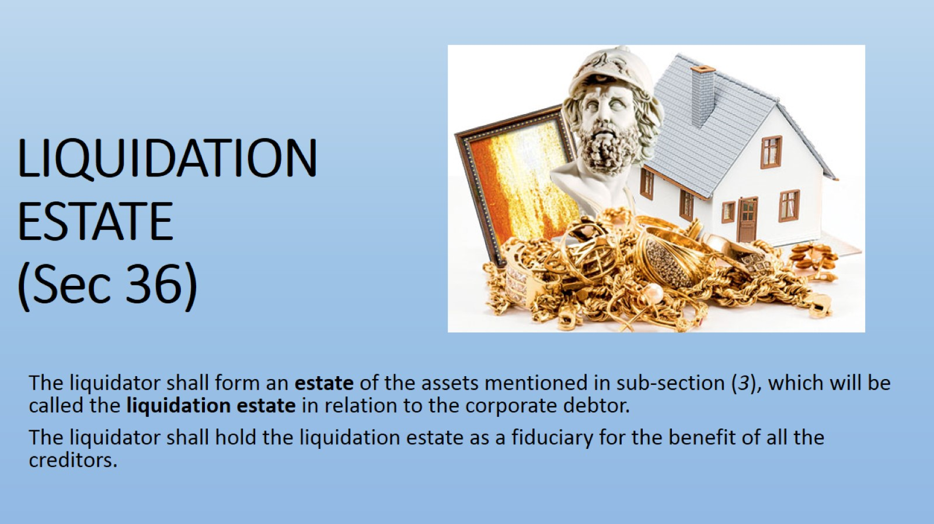
LIQUIDATION ESTATE
(Sec 36)

Slide 59
A. ASSETS WHICH ARE PART OF LIQUIDATION ESTATE
All assets over which the corporate debtor has ownership rights:
    As evidenced in the balance sheet; or
    As per records of an information utility; or
    Records in the registry; or
    Any depository recording securities of the corporate debtor; or
    Shares held in any subsidiary of the cd
    By any other means as may be specified by the board;
Assets that may or may not be in possession of the Corporate Debtor
Assets may or may not be encumbered;
All tangible assets, whether movable or immovable;
Intangible assets:
    Intellectual property,
    Securities (including shares held in a subsidiary of the corporate debtor); or
    Financial instruments,
    Insurance policies,
    Contractual rights;

Slide 60
ASSETS WHICH ARE PART OF LIQUIDATION ESTATE… Contd.
Assets Subject To The Determination Of Ownership By The Court Or Authority; (Status Quo To Be Maintained)
Any Assets Or Their Value Recovered Through Proceedings For Avoidance Of Transactions In Accordance With Section 43, 45, 50 & 66;
Any Asset Of The Corporate Debtor In Respect Of Which A Secured Creditor Has Relinquished Security Interest;
Any Other Property Belonging To Or Vested In The Corporate Debtor At The Insolvency Commencement Date; And
All Proceeds Of Liquidation As And When They Are Realized
All Recoveries Done From Receivables, Claims, Advances During Liquidation..

Slide 61
B. ASSETS WHICH ARE NOT PART OF LIQUIDATION ESTATE
Assets Owned By A Third Party, Bit Are In Possession Of Cd, Including:
Assets Held In Trust For Any Third Party;
Bailment Contracts;
All Sums Due To Any Workmen Or Employee From The Provident Fund, The Pension Fund And The Gratuity Fund;
Other Contractual Arrangements Which Do Not Stipulate Transfer Of Title But Only Use Of The Assets; And
Such Other Assets As May Be Notified By The Central Government In Consultation With Any Financial Sector Regulator;
Assets In Security Collateral Held By Financial Services Providers And Are Subject To Netting And Set-off In Multi-lateral Trading Or Clearing Transactions;
Personal Assets Of Any Shareholder Or Partner Of Cd Provided Such Assets Are Not Held On Account Of Avoidance Transactions That May Be Avoided Under Section 43, 45, 50 & 66
Assets Of Any Indian Or Foreign Subsidiary Of The Corporate Debtor; Or
Any Other Assets As May Be Specified By The Board, Including Assets Which Could Be Subject To Set-off On Account Of Mutual Dealings Between The Corporate Debtor And Any Creditor.

Slide 62
DISPUTES WITH REGARD TO WORKMEN DUES, PF, GRATUITY AND SUPERANNUATION FUND
Mr Savan Godiwala(the liquidator of Lanco Infratech Limited ) Vs. Mr. Apalla Siva Kumar (11/02/2020, NCLAT DELHI
NCLAT held that it is the settled position of law, that the provident fund, the pension fund and the gratuity fund, do not come within the purview of liquidation estate for the purpose of distribution of assets under Section 53 of the Code. Based on this, the only inference which can be drawn is that Pension Fund, Gratuity Fund and Provident Fund can‘t be utilised, attached or distributed by the liquidator, to satisfy the claim of other creditors.
In a case, where no fund is created by a company, in violation of the Statutory provision of the Sec 4 of the Payment of Gratuity Act, 1972, then in that situation also, the Liquidator cannot be directed to make the payment of gratuity to the employees because the Liquidator
Payment of Gratuity to employees depends on their entitlement of Gratuity, subject to the fulfilment of the conditions laid down under the payment of Gratuity Act, 1972 and also on the availability of the fund in this regard
Based on the judgment of NCLAT in case of the State Bank of India Vs. Moser Baer Karamchari Union and Another (19/3/2019), it is clear that in terms of sub-Section (4)(a)(iii) of Section 36 all sums due to any workman or employees from the Provident Fund, Pension Fund and the Gratuity Fund, do not form part of the liquidation estate/liquidation assets of the Corporate Debtor. It was held that the ‘Provident Fund Dues’, ‘Pension Fund Dues’ and ‘Gratuity Fund Dues’ cannot be part of Section 53 of the Code.

Slide 63
Distribution of assets (WATERFALL MECHANISM)
CIRP Cost and liquidation Cost (including any interim finance),
Secured debt together with workmen dues for the preceding 24 months rank highest in priority based on value of security interest of each creditor.
Employee dues for a period of12 months
Other unsecured financial creditors.
Central and state Government dues (2years)and remaining part of secured debt, if any after sale of mortgaged assets by financial creditors
Any remaining debts and dues, dues of suppliers of goods or services, remaining dues of workmen, employees and Govt. authorities
Preferential shareholders
Equity shareholders or partners (in the case of LLP)
Amount available under a Resolution Plan or proceeds of sale of assets of the liquidation estate will be distributed in the manner and in the priority based on the value of security Interest of each creditor:

Slide 64
DISTRIBUTION OF ASSETS OR DISTRIBUTION OF LIQUIDATION ESTATE
Section 53 of IBC
Sub section (1)
Notwithstanding anything to the contrary contained in any law enacted by the Parliament or any State Legislature for the time being in force;
The proceeds from the sale of the liquidation assets shall be distributed in the following order of priority; and
within such period as may be specified, namely
The insolvency resolution process costs and the liquidation costs paid in full;
The following debts which shall rank equally between and among the following; -
  workmen’s dues for the period of twenty-four months preceding the liquidation commencement date; and
  debts owed to a secured creditor in the event such secured creditor has relinquished security in the manner set out in section 52

Slide 65
DISTRIBUTION OF ASSETS OR DISTRIBUTION OF LIQUIDATION ESTATE... Contd.
Wages and any unpaid dues owed to employees other than workmen for the period of twelve months preceding the liquidation commencement date;
Financial debts owed to unsecured creditor
The following dues shall rank equally between and among the following: -
  Any amount due to the Central Government; and
    Any amount due to the State Government; including
    The amount to be received on account of the Consolidated Fund of India and the Consolidated Fund of a State, if any,
    In respect of the whole or any part of the period of two years preceding the liquidation commencement date
  Debts owed to a secured creditor for any amount unpaid following the enforcement of security interest

Slide 66
DISTRIBUTION OF ASSETS OR DISTRIBUTION OF LIQUIDATION ESTATE... Contd.
Any remaining debts and dues
For Example:
    workmen dues beyond 24 months
    wages and any amount due to employees beyond 12 months
    amount due to govt authorities for period beyond two years
    dues of parties against supply of goods or services
Preference shareholders, if any; and
Equity shareholders or partners, as the case may be

Slide 67
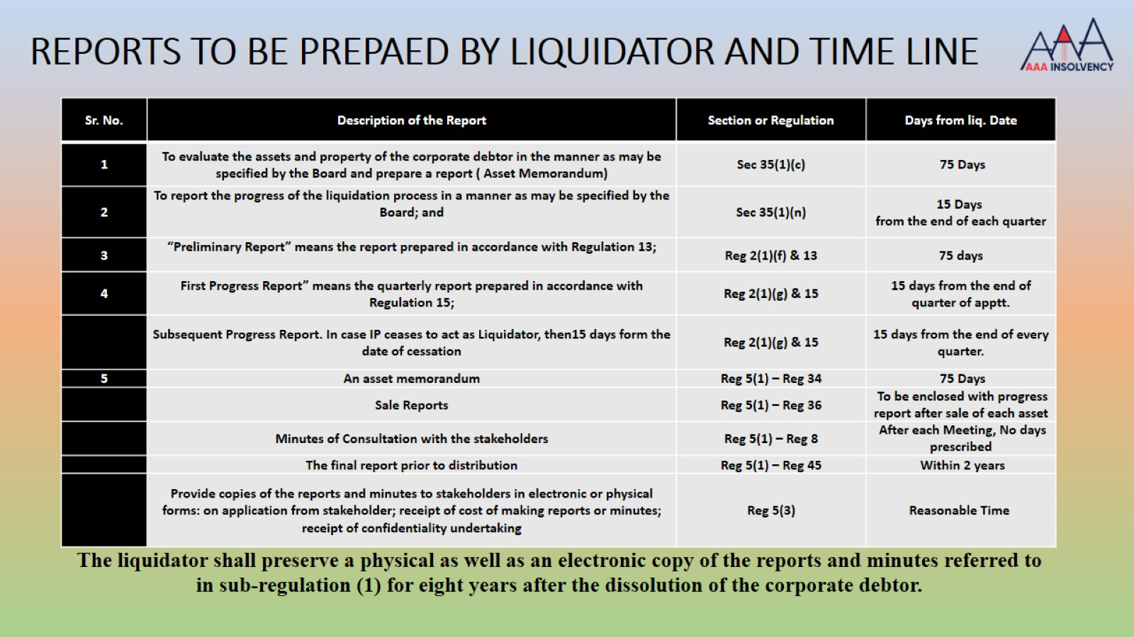
REPORTS TO BE PREPAED BY LIQUIDATOR AND TIME LINE

Slide 68
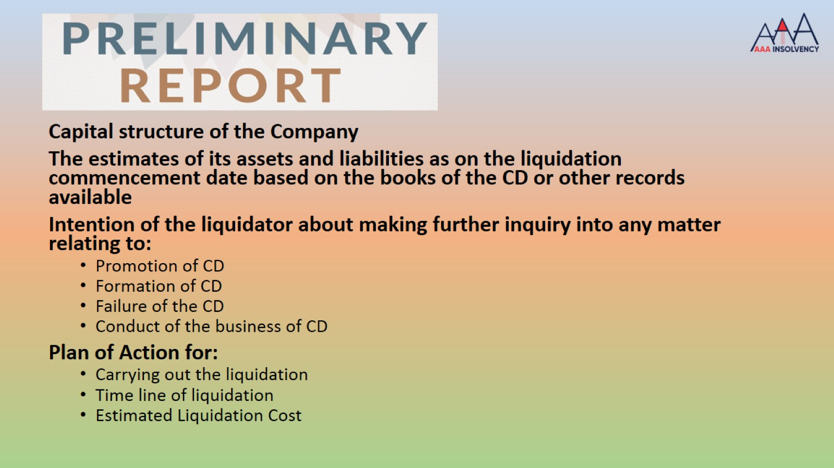

Slide 69
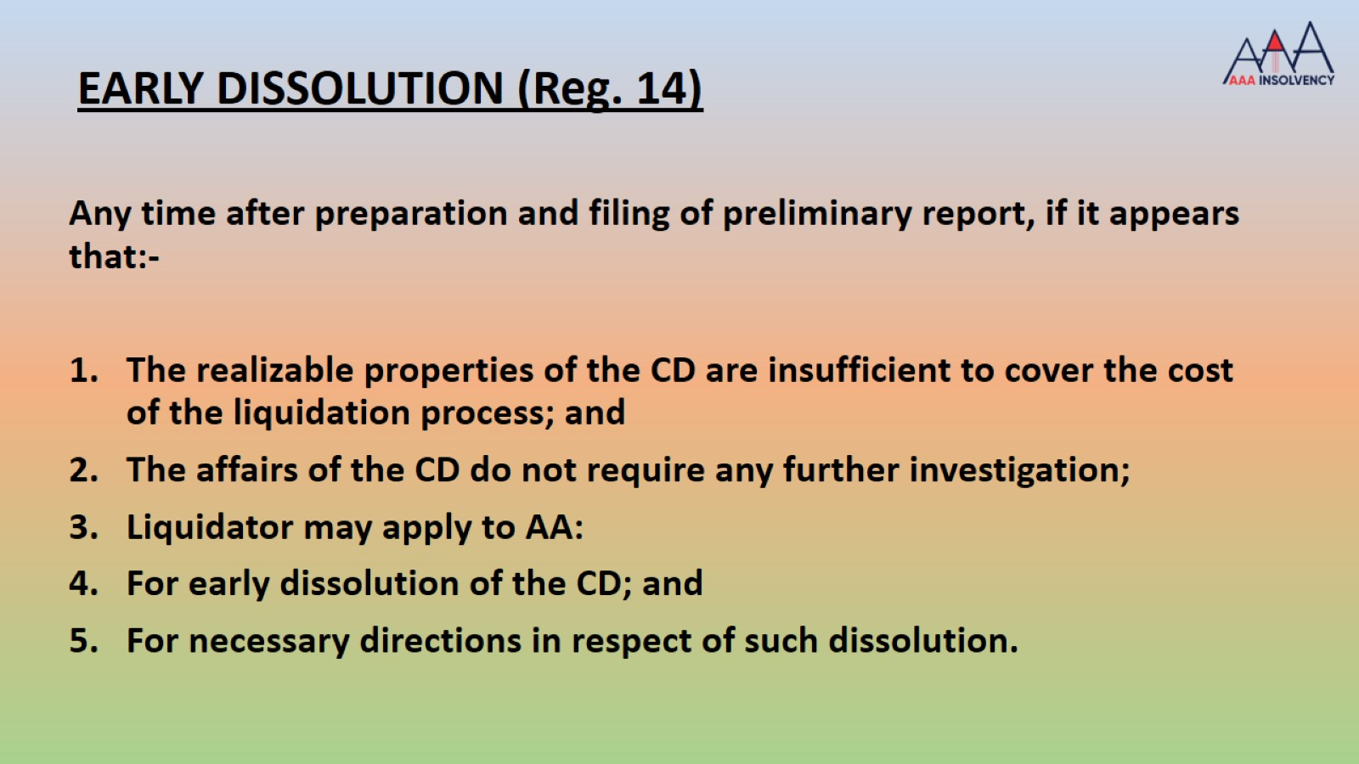

Slide 70
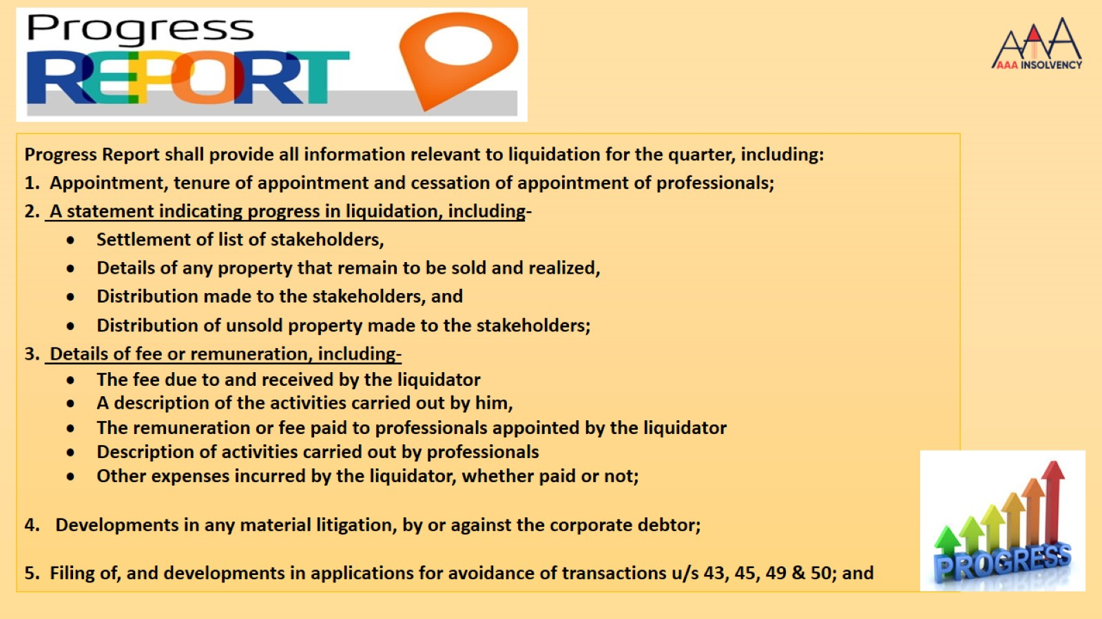

Slide 71
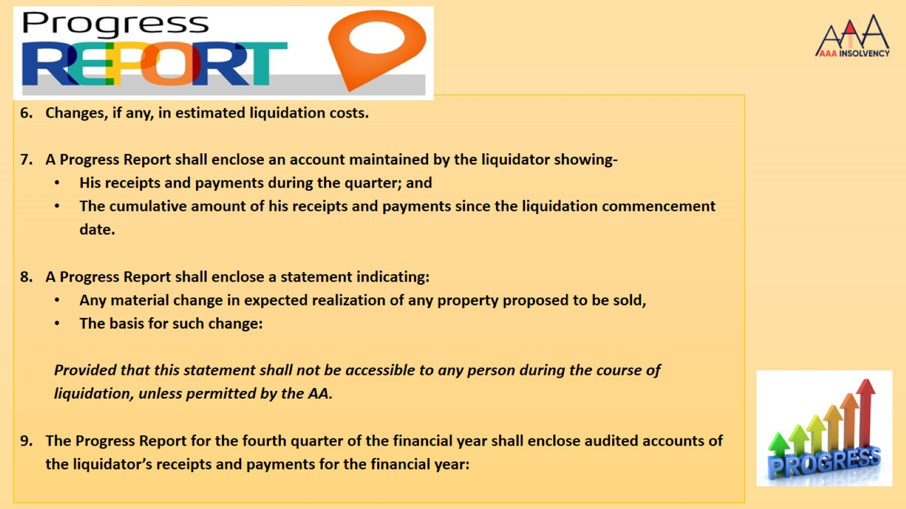

Slide 72
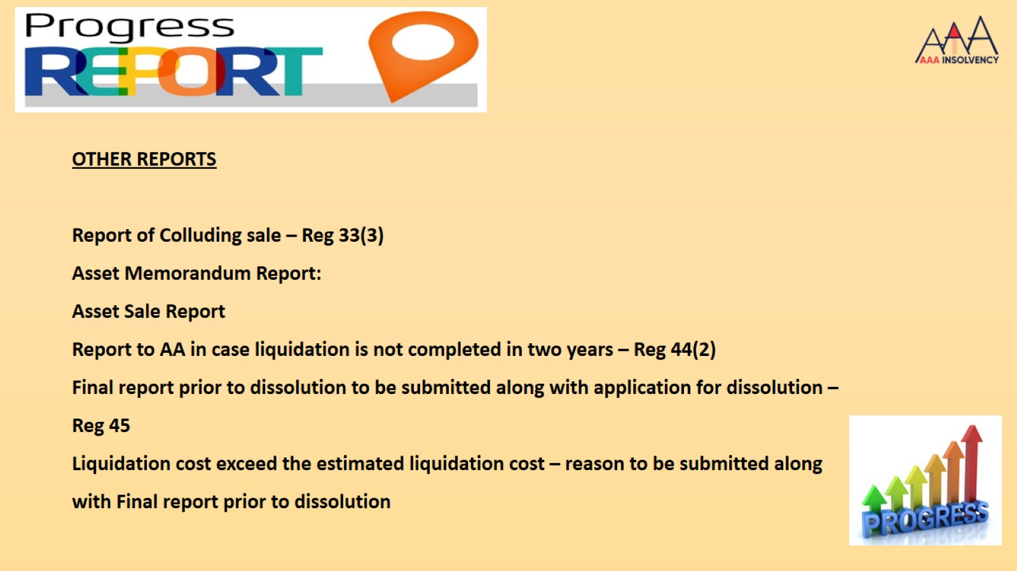

Slide 73
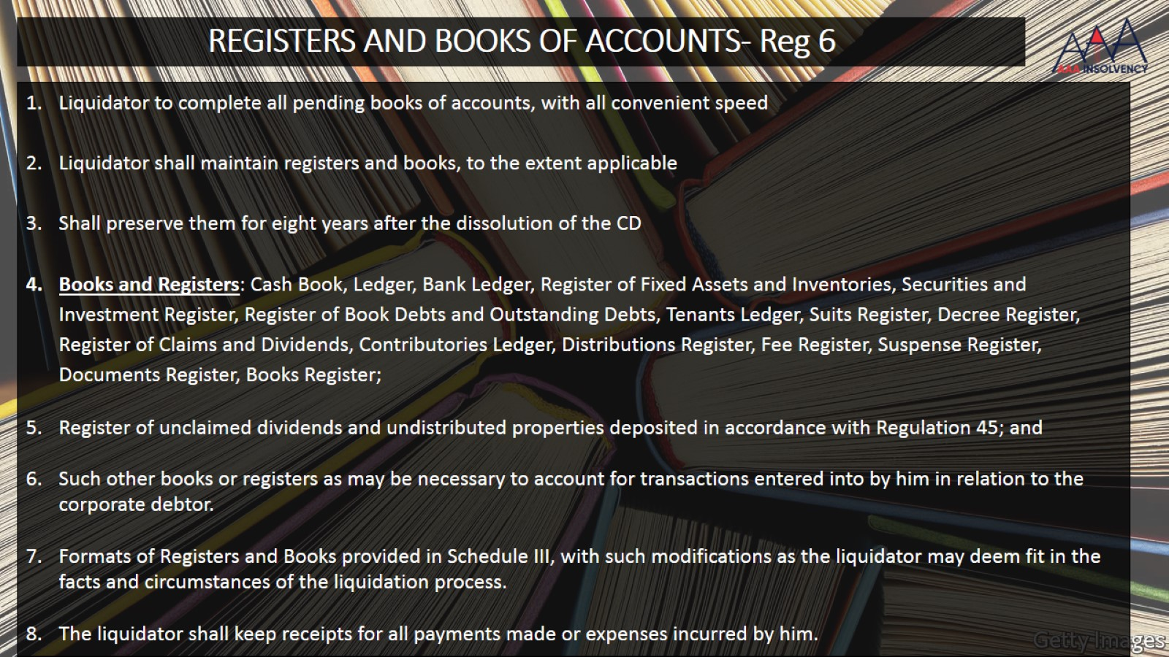
REGISTERS AND BOOKS OF ACCOUNTS- Reg 6

Slide 74
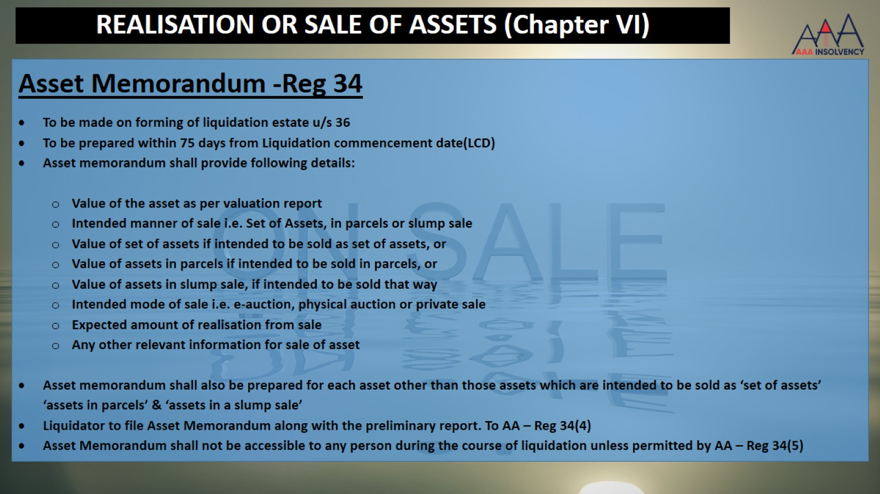
REALISATION OR SALE OF ASSETS (Chapter VI)

Slide 75

MANNER OF SALE – REG 32

Slide 76
VALUATION OF ASSETS or BUSINESS INTENDED TO BE SOLD – Reg 35
Liquidator can use the valuation done under reg 35 of CIRP regulations
Where liquidator is of the opinion that a fresh valuation is required, he shall appoint valuer within 7 days from LCD
Valuation would be done for all manner of sale i.e. clauses (a) to (f) of reg. 32
Valuation to be done after physical verification of assets in accordance with the Companies (Registered Valuers and Valuation) Rules, 2017
Average of two estimates shall be taken as the value of the assets or business or CD as a going concern

Slide 77
MAJOR HURDLES EXPERIENCED SO FAR IN LIQUIDATION PROCESS
Information and Documents: Non-cooperation by management is the key reason, no information about assets, no documents about assets, no details of the litigation, claims, refunds, etc., Original title deeds are not found, makes the recovery and sale tardy and frustrating
Valuation: unrealistic valuation makes the process difficult as it takes lot of time to reduce the price, SCC consent is not available for speedy reduction in price – although not required but needed for transparency and credible liquidation process.
Attachment of Assets under criminal offense : Section 32A inserted w.e.f 28/12/2019 has provided some relief otherwise most of our cases were impacted because of such attachment.
Liquidation Cost – No Contribution by Stakeholders: Liquidator can not work unless funds are available for the process
Customer not available: despite efforts by the liquidator, the customer may not be available in some cases and SCC is not ready to reduce the price.

Slide 78
MAJOR HURDLES EXPERIENCED SO FAR IN LIQUIDATION PROCESS – Contd..
Large Assets: under the current market scenario and in the recent past, there is no demand for large industrial assets having no alternative use
Industry Segment not in Demand: there are some industry segments which are not in demand as a going concern e.g. rice processing, thermal power without PPA, FSA, etc., in case we sell as piece meal – no value for building is realised.
Litigation: litigation over valuation, claims, stay by NCLT/NCLAT over sale of assets, Stay by HC on account of workmen dues despite having no jurisdiction, application u/s 230 pending, etc.
Tenancy: a bonafide tenants rights are protected like SARFAESI, the property can be sold alongwith the tenant only and may not find customer, the tenancy is fraudulently created and rent is very small.
Third Party Interest: in some assets third party interest is created by taking advance and those parties are taking stay from courts,

Slide 79
THIRD PARTY LITIGATIONS ON SALE OF ASSETS UNDER LIQUIDATION
D & I Taxcon Services Private Limited Vs. Mr. Vinod Kumar Kothari Liquidator of Nicco Corporation Limited (03-Mar-20, NCLAT DELHI)
Being a tenant, does not have no locus standi under Sec. 47(1) of the Code to seek any direction against the Liquidator as regards alleged undervalued sale transaction. It was alleged that property sold was under valued and price reduced beyond 25% without NCLT approval.

Slide 80
ATTACHMENT OF ASSETS BY STATUTORY AUTHORITIES – New Section 32A – 28/12/2019
New Section 32A is inserted by Ordinance dated 28/12/2019 as non-obstante section/clause and provide as: -
The liability of Corporate Debtor for any offence committee prior to CIRP shall cease;
Corporate Debtor shall not be prosecuted for such offence from the date Resolution Plan is approved
Even if the prosecution is instituted during CIRP, this section would be applicable;
Any person of officer who is in default for the offence, would continue to be liable for the offence and punishment, notwithstanding that the liability of the Corporate Debtor is ceased;
No action shall be taken against the property of the Corporate Debtor in relation to an offence committed prior to CIRP if that property is part of a Resolution Plan approved by AA, which results in to change in the management
No action shall be taken against the property of the Corporate Debtor in relation to an offence committed prior to CIRP if that property is sold during liquidation process under IBC

Slide 81
ATTACHMENT OF ASSETS BY STATUTORY AUTHORITIES
An action against the property of the corporate debtor in relation to an offence shall include the attachment, seizure, retention or confiscation of such property under such law as may be applicable to the corporate debtor;
The Corporate Debtor and any other person including Resolution Professional or Liquidator shall provide all the assistance and co-operation to the investigating agency regarding the offence committed before the commencement of CIRP
Conditions for this section:
Resolution Plan or sale during liquidation process results in change in the management or control of Corporate Debtor
The new management or the buyer during liquidation process is not a promoter or in the management or control of the corporate debtor or a related party of such a person; or
The new management or the buyer during liquidation process is not a person with regard to whom the relevant investigating authority has reason to believe that he had abetted or conspired for the commission of the offence

Slide 82
JUDICIAL PRONOUNCEMENTS UNDER SECTION 32A.
Tata Steel BSL Limited & Anr Vs. Union of India & Anr. (16-Mar-20, Delhi High Court)
Hon’ble High Court held that it is clear from the express language of the provision of section 32A of the Code that a Corporate Debtor would not be liable for any offence committed prior to commencement of the CIRP and the corporate debtor would not be prosecuted if a resolution plan has been approved by the Adjudicating Authority. In the present case, there is no dispute that a resolution plan has been approved by the Adjudicating Authority (NCLT) and in the circumstances, there is much merit in the contention that the petitioner cannot be prosecuted and is liable to be discharged. The petition is, accordingly, allowed and the impugned order dated 16.08.2019 and the impugned summons dated 21.08.2019, are set aside. The impugned compliant (CC No. 770/2019) against the petitioner, is also set aside.
Further the High Court clarified that this order will not affect the prosecution of the erstwhile promoters or any of the officers who may be directly responsible for committing the offences in relation to the affairs of the petitioner company

Slide 83
JUDICIAL PRONOUNCEMENTS UNDER SECTION 32A – Contd…
JSW Steel Ltd. Vs. Mahender Kumar Khandelwal & Ors.(17-Feb-20, NCLAT DELHI) In the CIRP of Bhushan Power & Steel Limited
ED asked for Self-declaration under Sec. 32A from JSW Steel that they are not a party to offense and they are related party – held ED can not ask for this – either RP or COC or AA can ask
COC or RP or AA can decide the ineligibility u/s 29A and 32A
Applicability of Sec. 32A retrospective or prospective - there is no basis to make distinction between a resolution applicant whose plan has been approved post or prior to the promulgation of the Ordinance
Surendra Kumar Joshi vs Rei Agro Limited (12-Mar-20, NCLT Kolkata Bench)
Thus I am of the view that attachment of the properties as referred to in prayer 1 is illegal and are liable to be de attached by the ED and handed over to the liquidator, to enable the liquidator to handle the property as per the provisions of the I&B Code

Slide 84
JUDICIAL PRONOUNCEMENTS UNDER SECTION 32A – Contd…
INTERPLAY BETWEEN IBC AND PMLA
DIRECTORATE OF ENFORCEMENT VS. MANOJ KUMAR AGARWAL & ORS.,
(NCLAT, Delhi, Comp. Appl. (AT)(Ins.) NO.575/2019 dated 09.04.2021)
The Hon’ble NCLAT, New Delhi in the above matter observed that :
The provisions of the Code will over-ride the attachment of the properties (of a corporate debtor) under the PMLA, even when such attachment took place prior to the initiation of the CIR Process.
The object and intention of the Code provides a free-hand to the creditors and the Resolution Professional to effectively revive and resolve the stress faced by the corporate debtor.
In doing so, if the properties of a corporate debtor are attached, it will jeopardize the efforts of the Resolution Professional and will hamper a successful resolution.

Slide 85
JUDICIAL PRONOUNCEMENTS UNDER SECTION 32A – Contd…
NITIN JAIN, LIQUIDATOR PSL LIMITED VS. ENFORCEMENT DIRECTORATE THROUGH RAJU PRASAD MAHAWAR, ASSISTANT DIRECTOR PMLA
(Delhi High Court, WP (C) No. 3261/2021 dated 15.12.2021)
FACTS:
Hon'ble NCLT on 11.09.2020 ordered liquidation of Corporate Debtor and assets of the CD were listed for sale by ways of an e-auction.
Meanwhile the Liquidator received the 1st summons from Enforcement Directorate, PMLA alongwith reminder Summons.
Due to above, the Liquidator filed a Writ Petition.
Interim Order dated 17.03.2021 was passed by Hon'ble High Court, whereby the Liquidator was allowed to list the assets of the CD for sale and keep the proceeds of sale in an escrow account.
On 09.04.2021, a bid of Rs.425.50 Cr. was received from M/s Lucky Holdings Pvt. Ltd., proposing to take over the assets of the CD and continue its functioning as a going concern. This was approved by AA on 08.09.2021.
Later, on 02.12.2021 a provisional attachment order (PAO) under PMLA was issued by the ED, against the CD, attaching its assets amounting to Rs. 274.60 Cr. prompting the Liquidator to seeking permission for disbursal of part of sale proceeds.
In response present Writ Petition was filed stating Section 32A of Code bars any proceedings against the CD during the Liquidation Period.

Slide 86
JUDICIAL PRONOUNCEMENTS UNDER SECTION 32A – Contd…
NITIN JAIN, LIQUIDATOR PSL LIMITED VS. ENFORCEMENT DIRECTORATE THROUGH RAJU PRASAD MAHAWAR, ASSISTANT DIRECTOR PMLA
(Delhi High Court, WP (C) No. 3261/2021 dated 15.12.2021)
ISSUES BEFORE COURT:
Whether the Enforcement Directorate can issue order attaching assets of the Corporate Debtor during the pendency of the Writ Petition.
Whether section 32A of the Code bars prosecution, attachment, seizure, action or confiscation against a Corporate Debtor after a resolution plan is Approved.
Primacy of IBC over PMLA

Slide 87
JUDICIAL PRONOUNCEMENTS UNDER SECTION 32A – Contd…
NITIN JAIN, LIQUIDATOR PSL LIMITED VS. ENFORCEMENT DIRECTORATE THROUGH RAJU PRASAD MAHAWAR, ASSISTANT DIRECTOR PMLA
(Delhi High Court, WP (C) No. 3261/2021 dated 15.12.2021)
JUDGEMENT/OBSERVATIONS:
The authorities under the Code are concerned with timely resolution of debts, those under the PMLA are concerned with the criminality attached to the offense of money laundering and confiscation of properties that were acquired.
Section 32A is “unambiguous” about its terms and would not allow any other proceedings to be carried out against the CD during the pendency of the Liquidation process or CIRP.
Once AA approves the mode selected in the course of liquidation the power vested in the ED under PMLA to provisionally attach or move against the properties of the Corporate Debtor would stand foreclosed.
The Liquidator entitled in law to proceed with the Liquidation process in accordance with the provisions of IBC.

Slide 88
SALE OF ASSETS – Reg 32
The liquidator may sell-
(a) an asset on a standalone basis;
(b) the assets in a slump sale;
(c) a set of assets collectively
(d) the assets in parcels;
(e) the corporate debtor as a going concern; or
(f) the business(s) of the corporate debtor as a going concern:
Liquidator can not sell the assets unless security interest has been relinquished

Slide 89
DHANLAXMI BANK LIMITED VS. TECHNO FAB MANUFACTURING LIMITED & ORS.
(NCLAT, Comp Appl. (AT) (Ins) No. 777 of 2021 dated 28.09.2021)
FACTS
The Appellant was a secured creditor in the liquidation process of CD.
The Appellant directed the Liquidator to realize its asset, over which under Section 52(1)(b) of Code he had exclusive first charge and physical possession of the asset.
On 05.09.2018 liquidation order was passed and the physical possession of the secured asset was handed over to the Appellant by the liquidator.
The first and second auctions of the secured asset were held.
The Liquidator asked the Appellant to vacate asset he was in physical possession of, and to return said asset back to the liquidation estate.
Thereafter, the Appellant requested to put further efforts to realize its security and accordingly, required an additional period of 6 months.

Slide 90
DHANLAXMI BANK LIMITED VS. TECHNO FAB MANUFACTURING LIMITED & ORS.
(NCLAT, Comp Appl. (AT) (Ins) No. 777 of 2021 dated 28.09.2021)….CONTD
ISSUES BEFORE COURT:
Whether the Secured Creditor is obligated to take immediate appropriate steps for auction of assets/ property and realize the security interest.
OBSERVATIONS/JUDGEMENT:
Regulation 21-A(2) of Liquidation Regulations provides that a Secured Creditor has to realize its security interest in time bound manner and has to relinquish the security interest to the liquidator within 90 days from LCD.
The secured creditor shall pay ‘excess’ of the realized value of the asset to security interest, over amount of his claims admitted, to the liquidator within 180 days from LCD.
Regulation 21(3) of Liquidation Regulation provides that where a secured creditor fails to comply with Regulation 21(2), the asset, which is subject to security interest, shall become part of the liquidation estate.
In present case, the Appellant was unable to realize the security asset over a period of 3 years thus, Appellant is obligated to handover the possession of the asset back to Liquidator within 7 days.

Slide 91
MODES OF EFFECTING A SALE UNDER REGULATION 32
The following are the modes by which sale can be effected under Regulation 32 –
Sale of Assets on Standalone Basis/ Piecemeal Basis: The option of selling the assets of the corporate debtor on standalone basis or on a piecemeal basis means that the liquidator can sell the assets of the corporate debtor individually, piece by piece, to different buyers or same buyer, by way of separate transactions.
Sale of Assets in Slump Sale: Regulation 32 of the Liquidation Regulation permits sale of assets of a corporate debtor in a slump sale. “Slump sale” is a construct under Section 2(42C) of the Income-Tax Act, 1961. It means the transfer of one or more undertakings as a result of the sale for a lump-sum consideration without values being assigned to the individual assets and liabilities in such sales

Slide 92
MODES OF EFFECTING A SALE UNDER REGULATION 32
The following are the modes by which sale can be effected under Regulation 32 –
Sale of a set of assets collectively: One of the various modes of sale of assets of the corporate debtor in liquidation is the sale of assets collectively. A liquidator while exercising his/her commercial wisdom should act in a manner to ensure maximisation of value of the assets of the corporate debtor from the sale thereof
Sale of the Corporate Debtor as a Going Concern: The Insolvency Law Committee in its report dated March 26, 2018 noted that the phrase “as a going concern” implies that the corporate debtor would be functional as it would have been prior to initiation of corporate insolvency resolution process, other than the restrictions put by the IBC.
Sale of the Business of the Corporate Debtor as a Going Concern: Regulation 32(f) of the Liquidation Regulation envisages that the business along with all the assets relevant to that particular business, including intangibles assets, of the corporate debtor will be transferred as a going concern to the acquirer, without transfer of the legal entity of the corporate debtor.

Slide 93
ASSESSMENT OF SALE AS A GOING CONCERN – Reg 39C of CIRP – w.e.f 25/07/2019
While approving a Resolution Plan or while deciding to liquidate the Corporate Debtor, the COC is required to do as under: -
May recommend that the Liquidator to first explore sale of Corporate Debtor as a going concern; or Sale of the business of the Corporate Debtor as a going concern
Shall identify group of assets and liabilities of the Corporate Debtor which can be sold as a going concern for commercial considerations
The Resolution Professional shall submit the recommendation of the COC to the Adjudicating Authority while submitting the application of approval of Resolution Plan or application for liquidating the Corporate Debtor

Slide 94
SALE AS A GOING CONCERN– Reg 32A
Where the COC has recommended sale as a going concern, or
where the liquidator is of the opinion that sale as a going concern shall maximise the value of the CD, he shall endeavour to first sell as going concern
The group of assets and liabilities of the CD, as identified by the COC under regulation 39C of CIRP Regulations shall be sold as a going concern.
Where the COC has not identified the assets and liabilities under Reg 39C, then the liquidator shall identify and group the assets and liabilities to be sold as a going concern, in consultation with the SCC
If the liquidator is unable to sell the CD or its business as a going concern within 90 days from the LCD, he shall sell the assets of the CD under clauses (a) to (d) of regulation 32

Slide 95
RATIONALE OF SALE OF AS A GOING CONCERN
Therefore, it is clear that during the liquidation process, step required to be taken for its revival and continuance of the ‘Corporate Debtor’ by protecting the ‘Corporate Debtor’ from its management and from a Corporate Death by liquidation. Thus, the steps which are required to be taken are as follows:
i. By compromise or arrangement with the creditors, or class of creditors or members or class of members in terms of Section 230 of the CompaniesAct,2013.
ii. On failure, the liquidator is required to take step to sell the business of the ‘Corporate Debtor’ as going concern in its totality along with the employees.
The last stage will be death of the ‘Corporate Debtor’ by liquidation, which should be avoided.

Slide 96
PROCEDURE FOR SALE AS A GOING CONCERN
The COC or liquidator will decide about group of assets and liabilities to be sold as a going concern
The term ‘Going Concern’ has not been defined under the Code or Regulations. In general parlance the term connotes that the corporate entity is being sold along with all the tangible and intangible assets.
The CD would be sold just like ‘resolution plan’ and liabilities can also be taken over by the prospective buyer in case lender agree for that – however practically it is not happening.
The sale as a going concern is considered beneficial as it Preserve the Intangible Assets, assures smooth transition of undertaking, collective value of assets can be quoted by bidders, retaining workers and employees is possible.
Some of the assets can be retained by the Liquidator to be sold separately under regulation 32
However most of the liabilities would be paid partially out of the proceeds of sale as a going concern and partly out of the sale of other assets retained by the Liquidator

Slide 97
PROCEDURE FOR SALE AS A GOING CONCERN – Contd…
The company along with the all intangible assets would be transferred to the bidder by way of extinguishment of existing share capital and issue of fresh shares to the bidder
The Liquidation Bank account of the CD can be retained by the Liquidator for distribution of proceeds and also for receiving the proceeds of other assets
The liquidator shall not submit an application to the adjudicating authority for dissolution of the corporate debtor, however, the application would be for the closure of liquidation process as the company has been sold as a going concern – Reg 45(3)
The Adjudicating Authority shall pass an order for the approval of sale as a going concern just like a resolution plan and would allow the Liquidator to continue to operate the Liquidation Bank Account and sale of other assets
All the claims would be settled by the Liquidator from the proceeds of sale

Slide 98
COMPROMISE OR ARRANGEMENT –
SECTION 230 CA, 2013
WHO CAN PROPOSE A COMPROMISE OR ARRANGEMENT BY WAY OF AN APPLICATION TO NCLT?
the company; or
any creditor; or
member of the company; or
the liquidator appointed under this Act or under the Insolvency and Bankruptcy Code, 2016
A COMPROMISE OR ARRANGEMENT CAN BE PROPOSED BETWEEN:
a company and its creditors or any class of them; or
a company and its members or any class of them,

Slide 99
COMPROMISE OR ARRANGEMENT –
SECTION 230 CA, 2013
APPLICATION U/S 230 SHOULD DISCLOSE TO NCLT FOLLOWING ON AFFIDAVIT
all material facts relating to the company
latest financial position of the company
the latest auditor's report on the accounts of the company and
the pendency of any investigation or
proceedings against the company;
reduction of share capital of the company, if any, included in the compromise or arrangement;
any scheme of corporate debt restructuring

Slide 100
COMPROMISE OR ARRANGEMENT –
SECTION 230 CA, 2013
IF APPLICATON U/S 230 INCLUDE A CORPORATE DEBT RESTRUCTURING, THEN FOLLOWING SHOULD ALSO BE DISCLOSED /SUBMITTED TO NCLT
Consent of not less than seventy-five percent of the secured creditors in value
a creditor's responsibility statement in the prescribed form;
IF APPLICATON U/S 230 INCLUDE A CORPORATE DEBT RESTRUCTURING, THEN FOLLOWING SHOULD ALSO BE DISCLOSED /SUBMITTED TO NCLT
safeguards for the protection of other secured and unsecured creditors;
report by the auditor that the fund requirements of the company after the corporate debt restructuring as approved shall conform to the liquidity test based upon the estimates provided to them by the Board;

Slide 101
COMPROMISE OR ARRANGEMENT –
SECTION 230 CA, 2013
IF APPLICATON U/S 230 INCLUDE A CORPORATE DEBT RESTRUCTURING, THEN FOLLOWING SHOULD ALSO BE DISCLOSED /SUBMITTED TO NCLT
where the company proposes to adopt the corporate debt restructuring guidelines specified by the Reserve Bank of India, a statement to that effect; and
a valuation report in respect of the shares and the property and all assets, tangible and intangible, movable and immovable, of the company by a registered valuer
NCLT WILL ORDER A MEETING TO BE CONVENED BETWEEN:
the creditors or class of creditors, or
the members or class of members
The Tribunal may dispense with calling of a meeting of creditor or class of creditors where such creditors or class of creditors, having at least ninety per cent. value, agree and confirm, by way of affidavit, to the scheme of compromise or arrangement.

Slide 102
COMPROMISE OR ARRANGEMENT –
SECTION 230 CA, 2013
NOTICE FOR THE MEETING ALONG WITH DOCUMENTS SHALL BE SENT TO :
all the creditors or class of creditors; and
all the members or class of members; and
the debenture-holders of the company
Central Government
Income-tax authorities
Reserve Bank of India
Securities and Exchange Board, if applicable, for placing on SEBI website
Registrar of Companies
respective stock exchanges, if listed, for placing on their website
Official Liquidator, if necessary
NCLT may also direct, the manner in which the meeting is to be called, held and conducted. The Tribunal may dispense with calling of a meeting of creditor or class of creditors where such creditors or class of creditors, having at least ninety per cent. value, agree and confirm, by way of affidavit, to the scheme of compromise or arrangement.

Slide 103
COMPROMISE OR ARRANGEMENT –
SECTION 230 CA, 2013
NOTICE FOR THE MEETING ALONG WITH DOCUMENTS SHALL BE SENT TO :
Competition Commission of India, if necessary
sectoral regulators or authorities, if applicable which are likely to be affected by the compromise or arrangement
to be placed on website of company
To be published in the newspapers as prescribed
Notices shall be sent individually to all at the address registered with the company
News paper notice shall indicate that when (the period in which) the scheme shall be available to concerned persons free of charge
Notice shall contain the details about the voting process

Slide 104
COMPROMISE OR ARRANGEMENT –
SECTION 230 CA, 2013
DOCUMENTS TO BE SENT ALONG WITH NOTICE FOR MEETING
a statement disclosing the details of the compromise or arrangement;
a copy of the valuation report, if any
explaining the effect of compromise or arrangement on any material interest of
  on creditors;
  key managerial personnel;
  promoters;
  non-promoter members;
  the debenture-holders;
  the directors of the company;
  the debenture trustees
HOW VOTING CAN BE DONE IN MEETING FOR ADOPTION OF SCHEME
may vote in the meeting in person; or
through proxies or
by postal ballot
within one month from the date of receipt of such notice

Slide 105
COMPROMISE OR ARRANGEMENT –
SECTION 230 CA, 2013
OBJECTIONS & REPRESENTATIONS TO SCHEME CAN BE MADE BY PERSONS:
holding not less than 10% of the shareholding
having outstanding debt amounting to not less than 5% of the total outstanding debt as per the latest audited financial statement
Representations can be made by following, if they are affected by the scheme
  Central Government
  Income-tax authorities
  Reserve Bank of India
  Securities and Exchange Board, if applicable, for placing on SEBI website
  Registrar of Companies
  respective stock exchanges, if listed, for placing on their website
  Official Liquidator, if necessary
  Competition Commission of India, if necessary
  sectoral regulators or authorities, if applicable which are likely to be affected by the compromise or arrangement

Slide 106
COMPROMISE OR ARRANGEMENT –
SECTION 230 CA, 2013
The objections and representations shall be made with 30 days of receipt of notice, failing which, it shall be presumed that they have no objections or representations to make on the scheme
Any aggrieved party may make an application to the Tribunal in the event of any grievances with respect to the takeover offer of companies other than listed companies and the Tribunal may, on application, pass such order as it may deem fit.
BUSINESS TO BE CONDUCTED AT THE MEETING
The scheme can be adopted by majority of persons either by voting in person or by proxy or by postal ballot or e-voting:
Representing 75% of creditors in value or class of creditors in value; or
Representing 7% of members or class of members
The results of the meeting would be submitted to NCLT and then NCLT would sanction the scheme by order

Slide 107
COMPROMISE OR ARRANGEMENT –
SECTION 230 CA, 2013
SCHEME WOULD BE BINDING ON FOLLOWING AFTER NCLT SANCTION
the company,
all the creditors, or class of creditors or
all the members or class of members,
the liquidator, if any
the contributories of the company.
NCLT WILL COVER FOLLOWING IN THE ORDER PASSED FOR SANCTION OF SCHEME
for conversion of preference shares into equity shares, the option of converting arrears of dividend
the protection of any class of creditors;
if the compromise or arrangement results in the variation of the shareholders' rights, it shall be given effect to under the provisions of section 48;
exit offer to dissenting shareholders, if any,
auditors certificate regarding accounting treatment, if any proposed in the scheme, conforms to accounting standards

Slide 108
COMPROMISE OR ARRANGEMENT –
SECTION 230 CA, 2013
NCLT WILL COVER FOLLOWING IN THE ORDER PASSED FOR SANCTION OF SCHEME
any other matter, which in the opinion of the Tribunal, are necessary to effectively implement the terms of the compromise or arrangement
Order shall be filed before ROC in 30 days of receipt of order
TIMELINE FOR PROCESS UNDER SECTION 230 OF THE CA, 2013 – REG 2B LIQUIDATION PROCESS REGULATIONS
A compromise or arrangement proposed under Section 230 of the Companies Act must be completed within 90 (ninety) days of the liquidation order and the time taken on compromise or arrangement will not be included in the liquidation period.

Slide 109
AMENDMENT TO LIQUIDATION PROCESS REGULATIONS DATED 30.09.2021
Omission of ‘“subsections (1) and (4) of’ from Sub -Regulation (1) to Regulation 2B Liquidation Process Regulations
Amended Regulation –
2B. Compromise or arrangement.
Where a compromise or arrangement is proposed under section 230 of the Companies Act, 2013 (18 of 2013), it shall be completed within ninety days of the order of liquidation under section 33.
Implication –
To give effect to Regulation 2B over all order of liquidation irrespective of the Sub-Section under which the application may have been filed

Slide 110
JUDICIAL PRONOUNCEMENTS ON SALE AS A GOING CONCERN AND SCHEME U/S 230
S.C. Sekaran vs. Amit Gupta and Ors, 2019 - NCLAT while upholding the liquidation order, directed the liquidator to first take steps under Section 230 of the Companies Act for revival of the corporate debtor, and if the process is not be completed in ninety days, proceed to sell the assets of the corporate debtor collectively and then in parts in accordance with law.
State Bank of India vs. Maithan Alloys Limited and Ors (2020)- upheld the sale of the corporate debtor as a going concern by rejecting the objections raised by the competitor bidders.

Slide 111
JUDICIAL PRONOUNCEMENTS ON SALE AS A GOING CONCERN AND SCHEME U/S 230
Y. Shivram Prasad and Ors. vs. S. Dhanapal and Ors (2019)- NCLAT laid down the steps required to be taken by the liquidator from protecting the corporate debtor into going in liquidation. NCLAT stated that the liquidator should first explore compromise or arrangement under Section 230 of the Companies Act, failing which the liquidator should take steps to sell the corporate debtor as going concern.
Alloys and Metal vs. Hindustan Paper Corporation Ltd. - NCLT, stated that a viable scheme under Section 230 of the Companies Act should be explored

Slide 112
JUDICIAL PRONOUNCEMENTS ON SALE AS A GOING CONCERN AND SCHEME U/S 230
Alloys and Metal vs. Hindustan Paper Corporation Ltd. - NCLT, Delhi, (2020) relying on Y. Shivram Prasad and Ors. vs. S. Dhanapal and Ors., stated that since one of the consortium members have shown interest in the stressed assets of the corporate debtor, subject to liquidator’s satisfaction, a viable scheme under Section 230 of the Companies Act should be explored.
Ashok Kumar and Ors. vs. K.T.C. Foods Private Limited 12, the NCLT, Chandigarh upheld sale of the corporate debtor as a going concern, and also clarified that dissolution of a corporate debtor is not necessary while being sold as a going concern under Regulation 32(e) of the Liquidation Regulation

Slide 113
JUDICIAL PRONOUNCEMENTS ON SALE AS A GOING CONCERN AND SCHEME U/S 230
V.K. Global vs. N. Prabhakar Liquidator(2020) - Smaat Indian Private Limited 13, the NCLT, Hyderabad, approved the closure of the liquidation process of the corporate debtor as a going concern after an application filed by the liquidator under Regulation 45(3)(s) of the Liquidation Regulations.
Gujarat NRE Coke Limited, 2018, NCLT Kolkata – AA acknowledged that the sale of assets of a corporate debtor as a going concern would save the livelihood of workers and would be beneficial to the creditors.

Slide 114
JUDICIAL PRONOUNCEMENTS ON SALE AS A GOING CONCERN AND SCHEME U/S 230 –
Invest Asset Securitisations & Reconstruction Pvt Limited vs. M/s Mohan Gems & Jewels Pvt. Limited 2018 - Dismissed the application for sale of corporate debtor as going concern on the ground that the amendment made under Regulation 45(3) of the Liquidation Regulations by the Board is beyond the powers of the Board. The NCLT, New Delhi, further stated that Regulation 45(3) of the Liquidation Regulations is in conflict with Section 54 of the IBC, which requires the liquidator make an application to the NCLT for dissolution of corporate debtor after the assets of the corporate debtor have been completely liquidated – Stay Granted over the Same by NCLAT

Slide 115
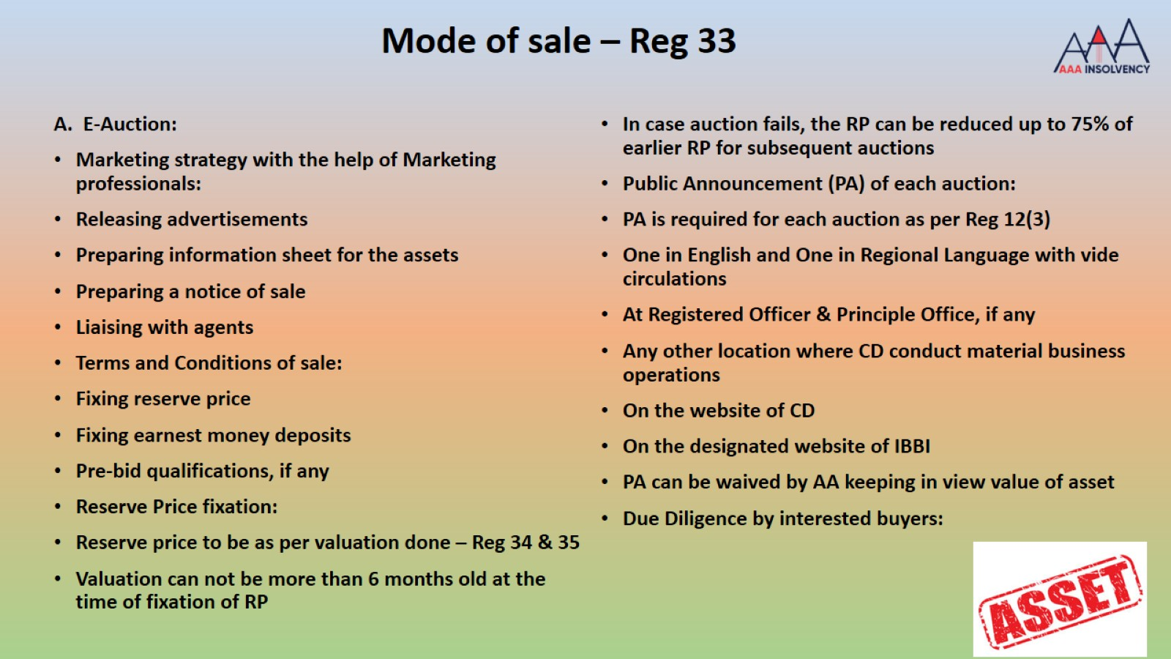
Mode of sale – Reg 33

Slide 116
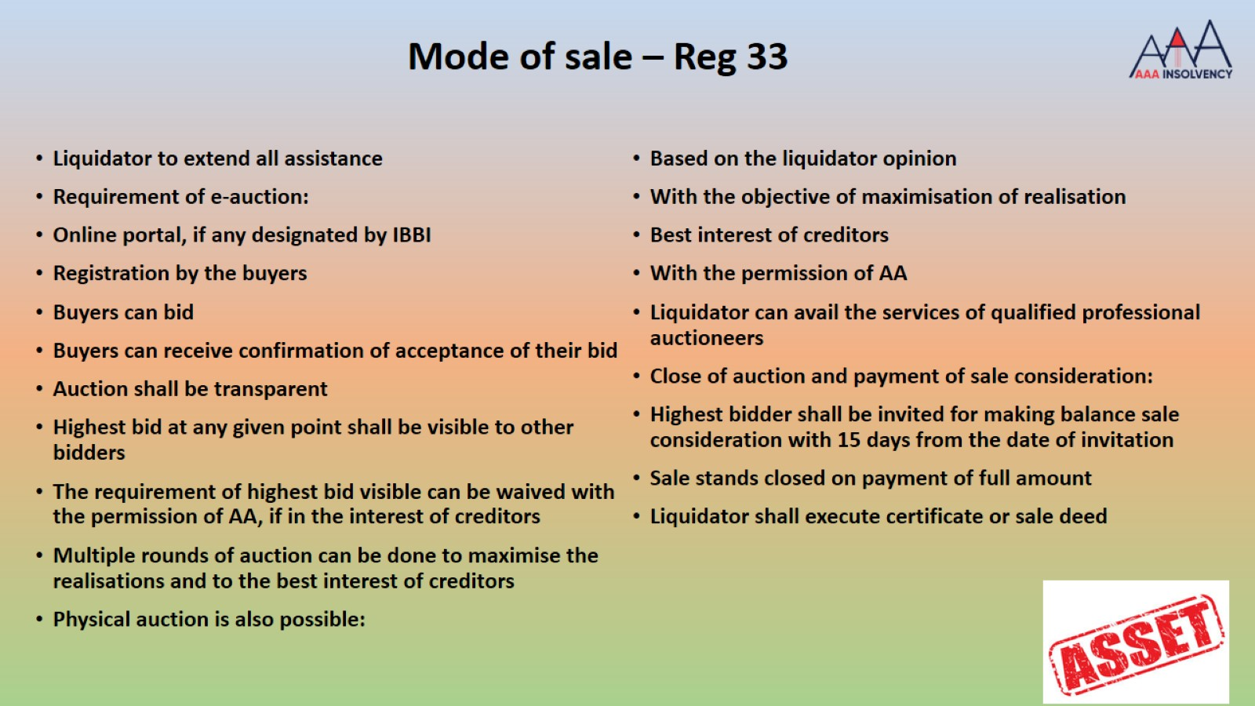

Slide 117
PUBLIC AUCTION IS FINAL
State Bank of India Vs. Maithan Alloys Limited (26.02.2020 NCLAT-New Delhi)
Sec 35(1)(f) of Code empowers liquidator to sell the property of the corporate debtor in liquidation by public Auction, Hence there was no need for adjudicating authority to direct the liquidator for considering the proposal of R- 2 to R-4 (OTHER PARTIES) who has approached the Adjudicating Authority after due date of finalisation of Auction

Slide 118
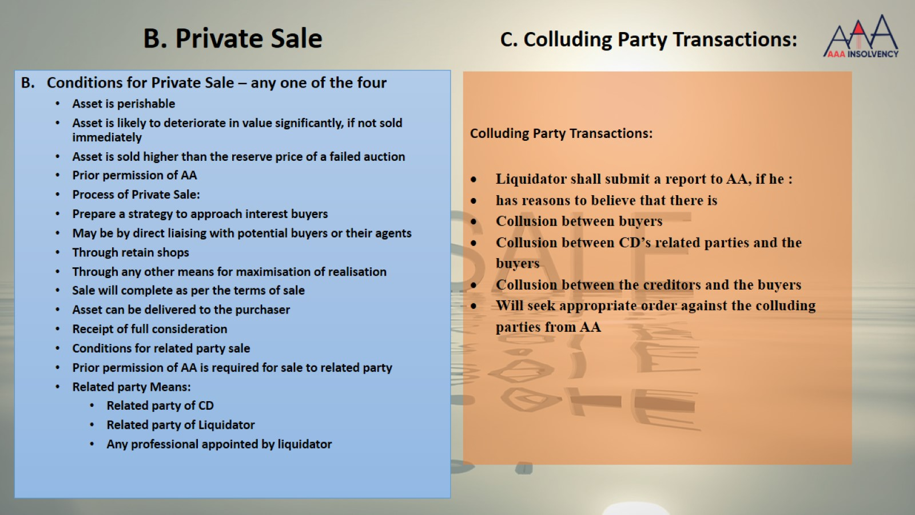

Slide 119
Recent Amendments in Liquidation Process – w.e.f. 25/7/2019
Recent Amendments in Sale Process – Schedule I - w.e.f. 25/7/2019
Liquidation process to complete in one year as against two years – Reg 44
Period for exploring sale as a going concern would be excluded
In case, Liquidator fails to complete, then an application would be filed to AA for extension along with reasons and way forward
Section 29A is also applicable to scheme of compromise or arrangement u/s 230
Reg 37 provides that secured creditor who have not relinquished security interest would not sell the assets to persons ineligible u/s 29A
Reserve price as per valuation under Reg 35
Where auction fails, reserve price can be reduced by 25%
Where auction still fails, the reserve price can be reduced by not more than 10%
The highest bidder is allowed to make payment in 90 days from the date of demand
However, payment made after 30 days shall attract an interest @ 12%
Sale shall be cancelled in case payment is not made in time

Slide 120
AMENDMENT NOTIFICATION DATED 30.09.2021
Amendments to Schedule I Liquidation Process Regulations
Amended Regulation – Schedule I
(3) The liquidator shall prepare terms and conditions of sale, including reserve price, earnest money deposit as well as pre-bid qualifications, if any.
“Provided that the liquidator shall not require payment of any non-refundable deposit or fee for participation in an auction under the liquidation process:
Provided further that the earnest money deposit shall not exceed ten percent. of the reserve price.”
(11) If required, the liquidator may conduct multiple rounds of auctions to maximize the realization from the sale of the assets, and to promote the best interests of the creditors.
“(11A) Where the liquidator rejects the highest bid in an auction process, he shall intimate the reasons for such rejection to the highest bidder and mention it in the next progress report.”.

Slide 121
HOW TO ASSURE TRANSPARENCY IN LIQUIDATION PROCESS
Regular sharing of progress and efforts made with stakeholders
Holding frequent SCC meetings and sharing the progress, efforts and hurdles e.g. litigation, lack of information, etc..
Monthly Progress Reports can be submitted to stakeholders and Quarterly Progress Reports can also be shared with stakeholders
Just like COC, appointment of professionals and major part of Liquidation Cost can be discussed in SCC Meetings and suggestions for better options may be discussed
Appointment of property or other brokers for sale of assets – big question on integrity except in the case of some internationally renowned companies for sale of big assets
Sharing of details of all the leads and interested parties in purchase of assets with the stakeholders along with contact details
Collating all the information and documents on VDR for sharing with prospective bidders

Slide 122
LITIGATION CHALLENGING THE DECISIONS OF LIQUIDATOR
Manjit Commercial LLP Vs. SPM Auto Pvt. Ltd. (In Liquidation) (5-Sep-19, NCLAT)
The contention of the Appellant is that the Liquidator reduced the Reserve Price of this asset from 7.24 Crores to 6.15 Crores with sole objective to favour pre-decided buyer.
Liquidator deliberately did not disclose the area of the asset for public advertisement so that the maximum bidders could not participate in the bidding process and the assets could have been sold to a known bidder.
The Liquidator deliberately reduced the time period to submit the bid forms, declaration form and EMD from 8 days, which was given in the first e-auction to 3 days in the second e-auction.
It is submitted that the Liquidator violated the Liquidation Regulations and provisions of the IBC
Held while dismissing the appeal
The Liquidator can reduce the Reserve Price for the reason that the earlier auction for this asset has failed.
While preparing the terms and conditions of sale, if it is necessary the period of liquidation process may be changed by the liquidator.

Slide 123
INFRASTRUCTURE REQUIRED FOR EFFECTIVE LIQUIDATION PROCESS
Sale of Assets require fully trained human resources which are completely different form CIRP teams
Making recoveries from other current asses e.g. sundry debtors, advances, claims, arbitrations, investments, etc.. require differently trained persons
Preservation and protection of still assets is difficult than operational assets as it is difficult to trust security agencies
Location of assets can be any where in India and coordination with prospective bidders may be difficult
Different manner and mode of sale may be required for different assets which may require different resources
Litigation may take substantial time as most proceedings would resume during liquidation process unlike CIRP as Continuation of pending suits or proceedings is allowed in Liquidation Process.

Slide 124
INFRASTRUCTURE REQUIRED FOR SALE OF ASSETS
Specially trained human resources working on sale of assets
Lead Generation: Public Notice as required under regulations, Posting of various property portal or business sale portals, bulk emails, bulk SMS, banner ads in property portals, display ad in news paper, posting on the website of IPE and banks; Display banner on the property.
Lead Management: Use of digital mobile number for the entire Company, use of same email for all the advertisements, use of software for lead capturing, allocation to leads to team members, regular monitoring by team leaders and Liquidator regularly
Due Diligence by customer: collective of all information and documents and uploading on Virtual Data Room (VDR), sharing of VDR link with prospective bidders, engaging with them for handling their questions and apprehensions, physical inspection thru local staff, developing a buyer for bidding, handholding for e-auction, etc.

Slide 125
IBBI’S ELECTRONIC PLATFORM FOR HOSTING PUBLIC NOTICES OF AUCTIONS OF LIQUIDATION ASSETS UNDER THE IBBI (LIQUIDATION PROCESS) REGULATIONS, 2016
Background
A liquidator is required to issue public notice of auctions on the website designated by IBBI
Liquidators are presently auctioning liquidation assets on various auction platforms. The information regarding such auctions is not available at a centralised place.
The New Portal/Website
The Board has provided an electronic platform on its website: www.ibbi.gov.in for hosting public notices of auctions of liquidation assets. The Board hereby designates this platform for the purposes of clause (5) of paragraph 1 of Schedule I of the Liquidation Process Regulations.
Liquidators are, therefore, directed to upload the public notice of every auction of any liquidation asset, with effect from 1st October, 2021, at www.ibbi.gov.in on the day of its publication in newspapers, through their designated login page.

Slide 126
STRATEGY NORMALLY USED FOR SALE OF ASSETS
Confidentiality about bidders: Number of bidders in a case should be kept as top secret and all should get an impression that there are more bidders.
Collection of EMD: The EMD can even be collected from a customer who is interested in lower price, EMD amount can be lesser to attract more bidders.
Frequent Price Reduction should be avoided: Price should be reduced only if a genuine interested party is available and is ready to give EMD, if we reduce reserve price quickly, then the customers will wait further reduction and would not bid.
Role of Security Guard at Site: The guard at site play a big role and can tell the whole story about the visitors, visitor book leads to cartelization, guard should be trained.
Specialised Agencies: There are Specialised agencies working in some fields e.g. Steel Scrap dealers, construction scrap dealers, textile machinery dealers, construction equipment dealers, motor vehicle dealers, etc.

Slide 127
PROCESS OF MAKING RECOVERIES FROM OTHER ASSETS
Investments: Taking control over Demat Accounts, physical certificates, replacing signatures of Liquidator and then selling, special efforts for each type of investments
Recoveries for Sundry Debtors: efforts for finding KYC, contact details, present financial position, serving information of liquidation, serving notice for recovery, issue of notice under IBC, filing of application under IBC, recovery suit in appropriate court or commercial court, sale of portfolio of receivables.
Recoveries from Claims, Refunds, etc..: Handling litigation, arbitration, tax assessments, insurance claims, etc.. needs a strong litigation and legal team; efforts may not bring results as information is insufficient and promoters are not cooperating.
Investment in Subsidiary or Associate Companies: taking control over management and operations, issue of appointing directors, running operations of subsidiary and associate companies till the investment is sold.
Avoidable Transaction Application: continued litigation on 43, 45, 50 or 66 applications

Slide 128
PROCESS OF MAKING RECOVERIES FROM OTHER ASSETS…Contd
Performance Bank Guarantees: It is the duty of the Liquidator to protect the performance bank guarantees outstanding on the LCD by performing the contract whatever is possible
Default Liability Performance: the Corporate Debtor can be kept as a going concern for avoiding the invocation of outstanding warranties supported by bank guarantees.
Retention Money kept with customers: The Liquidator can continuously provide some service to past customers so that the retention money kept by them is released.
Security Deposits : Recovery can be made from various security deposts given to different agencies for availing some services and the same can be recovered by liquidator by providing them all details of performance

Slide 129
APPLICATION UNDER IBC FOR RECOVERY OF DEBTS OF CORPORATE DEBTOR
Abhay N. Manudhane Vs. Gupta Coal India Pvt. Ltd (1-Oct-19, NCLAT Delhi)
No application under Chapter II (CIRP) can be filed by the ‘Corporate Debtor’, which is under Liquidation of which the Appellant is Liquidator
However, in case where matter does not relate to any secured asset and recovery of any money by the ‘Corporate Debtor’, which is not under Liquidation, a suit or other legal proceedings may be instituted by the Liquidator on behalf of the ‘Corporate Debtor’, but not an application under Section 9 of the Code.
AMENDMENT IN SEC 11 – Clarified by Exp II inserted on 28/12/2019
Explanation II.- For the purposes of this section, it is hereby clarified that nothing in this section shall prevent a corporate debtor referred to in clauses (a) to (d) from initiating corporate insolvency resolution process against another corporate debtor

Slide 130
MANAGEMENT OF SUBSIDIARY AND ASSOCIATE COMPANIES AND RECOVERY OF INVESTMENT
Rajive Kaul Vs. Vinod Kumar Kothari & ors (20-Mar-20, NCLAT Delhi) in the case of NICCO Corporation Ltd
  It is an axiomatic principle in Law that a Company in liquidation acts through the ‘Liquidator’ and the ‘Liquidator’ steps into the shoes in the Board of the Directors of the Company under Liquidation for the purpose of discharging is statutory duties. In reality, the property of the Company forming part of Liquidation still remain vested in the Company.
  The orders passed by NCLT are free from any legal flaws.
  Further it is held that the Liquidator is armed with requisite powers to remove the ‘Nominee Directors’ and is entitled to nominate the ‘Directors’ and the Subsidiary Company is enjoined to act upon the replacement proposal of the ‘Existing Nominee Directors’ of ‘Corporate Debtor’.
The Assistant Provident Fund Commissioner & Recovery Officer Employees Provident Fund Organization vs Florind Shoes Pvt. Ltd. (CD) & Ors.- (28-Jan-20, NCLAT Delhi)
  NCLAT has held that as in terms of provisions of Section 36(4)(d) of the Code assets of its subsidiary did not fall within the ambit of liquidation Estate.

Slide 131
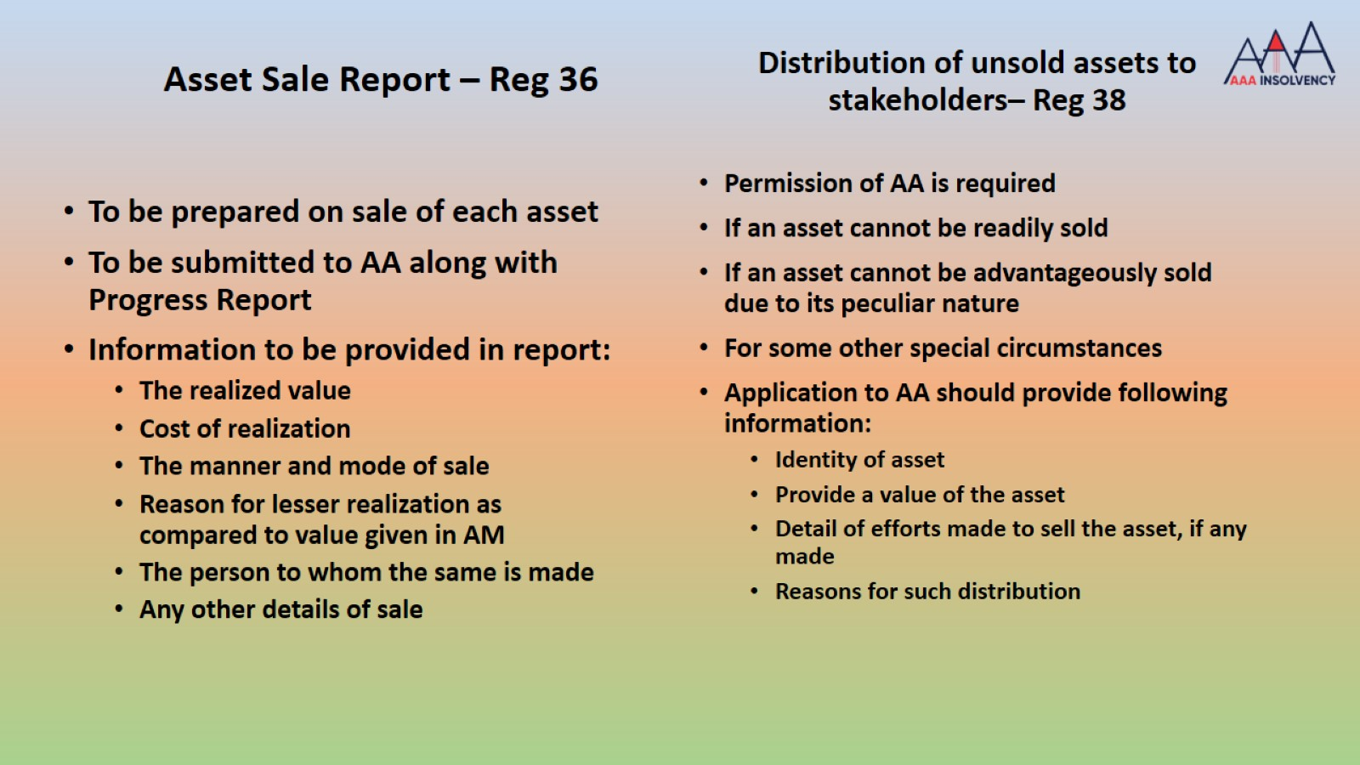

Slide 132
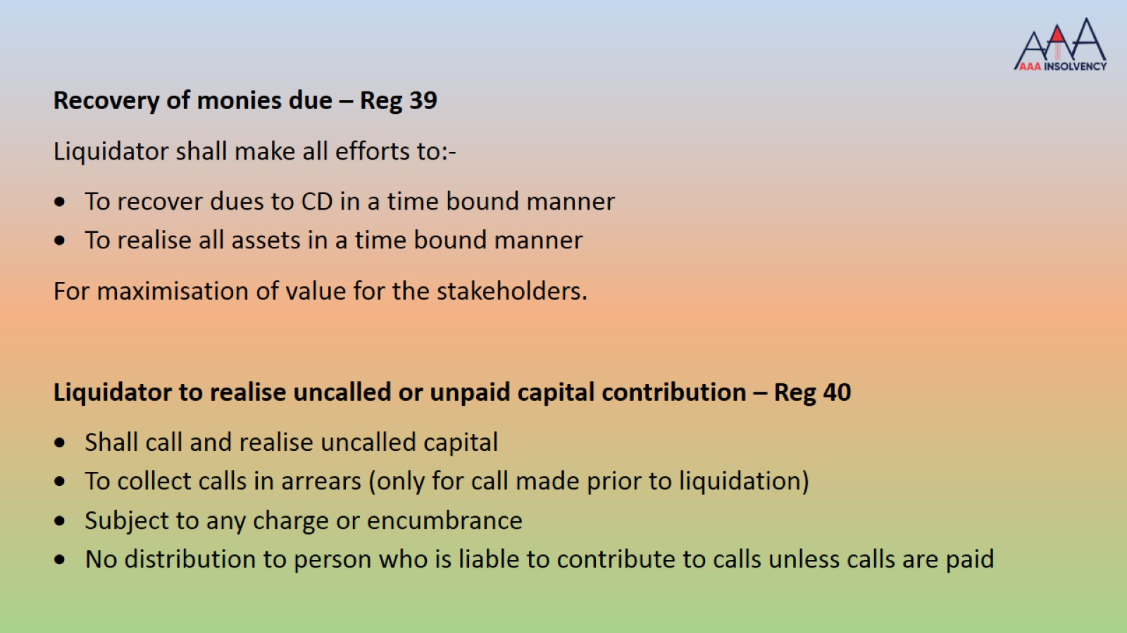

Slide 133
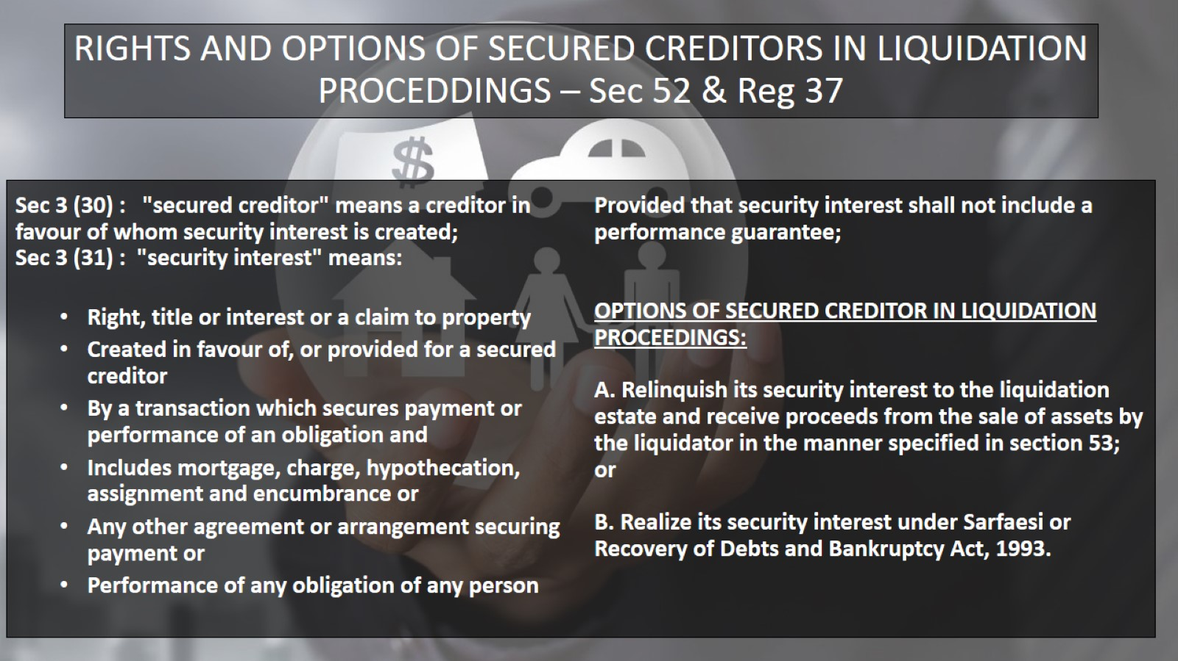
RIGHTS AND OPTIONS OF SECURED CREDITORS IN LIQUIDATION PROCEEDINGS – Sec 52 & Reg 37

Slide 134
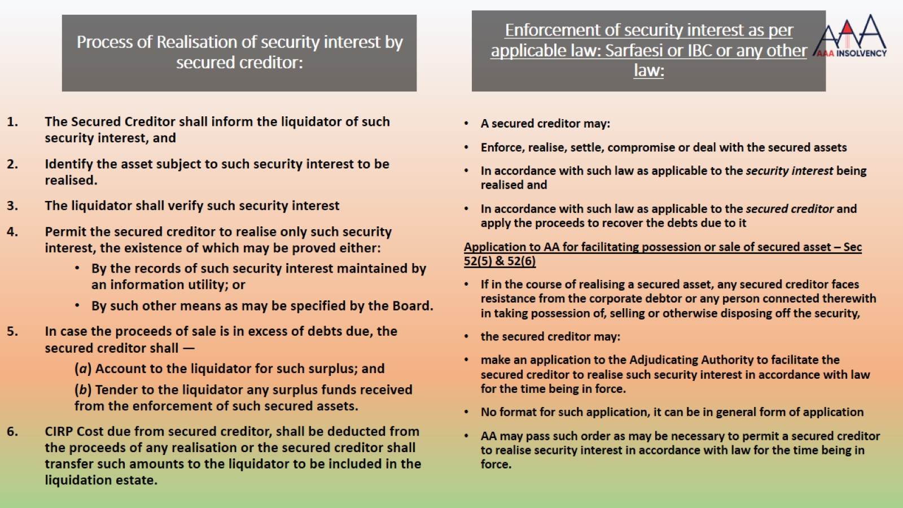
Process of Realisation of security interest by secured creditor:

Slide 135
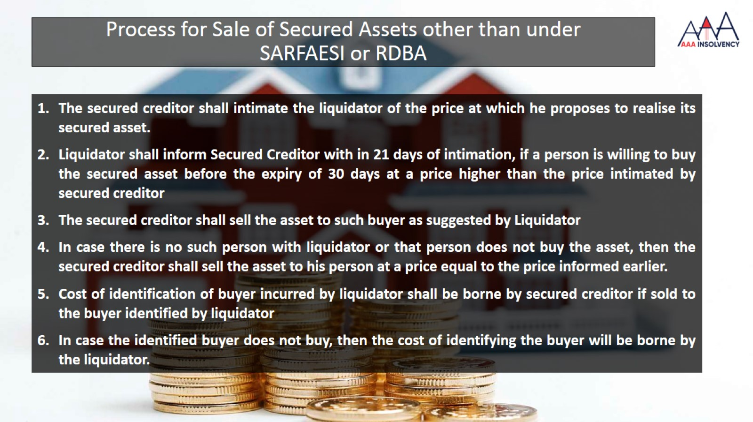
Process for Sale of Secured Assets other than under
SARFAESI or RDBA

Slide 136

INCOME TAX PROVISIONS APPLICABLE TO COMPANIES UNDER CIRP OR LIQUIDATION

Slide 137
INCOME TAX PROVISIONS APPLICABLE TO COMPANIES UNDER CIRP OR LIQUIDATION
Section 178, which provides for
Liquidator to notify to Assessing Officer about commencement of liquidation
Assessing Officer to notify amount due from the Company to Liquidator
Liquidator to take prior approval from IT Department before sale of assets
THESE PROVISIONS ARE NOT APPLICABLE TO COMPANIES UNDER IBC
Section 46 - Capital gains on distribution of assets by companies in liquidation
Where the assets of a company are distributed to its shareholders on its liquidation
Such distribution shall not be regarded as a transfer by the company for the purposes of section 45
Shareholder who have received any money or assets would be taxed in his individual hands
These provisions are applicable to most of the Companies undergoing Voluntary Liquidation under IBC

Slide 138
INCOME TAX PROVISIONS APPLICABLE TO COMPANIES UNDER CIRP OR LIQUIDATION
Section 288, which provides for
Authority would be provided to RP and Liquidator to appear before the IT authorities as ‘Authorised Representative’ w.e.f. 01/04/2020
Section 140, which provides for Verification of return of income can be authorised by RP or Liquidator as may be prescribed w.e.f. 01/04/2020
– earlier RP was allowed w.e.f 01/04/2018
Section 56(2)(x) of the Income-tax Act
Provide for chargeability of income in case of receipt of money or specified property for no or inadequate consideration
Section 50CA of the Income-tax Act
Provides for deeming of fair market value of unquoted shares for computing the capital gains from the transfer of such shares
For both these provisions, the fair market value is determined based on the prescribed method. Currently, the provisions of section 56(2)(x) are not applicable to certain specified transactions. However, no such exemption is available under section 50CA.
Amended these sections to empower the Board to prescribe transactions undertaken by certain class of persons to which the provisions of section 56(2)(x) and 50CA shall not be applicable. w.e.f. 01/04/2020 – conditions may be provided

Slide 139
Capital Gain tax on sale of assets during liquidation process
Section 178, which was used for recovering tax dues and not for taxing sale of assets, is not applicable to companies under liquidation
Section 140 does not provide for verification of return by Companies under liquidation, it only provides for verification of return of income during CIRP
Section 238(2) provides a right to liquidator claim refunds under Income tax Act
Section 46 provides for capital gain tax on distribution of assets or money to shareholders by Companies in liquidation
On sale of secured assets – sale proceeds are paid to secured creditors and tax if any on sale of asset would be payable as a claim of operational creditor

Slide 140
Capital Gain tax on sale of assets during liquidation process
On sale of unencumbered assets of companies under liquidation – sale proceeds would be paid to claimants as per priority u/s 53, in case funds are available the same would be paid to Operational Creditors also.
In case any asset or money is transferred to shareholders, the same would be taxable u/s 46 in the hands of shareholders and not in the hands of Company
Return of Income can be filed for the Company as a whole and not as ‘Head of Income’ basis. Return of income can not be filed for each source separately. No return of income can be filed unless financial statements are not drawn during Liquidation Process.
Regulation 15 of the IBBI (Liquidation Process) Regulations, 2016 provides that Liquidator is required to maintain and get the auditing done for Receipt and Payment account of the Liquidator. Preparation and auditing of financial statements are not required

Slide 141
Ms. Pooja Bahry vs. Gee Ispat Pvt Ltd
NCLT – New Delhi Bench
Income -tax Department claimed that capital gain tax to be deposited first as per Income Tax Act
Held that liquidated assets are those released by the secured creditor under the code
Secured creditor is not paying any capital gain tax in case assets are sold under SARFAESI Act
It was held that the tax liability arising out of sale of assets shall be distributed in accordance with the provisions of section 53 of the code.

Slide 142
GST on sale of Capital Goods under liquidation
Schedule II CGST Act, Para 4(a)
1. goods forming part of the assets of a business are transferred or disposed
2. by or under the directions of the person carrying on the business
3. no longer to form part of those assets
1. Transaction is done for consideration or without consideration
2. ITC has been availed on those goods or not
3. Goods belong to Pre GST era or Post GST era
1. Transaction involves consideration
2. Transaction is without any consideration
3. If transaction is intentional
4. If transaction is unintentional
1. Where ITC has not been availed on Capital Goods
2. Where ITC has been availed on Capital Goods
3. Value of supply has to be determined.

Slide 143
RIGHTS OF TAX AUTHORITIES DURING LIQUIDATION PROCESS
Govt. Authorities have been given one seat on the Stakeholders’ Consultation Committee
Maximum seats in the SCC are 11 and one seat is given to Govt. Authorities, if there are claims filed by Govt. Authorities
The SCC members are not having any power except to observe the process of sale of assets and understand Liquidation Value
SCC can direct Liquidator to do some act or not to do some act, however, the liquidator would still have powers to do as he deems fit after recording reasons

Slide 144

PENDING ASSESSMENTS DURING CIRP &
IN RESOLUTION PLANS
The pending assessment or any other proceedings would be revived, and assessments would be completed based on the information available.
No enforcement can be done to recover dues and no assets can be attached as liquidator has been appointed and he has the power to take control and custody of all the assets of Corporate Debtor
Claim would be filed by Govt Authorities before the liquidator after completion of the proceedings.
The due of Govt Authorities would be paid as per the priority of section 53 of the Code.
During Liquidation Process

Slide 145
GST on sale of business or a part as a Going Concern
Ministry of Finance vide its notification no 12/2017- Central Tax (Rate) dated 28th June 2017
Service by way of transfer of a going concern, as a whole or an independent part thereof” in serial no 2 of the said notification to constitute under supply of service
Further, activity of transfer of a going concern shall have “nil” rate of tax on such supply.
1. Transfer of business assets: Supply of goods
2. Transfer of business: Supply of Service
3. Transfer of business/ or a part thereof as a going concern : Supply of service and exempt via notification
The above view has also been upheld by the Authority for Advance Rulings, in Karnataka In the case of M/s Rajashri Foods Pvt Ltd. – Advance Ruling No. KAR ADRG 06/2018 dated 23 April 2018.

Slide 146
APPLICABILITY OF GST ON SALE AS A GOING CONCERN
The term going concern has not defined in the GST law or any other law for that matter. The terms is generally used a reference to legal entities. However, GST statutes does not deal with taxation of legal entities but is a tax on transaction between legal entities.
Accordingly, the word going concern has to be given a contextual meaning while interpreting Entry 2 to Notification No. 12/2017 – CT (Rate) dated 28.6.2017.
Therefore in order to avail the above exemption, the following conditions shall be satisfied –
The transfer of business shall be transfer of a going concern.
The business which is being transferred shall be transferred as a whole or independent part

Slide 147
APPLICABILITY OF GST ON SALE AS A GOING CONCERN
Section 7 of CGST Act, 2017 prescribes Scope of supply where, as per sub-section (1) the expression “supply” includes — a. all forms of supply of goods or services or both such as sale, transfer, barter, exchange, licence, rental, lease or disposal made or agreed to be made for a consideration by a person in the course or furtherance of business;
Therefore in a sale as Going Concern basis transaction involves sale of land, building which is an immovable and plant & machinery attached to the earth. All these are being sold as one unit as per the liquidation process and are being sold at a single bid price. Sale of land and building is not covered under Section 7 as the said transaction pertains to immovable which is not goods

Slide 148
TDS & TCS Provisions during CIRP & Liquidation Process
All TDS provisions are applicable during CIRP and Liquidation Process
Resolution Professional is under obligation to comply with all TDS /TCS provisions during CIRP and file all returns as required
Liquidator is also required to comply with the TDS /TCS provisions during Liquidation Process and file all returns as required
Liquidator is entitled to claim refund of any TDS deducted for the Corporate Debtor while selling some assets u/s 238(2)

Slide 149
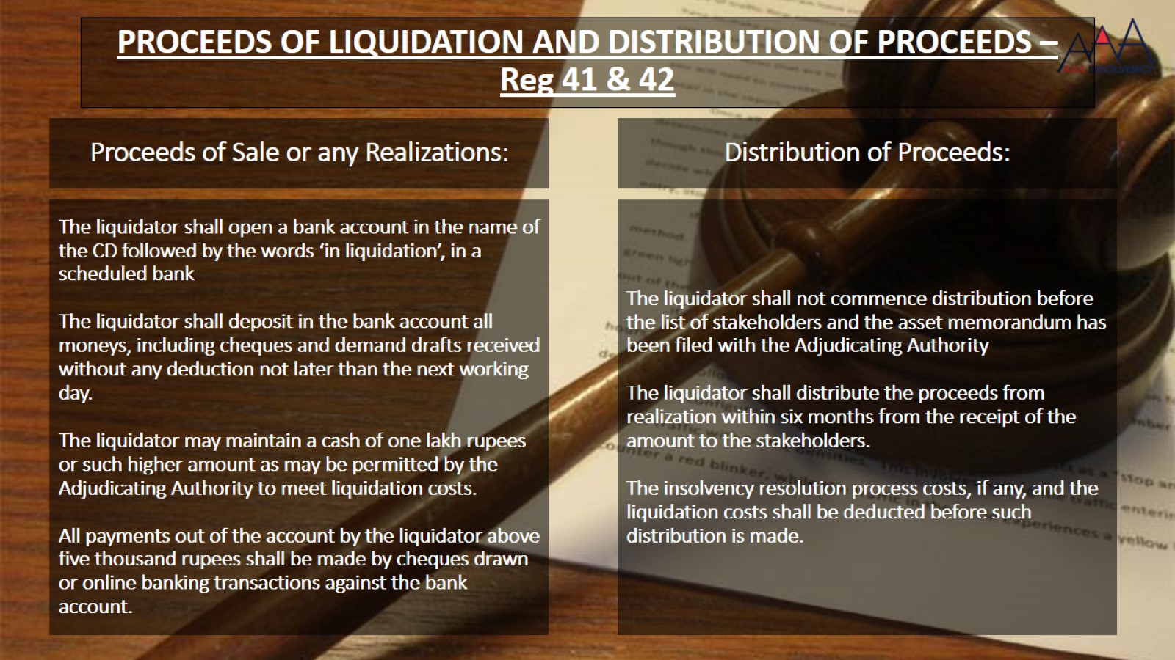
PROCEEDS OF LIQUIDATION AND DISTRIBUTION OF PROCEEDS – Reg 41 & 42

Slide 150


