Slide 1
Audit by GST Authorities
CA Pritam Mahure and Associates
[09-06-2023]

Slide 2
Key Points!
Legal Provisions
Outward Supply
Inward Supply
Issues and Challenges
Questions

Slide 3
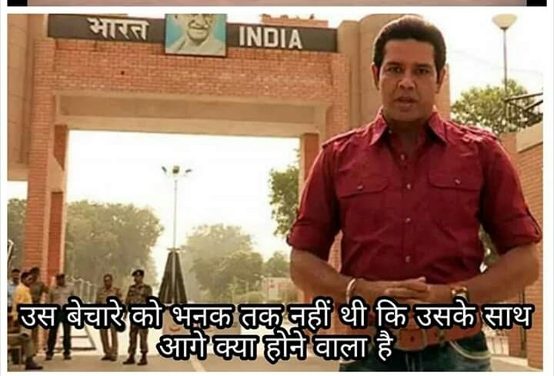
GST – 1.07.2017!

Slide 4
Real Time!
Upload E-way Bills!
Upload E-invoices!

Slide 5
Objective!
Answers!
Process of discovering answers!

Slide 6
Are there any definite answers?
Excise
77 years
ST
29 years
GST
5.25 yrs

Slide 7
Audit!

Slide 8
Audit!
Its
Nth time!
First time!
At stake!
Revenue
Expense
Approach
Facts
Law

Slide 9
Tool!
Income (Value, Rate, ToS, PoS, RP etc)
Expenses (RCM)
ITC (Eligible, ratio)
Others (Export, compliances)

Slide 10
Other aspects!
Financials
Contracts
FEMA
Customs
TB
P/L
B/S
ERP
Other laws
Customers
Vendor
Employee
Related Persons
Income Tax Act
Accounting system/ policies
Factory Act etc
Notes to Accounts

Slide 11
BHARTI AIRTEL LTD. & ORS! [2021-TIOL-251-SC-GST]
What H’ble Apex Court held?

Slide 12
Books/ records are ‘primary’ source!
... books of accounts and record … are primary documents and source material on the basis of which self-assessment is done by the registered person including about his eligibility and entitlement to get ITC and of OTL.
The primary source is in the form of agreements, invoices/ challans, receipts of the goods and services and books of accounts which are maintained by the assessee manually/electronically.

Slide 13
GST to be self-assessed!
The position is no different in the post-GST regime, both in the matter of doing self-assessment and regarding dealing with eligibility to ITC and OTL. Indeed, that self-assessment and declarations would be any way subject to verification by the tax authorities.

Slide 14
GSTR-3B is a return!
…the efficacy of Form GSTR3B being a stop gap arrangement for furnishing of return, as was required under Section 39 read with Rule 61, would not stand whittled down in any manner. It would still be considered as a return for all purposes though filled manually electronically.

Slide 15
Amendment only in specified manner!
... registered person is not denied of the opportunity to rectify omission or incorrect particulars, which he could do in the return to be furnished for the month or quarter in which such omission or incorrect particulars are noticed.
… the law permits rectification of errors and omissions only at the initial stages of Forms GSTR1 and GSTR3, but in the specified manner.

Slide 16
Amendment in return cannot be unilateral!
… assessee cannot be permitted to unilaterally carry out rectification of his returns submitted electronically in Form GSTR3B, which inevitably would affect the obligations and liabilities of other stakeholders, because of the cascading effect in their electronic records.

Slide 17
GSTR-1!
Taxable Income
Zero rated income
Exempt income
Non-GST income
HSN summary
List of Documents issued

Slide 18
GSTR-3B!
Outward Tax Liability
RCM Liability
Import of Goods
In-eligible ITC
Import of Services
Domestic
Eligible
ITC

Slide 19
Outward Supply

Slide 20
Taxable Supply!
What is nature of Supply? Goods/Service/Composite/Mixed
Classification
Time of Supply of Goods and Time of supply of Service
Place of Supply
Valuation
Invoice / Bill of Supply

Slide 21
Burden of proof!
Supply
ITC
?
Section 155 Burden of proof — Where any person claims that he is eligible for input tax credit under this Act, the burden of proving such claim shall lie on such person.

Slide 22
Types of Supply under GST!
Taxable supply
Zero Rated Supply or SEZ supply
Exempt Supply / Nil Rated Supply / Non-GST Supply

Slide 23
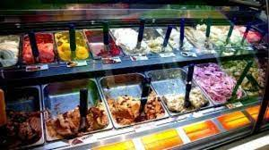
Ice-cream?

Slide 24
Ice-creme
Particulars | Goods | Services
Description | Ice cream and other edible ice, whether or not containing cocoa | (ii) Supply of ‘restaurant service‘ other than at ‘specified premises‘ …
Not. No. | 1/2017-CT | 11/2017-CT
Rate | 18% (Sr. No. 22 of Sch. III) | 5% (Sr. No. 7 of Sch. III)
Heading / SAC | 2105 00 00 | Heading 9963 (Accommodation, food and Beverage services)

Slide 25
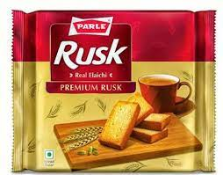
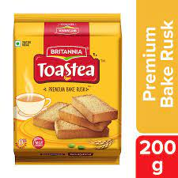
Bread?

Slide 26
Mere rusk-e-…!
Particulars | Bread | Rusk
Description | Bread (branded or otherwise), except when served for consumption and pizza bread | Rusks, toasted bread and similar toasted products
Not. No. | 2/2017-CT | 1/2017-CT
Rate | Nil (Sr. No. 97) | 5% (Sr. No. 100 of Sch. III)
Heading / SAC | 1905 | 1905 40 00

Slide 27
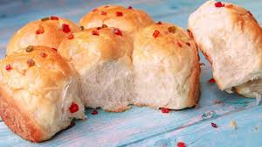
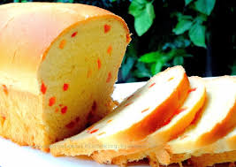
Bread?

Slide 28
Khari?

Slide 29
Khari!
Particulars | Rusk | Others
Description | Rusks, toasted bread and similar toasted products | Pastry, cakes, biscuits and other bakers’ wares, whether or not containing cocoa; communion wafers, .., sealing wafers, rice paper and similar products …
Not. No. | 1/2017-CT | 1/2017-CT
Rate | 5% (Sr. No. 100 of Sch. I) | 18% (Sr. No. 16 of Sch. III)
Heading / SAC | 1905 40 00 | 1905

Slide 30
Kachori and Samosa

Slide 31
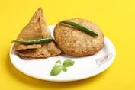
Kidhar hai?
Goods
Supplied as ‘Service’
Service
Supplied as ‘Service’
Supplied as ‘Goods’
Supplied as ‘Goods’
Goods
Service

Slide 32
Classification – Burden of proof on Authorities!
… the burden of proof is on the State Government and the onus also lies on them to first establish conclusively that by no conceivable process of reasoning can the said product be brought under any of the tariff items and hence the product was being brought under the residuary item.
Kesharwani Entp. [2019 (28) GSTL 397 (Chattis.)]
Para 26/27
… unless the department can establish that the goods in question can by no conceivable process of reasoning be brought under any of the tariff items, resort can be had to the residuary item.

Slide 33
Not. No. 1/2017-CT (R) provides as under:
Why to refer to Customs Tariff?
“Explanation. – For the purposes of this Schedule,
(iv) The rules for the interpretation of the First Schedule to the Customs Tariff Act, 1975 (51 of 1975), including the Section and Chapter Notes and the General Explanatory Notes of the First Schedule shall, so far as may be, apply to the interpretation of this notification.
…
(iii) “Tariff item”, “sub-heading” “heading” and “Chapter” shall mean respectively a tariff item, sub-heading, heading and chapter as specified in the First Schedule to the Customs Tariff Act, 1975 (51 of 1975).

Slide 34
Not. No. 11/2017
Particulars | Sch. I - 101A | Sch. III – 23
HSN | 2106 90 | 2106
Description | Namkeens, bhujia, mixture, chabena and similar edible preparations in ready for consumption form, other than those put up in unit container… | Food preparations not elsewhere specified or included [other than roasted gram, sweetmeats, batters including idli/dosa batter, namkeens, bhujia, mixture, chabena and similar edible preparations in ready for consumption form, khakhra, chutney powder, diabetic foods
Rate | 5% | 18%

Slide 35
Classification – Residuary entry covers goods which are outside main entry!
Parle Agro Pvt Ltd [2019 (20) GSTL 238 (Chattis.)]
Para 18
Supreme Court in A.R. Thermosets Private Limited’s case (supra) … held … that residuary entry is made to cover only those category of goods which clearly fall outside the ambit of the main entry…

Slide 36
Is there a specific entry - 210690
Namkeens
Bhujia
Mixture
Chabena and
Similar edible preparations in ready for consumption form…

Slide 37
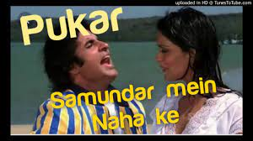
What is a Namkeen?
Generic
Is samosa / kachori known as ‘namkeen’?
Namkeen is ordinarily understood as mixtures and daalmot. It is unlikely that if a person walks into a shop and asks for namkeen, he would be offered samosa - Samosas are more appropriately dealt with under the entry “cooked food” rather than “namkeen”
SARVA SHRI NEERAJ MISTHAN BHANDAR 2019 (24) G.S.T.L. 513

Slide 38
is there a class of product?
Fried or roasted
Crunchy
Specific
Namkeen, Bhujia, mixture, chabena
Shelf-life
Attributes
Hunger

Slide 39
“And Similar edible preparations in ready for consumption form…”
The term “Similar edible preparation” & interpretation of the word ‘similar’ cannot be restricted to mithai as the term does not mean ‘the same’ or “identical”.
HINDUSTAN LEVER LTD. 2005 (189) E.L.T. 53 (Tri. - Mumbai)

Slide 40
What is likely to be covered?
Daalmot
Puffs
Cheeslings
Chittos etc
Navratan mixture
Cheese balls

Slide 41
What was not said?
“Namkeens, bhujia, mixture, chabena and similar Edible preparations in ready for consumption form…”
Ready to eat food…
[MTR Foods 2010 (252) E.L.T. 580 (Tri. - Bang.)]
Notes:
… would indicate that intention was to give exemption only to items indicated in the notification.

Slide 42
CN/ SN
Tariff item 2106 90 99 includes sweet meats commonly known as “Misthans” or “Mithai” or called by any other name. They also include products commonly known as “Namkeens”, “mixtures”, “Bhujia”, “Chabena” or called by any other name. Such products remain classified in these sub-headings irrespective of the nature of their ingredients

Slide 43
What Apex Court has held?
Bharat Forge & Press Industries (P) Ltd. [1990 (45) E.L.T. 525]
…only such goods as cannot be brought under the various specific entries in the tariff should be attempted to be brought under the residuary entry. In other words, unless the department can establish that the goods in question can by no conceivable process of reasoning be brought under any of the tariff items, resort cannot be had to the residuary item…

Slide 44
Classification – Residuary entry covers goods which are outside main entry!
Parle Agro Pvt Ltd [2019 (20) GSTL 238 (Chattis.)]
Para 18
Supreme Court in A.R. Thermosets Private Limited’s case (supra) … held … that residuary entry is made to cover only those category of goods which clearly fall outside the ambit of the main entry…

Slide 45
What Notification says?
Sr | HSN | Description | Rate
99A | 1905/ 2106 | Khakhra, Plain chapatti or roti | 5%
100 | 1905 4000 | Rusks, toasted bread and similar toasted products | 5%
101 | 2106 90 | Sweetmeats | 5%
Notes:
Similar – more than 150 times

Slide 46
What Apex Court has held?
Dilip Kumar – Constitution Bench - 2018
(1) Exemption notification should be interpreted strictly; the burden of proving applicability would be on the assessee to show that his case comes within the parameters of the exemption clause or exemption notification
(2) When there is ambiguity in exemption notification which is subject to strict interpretation, the benefit of such ambiguity cannot be claimed by the subject/ assessee and it must be interpreted in favour of the revenue.

Slide 47
To fight for?
Representation for clarification
Penalty
Amnesty
Interest
Ice-crème
Tax is paid
ITC

Slide 48
We serve only freshly made samosa/ kachori!

Slide 49
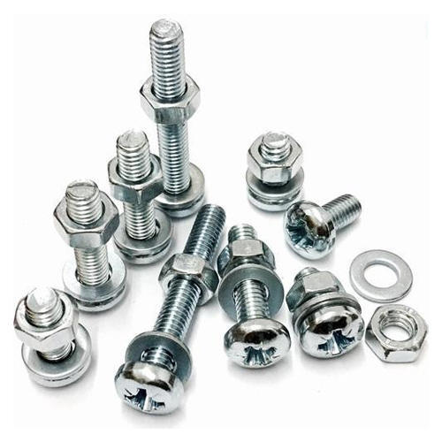
Fasteners!

Slide 50
Relevant tariff provisions!
Particulars | Heading 7318 | Heading 8708
Chapter | 73 | 87
Section | XV | XVII
Section Notes | 2 (a) | 2 (b) and 3
Rate of GST | 18% | 28%

Slide 51
Sr. No. 232 to Not. No. 1/2017-CT (R) [Sch. III]
Sr. | Chapter / Heading / Sub-heading / Tariff item | Description of Goods | Rate
232. | 7318 | Screws, bolts, nuts, coach screws, screw hooks, rivets, cotters, cotter-pins, washers (including spring washers) and similar articles, of iron or steel | 9%
Sr. No. 170 to Not. No. 1/2017-CT (R) [Sch. IV]
Sr. | Chapter / Heading / Sub-heading / Tariff item | Description of Goods | Rate
170. | 8708 | Parts and accessories of the motor vehicles of headings 8701 to 8705 [other than specified parts of tractors] | 14%

Slide 52
Electricity supply to tenants – It’s a service!
Srijan Realty Pvt. Ltd. [2019 (24) GSTL 169 (Cal.)]*
Para 18
It also cannot be said that, the petitioner is engaged in the supply or trading of electricity … The petitioner does not have a licence to undertake trading in electricity…therefore, the petitioner cannot be said to be distributing or selling or trading in electricity … to the occupants of the commercial complex… the only other thing that remains to describe the activity undertaken by the petitioner, is service.

Slide 53
Zero Rated Supply!
Whether qualifies as Export of service and Export of Goods?
Whether Export proceed realized in Foreign Currency?
What if realized in Indian Currency? GST will applicable?
What if it become bad debts? GST will appliable?
Whether realized in time limit prescribed in law?
Any agreement clause for Reimbursement?

Slide 54
Exempt Supply and Nil Rated Supply
Exempt Supply
Available?
If conditional, then complied?
Nil Rated Supply
Any changes in Rate notified
Withdrawal yet continue to avail?

Slide 55
Process of Scrutiny by PO
Information available in
Returns
Statements
DGRAM
ADVAIT
GSTN
E-way Bill etc.

Slide 56
Financial Turnover vis-à-vis GST Turnover

Slide 57
To Check!
Set off Income with Expenses
Debit Notes considered or not in Financial Statement
Employee Recoveries
Penalties from Vendors
Free of cost supplies to Employee or Customer
OPE
Reimbursement
Escalation Clause

Slide 58
To Check!
Freight and Insurance recovered
Profit & loss on sale of asset
Amalgamations/ Merger / Acquisition
Actionable claims
Inter-Branch Transfer within / outside state
Service to Associates / Group companies
Interest/Commission Received
Deduction from Payment
Barter Transaction
Credit Balance Write off
Profit & loss on sale of investment
Sale of Scrap/ Damaged goods/Waste

Slide 59
Data points!
Profit and Loss Credit side
Balance sheet – Investment in subsidiary, Debtors, Deposit, Unbilled Revenue, Advance Received
Cashflow – Operating Activities, Investing Activities
Tax audit Report – Clause 21 Prior period Income
CARO Report – Related Party Transaction, Disputed Tax liability,
TDS Certificate – Income earned during the year from various sources and their implication
Director Report – Foreign Exchange earned and paid during the year
Notes to Account – Related party transaction, MEIS scrip, Export Incentives, Statutory Dues etc.

Slide 60
Inward Supply

Slide 61
Input Tax Credit!
Input Tax Credit
Used or intended to be used?
What is eligible as ITC?
In the course or furtherance of his business

Slide 62
Key Points!
Goods or Services received!
Invoice documents contain all particular as prescribed!
ITC reflected in GSTR 2A is actually paid to the Government!
ITC on Goods received in lots or instalment on last!
Payment within 180 days (Vendor payment cycle)!
Eligible or Restricted U/S 17(5)?
ITC on lost, stolen, destroyed, written off, free sample /gifts
Deduction of ITC for credit note issued by vendor
Availment of ITC on goods sent to Job work
Whether Ineligible availed?
ITC on Capital Goods availed or capitalised

Slide 63
Key Points!
Reversal under Rule 42 and Rule 43 for Exempt and Capital Goods
Apportionment of ITC between business and personal use

Slide 64
Data points!
Notes to Account
Contingent Liability
Statutory Dues
Reconciliation of Inputs lying with Job worker
Major expenditure on research and development
Tax Audit Report
Clause 18 – ITC availed on Capital goods
Clause 27 – ITC claimed
CARO Report
Physical verification of Inventory

Slide 65
Reverse Charge Mechanism

Slide 66
RCM!
Domestic RCM
Unregistered Domestic RCM
Import of services
E-Commerce Service
OIDAR Service

Slide 67
Data points!
Profit and Loss Account (DR side)
RCM transaction based on Notification i.e., License fee, Director setting fee, Sponsorship service, etc
Ocean Freight
Import of Service
Balance Sheet
Guarantee given or provided
Creditors
Intangible asset – Import or Domestic?

Slide 68
Data points!
Notes to Account
Foreign currency Payment for Service and Goods
Director Report
Board Report

Slide 69
Ratio Analysis
ITC availed / Tax paid through Cash (+) Credit
Total Inward Supply : Total Outward Supply
ITC availed on Capital Goods : Addition to Capital Asset
Other Income : Sales
Outward Supply of Scrap : Total Outward Supplies made
Value of Zero-Rated Supply : Total Supply
Non-GST Supply : Total Supply
Notes:
Member Club vs Propriety Club

Slide 70
Documentation

Slide 71
Documentation!
Various Return
GSTR 1
GSTR 3B
Financial Statement
Balance sheet
Income Tax Return
Turnover Reconciliation
GSTR 1
GSTR 3B
GSTR 9
GSTR 9C
Cost Audit Report
Annual Return
GSTR 9
GSTR 9C
Form 26AS
Internal Audit Report
GSTR 2A

Slide 72
Documentation!
Reconciliation
Output liability ledger as per Books of Account with E- liability Ledger
Copies
Work order, Purchase Order and Agreement or renewed agreement entered by the Company
ITC ledger as per Books of Account with E-credit Ledger and E-Cash Ledger
ITC with GSTR 2A at invoice level as well as consolidated level
RCM with Corresponding booking of transaction in Books of Account
Invoices issued with all parameter of GST law
Invoices on which ITC has been availed with all parameter of GST law
Other
Business Profile of the Company / Entities
Expenditure or Income of major head compared with previous year’s amount to find the major variation
Notes:
Member Club vs Propriety Club

Slide 73
Compliances

Slide 74
Compliances!
Compliances
Self Invoice and Payment Voucher
Receipt Voucher or Refund Voucher
Updated GST Registration Certificate
E-way Bill Compliance
Job work compliance
Notes:
Member Club vs Propriety Club

Slide 75
Errors!
Wrong payment of Tax under tax head!
Wrong disclosure / Nondisclosure in return!
Non – Issuance of Bill of Supply!
Non filing of LUT!

Slide 76
Compliances!
Additional Place of Business where Job worker is unregistered, or goods stored at any other place
Contents of Invoice
Bill of Supply for Exempt supply
HSN / SAC Code

Slide 77
Audit commenced – Then investigation cannot be proceeded with!
R.P. Buildcon (P.) LTD. [2018 (37) GSTL 37 (Del)]*
Para 7
…we are of the view that since the audit proceedings under Section 65 of the Act has already commenced, it is but appropriate that the proceedings should be taken to the logical end. The proceedings initiated by the Anti Evasion and Range Office for the very same period shall not be proceeded with any further.
GST

Slide 78
Questions?

Slide 79
Thank You
We would love to hear your suggestions or queries!
Office : 103, Fortune House, Next to Regent Plaza, Baner-Pashan Link Road, Pashan, Pune- 411 021
https://pmaconsulting.in/
CA Pritam Mahure- pritam.mahure@lawgical.in / +91 9920644648 / 020-29524913

