Slide 1

Study of financial statements from GST point of view-Balance-sheet, Trial Balance, Notes to accounts etc
Manoj Malpani, FCA, ACMA
+91 8007 99 4444

Slide 2
Coverage
GST Issues – Review of Financial Statements
Analysis/ Observations/ Issues
Ratio Analysis
Use of ratio analysis to identify GST leakages

Slide 3
Annual Report
Annual reports are comprehensive documents designed to provide readers with information about a company’s performance in the preceding year.
The reports contain information, such as performance highlights, a letter from the CEO / directors, financial information, notes to accounts, exceptional items.
There are many users of annual reports, including shareholders and potential investors, employees, customers, auditors and Government authorities.

Slide 4
Which information is relevant from Annual Report?
Nature of business
Overall turnover
Different types of Income (local, exports, services etc)
Nature of expenses
Profitability
Notes to accounts
Related party transactions and
many more..

Slide 5
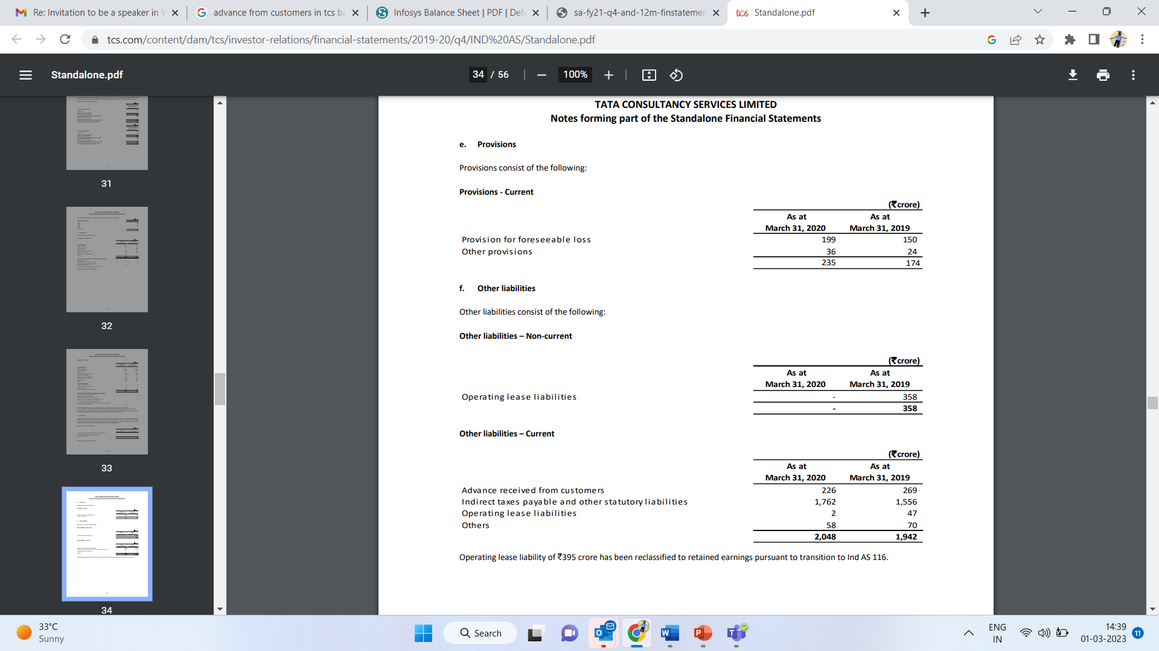
GST – Review of Balance Sheet

Slide 6
GST – Review of Balance Sheet
Whether Advance received from Customers in pertaining to Services or Goods?
Whether GST paid on the advances received from Customers towards provision of services?
Whether the advances has been properly adjusted against the invoices raised?
Whether there is any double payment of taxes?
Whether there are any unpaid Indirect Tax liabilities and action thereon?

Slide 7
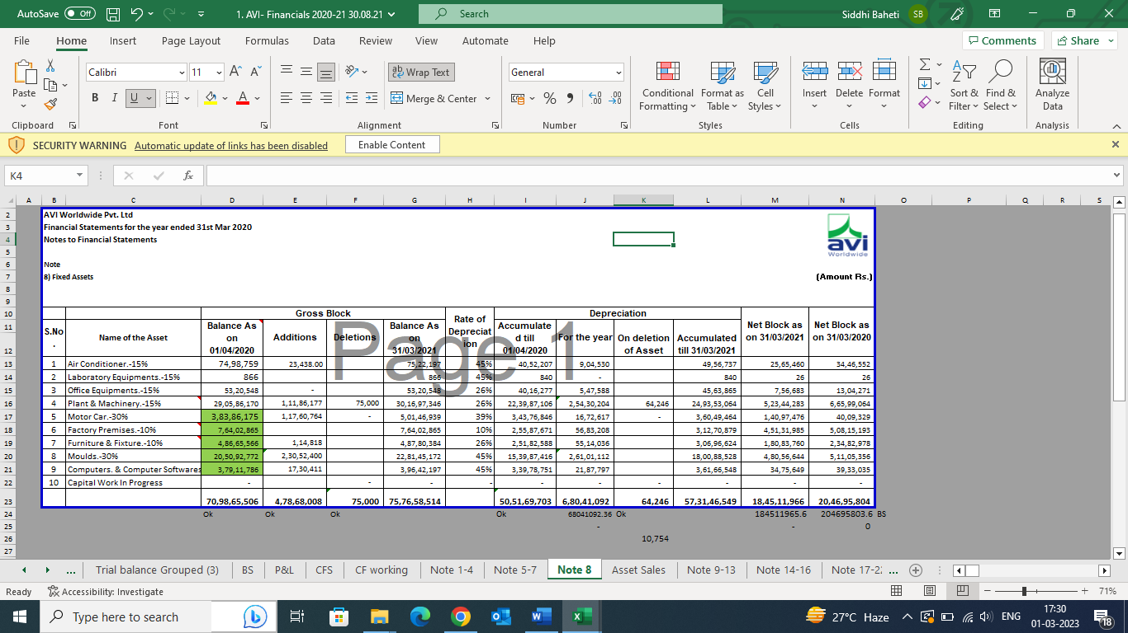
GST – Review of Balance Sheet

Slide 8
GST – Review of Balance Sheet
Whether any assets installed at the location other than the location covered under GST registration?
Whether GST has been discharged on the asset disposal / sale?
Whether GST on capital goods is wrongly considered for computation of GST refund in case of exports?

Slide 9
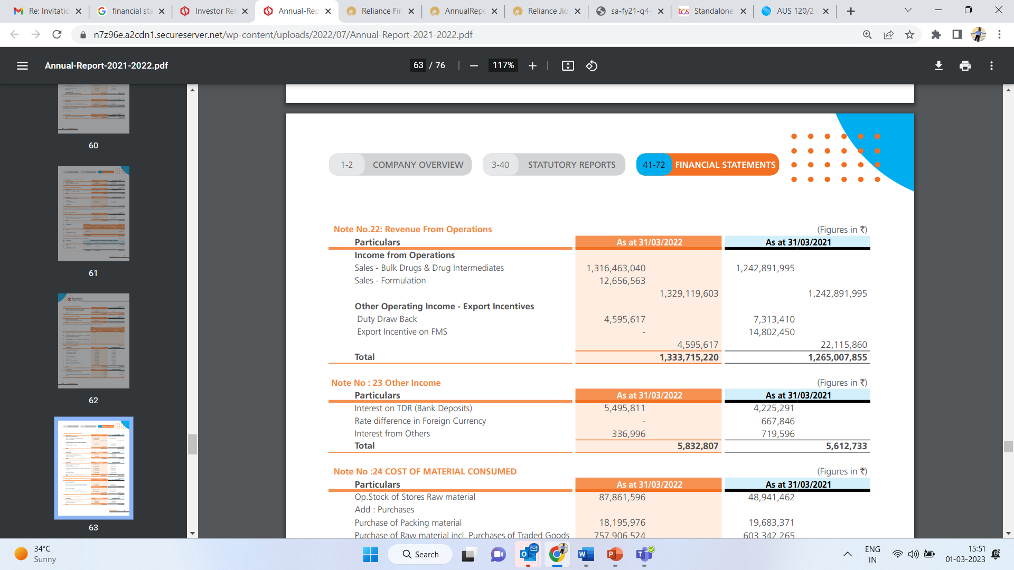
GST – Review of Profit & Loss Accounts

Slide 10
GST – Review of Profit & Loss Accounts
Whether company has exports?
Whether GST refund has been correctly computed & claimed?
Whether company has claimed GST refund which is not eligible to them?
Whether the exports is completed within 90 days from the date of invoice?
Whether there are any sales returns for which the credit notes are issued within the timeline specified?
Whether any merchant export transactions and compliances thereof?

Slide 11
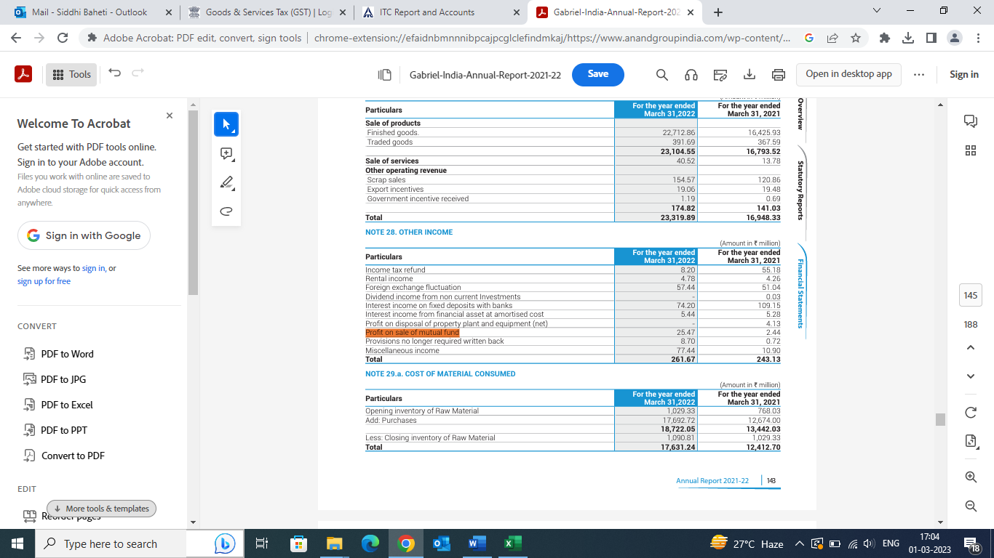
GST – Review of Profit & Loss Accounts

Slide 12
GST – Review of Profit & Loss Accounts
Whether there is any exempt Sale during the period?
What is the value of the transactions made during the period?
Whether the input tax credit has been correctly reversed on the same under Rule 42 of the CGST Rules?
Whether ITC has been availed on the services which are taken specifically for the exempt supplies?

Slide 13
GST – Review of Profit & Loss Accounts

Slide 14
GST – Review of Profit & Loss Accounts
What was the loss for which insurance claim received?
Whether any RM / Capital goods lost on account of fire / theft etc?
Whether ITC on the same has been reversed under Section 17 (5) (h) of the CGST Act, 2017?

Slide 15
GST – Review of Profit & Loss Accounts

Slide 16
GST – Review of Profit & Loss Accounts
Whether any goods are sent outside for job work?
List of open challan to check / verify whether any goods lying with job worker for a period more than 1 year?
Whether any goods are directly received at job worker place or dispatched from job worker place? Check compliances thereof.
Treatment given for scrap generated at job worker end?
Whether any Goods are lost / destroyed at job worker end and cost of the same recovered from the job worker?
Whether ITC-04 return is filed on time and method of reporting of transactions in the same?

Slide 17
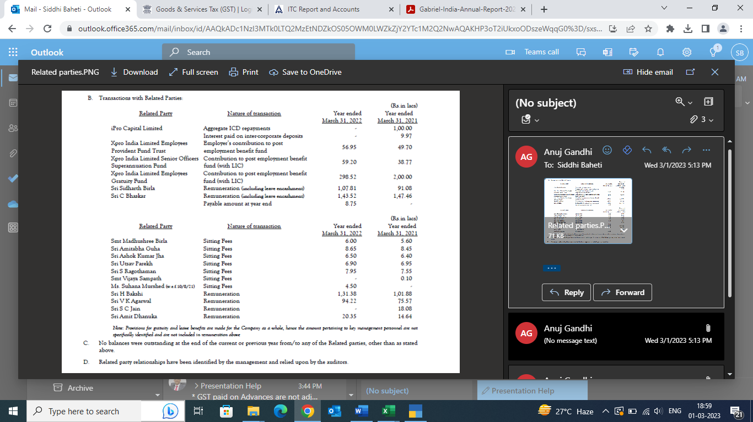
GST – Notes to Accounts

Slide 18
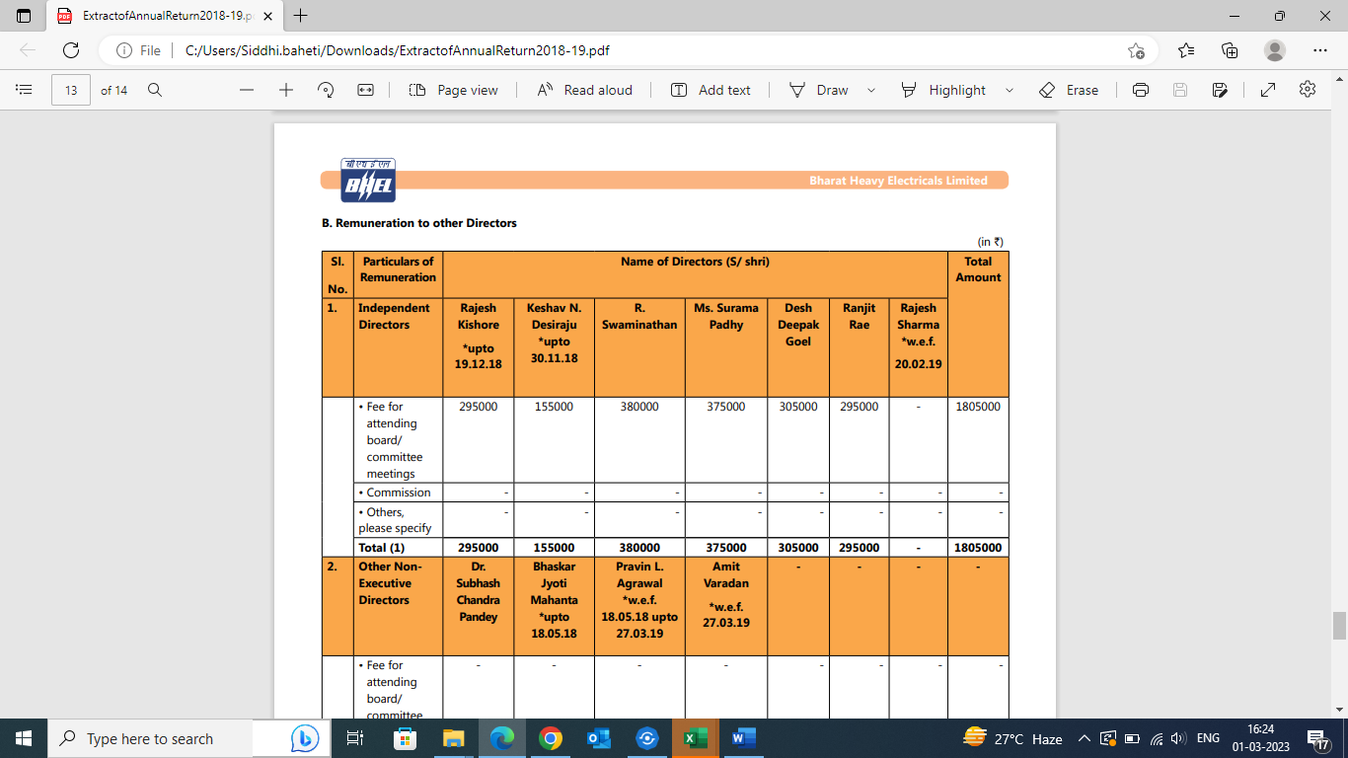
GST – Notes to Accounts

Slide 19
GST – Notes to Accounts
Valuation for Related party transactions?
Director’s remunerations – whether RCM discharged?

Slide 20
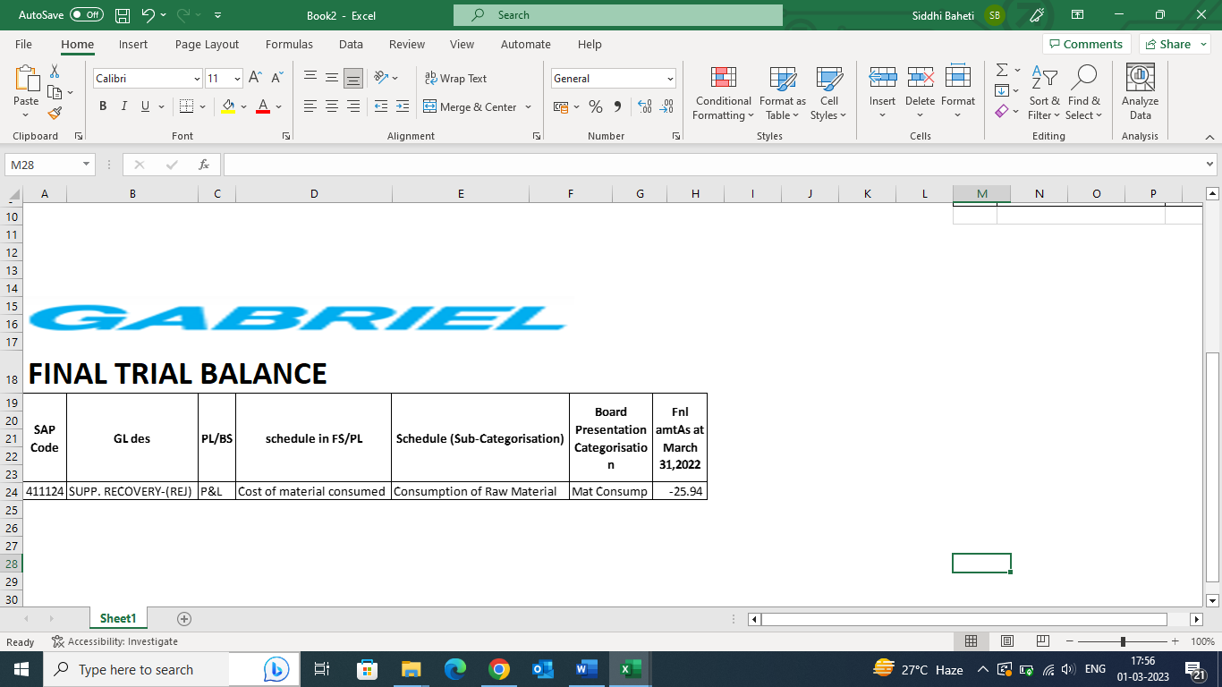
GST – Review of Trial Balance

Slide 21
GST – Review of Trial Balance
Whether supplier rejection is returned to supplier?
Whether the purchase returns made by raising tax invoice?
Whether the supplier has raised credit notes and reported the same in his GSTR-1?
If yes, whether ITC on the same has been reversed on the same?

Slide 22
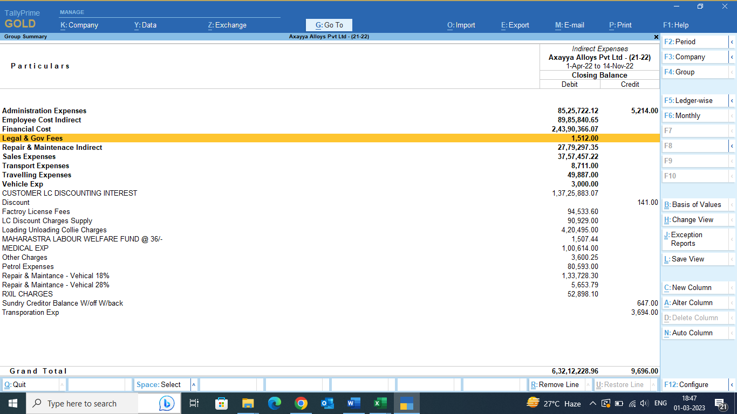
GST – Review of Trial Balance

Slide 23
GST – Review of Trial Balance
Whether RCM paid on Government charges / fees?
Whether RCM paid on services received from Advocate?

Slide 24
GST – Other Transactions which can be reviewed from Trial Balance / Notes
Purchase Return - Debit notes issued for purchase return, ITC reversed but no Credit Note issued from the Supplier.
Sales Return - Credit Notes issued with GST not properly adjusted, Credit notes issued beyond the period of September of subsequent year are reported and GST liability is also reduced.

Slide 25
GST – Other Transactions which can be reviewed from Trial Balance / Notes
Sale of Business Unit / Spin off-
Review of Business Transfer Agreement.
Whether the transfer was slum sale basis?
Whether ITC has been transferred to new company?
Whether any services taken for transfer of business?

Slide 26
GST – Other Transactions which can be reviewed from Trial Balance / Notes
In majority of cases RCM liability is not getting paid. E.g., on
  Import Services such as product registration, Consultancy Services, reimbursement to foreign agent and Govt. Fees – (Review TDS under Section 195 ledger).
  Sponsorship fees,
  GTA, Rent-a-cab, Security – (Review TDS Ledger under Section 194C)
  Director sitting fees or directors' remunerations not being salary

Slide 27
Ratio Analysis
To identify removal of goods without payment of duty,
To detect wrong Input Tax Credit availed,
To identify under valuation of goods,
To identify claiming of input tax credit on inputs used in exempted products,
To identify Fraudulent availment of credit like availment of credit without receipt/actual use of input,
To identify supply of essential parts of outward supply as exempted supplies, undervaluation
Many More..

Slide 28
Use of Ratios (Goods)-1
Sr | Nature of Ratio /Method of calculation | Utility of the Ratios
1 | Input Tax Credit availed (A): | i) To identify wrong availlment of input tax credit
 | Total tax paid through (Electronic cash ledger + Input Tax Credit) (B) = (A)/(B) | ii)To identify under valuation of goods as value-addition should involve adequate difference between the two.
 | Source Document: | iii) To identify removal of goods without payment of duty.
 | Annual or Monthly GST returns | iv) To identify claiming of input tax credit on inputs used in exempted products.
ITC Availed
-------------------------
Total tax paid through Elec Ledgers

Slide 29
Use of Ratios (Goods)-2
Total Inward Supply Costs
---------------------
Total Outward Supply Value
Source: Monthly GSTR
This ratio shows the part of outward supply value represented by
inward supply cost. The balance outward supply value represents the value addition on account of non-taxable elements like wages, overheads, depreciation, interest.
Theoretically, this ratio should have a bearing on the ratio of Input tax credit: Total tax payment (Sl.No.1).
If this ratio is lower than ratio at Sl.No.1 or more than previous year’s ratio, it may be on account of the following:
Wrong availment of credit like cases of availing value of goods as credit or availment of credit of basic custom duties in case of import or double credit on same document.
Fraudulent availment of credit like availment of credit without receipt/actual use of input.
Rejection/return/clearances of inputs without reversal of credit
Receipt of inputs and availment of credit but clearances of finished goods without payment of duty.
Under valuation of finished goods.
Important points to be considered:
Only taxable goods sales value should be considered.
Export value to be excluded from sales value, if export is under bond (if export was on payment of duty, in that case, export value should be included).
Exclude the GST from sales value, if details are available.

Slide 30
Use of Ratios (Goods)
ITC availed on Capital goods/ Addition to Capital Goods
Addition to the Plant & Machinery is available from the Fixed Assets Schedule enclosed to the Balance sheet.
Other income/ Total Sales
If this ratio is higher than previous period, it may be on account of the following
Under valuation of finished goods by non-inclusion of other incomes like recovery of Advertisement expenses, Packing and Forwarding Expenses in the assessable value.
Non-payment of duty on scrap/rejects/job work.
GST liability on Other Income may also be examined.
Outward supply of Scrap: Total outward supplies made
If ratio in the current year is lower, it may be on account of the following:
outward supply of scrap made without payment of duty
Non receipt of scrap from job worker.

Slide 31
Use of Ratios (Goods)
Value of exempted outward supply: value of total outward supplies
To identify outward supplies made in the guise of exempted supplies.
Input tax credit availed on inputs: Purchase price of inward supplies
i) Non reversal of credit/payment of duty on inputs rejected/short received/cleared to other units/cleared as spare during warranty period
Value of Zero-rated supply : Total supply
i) To identify outward supplies made in the guise of zero-rated supplies.
To identify supply of essential parts of outward supply as exempted supplies.
To identify under valuation of outward supplies by overvaluing exempted outward supp
ii) To identify under valuation of outward supplies by overvaluing zero rated supply outward supply

Slide 32
Use of Ratios (Goods)
Non-GST Supply : Total supply
i) To identify outward supplies made in the guise of non-GST supplies.
ii) To identify supply of essential parts of outward supply as non-GST supplies.
iii) To identify under valuation of outward supplies by overvaluing Non-GST outward supply

Slide 33
Use of Ratios – Sample Case study
Particulars |  |  | Calculated as
Sr. No. | Ratios (During the month) | Jan-21
A | Input Tax Credit availed (A): Total tax paid through Electronic cash ledger + Input Tax Credit (B) = (A)/(B) | 150.62% | Total net ITC availed in GSTR 3B after reversals, if any, are compared to total tax liability as reported in GSTR 3B.
B | Total inward supply cost / Total outward supply value | 66.93% | Value of taxable total inward supplies compared to total value of outward supply.
C | Input tax credit availed on Capital Goods purchased during the month to addition to Capital Goods | 16.95% | Total input tax credit availed on capital goods compared to taxable value of capital goods.
D | Outward supply of Scrap / Total outward supplies | 0.06% | Total outward supply booked in Scrap GL compared to total outward supply
E | Value of exempted outward supply / value of total outward supplies | 0.00% | Total exempt supply (E.g., Sale of MEIS) compared to total outward supply
F | Input tax credit availed / Purchase price of inward supplies | 19.53% | Net ITC availed in GSTR 3B compared to taxable value of all the inward supplies
G | Value of Zero-rated supply / Total supply | 46.94% | Zero rated supplies compared to total supply

Slide 34
Thank You
Manoj Malpani, FCA, ACMA
+91 8007 99 4444

