Slide 1
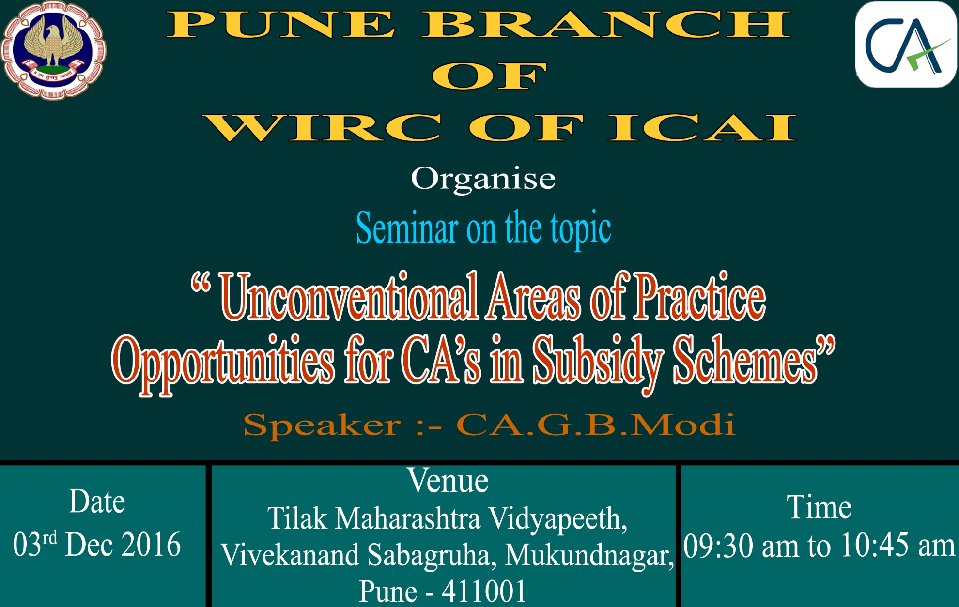

Slide 2



Slide 3
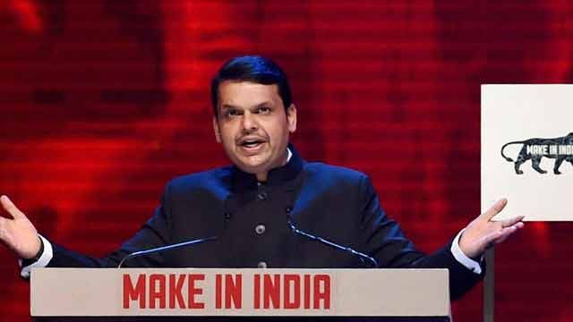
CM Devendra Fadnavis talks of ‘Make In Maharashtra’ for industrial growth
Devendra Fadnavis promised to set up a committee to fast track the projects which are inordinately delayed due to non-clearance from ministry of environment.

Slide 4


Slide 5
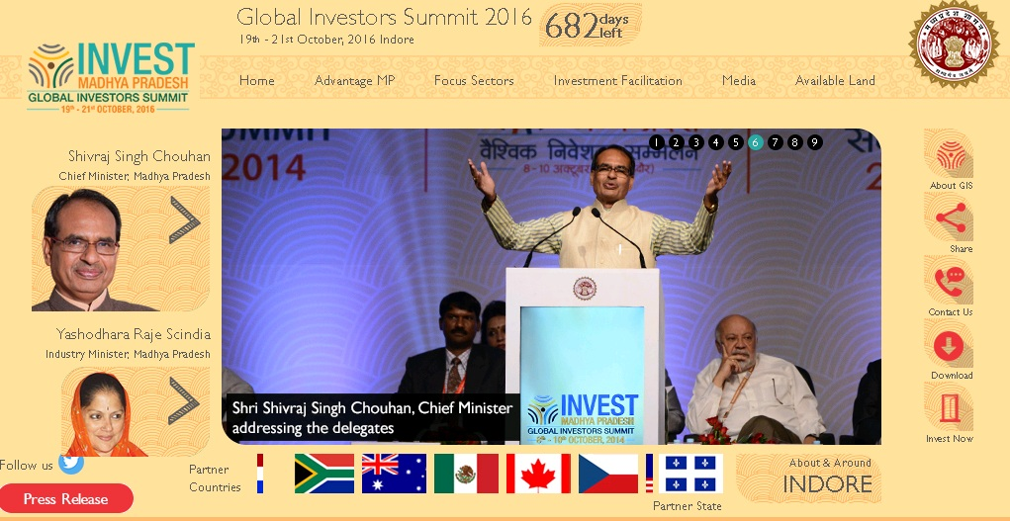

Slide 6



Slide 7
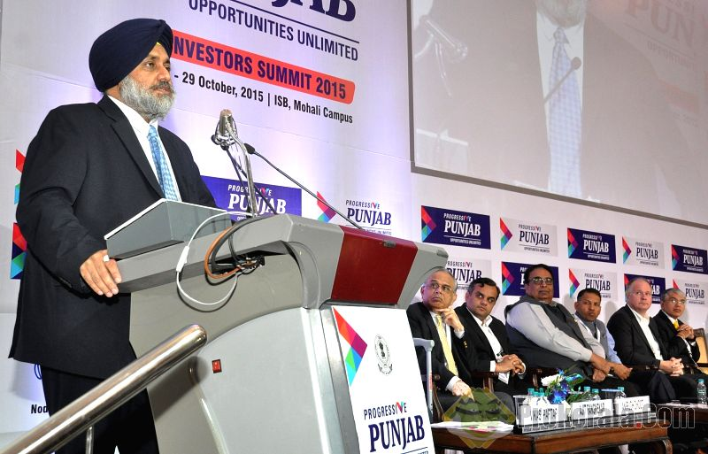


Slide 8
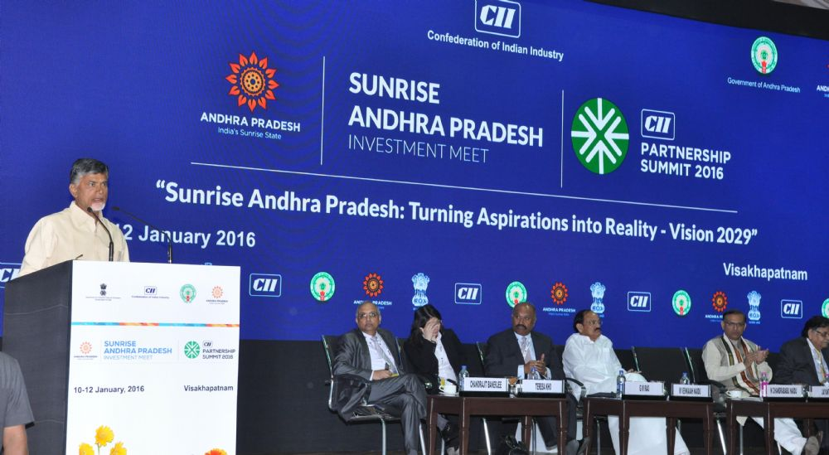

Slide 9


Slide 10


Slide 11
PERIOD OF OPERATION
The 2013 Scheme, as may be amended by the Government from time to time, shall remain in operation from:-
1st April, 2013
to
31st March, 2018

Slide 12
CLASSIFICATION OF AREAS FOR PSI-2013
For the purposes of the PSI- 2013, detailed Taluka wise classification of different areas of the State as Group, A /B/ C/ D/ D + etc., on the basis of their level of industrial development is as follows –
Group A
Denotes Industrially developed areas.
Group B
Denotes Areas where some industrial development has taken place, but are less developed than the areas under Group A.
Group C
Denotes Areas, which are less developed than those covered under Group B.
Group D
Denotes the lesser-developed areas of the State, not covered under Group A Group B/Group C.

Slide 13
Group D+
Denotes the least developed areas, not covered under Group A/Group B/Group C/Group D.
No Industry District
Denotes District having no industries and not covered under Group A / B/ C / D & D+.
Naxalism Affected Area
Denotes Area affected by naxalism, as described in GR No NAVIKA-2008/C.R.209/Ka. 1416 Dated 31.5.2009.

Slide 14
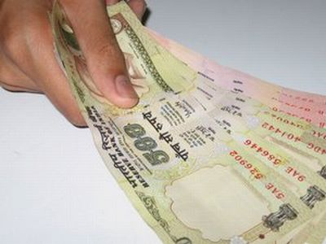


FINANCIAL INCENTIVES FOR MSMEs/LSIs UNDER PSI-2013

Slide 15
FINANCIAL INCENTIVES FOR MSMEs/LSIs UNDER PSI-2013
New MSME/LSI Units will eligible for BASKET OF INCENTIVES which includes:-
Industrial promotion subsidy
Interest Subsidy
Power tariff Subsidy
The total quantum of incentives will be linked to the Fixed Capital Investment.
The total quantum of incentives excluding the incentives of :-
exemption of electricity duty and
Waiver of stamp duty

Slide 16
Talulka/Area | Ceiling as % of Fixed Capital Investment |  | No. of Years
Micro, Small & Medium Enterprises |  | LSI | Micro, Small & Medium Enterprises | LSI
A | --- | --- | 7 | 7
B | 20 | --- | 7 | 7
C | 40 | 30 | 7 | 7
D | 70 | 40 | 10 | 7
D+ | 80 | 50 | 10 | 7
No Industry District | 90 | 70 | 10 | 7
Naxalism Affected Area | 100 | 80 | 10 | 7

Slide 17
Example – 1 SSI/MSI
Eligible subsidy according to location
Taluka / Area | Ceiling as % of Fixed Capital Investment | Cost of Project Rs 10 Crore | Eligible Amount of Subsidy | No. of Year | Per Year Subsidy
A | Nil | 10 Cr | Nil | Nil | Nil
B | 20 % | 10 Cr | 2 Cr | 7 Year | 28.57 Lac
C | 40 % | 10 Cr | 4 Cr | 7 Year | 57.14 Lac
D | 70 % | 10 Cr | 7 Cr | 10 Year | 70 Lac
D+ | 80 % | 10 Cr | 8 Cr | 10 Year | 80 Lac
No Industry District | 90 % | 10 Cr | 9 Cr | 10 Year | 90 Lac
Naxalism Affected Area | 100 % | 10 Cr | 10 Cr | 10 Year | 10 Lac

Slide 18
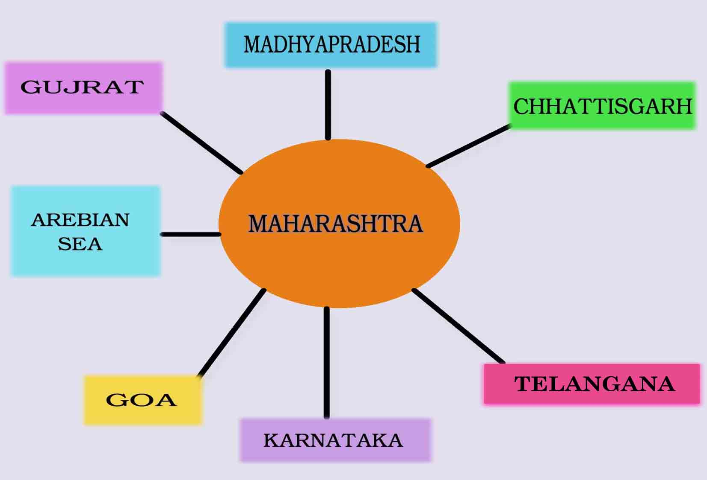

Slide 19

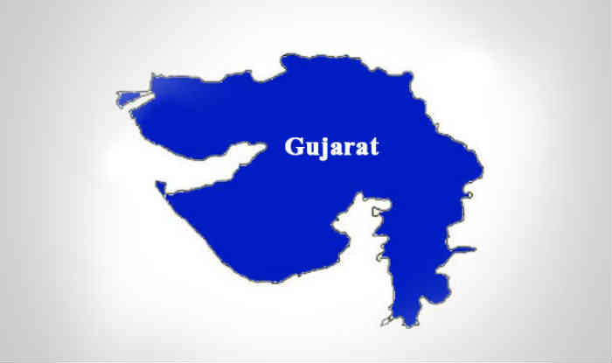
Example – 2 SSI/MSI
STATE | DISTRICT | TALUKA | AREA | ELIGIBLE SUBSIDY IN RS
MAHARASHTRA & GUJRAT | THANE | THANE | A | Nil
 |  | PALGHAR | A | Nil
 |  | TALASARI | D+ | 8 Cr
 |  | JAVHAR | D+ | 8 Cr
 |  | MOKHADA | D+ | 8 Cr
 |  | VASAI | A | Nil
 | NASIK | SURGANA | D+ | 8 Cr
 |  | SATANA | D+ | 8 Cr
 |  | PETH | D+ | 8 Cr
 | DHULE | SAKRI | D+ | 8 Cr
 | NANDURBAR | NANDURBAR | D+ | 8 Cr
 |  | AKKALKUWA | D+ | 8 Cr
 |  | NAVAPUR | D+ | 8 Cr
 |  | DHADGAON | D+ | 8 Cr

Slide 20

STATE | DISTRICT | TALUKA | AREA | ELIGIBLE SUBSIDY IN RS
MAHARASHTRA & MADHYAPRADESH | NANDURBAR | DHADGAON | D+ | 8 Cr
 |  | SHAHADA | D+ | 8 Cr
 | DHULE | SHIRPUR | D+ | 8 Cr
 | JALGAON | CHOPADA | D+ | 8 Cr
 |  | YAVAL | D | 8 Cr
 |  | RAVER | D+ | 8 Cr
 | BULDHANA | JAMOD | D+ | 8 Cr
 |  | MALKAPUR | D+ | 8 Cr
 | AMARAWATI | CHIKHALDARA | D+ | 8 Cr
 |  | ACHALPUR | D+ | 8 Cr
 | NAGPUR | NARKHER | D+ | 8 Cr
 |  | SAONER | D+ | 8 Cr
 |  | PARSEONI | D+ | 8 Cr
 |  | RAMTEK | D+ | 8 Cr
 | GONDIA | GONDIA | D+ | 8 Cr
 |  | AMGAON | D+ | 8 Cr
 |  | SALEKASA | D+ | 8 Cr
 | BHANDARA | TUMSAR | D+ | 8 Cr

Slide 21
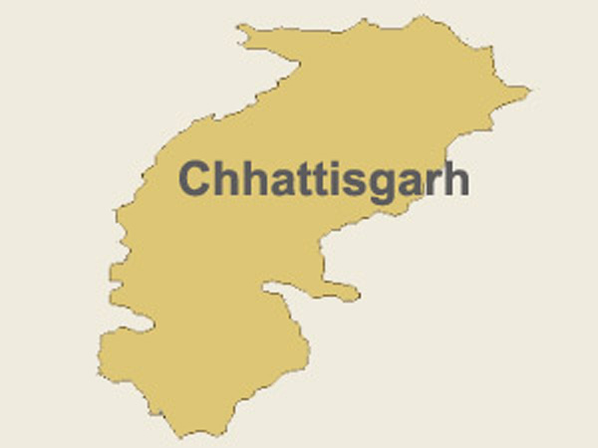
STATE | DISTRICT | TALUKA | AREA | ELIGIBLE SUBSIDY IN RS
MAHARASHTRA & CHHATTISGARH | GONDIA | DEORI | D+ | 8 Cr
 |  | SALEKASA | D+ | 8 Cr
 | GADCHIROLI | KORACHI | NO INDUSTRY DISTRICT
 |  | DHANORA
 |  | ETAPALLI
 |  | BHAMARGAD
 |  | SIRONCHA

Slide 22

STATE | DISTRICT | TALUKA | AREA | ELIGIBLE SUBSIDY IN RS
MAHARASHTRA & TELANGANA | GADCHIROLI | SIRONCHA | NO INDUSTRY AREA | 9 Cr
 |  | AHERI
 |  | MULCHERA
 |  | CHAMORSHI
 | CHANDRAPUR | CHANDUR | D+ | 8 Cr
 |  | RAJURA | D+ | 8 Cr
 |  | VIRUR | D+ | 8 Cr
 |  | DABHA | D+ | 8 Cr
 |  | GONDPIPARI | D+ | 8 Cr
 | YAVATMAL | WANI | D+ | 8 Cr
 |  | KELAPUR | D+ | 8 Cr
 |  | PUSAD | D+ | 8 Cr
 | NANDED | BHOKAR | D+ | 8 Cr
 |  | UMARI | D+ | 8 Cr
 |  | DHARMABAD | D+ | 8 Cr
 |  | BILOLI | D+ | 8 Cr
 |  | DEGLUR | D+ | 8 Cr
 |  | KINWAT | D+ | 8 Cr

Slide 23

STATE | DISTRICT | TALUKA | AREA | ELIGIBLE SUBSIDY IN RS
MAHARASHTRA &KARNATAKA | NANDED | DEGLUR | D+ | 8 Cr
 |  | MUKHED | D+ | 8 Cr
 | KOLHAPUR | SHIROL | D | 8 Cr
 |  | KAGAL | D+ | 8 Cr
 |  | BHUDARGAD | D+ | 8 Cr
 |  | CHANDGAD | D+ | 8 Cr
 | SANGALI | JAT | D+ | 8 Cr
 |  | KAVATHEMAHAANKAL | D+ | 8 Cr
 |  | MIRAJ | D | 8 Cr
 | LATUR | UDGIR | D+ | 8 Cr
 |  | DEONI | D+ | 8 Cr
 |  | NILANGA | D+ | 8 Cr
 | SOLAPUR | AKKALKOT | D+ | 8 Cr
 |  | SOLAPUR (SAUTH) | D+ | 8 Cr
 |  | MANGALVADHE | D+ | 8 Cr
 | OSMANABAD | UMARGA | D+ | 8 Cr

Slide 24

STATE | DISTRICT | TALUKA | AREA | ELIGIBLE SUBSIDY IN RS
MAHARASHTRA & GOA | SINDHUDURG | SAWANTWADI | D+ | 8 Cr

Slide 25
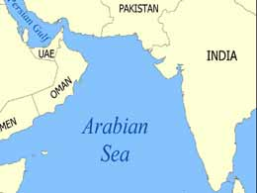
STATE | DISTRICT | TALUKA | AREA | ELIGIBLE SUBSIDY IN RS
MAHARASHTRA & AREBIAN SEA | SINDHUDURG | VENGURIA | D | 8 Cr
 |  | MALWAN | D+ | 8 Cr
 |  | DEVGARH | D+ | 8 Cr
 | RATNAGIRI | GUHAGAR | D+ | 8 Cr
 |  | RATNAGIRI | C | 4 Cr
 |  | RAJAPUR | D+ | 8 Cr
 | RAIGARH | PANVEL | A | Nil
 |  | URAN | A | Nil
 |  | ALIBAG | A | Nil
 |  | MURUD | C | 4 Cr
 |  | TALA | D+ | 8 Cr
 |  | SHRIVARDHAN | D | 7 Cr
 | THANE | TALASARI | D+ | 8 Cr
 |  | PALGHAR | A | Nil
 |  | VASAI | A | Nil

Slide 26

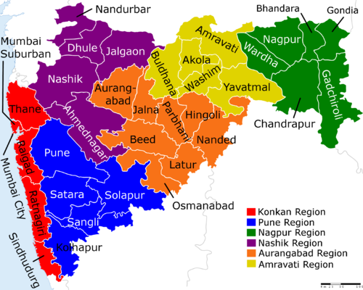
PACKAGE SCHEME OF INCENTIVES
2013
GOVERNMENT OF MAHARASHTRA

Slide 27
COVERAGE UNDER THE PSI - 2013
The following categories of Eligible Industrial Units in the Private Sector, Co-operative Sector, Central Public Sector, State Public Sector/ Joint Sector shall be eligible to be considered for incentives under the PSI- 2013 :-
Industries listed in the First Schedule of the Industries (Development and Regulation) Act, 1951, as amended from time to time.
Manufacturing Enterprises as defined in the Micro, Small and Medium Enterprises Development Act, 2006. (MSMED Act, 2006).
Information Technology Manufacturing Units registered with the Directorate of Industries or the Maharashtra Industrial Development Corporation (MIDC) or the Development Commissioner, Santacruz Electronic Export Processing Zone (SEEPZ) or Software Technology Parks of India (STPI) in the State.

Slide 28
COVERAGE UNDER THE PSI - 2013
Bio-technology Manufacturing Units as specified by the Government from time to time, which are outside the purview of any registering authority mentioned above.
Cold Storages.
Mechanized Food/Agro Processing Industries in the following sectors:
Dairy, Fruit and Vegetable Processing.
Grain Processing.
Fish Processing.
Consumer foods including Packed foods.
Non alcoholic beverages from fruits and vegetables.
Central Public Sector Units.

Slide 29


DEFINITIONS

Slide 30
EARLIER SCHEME
'Earlier Scheme' shall mean and include the Package Scheme of Incentives implemented from time to time prior to PSI-2013.

Slide 31
MICRO & SMALL MANUFACTURING ENTERPRISES,MEDIUM MANUFATURING ENTERPRISES
Micro, Small and Medium Manufacturing Enterprises (MSMEs) :-
MSMEs shall be construed as per the definition in the Micro, Small and Medium Enterprises Development Act, 2006. ( MSMED Act, 2006)
Large Scale Units:- Industrial Units, having investment more than the Medium Manufacturing Enterprises as defined under the MSMED Act, 2006, but less than the Mega Projects defined below, shall be classified as Large Scale Units (LSI).

Slide 32
EXISTING UNIT
An Existing Unit shall mean and include:
A Unit which has been set up and is in production on or any time prior to the 1st April, 2013,
OR
A Unit which has been granted an Eligibility Certificate(EC) or has availed of any incentives (excluding Stamp Duty) under any of the Earlier Schemes,
OR
A Unit which has filed a valid application for grant of an EC under the PSI- 2007 with any of the Implementing Agencies on or before the 31st March 2013.

Slide 33
NEW UNIT
A New Unit shall mean a Unit which is set up for the first time by an entity in the Private Sector / Co-operative Sector / State or Central Public Sector / Joint Sector in any Taluka where there is no Existing Unit set up by the said entity, provided that such Unit satisfies the following conditions:
It is not an Existing Unit.
At least one of the Effective Steps is completed on or after the 1st April, 2013 for setting of the Unit.
It is not formed as a result of re-establishment, mere change of ownership, change in the constitution, reconstruction or revival of an Existing Unit.
Explanation- The incentives available to a New Unit under the PSI-2013 shall, however, be available to the Units which get established as result of purchase of the assets of the Existing / Defunct / Closed / Sick Units, subject to and to the extent mentioned in Annexure III to this Resolution.

Slide 34
EXPANSION/ DIVERSIFICATION PROJECT
An investment shall be regarded as Expansion Project or a Diversification Project, as the case may be, if an Existing / New Unit in any of the areas covered under.
Group “B”,
Group “C”,
Group “D”,
Group D+,
Naxalism Affected Areas
No-Industry- Districts,
Made, on or after the date 1st April, 2013, an additional fixed capital investment in additional production / manufacturing facilities for manufacture of the same product / products as of the Existing /New Unit or for manufacture of different products, as the case maybe provided it satisfies the following conditions, namely.

Slide 35
EXPANSION / DIVERSIFICATION PROJECT
The said additional Fixed Capital Investment for expansion / diversification of the Existing/ New Unit should exceed 25 per cent of the Gross Fixed Capital Investment of the Existing / New Unit immediately prior to setting up of the additional production /manufacturing facilities, as on the last day of the previous financial year, subject to a minimum additional fixed capital investment of Rs. 5 crores in case of non-MSMEs and Rs. 25 Lacks, in case of MSMEs.
In the case of Expansion or Expansion-cum-Diversification but not mere Diversification “per se”, the said additional Fixed Capital Investment should result in increase of existing installed capacity by at least 25 percent; and
Such Expansion / Diversification should increase the employment in the non-supervisory category at least to the extent of 10 percent of the pre expansion/diversification level of such employment and 80 percent of such additional employment should be from amongst local persons.

Slide 36
ELIGIBILITY CERTIFICATE
Eligibility Certificate shall mean the certificate issued by the Implementing Agency to the Eligible Unit under the Package Scheme of Incentives which indicates :-
The accepted Fixed Capital Investment,
Actual Fixed Capital Investment made,
Finished Products
Other details
Quantum of Incentives,
Period of validity for availing of incentives
AND
the terms and conditions to be complied with by the concerned Unit in whose favour such certificate is issued.

Slide 37
ELIGIBILITY PERIOD
For the purpose of incentives of :-
Industrial Promotion Subsidy,
Interest Subsidy,
Electricity Duty Exemption,
Power Tariff Subsidy etc.,
Applicable to an Eligible Unit subject to the fulfilment of the conditions of the PSI-2013, the period of eligibility shall be computed from the Effective date of Eligibility and depend on the nature and location of the Eligible Unit.
In respect of Mega Projects/ Ultra Mega Projects, the eligibility period shall be as, approved by the “Cabinet Sub Committee” or the “High Power Committee”, subject to fulfilment of the conditions of the PSI- 2013.

Slide 38
OPERATIVE PERIOD
Operative Period” shall mean an include the minimum period of Operation of Unit as laid down under the Government Resolution, Industries, Energy and Labour Department, No. PSI-2108/CR 35 /IND-8, dated the 21st May, 2008 .

Slide 39
EFFECTIVE STEPS
Effective Steps” shall mean and include –
Effective possession of land / shed / gala by an Eligible Unit. If the rental period/ lease period is less than the sum of Eligibility Period and Operative Period, then there should be a provision of automatic extension of the agreement for further minimum period which should be equivalent to the sum of Eligibility Period and Operative Period of the eligible unit.
Explanation: Effective possession of land, in case of rental / lease of land / premises, means physical possession of land with registered deed with clear title documents and / or registered lease deed. However for land in MIDC area , effective possession of land means physical possession with registered Agreement to lease.

Slide 40
EFFECTIVE STEPS
Registration, in case of Firm / Company / Trust / Society / Co-operative Society. However, in case of Partnership Firm, the evidence of execution of a Partnership Deed and filing of a requisite application with payment of necessary registration fees with the Registrar of Firms and acknowledgement by the office shall be necessary.
Enterprises Memorandum / Letter of Intent / Registration for IT/BT Units from the Directorate of Industries or MIDC / Letter of Intent from the Government of India and / or permission from the State Government for setting up / shifting of the Unit, if such permission is required to be obtained.

Slide 41
A copy of the Industrial Entrepreneur’s Memorandum (IEM) along with a copy of its acknowledgement in the case of an LSI Unit/Mega Unit/Ultra Mega Unit, not covered. under the licensing provisions of the Industries (Development & Regulation) Act, 1951 or letter of intent, which is covered under license provision of the said Act.
Explanation- Based on the documentary evidence produced by the Eligible Unit, the Implementing Agency shall determine the date on which the Effective Steps are completed, subject to such directions as the Government may issue from time to time.

Slide 42
FIXED ASSETS
The term Fixed Assets shall mean and include :
Land / area in effective possession for a minimum further period equivalent to sum of Eligibility Period and Operative Period, prescribed under the scheme and as required for the project.
Building, i.e. any built-up area used for the Eligible Unit including administrative building, residential quarters, industrial housing and accommodation for all such facilities as are required for the manufacturing processes.
Plant and Machinery, i.e. Tools and equipment including handling and haulage equipment or tools as are necessarily required and exclusively used for sustaining the working of the Eligible Unit.

Slide 43
FIXED ASSETS
The cost of development of the location of the Eligible Unit, such as fencing, construction of roads and other infrastructure facilities which the Eligible Unit has to incur under the project.
Installation charges and pre-operative expenses capitalized.
Technical know-how including cost of drawings and know-how fees.
The amount paid to the Electricity Distribution Company for supply of power to the Eligible Unit, or to the Maharashtra Industrial Development Corporation (MIDC) for development of infrastructure for the Eligible Unit, or to any other Government Agency for similar purpose.

Slide 44
GROSS FIXED CAPITAL INVESTMENT
Gross Fixed Capital Investment shall, in the case of New Fixed Assets, mean and include the value of new Fixed Assets acquired at site and duly paid for. Provided that –
Only new Fixed Assets as per the Project Scheme accepted by the Implementing Agency, based on the project appraisal done by the lender who has given term loan for the Project or by the Scheduled Commercial Bank / SICOM in case of projects financed by Non- Banking Finance Company/Credit Society/self-financed project, which are acquired by an Eligible Unit / Enterprises within the relevant period shall be considered. (The Land cost prior to submission of valid application shall be considered for Fix Capital Investment).
The value for which imported second hand fixed assets (Used imported machinery) are acquired or the value thereof as certified by an approved valuer, whichever is less, subject to the condition that the assets shall have residual performing life of a minimum 10 years as certified by an approved valuer, shall also be considered towards Gross Fixed Capital Investment.
The investment in intangible assets including pre- operative expenses, interest capitalized, technical know-how, deposits paid for utility services etc. shall be considered only to the extent of 10% of the total project cost for the purpose of incentives.

Slide 45
GROSS FIXED CAPITAL INVESTMENT
Fixed Assets acquired by an Eligible Unit and forming part of the Gross Fixed Capital Investment cannot be disposed of / sold / shifted / written off except with the prior written permission of the Implementing Agency. The Implementing Agency may ordinarily grant such permission if it is satisfied that the overall production capacity and existing employment strength of the Eligible Unit will not thereby suffer and that the Eligible Unit has definite Plans /proposals for replacement of the Fixed Assets being disposed of / sold / written off either by similar Fixed Assets or by Fixed Assets with better output / higher production capacity with or without change in the finished product/s. However, shifting of assets will be permitted only if the contemplated shifting is to a place in an equivalent or lesser-developed area of the State (e.g. from Group 'C' to 'C‘or 'D' area, but not from Group 'C' to 'B' area .)
The Gross Fixed Capital Investment at:-
  The end of each year will be computed as Gross Fixed Capital Investment at the beginning of the year, plus additions as per the approved Project Scheme made, if any, to the Gross Fixed Capital Investment during the year, less the original value of any Fixed Assets of the Eligible Unit shifted disposed of / sold / written off, if any, during the year.

Slide 46
GROSS FIXED CAPITAL INVESTMENT
If the admissible Gross Fixed Capital Investment as endorsed in the EC is reduced as a result of any shift / disposal / sale / write off / replacement of the Fixed Assets, the ceiling as endorsed in the EC shall be reduced proportionately and if the incentives availed by the Eligible Unit exceed the ceiling revised as a result of shifting / disposal / sale / write off / replacement, the benefits availed in excess of such revised ceiling shall stand recoverable/refundable forthwith with interest at the rate of 12% from the date of such excess availment till the date of actual payment.
Any increase in the Gross Fixed Capital Investment as a result of replacement of any of the Fixed Assets earlier considered under the EC shall not have any additional incentives.

Slide 47
ELIGIBLE INVESTMENT
Eligible Investment shall mean and include the investment in the fixed assets acquired at site and paid for within the permissible investment period , limited to the item wise maximum limit ( i.e. Land, Land development, Building, Plant and Machinery etc.) as per the approved Project Scheme by the concerned term lending agency or as appraised by the approved agency in case of self financed projects and accepted by the Implementing Agency.
Explanation :- The amount shown under the head of contingency against each item shall not be allowed in excess of 10% of the cost shown therein and shall be considered only if the same has been provided in appraisal/assessment done by the concerned term lending agency/Financial Institution and accepted by the Implementing Agency

Slide 48
DIRECT EMPLOYMENT
Direct Employment shall mean employees on the pay roll of the company covered under Employee’s Provident Funds and Miscellaneous Provisions Act, 1952 and Employee’s Provident Funds Scheme, 1952 and for which Employees’ Provident Fund ( EPF) contribution is paid by the Eligible Unit and shall not include employees on the pay roll of contractors.

Slide 49
FINISHED PRODUCT
Finished product shall mean and include the item/s of manufacture by the Eligible Unit as considered under the project scheme approved by the concerned term lending agency and / or by the Implementing Agency, together with by-product /scrap which may get generated as incidental to and during the main production activity.
Explanation: The units will be allowed inclusion of items freely during the eligibility period. However the incentives for included items will be available prospectively and addition to the Fixed Capital Investment made for purpose of additional items shall not be entitled for additional incentives.

Slide 50
IMPLEMENTING AGENCIES FOR IMPLEMENTATION OF
PSI-2013
The Implementing Agencies for the purpose of the PSI - 2013 shall be as follows:
Explanation: Where an Eligible Unit is already holding an EC, it will be covered for benefits under the PSI- 2013 according to its status as Micro, Small and Medium Manufacturing Enterprise or Large Scale Industry (LSI), consequent upon the new /expansion / diversification project undertaken by it and shall accordingly file its application with the concerned Implementing Agency.

Slide 51
Sr.No | Category of Industrial Units | Area | Implementing Agency
1 | Micro & Small Manufacturing Enterprises. Cold Storages and processing units mentioned in Para No. 1.2 (v) & (vi) wherein investment in equipments is at par with Micro and Small Manufacturing Enterprises, | Mumbai and Mumbai sub-urban Districts | The Joint Director of Industries (Mumbai Metropolitan Region) [JDI (MMR)]
 |  | All other Districts | District Industries Centre (DICs)
2 | Medium Manufacturing Enterprises Cold Storages and processing units mentioned in Para No. 1.2 (v) & (vi) wherein investment in equipments is at par with the Medium Manufacturing Enterprises as defined in the MSMED Act, 2006. | Mumbai and Mumbai Sub-urban Districts | The Joint Director of Industries (Mumbai Metropolitan Region) [JDI (MMR)]
 |  | Regions | The Regional Joint Directors of respective Regions
 |  | Nanded Sub- Region | Superintending Industries Officer, Nanded Sub –Region
Where an Eligible Unit is already holding an EC, it will be covered for benefits under the PSI- 2013 according to its status as Micro, Small and Medium Manufacturing Enterprise or Large Scale Industry (LSI), consequent upon the new /expansion / diversification project undertaken by it and shall accordingly file its application with the concerned Implementing Agency.

Slide 52
PROVIDED THAT
The total quantum of incentives for the FOOD/AGRO PROSSESING UNITS covered under PSI 2013 will be 10 % OVER AND ABOVE the limits mentioned above and such units will get ONE MORE YEAR of eligibility to avail of the incentives.

Slide 53
EXPANSION/ DIVERSIFICATION UNITS
Existing/New Micro, Small and Medium Manufacturing Enterprises, LSI (including Manufacturing IT/BT) Units, qualifying as Expansion/Diversification Units, will also be eligible to get the Incentives for Expansion /Diversification, equivalent to 75% of the incentives admissible for New Units.
The eligibility period for availing of the incentives will however be reduced by one year in case of Expansion/Diversification Units.

Slide 54
EXPANSION/ DIVERSIFICATION UNITS
Example:
For example, if an Eligible New Micro, Small and Medium Manufacturing Enterprise located in D area has obtained EC and its date of commencement of commercial production is 09/10/2013, the Eligible unit will be entitled to Industrial Promotion Subsidy, Interest Subsidy, Power Tariff Subsidy, etc. all taken together up to a maximum of 70% of its eligible investment for 10 years from 01/11/2013.
In addition, the Unit will also be eligible for exemption from payment of Stamp Duty during the Investment period and Electricity Duty exemption for a period of 10 years .
If the Unit in above example is an Expansion / Diversification Unit, then the maximum quantum of incentives in the above example will be 52.5% of its eligible investment and the Eligibility period will be 9 years (Except Electricity Duty exemption).

Slide 55


INDUSTRIAL PROMOTION SUBSIDY (IPS)FOR MSMEs –

Slide 56
INDUSTRIAL PROMOTION SUBSIDY (IPS)FOR MSMEs
The eligible New/Expansion Micro, Small and Medium Manufacturing Enterprises, which are set up in different parts of the State, will be eligible for Industrial Promotion Subsidy (IPS) as follows.

Slide 57
Sr. No. | Taluka/Area Classification | The quantum of Industrial Promotion Subsidy Every Year
1) | Naxalism Affected Area | VAT on local sales minus Input Tax Credit (ITC) or zero whichever is more + CST payable +
2) | No Industries District | VAT on local sales minus ITC or zero whichever is more + CST payable + 75% of ITC
3) | Entire Vidarbha and Marathwada (Other than Sr. No. 1 & 2.) | VAT on local sales minus ITC or zero whichever is more + CST payable + 65% of ITC
4) | Group D+ Taluka (Other than Sr.No.1 and 3) | VAT on local sales minus ITC or zero whichever is more + CST payable + 50% of ITC

Slide 58
Sr. No. | Taluka/Area Classification | The quantum of Industrial Promotion Subsidy Every Year
5) | Group D Taluka (Other than Sr.No.1and 3) | VAT on local sales minus ITC or zero whichever is more + CST payable + 40% of ITC
6) | Group C Taluka | VAT on local sales minus ITC or zero whichever is more + CST payable + 30% of ITC
7) | Group B Taluka | VAT on local sales minus ITC or zero whichever is more + CST payable + 20% of ITC

Slide 59
INTEREST SUBSIDY
All eligible NEW Micro, Small and Medium Manufacturing Enterprises in areas other than Group "A” will be eligible for interest subsidy. (B/C/D/D+)
The Interest Subsidy will be payable only on the interest actually paid to the Banks and Public Financial Institutions on the amount of term loans taken for acquisition of Fixed Assets.
The amount of interest subsidy will be calculated @ effective rate of interest, after deducting the interest subsidy receivable from any institution or under any Govt. of India Scheme and the penal/compound interest or 5 % per annum, whichever is less.
The quantum of interest subsidy payable every year will not exceed the bills paid for electricity consumed during the relevant year.

Slide 60
EXEMPTION FROM ELECTRICITY DUTY
All Eligible New Units in Group C, D, and D+ areas and No-Industry District(s) and Naxalism affected Area will be exempted from payment of Electricity Duty during eligibility period not exceeding 15 years.
In Group A and B areas:-
100% Export Oriented Units (EOUs),
Information Technology Manufacturing Units and
Bio-Technology Manufacturing units will also be exempted from payment of Electricity Duty for a period of 7 Years.
Necessary Notification under the provisions of the Electricity Duty Act 1958 will be issued separately by the Energy Department.

Slide 61
WAIVER OF STAMP DUTY
New Units as well as Units undertaking Expansion/ Diversification (including Mega and Ultra Mega Projects) will be exempted from payment of Stamp duty during the Investment period in Group “C, D, D+ Talukas, No Industry Districts and Naxalism affected areas.
In Group A and B areas, stamp duty exemption would be available as given below:
BT Manufacturing and IT Manufacturing Units in Public Parks : 100%
BT Manufacturing and IT Manufacturing Units in Private Parks : 75%
Mega Projects - 50% for first conveyance deed only
Explanation: Eligible New/Expansion Units of PSI-2007 will also be eligible for Stamp Duty Exemption during their investment period.
Necessary Notification under the provisions of the Bombay Stamp Act 1958 will be issued separately by the Revenue & Forest Department.

Slide 62
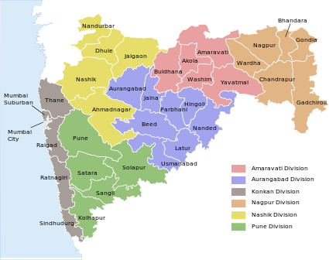
POWER TARIFF SUBSIDY

Slide 63
POWER TARIFF SUBSIDY
Eligible New Micro, Small and Medium Enterprises (MSME) will be eligible for power tariff subsidy.
The subsidy will be to the tune of Rs 1/- per unit for the Units located in
Vidarbha,
Marathwada,
North Maharashtra and the Districts of
Raigad, Ratnagiri ,Sindhudurg in Kokan Region
And
Rs 0.50 per unit for the Units in other areas of the State for a period of 3 years from the date of commencement of commercial production, for the energy consumed and paid.
The Units in Group “A” areas will however not be eligible for this incentive.

Slide 64
INCENTIVES FOR STRENGTHENING MSMEs AND LSIs
The followings incentives shall be admissible to the MSMEs and LSIs so as to promote :-
Quality Competitiveness
Research & Development
Technology Upgradation
Water & Energy Conservation
Cleaner Production Measures and Credit Rating –

Slide 65
New MSMEs and Expansion thereof in all categories of areas will be eligible for following incentives
INCENTIVES FOR TECHNOLOGY UP-GRADATION
5% subsidy on capital equipment for Technology Up –gradation, subject to a maximum of Rs.25 lacs
What is Technology Upgradation :
Technology up-gradation would ordinary mean induction of state of the art or near state of the art technology.
It would also mean a significant step up from the present technology level to substantially higher one involving improved environmental of improved packaging techniques as well as anti-pollution measures and energy conversation machinery.
Further, the units in need of introducing facilities for in-house testing and on-line quality control would qualify for assistance.
Types of Units covered under the scheme:
Units holding eligibility certificate under PSI-2007 and to which assistance is sanctioned under Credit Link capital subsidy scheme (CLCSS) of MSME or Technology Up-Gradation Fund Scheme for Textile and jute Industries (TUFS) or Technology Mission on cotton (TMC) Scheme of Ministry of Textile, Govt.of India during the period 01/04/2007 to 31/03/2011 shall be considered eligible for receipt of Technology up-gradation incentives.

Slide 66
New MSMEs and Expansion thereof in all categories of areas will be eligible for following incentives
SUBSIDY ON CLEANER PRODUCTION MEASURES
25% on capital equipment for cleaner production measures ,limited to Rs.5 Lakhs
Types of Unit Covered under the scheme :
Unit holding eligible certificate under PSI-2007 and who has filed valid application with the implementing agency after issue of eligibility certificate within 6 months from expiry of the period of eligibility certificate as defined under PSI-2007.
Failure to file valid application within the prescribed period shall render the application invalid.
The above subsidies are paid one time.

Slide 67
INCENTIVES FOR STRENGTHENING MSMEs AND LSIs
New MSMEs and Expansion thereof in all categories of areas will be eligible for following incentives –
75 % subsidy on the expenses incurred on quality certification limited to Rs. 1 Lakh.
25% subsidy on capital equipment for cleaner production measures ,limited to Rs.5 Lakhs
75 % subsidy on the expenses incurred on patent registration limited to Rs. 10 Lakh for the National patents and Rs. 20 lakh for the International patents.

Slide 68
INCENTIVES FOR STRENGTHENING MSMEs AND LSIs
Incentives for Credit Rating of MSMEs in all categories of areas –
75% of the cost of carrying out Credit Rating by Small Industries Development Bank of India/ Government accredited Credit Rating Agency, limited to Rs. 40,000.
New MSMEs, LSI and Expansion thereof will be eligible for the following incentives in all categories of areas –
75% of cost of water audit limited to Rs. 1.00 lakh.
75% of cost of energy audit limited to Rs. 2.00 lakh.
50% of the cost of Capital Equipment under the measures to conserve/recycle water, limited to Rs. 5 lakh
50% of the cost of Capital Equipment for improving energy Efficiency, limited to Rs. 5 lakh.

Slide 69

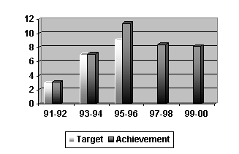
YEARLY CAP FOR THE INCENTIVES

Slide 70
YEARLY CAP FOR THE INCENTIVES
The amount of incentives to be disbursed to the MSMEs and LSI Units every year will be limited to the total quantum of incentives divided by the number of years as per the applicable Eligibility period with the provision of carrying forward the differential between the actual sanctioned amount for a given year and the yearly disbursement limit.
The Carry forward principle will be applicable. The balance quantum of incentives will be allowed to be availed of after 10 years with yearly cap as above. Proportionate quantum of incentives will be calculated for a part of the year.

Slide 71


PROCEDURE FOR APPLICATION UNDER PSI-2013

Slide 72
APPLICATION FOR ELIGIBILITY
An application for eligibility under the PSI 2013 Scheme shall be submitted to the Implementing Agency by an Eligible Unit only after it has taken all the Effective Steps but not later than the 31st March, 2018. It shall be supported by documentary evidence with regard to completion of the Effective Steps.
For claiming eligibility under the PSI-2013, any New/Expansion/ Diversification, Eligible Unit shall commence the commercial production and also acquire the fixed assets at site, having paid for the same, and paid for it within the investment period.
The Investment Period for Micro, Small and Medium manufacturing Enterprises will be three years, and for the LSI units, four years.

Slide 73
APPLICATION FOR ELIGIBILITY
The Investment Period will be counted from the date of submission of application to the Implementing Agency or the date suggested by the Eligible Unit. However, this date should be within this Scheme Period and the assets acquired prior to and beyond the investment period will not be considered eligible for incentives, However, the Land cost prior to submission of valid application shall be considered for Fix Capital Investment.
Delay in commencement of commercial production will entail proportionate curtailment of incentives and the Eligibility Certificate period.

Slide 74
APPLICATION FOR ELIGIBILITY
If a Unit has completed all Effective steps but not started the production before the 1st April, 2013 and has not filed an application with the Implementing Agency under PSI 2007, such unit can submit the application under PSI - 2013.
However, the incentives applicable to such Eligible Unit shall be as per PSI- 2007 or PSI - 2013 , whichever is lower. For such unit , the investment made within the investment period from the date of application only will be considered for Incentives.

Slide 75
APPLICATION FOR ELIGIBILITY
However, the Unit should complete the effective steps and file an application with the Implementing Agency within the operative period of PSI -2013, but before starting the commercial production.
An application for eligibility shall be submitted to the Implementing Agency on or before the date of commencement of commercial production. If there is any delay, the E.C. period and entitlement will be curtailed proportionately.

Slide 76
EFFECTIVE DATE OF ELIGIBILITY CERTIFICATE
In An Eligibility Certificate (EC) under the PSI-2013 will be issued by the Implementing Agency after ascertaining that the Eligible Unit has complied with the provisions of the Scheme and has commenced its commercial production.
The EC will be issued with effect from the date of commencement of commercial production by the Eligible Unit. The date of commencement of commercial production will be determined by the Unit, supported by the relevant extract of the Excise Register or, in case Excise Duty is not applicable, by the first sale bill issued by the Unit in respect of such production or as may be Specifically permitted by the Government of Maharashtra in respect of Mega Projects. For the purpose of the EC, the date of commencement of commercial production shall be deemed to be the first day of the month following the month in which such production has commenced.
The Implementing Agency shall send a copy of the Eligibility Certificate to all the concerned agencies offering various incentives e.g. concerned Electrical Inspector, Sales Tax Officer.

Slide 77
PROCEDURE FOR CLAIMING BENEFITS UNDER EXPANSION / DIVERSIFICATION
The eligible unit claiming benefits under Expansion / Diversification shall be required to maintain separate record of production for such expansion.
In case, however, maintaining separate record is not possible, the benefits for such eligible units shall be available in the ratio of additional fixed capital investment to the total gross fixed capital investment. There will no limit of number expansions/ diversifications in the Scheme period.

Slide 78
Claim for Incentives
No right or claim for any incentives under the PSI - 2013 shall be deemed to have been conferred by the PSI - 2013 merely because the applicant Unit has fulfilled the conditions of the PSI-2013.
The incentives under the PSI - 2013 (except Stamp Duty Exemption) cannot be claimed unless an EC has been issued under the PSI - 2013 by the Implementing Agency and the Eligible Unit has complied with the stipulations/conditions of the EC.
The Implementing Agency shall issue EC to the Eligible Unit within 30 days of the Unit complying with the stipulations of the PSI – 2013 and submitting documentary evidence thereof.

Slide 79


MONITORING AND REVIEW

Slide 80
Monitoring and Review of the Fixed Capital Investment and
Production activities of the Eligible Unit
The Eligible Unit shall submit a report duly signed by its authorised representative covering information and details regarding production and sales, indicating the period of stoppage of production and/or closure of the Unit, if any, with reasons therefore, addition to the Fixed Capital Investment, disposal of Fixed Assets, and changes in the constitution of the Eligible Unit.
The Eligible Unit shall also submit to the Implementing Agency, within a period of 9 months from the close of every year, a certified true copy of the audited annual statement of accounts and Balance Sheet for the said year.
The Implementing Agency shall be entitled to call for any information and details for a shorter period even prior to the close of the year. The implementing Agency shall independently examine the position from time to time in order to ensure that the incentives drawn/availed of are within the ceilings specified under the PSI-2013 or under the relevant earlier Scheme, as the case may be.

Slide 81
Monitoring and Review of the Fixed Capital Investment and
Production activities of the Eligible Unit
Failure on the part of an Eligible Unit to submit any of the above information / documents within the specified time shall mount to breach of the provisions of the PSI-2013, entailing suitable action as provided under the Procedural Rules, including action to cancel the EC, or premature recall of and immediate recovery of the incentives drawn / availed.
The Implementing Agencies shall, as far as possible, ensure that the Eligible Unit and the relevant Agency for supply of power, and the Electrical Inspector are kept informed of the continuance or discontinuance of the EC during the tenure in accordance with the Procedural Rules.
If and when the Eligible Unit reaches the relevant ceilings prescribed in the EC prior to expiry of the EC period, or if it contravenes any of the conditions there under, the Implementing Agencies shall take prompt action to cancel the EC.

Slide 82
CLASSIFICATION OF TALUKAS / AREAS

Slide 83
District | Group A | Group B | Group C | Group D | Group D
KONKAN DIVISION
Greater Mumbai | Greater Mumbai
Thane | Thane Vasai Palghar Kalyan Ulhasnagar Ambernath | Dahanu Murbad | Bhivandi Shahapur |  | Jawhar Mokhada Talasari Wada Vikramgad
Raigad | Alibag @ Uran Panvel Karjat @ Khalapur Pen @ Roha | Alibag $ Pen $ Sudhagad | Karjat $ Mahad Mangaon Murud | Shrivardhan | Poladpur Mhasala Tala

Slide 84
District | Group A | Group B | Group C | Group D | Group D
KONKAN DIVISION
Ratnagiri |  | Ratnagiri Chiplun |  | Khed | Guhagar Dapoli Lanja Mandangad Rajapur Sangameshwar
Sindhudurg |  |  |  | Vengurla | Kankavli Kudal Sawantwadi Malvan Deogad Vaibhavwadi Doda Marg

Slide 85
District | Group A | Group B | Group C | Group D | Group D
PUNE DIVISION
Pune | Pune City Maval Haveli @ Bhor @ | Haveli $ Mulshi $ | Shirur $ Daund $ Bhor $ Khed $ | Ambegaon Junnar | Velhe
 | Daund @ Shirur @ Khed @ Mulshi @ |  | Indapur Baramati Purandar

Slide 86
District | Group A | Group B | Group C | Group D | Group D
PUNE DIVISION
Solapur |  |  |  | Solapur ( North ) Pandharpur Malshiras | Barshi Akkalkot Solapur (South) Mohol Mangalwedhe Sangole Karmala Madha
Satara |  |  |  | Satara Khandala Koregaon Phaltan Khatav Karad Mahabaleshwar | Wai Man Patan Jaoli

Slide 87
District | Group A | Group B | Group C | Group D | Group D
PUNE DIVISION
Sangli |  |  |  | Miraj | Tasgaon Khanapur Atapadi Jat KavatheMahaankal Walwa Shirala Kadegaon Palus
Kolhapur |  |  |  | Karveer Panhala Hatkanangale Shirol | Kagal Gadhinglaj Chandgad Ajra Bhudargad Radhanagari Bavada Shahuwadi

Slide 88
District | Group A | Group B | Group C | Group D |  | Group D
NASIK DIVISION
Nasik |  | Nasik | Niphad Sinnar | Dindori Yeola Igatpuri | Peth Surgana Kalwan Baglan
 |  |  |  |  | Chandwad Nandgaon Trimbakeshwar Deola Malegaon

Slide 89
District | Group A | Group B | Group C | Group D | Group D
NASIK DIVISION
Ahmednagar |  |  |  | Nagar Rahuri Shrirampur Newasa Karjat Shrigonda Akola Sangamner Kopergaon Rahata | Shevgaon Pathardi Jamkhed Parner

Slide 90
District | Group A | Group B | Group C | Group D | Group D
NASIK DIVISION
Dhule |  |  |  | Dhule | Sakri Shirpur Shindkheda
Nandurbar |  |  |  |  | Nandurbar Nawapur Shahade Talode Akrani Akkalkuva
Jalgaon |  |  |  | Jalgaon Yawal Chalisgaon Amalner Dharangaon | Chopada Raver Edalabad Bhusawal Jamner Pachora Bhadgaon Parola Erandol Bodwad

Slide 91
District | Group A | Group B | Group C | Group D | Group D
AURANGABAD DIVISION
Aurangabad |  |  |  | Aurangabad | Khuldabad Kannad Soegaon Sillod Paithan Gangapur Vaijapur Phulambri
Jalna |  |  |  |  | Jalna Ambad Jafferabad Partur Bhokardan Badnapur Ghangsavangi Mantha

Slide 92
District | Group A | Group B | Group C | Group D | Group D
AURANGABAD DIVISION
Beed |  |  |  |  | Beed Georai Majalgaon Ambejogai Kaij Patoda Ashti Dharur Parli Wadavani Shirur Kasar

Slide 93
District | Group A | Group B | Group C | Group D | Group D
AURANGABAD DIVISION
Osmanabad |  |  |  |  | Osmanabad Kalamb Omerga Tuljapur Paranda Bhum Washi Lohara
Parbhani |  |  |  |  | Parbhani Jintur Selu Gangakhed Pathri Palam Purna Manawat Sonpeth

Slide 94
District | Group A | Group B | Group C | Group D | Group D
AURANGABAD DIVISION
Hingoli | NO INDUSTRY DISTRICT
Latur |  |  |  |  | Latur Ahmedpur, Udgir Nilanga Ausa Chakur Deoni Shirur-Anantpal Jalkot Renapur

Slide 95
District | Group A | Group B | Group C | Group D | Group D
AURANGABAD DIVISION
Nanded |  |  |  |  | Nanded Bhokar Hadgaon Kinwat Biloli Deglur Mukhed Kandhar Loha Mudkhed Ardhapur Naigaon Dharmabad Himayatnagar Umari Mahur

Slide 96
District | Group A | Group B | Group C | Group D | Group D
AMARAVATI DIVISION
Amravati |  |  |  |  | Amravati Achalpur Bhatkuli Nandgaon- Khandeshwar Chandur Bazar Morshi Warud Chandur Rly. Teosa Daryapur Anjangaon -Surji Chikhaldara. Dharni Dhamangaon- Rly. Akola

Slide 97
District | Group A | Group B | Group C | Group D | Group D
AMARAVATI DIVISION
Akola |  |  |  |  | Akola Barshitakli Akot Telhara Balapur Patur Murtijapur
Washim |  |  |  |  | Buldhana Chikhali Shegaon DeulgaonRaja Malkapur Motala Nandura Jalgaon Jamod Sangrampur Khamgaon Mehkar Sindakhed –Raja Lonar

Slide 98
District | Group A | Group B | Group C | Group D | Group D
AMARAVATI DIVISION
Yavatmal |  |  |  |  | Yavatmal Babhulgaon Kalamb Kelapur Ralegaon Ghatanji Wani Maregaon Pusad Mahagaon Umarkhed Darwaha Ner Digras Arni Zari-Jamdi

Slide 99
District | Group A | Group B | Group C | Group D | Group D
NAGPUR DIVISION
Nagpur |  |  |  | Nagpur City | Nagpur (R) Kamptee Hingana Katol Narkhed Savner Kalmeshwar Ramtek Parseoni Mauda Umred Bhiwapur Kuhi
Bhandara |  |  |  |  | Bhandara Pauni Tumsar Mohadi Sakoli Lakhandur Lakhani

Slide 100
District | Group A | Group B | Group C | Group D | Group D
NAGPUR DIVISION
Gondia |  |  |  |  | Gondia Goregaon Tirora Arjuni- Morgaon Deori Sadakarjuni Amgaon Salekasa
Wardha |  |  |  |  | Wardha Deoli Seloo Arvi Karanja Ashti Hinganghat Samudrapur
Gadchiroli | NO INDUSTRY DISTRICT

Slide 101
Naxalism affected Talukas

Slide 102
Sr. | District | Talukas
1. | Gadchiroli | All Talukas
2. | Gondia | All Talukas
3. | Chandrapur | Chandrapur, Gondpipri, Rajura, Korpana, Jiwati, Ballarsha, Pobhurna, Mul, Sawali
4. | Bhandara | Sakoli, Lakhandur, Lakhani
5. | Yavatmal | Pandharkawda, Wani, Zari-Jamdi, Ghatanji, Arni
6. | Nanded | Kinwat

Slide 103


