Slide 1
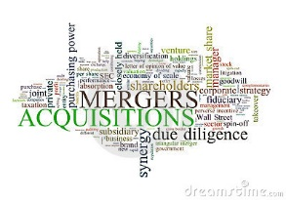

SageOne Investments Advisors LLP
Quest for Outstanding Investments
    India dedicated long only equity advisors with mission to preserve the purchasing power of capital whilst providing superior sustainable returns over long term
Confidential Discussion Document. See important legal information inside.

Slide 2

Investing Capital : Business of Business !!!

Slide 3
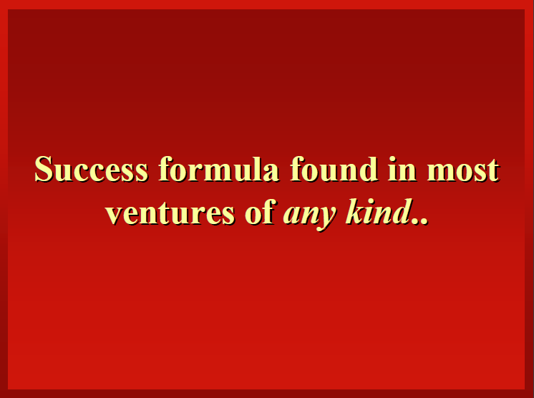
Magic Formulae

Slide 4

Magic Formulae

Slide 5
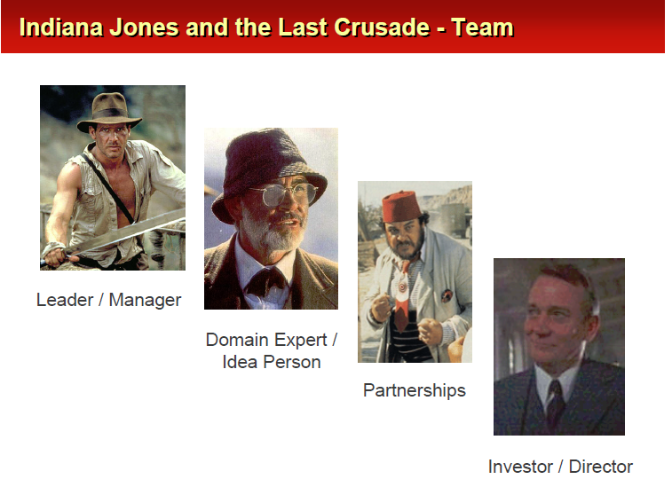
Magic Formulae

Slide 6
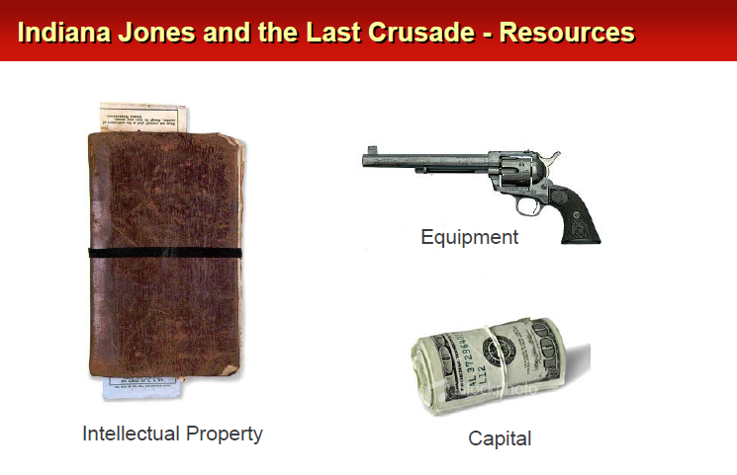
Magic Formulae

Slide 7
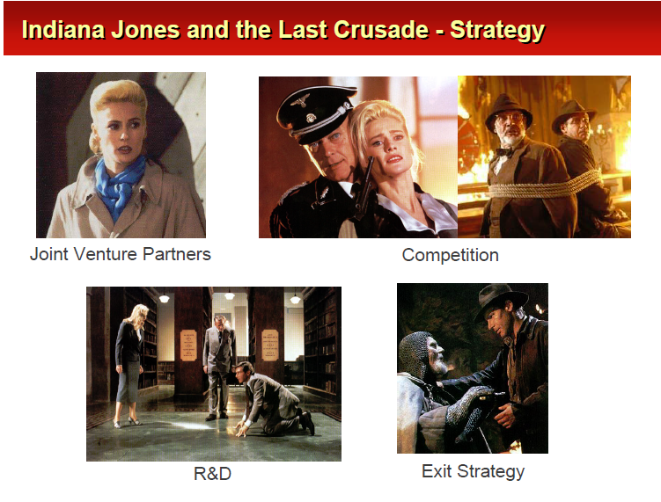
Magic Formulae

Slide 8
Build v/s Buy v/s Partner
 | Internal Development ( build) | Acquisition ( buy) | Strategic Alliance ( ally)
Potential advantages Potential disadvantages | Control over execution Focused development Control over cost Lengthy execution period Inbred perspective Uncertain market acceptance Increased competition | Speed of execution Cross –company synergies Complementary expertise Removal of a competitor Low market entry risk High Integration risk High entry cost Unwanted assets and unwelcome liabilities | Low entry cost Cross-company synergies Complementary expertise Low market entry risk Ability to learn Shared benefits Complex management Disagreements regarding control Questionable sustainability

Slide 9
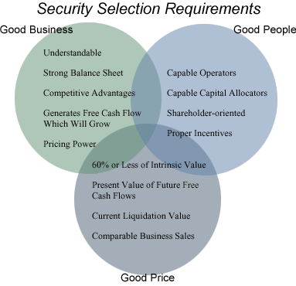
Shareholders View: Desirable Qualities
Longevity + Growth + Capital Efficiency + Sustainability

Slide 10
Shareholder View

Slide 11
Shareholders View: Value Creation

Slide 12
Value creation

Slide 13
Value Creation

Slide 14
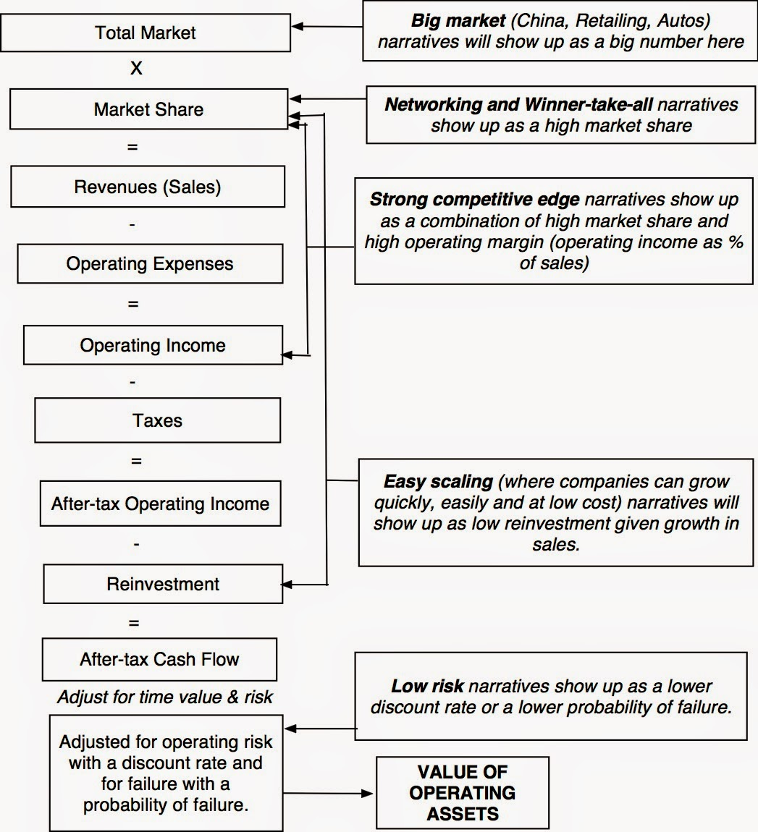
Value Drivers

Slide 15
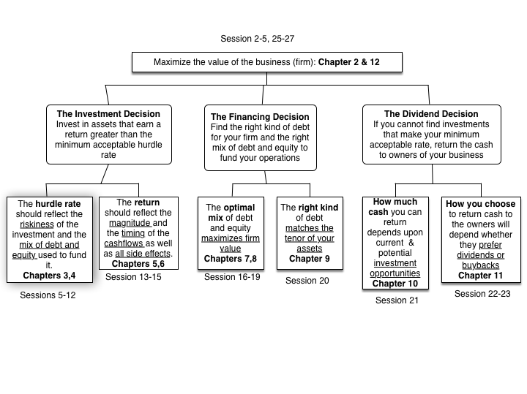
Capital Allocation matters !!!

Slide 16
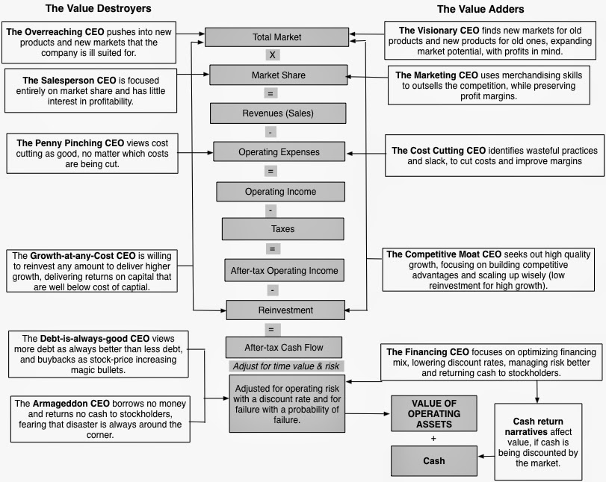
Management Matters !!!

Slide 17
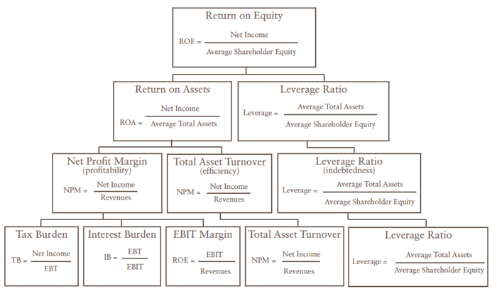
Value creation: DuPont Analysis
Analyses profitability drivers on the scale of operating efficiency &
capital
allocation
efficiency.
Analyses
sustainability
of profitability

Slide 18
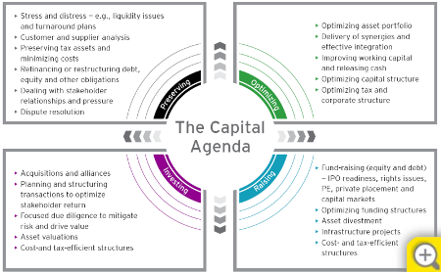
The Capital Agenda

Slide 19
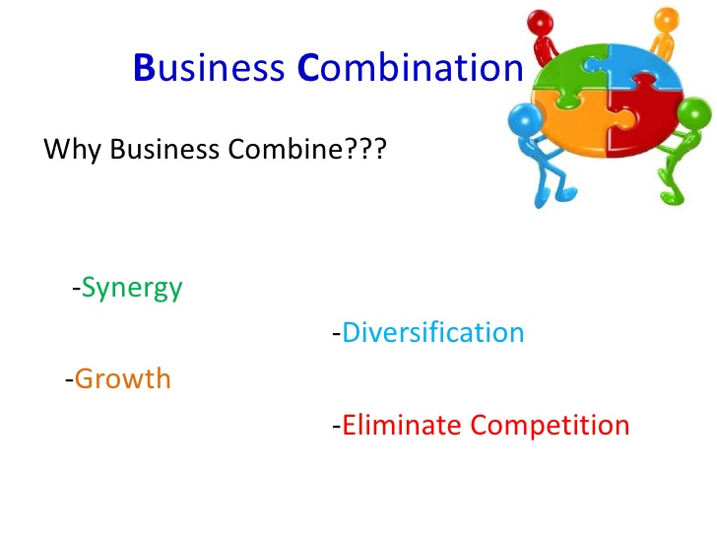
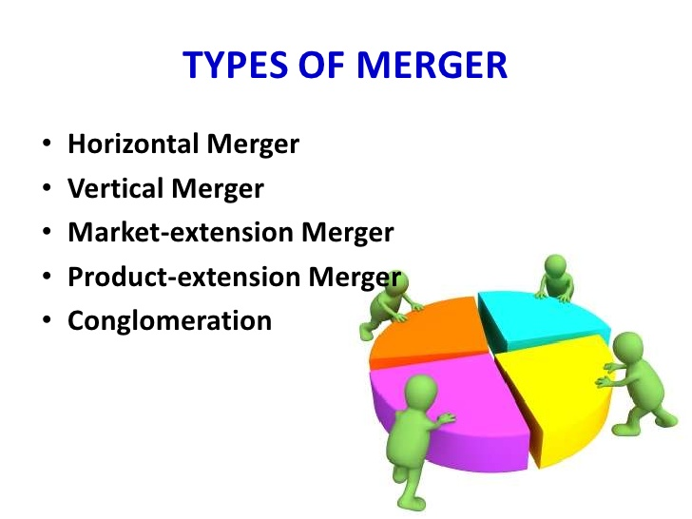
Rationale

Slide 20
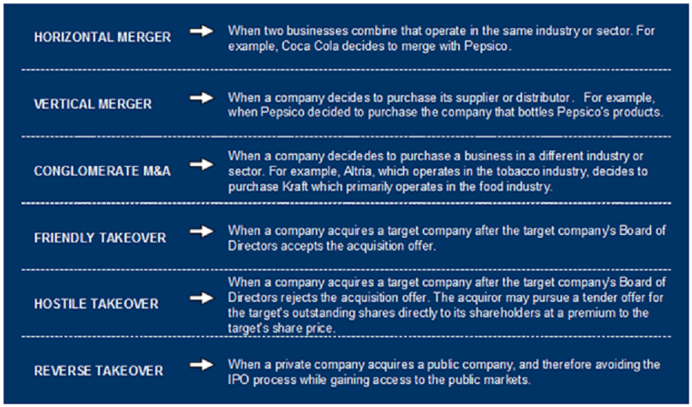
Types

Slide 21
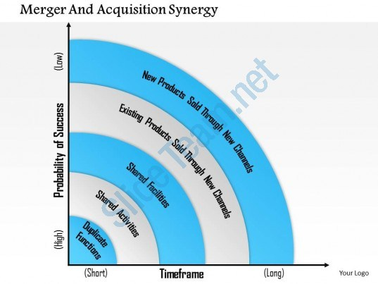
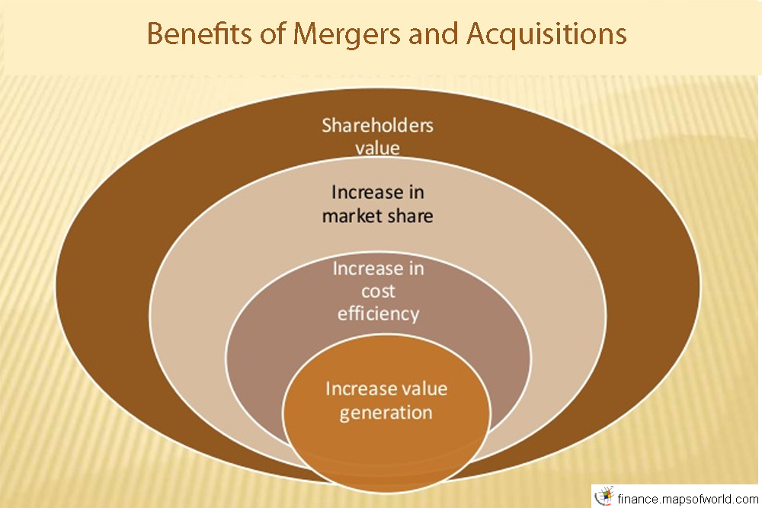
Rationale

Slide 22
Motive to Sell & Discipline
Fundamentals of business have deteriorated and our original assumptions are no longer valid
Recent Industry dynamics indicate diminished possibility of creating shareholder value
Price has gone beyond what’s warranted by fundamentals. Rarely the case other than extreme bubbles
Another opportunity with similar fundamentals (or valuation) but with much attractive valuations (or fundamentals) has appeared on the horizon

Slide 23
STRATEGIC DEAL RATIONALE:
THE EIGHT CS: Strategic reasons for deals vary from firm to firm and transaction to transaction.
Costs: to realize efficiencies of scale across duplicate functions
Channels: to gain new means of distribution, such as retail outlets, a direct sales force, or an internet presence
Content: to obtain new products or services
Capabilities: to gain new or augment current strengths, such as R&D, marketing, or technology
Customers: to obtain access to new customer segments, including lower, middle, or upper market purchasers
Countries: to gain entrée to various regions or countries in which they did not previously have a presence
Capital: to obtain available cash or access to capital markets that a target firm may possess
Capacity: to increase the available volume of operations

Slide 24
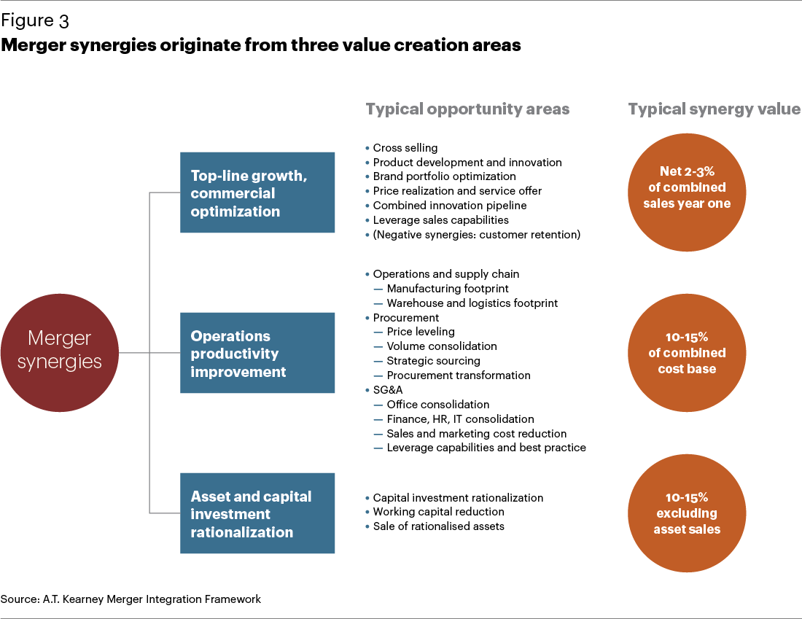
Merger synergies

Slide 25
Value Creation by Corporate action
Companies that choose to enhance the value of assets acquired at historical prices by corporate actions, which involve repositioning assets to higher uses, better financing of asset acquisitions, the refinancing of liabilities or both; and the creation of tax advantages.
These companies can do so via M&As, leveraged buyouts or gearing to a healthy level by cheaper debt, spin-offs, and asset sales. Equity ownership is residual claim not only on earnings but also on assets of a company and repositioning of assets for better usage can create value

Slide 26
Use of Overvalued Equity
Another source of ignored value is access to capital markets (debt and equity) at super-attractive terms and prices. There seems little question that far more corporate wealth has been created by taking advantage of attractive access to outside capital.
If one can acquire capital market currency which can be issued at favourable terms at periodic intervals of high market valuations, the same can be a superlative source of competitive advantage if the company is run by an able capital allocator.
Issuance of one’s common stock for another business before or during or immediately after M&A requires evaluation and valuation of both acquirer and acquired. Hence, the need of good capital allocator to do so. Thus, an overpriced stock in hand of capable competent management can be its most important asset and the same can be said of an under-priced stock if the management resorts to buybacks.
This is extremely neglected in most financial literature but is a great source of value creation if done right.

Slide 27
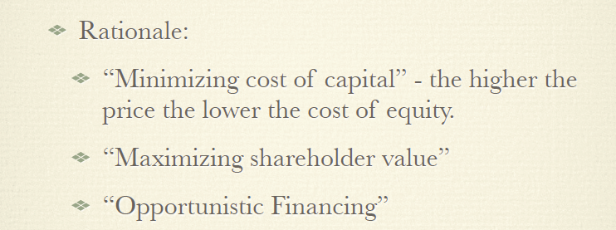
Alchemy of High priced Share Dilution

Slide 28
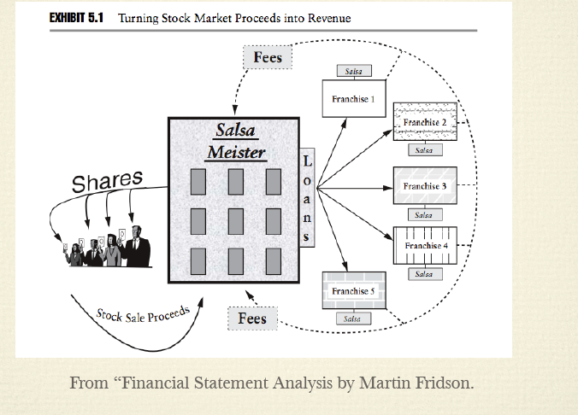
Alchemy of High priced Share Dilution

Slide 29
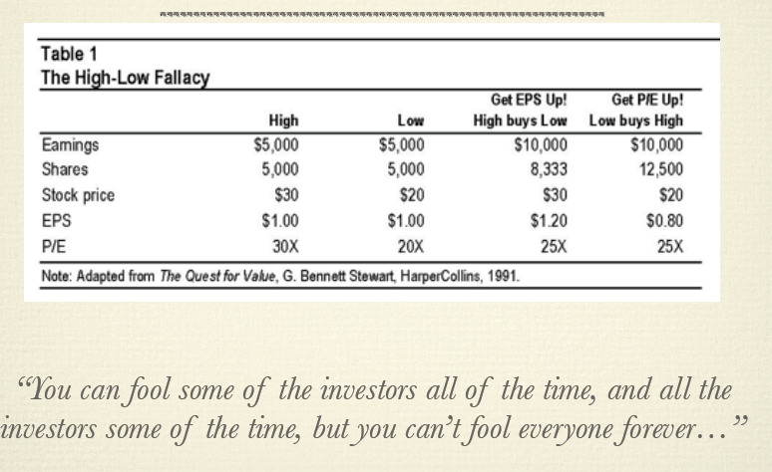
EPS accretive M&A

Slide 30
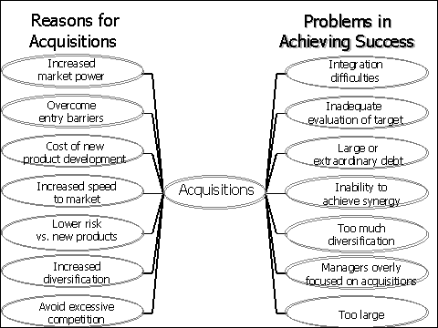
Reality

Slide 31
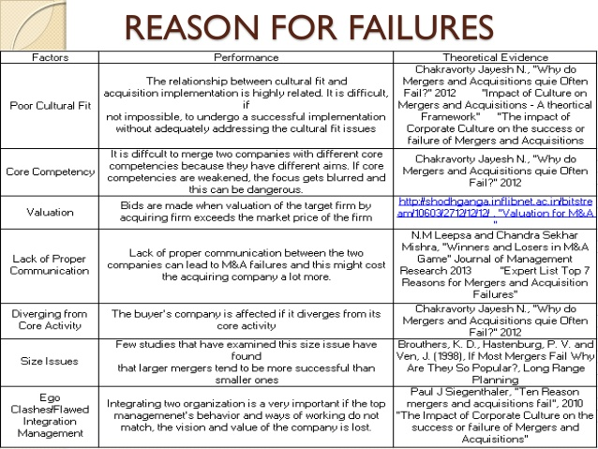
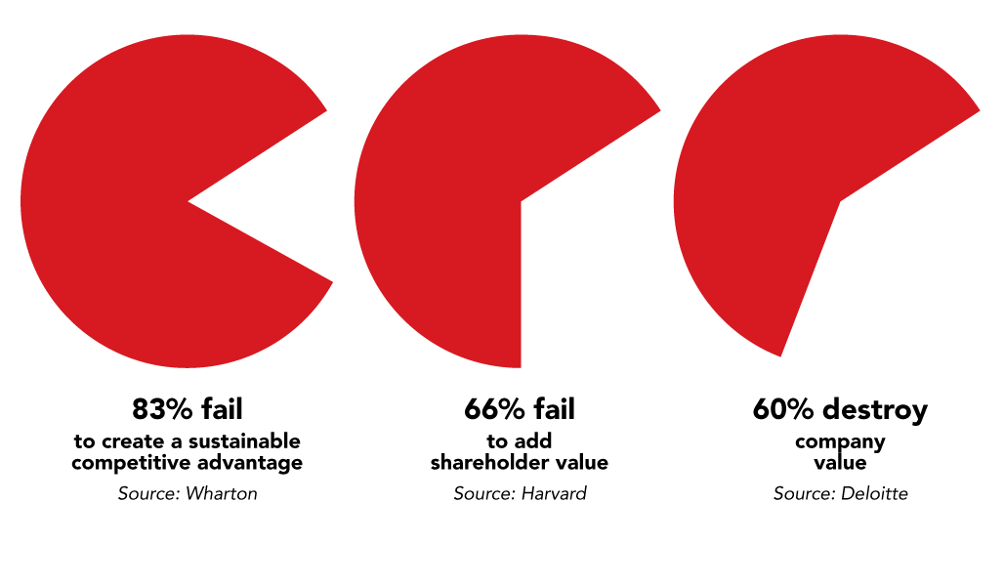
M&A : Mixed Track Record

Slide 32
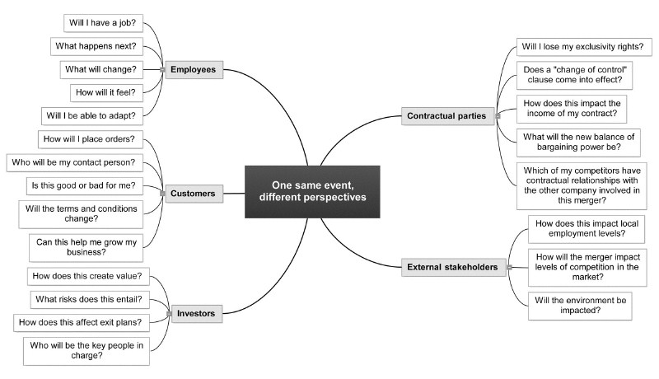
Vantage point

Slide 33
Culture Fit

Slide 34
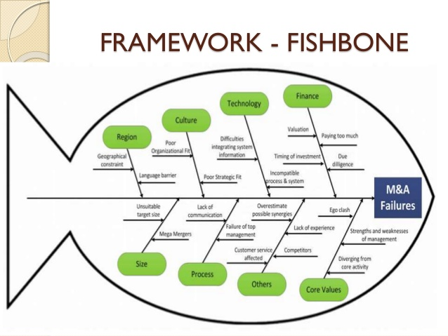

Slide 35
Key Financial considerations
Type of reorganization
Form of payment
Source of funds
Taxability of Transaction
Taxability of Investors
Parents exposure to Targets liability
Voting by shareholders and proxy issues
Minority Squeeze out
Transfer of contracts
Transferability of Tax benefits

Slide 36
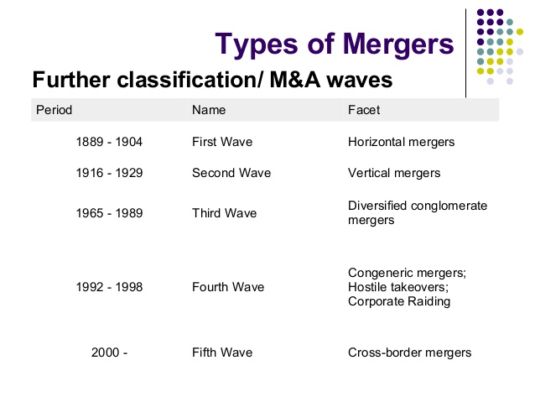
Waves

Slide 37
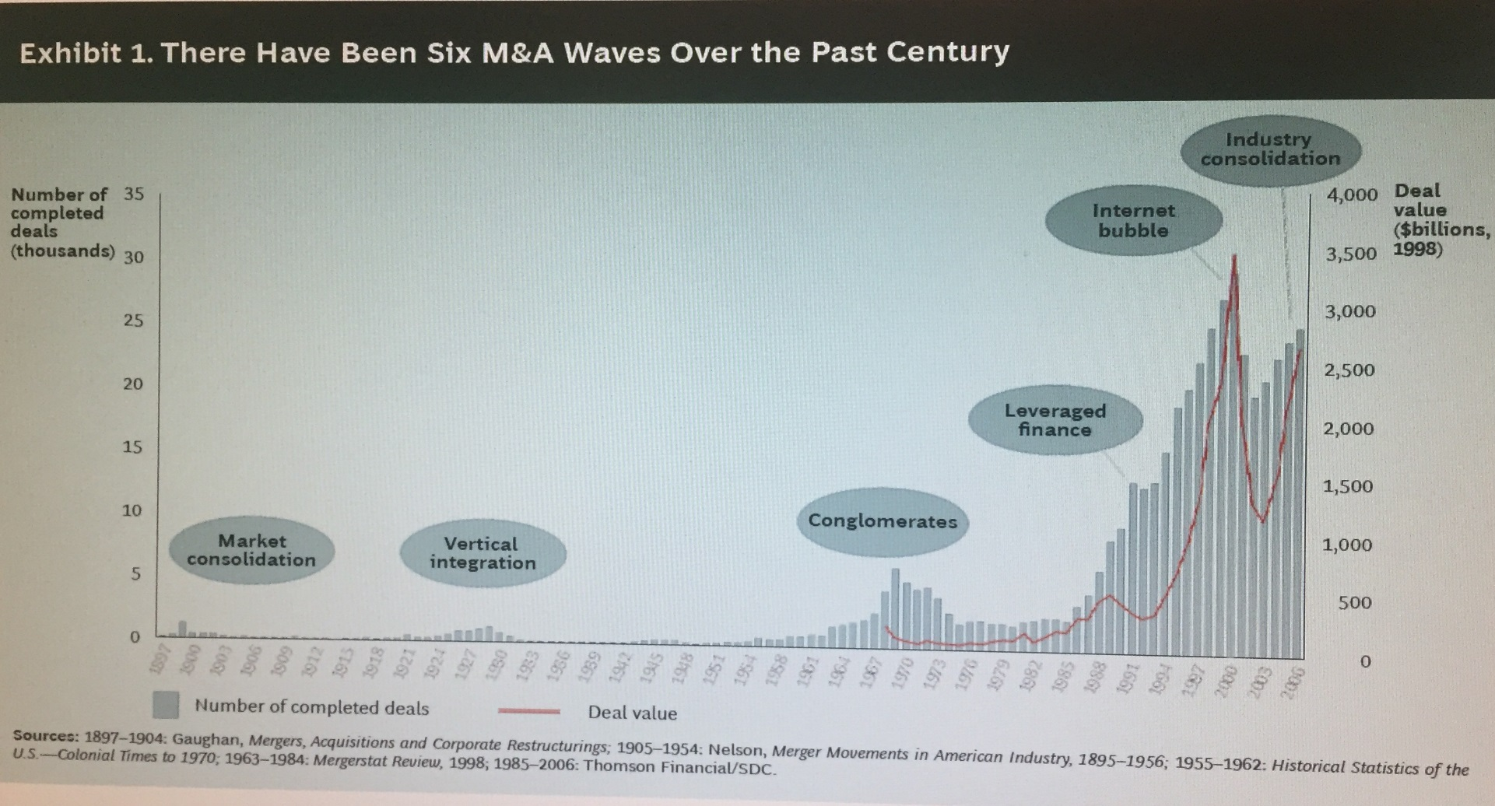
Waves

Slide 38
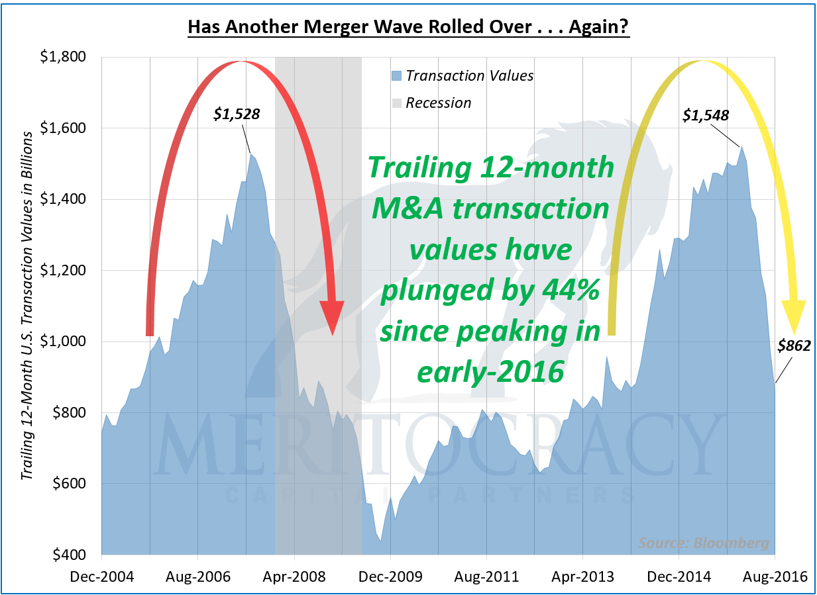
Waves and Business Cycles

Slide 39
What is at intersection?
Biases
Psychology
Financial Markets
Value Investing
Human Misjudgements
Heuristics
Man Made phenomenon's
Cash & Courage
Leverage, Liquidity & Complexity
Periods of underperformance
Inefficient
Extremities of valuations

Slide 40
Interest Rate & Inflation Expectation : Drive Asset prices

Slide 41
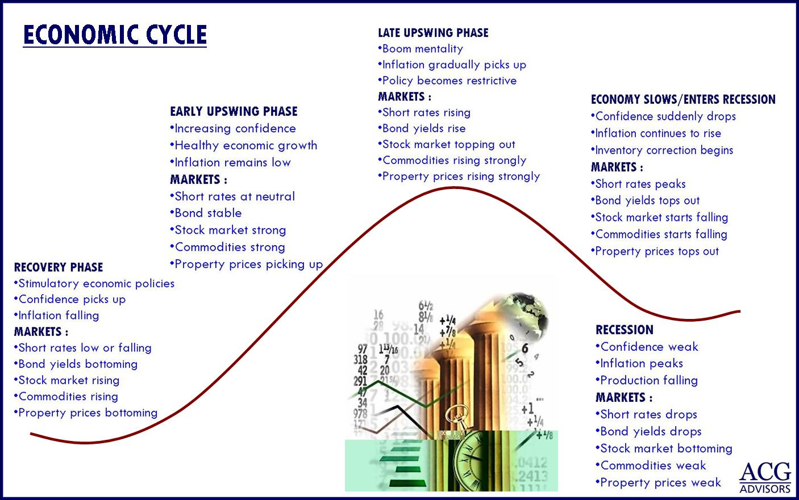

Slide 42
Interest Rate : Liquidity: Market cycle : Volatility in Asset Prices

Slide 43


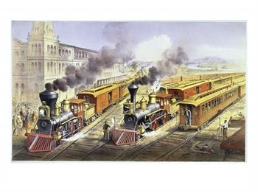


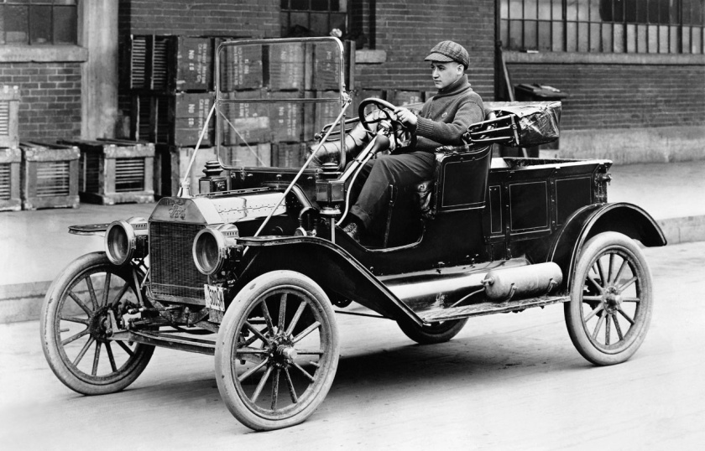

Catalyst Agent

Slide 44
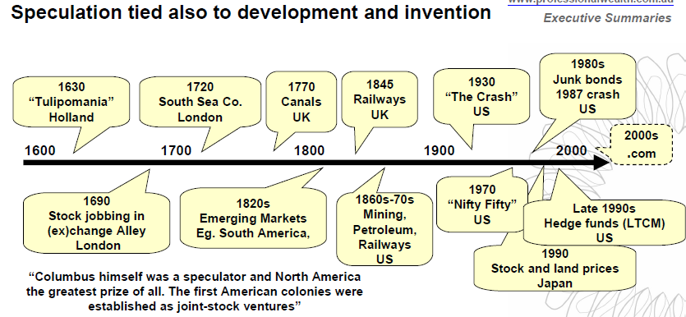
Catalyst which capture fancy and leading to overvaluations

Slide 45
Factors Impacting M&A
Macro
Low interest rate
Debt/Equity disconnect
Governance weakened by large Institutional, ETF Index Fund holding
Company Specific
Conglomerate holding structure
Capital allocation & Structure
Lazy balance sheet and non core assets
Treatment of minority as 2nd class citizens
Materially adverse related party transactions
Sycophant Board of directors
Regulatory Changes
Pro-minority regulations
Anti Trust laws
Class action suit permitted
Drivers of growth
Investor Community
Preference for pure play & clarity in capital allocation
Driven by earnings but not asset valuation
Propensity to sell rather than engage & manage

Slide 46
Client Profiling
  Time horizon
Cash Flows
Ability to Digest new business
Tax and legal status
Reference Currency
Loss aversion
Rationale of M&A
Specific preferences
Investment Process
Information
Information Analysis
Decision making
Sources
Diversity
Weighing
Economic focus
Competitive strategy
Analogy and metaphor
Proper framing
Avoid pitfalls
Internalize techniques
Business Evaluation
Valuation, Accounting & Taxation
Psychological Discipline
Size of opportunity
Profit Drivers
Sustainability
Competitive Advantage
Normalizations
Margin of safety
Embedded Expectations
Alternative opportunity cost
Proper framing
Avoid pitfalls
Avoid bias and misjudgements
Rinse & Repeat
Communication
Information
Business Cycle
Investment Cycle
A living process
A Recurrent
Process

Slide 47
Investment Philosophy
Superior Businesses
Margin of safety @ Price
Funding
Share Swap
Cash payment through Share issuance
Internal Retained Earning
Risk Budgeting
Screening
Investible Universe
Offer & Liquidity filters
Watch list
Attractive Financials
Sector tailwind
New markets/products
Competent management
Focus List
Competitive Analysis
Entry Barriers
Cyclicality
Accounting and Corporate
Governance
Core List
Active Monitoring
Optimization
Deep fundamental overlay
Downside analysis
Investment decision
Valuation
Capital Allocation: Size
Risk to hypothesis
Diversification & Correlation
Range of outcomes
Execution & Monitoring
14 to 20 month Intense
Disconfirming evidence
Corrective action
Measurement and performance evaluation
Reporting
Process improvement

Slide 48
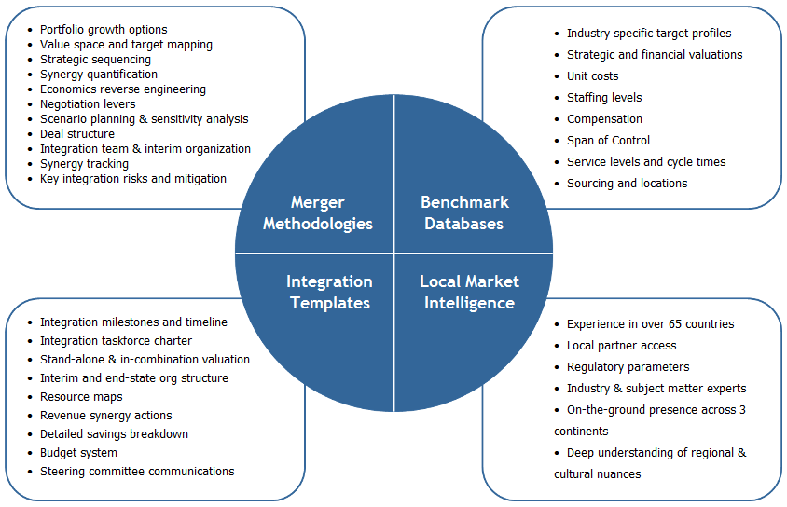
Merger Strategy

Slide 49
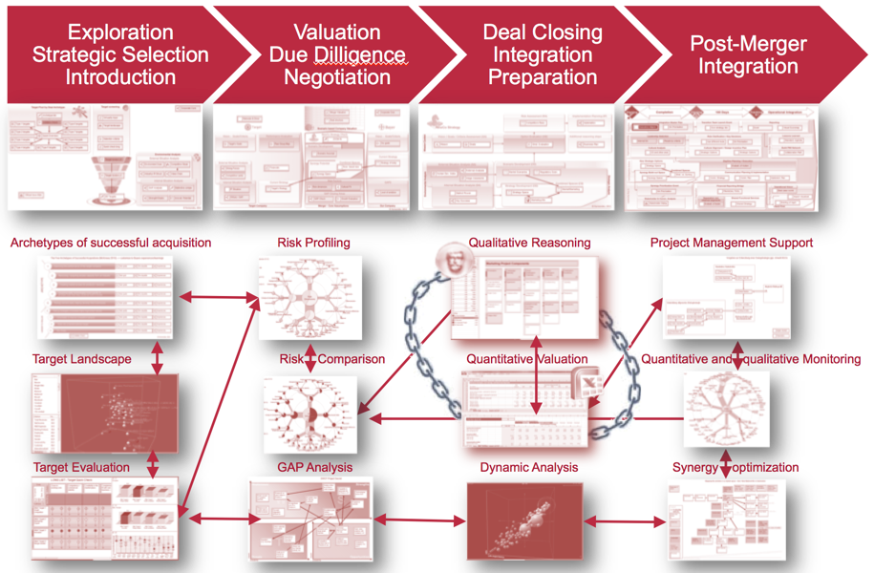
Strategy

Slide 50
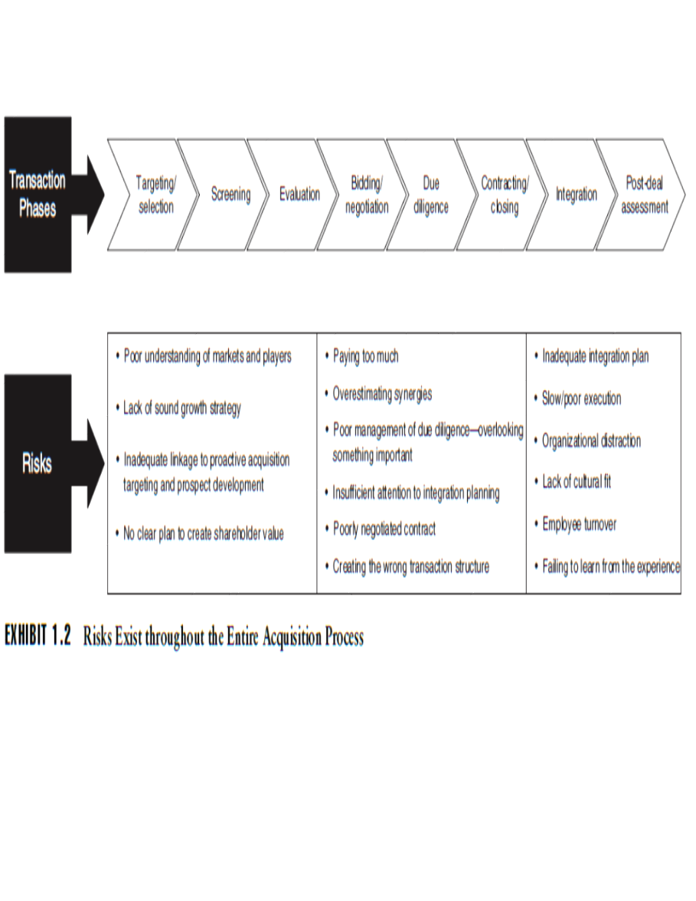
Risk @ each Stage

Slide 51
Risk Mitigation
Risk Mitigation framework
Operational Risk
Structural Risk
Accounting Risk
Transactional Risk
History
Shareholding Structure
E.g. Key Promoter Holding
Regulatory System
E.g. internal & external auditors, independent board members
Related Parties
E.g. Key related parties, nature of their businesses
Loss hiding
E.g. losses written directly to BS, “one-offs”, etc.
Balance sheet risk
E.g. contingent liabilities, debtors, creditors etc.
Non-conservative accounting
e.g. – notes by auditors etc.
Nature of transactions
E.g. loans, sales made to related parties
Materiality
E.g. amount in relation to revenues/profits
Disclosure
e.g. – disclosure of related party transactions, subsidiary accounts
Events that have raised investor concern in past
Analysis of abusive related party transactions and practices for last 15 years
Up to date Database of Decoded Complex web of financial transaction and case studies

Slide 52
M&A Investor View
Companies spend more on mergers and acquisitions (M&A) than any other alternative for capital allocation on global basis.
Empirical analysis shows that M&A creates value in the aggregate, but that the seller tends to realize most of that value.
While the market’s initial read of a deal is not perfect, there does not appear to be a bias.
Careful studies show that value creation is largely independent of EPS accretion or dilution.
Buyers see their stock rise when the present value of synergies exceeds the premium they pledge to the seller.
The form of financing and structuring are key Investor related issues.
A buyer that uses stock shares the risk and reward and need to keep in mind the hypothesis that buyers issue stock when they believe that their stock is overvalued.

Slide 53
Deal Types and Success
“Opportunistic ” deals where a weak competitor sells out, succeed at a rate of around 90 percent.
“Operational” deals, or cases where there are strong operational overlaps, also have an above-average chance of success.
The rate of success varies widely for “transitional” deals, which tend to build market share, as the premiums buyers must pay to close those deals can be prohibitive.
Finally, the success rate of “transformational” deals, large leaps into different industries, tends to be very low

Slide 54
M&A Investor View
Managements generally sell stock when it’s expensive,
M&A waves are cyclical depending on Interest rate, Liquidity and Business cycles.
Companies that act early in an M&A cycle tend to generate higher returns than those that act later. The first movers enjoy the benefits of a larger pool of targets and cheaper valuations than companies that buy later in the cycle.
Cheap and accessible financing prompts action by imitators at the end of the cycle
Forms of Payment: First, you can think of a deal financed with stock as two separate transactions: the buyer sells stock to the public and then uses the proceeds to acquire the target
Second, the buyer takes on all of the deal’s risk and reward in a cash transaction. The buyer shares the risk and reward with the seller in a stock-for-stock deal. A stock deal is a weaker signal of conviction than a cash deal.
Common challenges companies cite for synergy realization include delays in implementing planned actions, underestimation of costs and complexities, and flat-out overestimation of synergies

Slide 55
Capital Consideration & Transaction Structuring Considerations
Cash purchase of assets
Cash purchase of stock
Merger for a swap ratio
Stock for assets transaction
Multistage Transaction
Cash
Stock
Preferred Debt
Royalty or IP rights

Slide 56
Key Investor Issues
Motive and rationale of deal
Premium the buyer pledges
How the buyer intends to pay for the deal: The SVAR in a stock swap deal is always lower than that for a cash deal because the seller becomes an owner in the combined firm and thus assumes a portion of the risk.
If the market perceives that the buyer is overpaying, it will drive the buyer’s price down and hence reduce the acquisition value proportionately
If the SVAR is material, you need to spend time assessing the deal carefully. But if the SVAR is small, you know that the economic impact of the deal is modest.
Acquirer | Seller | Price | Premium | SVAR
2 bn $ | 800 mn $ | 1 bn $ | 25 % | 10 % (200/2000)
2 bn $ | 800 mn $ | Swap |  | 6.7 % (200/3000)

Slide 57
Impact of leverage on shareholders returns

Slide 58
Wrong Metrics
EPS accretion or dilution was deemed to be, by far, the most important metric as per management communication.
Most announced M&A deals today are accretive to the EPS of the buying company.
This reflects a change in the accounting rules that eliminated the amortization of goodwill, which used to be a drag on earnings, as well as the fact that low prevailing interest rates provide companies with a cheap source of funding.
EPS accretion or dilution provides little or no insight because value creation is based on cash flows rather than accounting measures, and the cost of capital rather than the funding source.
Net present value of the deal for the buyer = present value of the synergies – premium
Cost Synergies Are More Reliable Than Revenue Synergies

Slide 59
Winners Curse
Why creating value through M&A is so challenging for a buyer.
First, if the premium is too large the buyer cannot recoup its investment even if the deal makes strategic sense.
Second, often competitors can replicate the benefits of a deal or take advantage of the buyer’s lack of focus as it goes through an integration process.
Third, M&A requires payment up front for benefits down the road. This makes investors legitimately sceptical.
Finally, M&A deals are generally costly to execute and costly to reverse

Slide 60
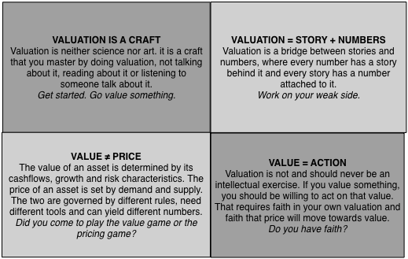
Evaluation
Company's Business | Company's Managers | Company Pricing | Investment Decision
Good (Strong competitive advantages, Growing market) | Good (Optimize investment, financing, dividend decisions) | Good (Price < Value) | Emphatic Buy
Good (Strong competitive advantages, Growing market) | Bad (Sub-optimal investment, financing, dividend decisions) | Good (Price < Value) | Buy & hope for management change
Bad (No competitive advantages, Stagnant or shrinking market) | Good (Optimize investment, financing, dividend decisions) | Good (Price < Value) | Buy & hope that management does not change
Bad (No competitive advantages, Stagnant or shrinking market) | Bad (Sub-optimal investment, financing, dividend decisions) | Good (Price < Value) | Buy, hope for management change & pray company survives
Good (Strong competitive advantages, Growing market) | Good (Optimize investment, financing, dividend decisions) | Bad (Price > Value) | Admire, but don't buy
Good (Strong competitive advantages, Growing market) | Bad (Sub-optimal investment, financing, dividend decisions) | Bad (Price > Value) | Wait for management change
Bad (No competitive advantages, Stagnant or shrinking market) | Good (Optimize investment, financing, dividend decisions) | Bad (Price > Value) | Sell
Bad (No competitive advantages, Stagnant or shrinking market) | Bad (Sub-optimal investment, financing, dividend decisions) | Bad (Price > Value) | Emphatic Sell

Slide 61
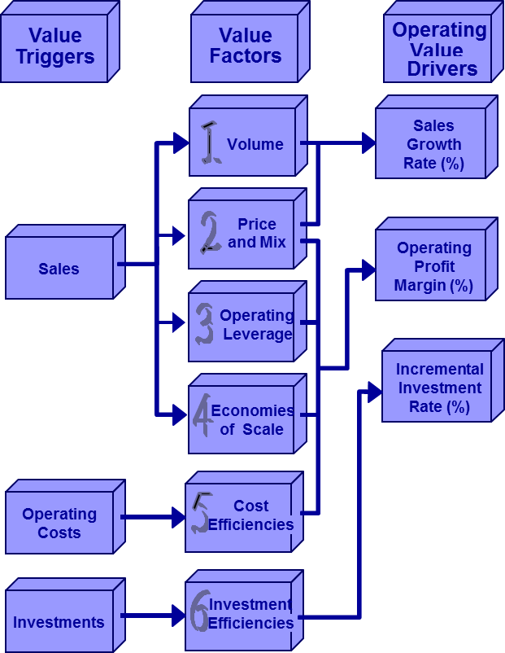
Expectations Investing: How do we Think about Outcomes?

Slide 62
M&A Success: Attributes Needed
Properly assess strategy (or how a business makes money).
Be numerate (and understand accounting)
Understand value (the present value of free cash flow).
Compare effectively (expectations versus fundamentals).
Think probabilistically (there are few sure things).
Update your views effectively (beliefs are hypotheses to be tested, not treasures to be protected).
Beware of behavioural biases (minimizing constraints to good thinking).
Know the difference between information and influence
Position sizing (maximizing the payoff from edge)
Read (and keep an open mind).

Slide 63
Avoid Herd Mentality
Fads are a by-product of human behaviour, and human behaviour is all too predictable.
The details of each fad may be different, but the general patterns remain very similar.
When people are in doubt they tend to look at others to confirm their behaviour. Many would rather adopt to others opinion rather than forming ones own.
Men, it is has been well said, think in herds. It will be seen that they go mad in herds, while they only recover their senses slowly, one by one. Charles Mackay

Slide 64
Odds In Your Favor
Stock prices are the clearest and most reliable signal of the market’s expectations about a company’s future performance. The key to successful investing is to estimate the level of expected performance embedded in the current stock price and then to assess the likelihood of a revision in expectations
Asset prices reflect a set of expectations, management must understand those expectations
Expectations are analogous to the odds—and the goal of the process is finding mis-pricings
Perhaps the single greatest error in the investment business is a failure to distinguish between knowledge of a company’s fundamentals and the expectations implied by the price

Slide 65
Key considerations
The single greatest error in the M&A business : Failure to distinguish between knowledge of a company’s Fundamentals and the expectations implied by the price.
Opportunity cost of capital providers: Cost of equity is greater than the cost of debt & Cost of capital can be tricky to estimate
Reversion to the mean fastest in fast-changing industries
Some companies and industries demonstrate persistence
Competitive Advantage Period cluster by investment neighborhood

Slide 66
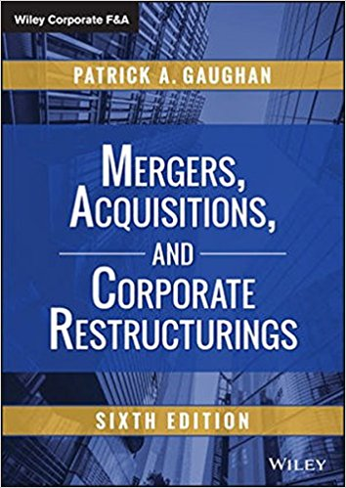
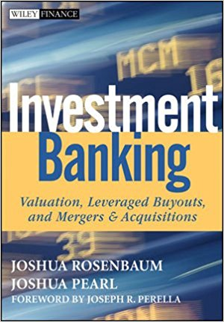

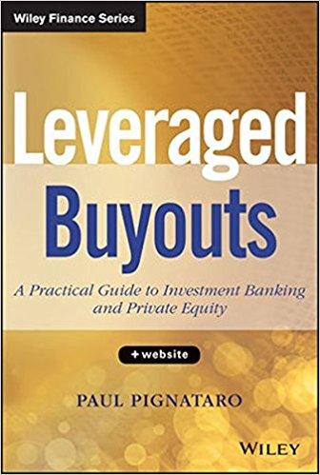
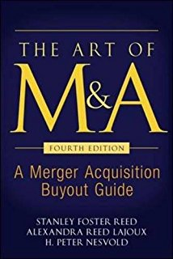
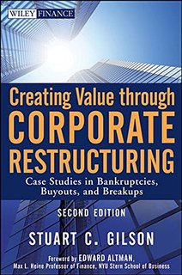
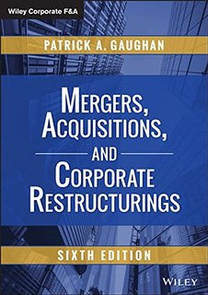
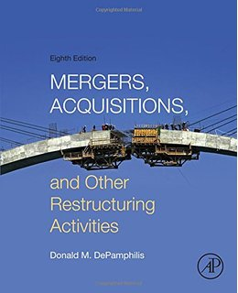
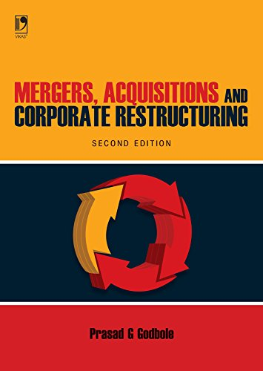
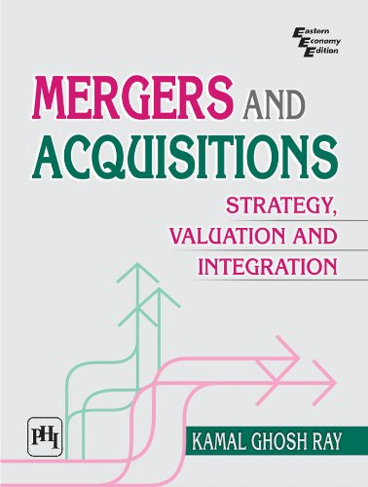
Books : M&A

Slide 67
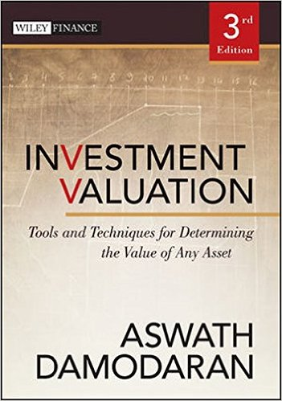
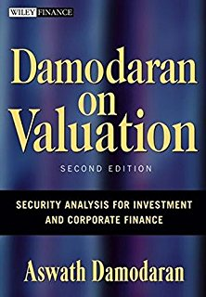
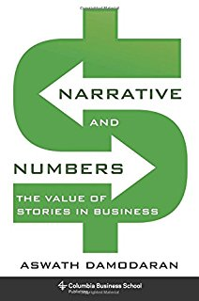
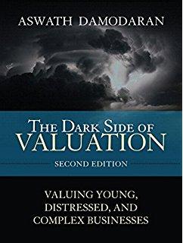






Books on Valuation

Slide 68










Additional References

Slide 69
Real Life drama
Barbarians at the Gate

Slide 70


When a person with money meets a person with experience, the person with experience winds up with the money and the person with the money ends up with the experience. —Harvey MacKay

Slide 71

Short as life is, we make it shorter by the careless waste of time. Victor Hugo
Thank You

Slide 72

Price v/s value

Slide 73

Price is what you pay Value is what you get

Slide 74

To a man with the hammer, entire world looks like a nail

Slide 75

Always Invert and have a rounded View

Slide 76

Tools, methodology & process

Slide 77


Checklist for Life saving Tasks
Why a checklist?

Slide 78

In my whole life, I have known no wise people (over a broad subject matter area) who did not read all the time – none, zero…Charlie Munger

Slide 79

Roadmap

Slide 80

Reverse Engineering a Simple Valuation:
Cost of capital is 9%; the terminal growth rate of FCF is forecasted at 5% p.a. The value of debt as of the end of 1999 is $4,435. The number of shares outstanding is 2,472.
2000E 2001E 2002E 2003E 2004E
Cash from operations: 3,657 4,097 4,736 5,457 5,929
Cash investments: 947 1,187 1,167 906 618
Free cash flow: 2710 2910 3569 4551 5311

Slide 81
Improving decision

Slide 82
Errors
1. Errors in the discount rate calculation and concerning the riskiness of the company
A. Wrong risk-free rate used for the valuation
1. Using the historical average of the risk-free rate.
2. Using the short-term Government rate.
3. Wrong calculation of the real risk-free rate.
B. Wrong beta used for the valuation
1. Using the historical industry beta, or the average of the betas of similar companies, when the result goes against common sense.
2. Using the historical beta of the company when the result goes against common sense
3. Assuming that the beta calculated from historical data captures the country risk.
4. Using the wrong formulae for levering and unlevering the beta.
5. Arguing that the best estimation of the beta of a company from an emerging market is the beta of the company with respect to the
S&P 500.
6. When valuing an acquisition, using the beta of the acquiring company.
7. Using the so-called “book value beta”.
8. Forgetting the beta of the debt when levering the beta of the shares.
9. Calculating the beta using strange formulae

Slide 83
Errors
C. Wrong market risk premium used for the valuation
1. The required market risk premium is equal to the historical equity premium.
2. The required market risk premium is equal to zero.
3. Assume that the required market risk premium is the expected risk premium.
4. Using interchangeably historical, implicit, expected and required risk premium.
5. Using a risk premium recommended by a book even though it goes against common sense.
D. Wrong calculation of WACC
1. Wrong definition of WACC.
2. Debt to equity ratio used to calculate the WACC is different than the debt to equity ratio resulting from the valuation.
3. Using discount rates lower than the risk free rate.
4. Using the statutory tax rate, instead of the effective tax rate of the levered company.
5. Valuing all the different businesses of a diversified company using the same WACC (same leverage and same Ke).
6. Considering that WACC / (1-T) is a reasonable return for the stakeholders of the company.
7. Using the wrong formula for the WACC when the value of debt is not equal to its book value.
8. Calculating the WACC assuming a certain capital structure and deducting the outstanding debt from the enterprise value.
9. Calculating the WACC using book values of debt and equity.
10. Calculating the WACC using strange formulae.
E. Wrong calculation of the value of tax shields
1. Discounting the tax shield using the cost of debt or the required return to unlevered equity.
2. Odd or ad-hoc formulae.
3. Using the Modigliani-Miller formula when it is not appropriate.
4. Using the Milles-Ezzell formula when it is not appropriate.

Slide 84
Errors
F. Wrong treatment of country risk
1. Not considering the country risk, arguing that it is diversifiable.
2. Assuming that a disaster in an emerging market will increase the beta of the country’s companies calculated with respect to the
S&P 500.
3. Assuming that an agreement with a government agency eliminates country risk.
4. Assuming that the beta provided by Market Guide with the Bloomberg adjustment incorporates the illiquidity risk and the small
cap premium.
5. Odd calculations of the country risk premium.
G. Including an illiquidity, small-cap, or specific premium when it is not appropriate
1. Including an odd small-cap premium.
2. Including an odd illiquidity premium.
3. Including a small-cap premium equal for all companies.
2. Errors when calculating or forecasting the expected cash flows
A. Wrong definition of the cash flows
1. Forgetting the increase in Working Capital Requirements when calculating Cash Flows.
2. Considering the increase in the company’s cash position or financial investments as an equity cash flow.
3. Errors in the calculation of the taxes that affect the FCF.
4. Expected Equity Cash Flows are not equal to expected dividends plus other payments to shareholders (share repurchases, …)
5. Considering net income as a cash flow.
6. Considering net income plus depreciation as a cash flow. 7. Considering NOPAT as a flow.
B. Errors when valuing seasonal companies
1. Wrong treatment of seasonal working capital requirements.
2. Wrong treatment of stocks that are cash equivalent.
3. Wrong treatment of seasonal debt.
C. Errors due to not projecting the balance sheets
1. Forgetting balance sheet accounts that affect the cash flows. 2. Considering an asset revaluation as a cash flow.
3. Interest expenses not equal to D Kd.
D. Exaggerated optimism when forecasting cash flows.

Slide 85
3. Errors in the calculation of the residual value
A. Inconsistent Cash Flow used to calculate perpetuity.
B. Debt to equity ratio used to calculate the WACC to discount the perpetuity is different to the Debt to equity ratio resulting from the
valuation.
C. Using ad hoc formulas that have no economic meaning.
D. Using arithmetic averages instead of geometric averages to assess growth.
E. Calculating the residual value using the wrong formula.
F. Assume that a perpetuity starts a year before it really starts
4. Inconsistencies and conceptual errors
A. Conceptual errors about the free cash flow and the equity cash flow
1. Considering the cash in the company as an equity cash flow when the company has no plans to distribute it.
2. Using real cash flows and nominal discount rates or viceversa.
3. The free cash flow and the equity cash flow do not satsify ECF = FCF + ΔD – Int (1-T).
B. Errors when using multiples
1. Using the average of multiples extracted from transactions executed over a very long period of time.
2. Using the average of transactions multiples that have a wide dispersion.
3. Using multiples in a way that is different to their definition.
4. Using a multiple from an extraordinary transaction.
5. Using ad hoc valuation multiples that conflict with common sense.
6. Using multiples without using the common sense.
C. Time inconsistencies
1. Assuming that the equity value will be constant for the next five years.
2. The Equity value or the Enterprise value do not satisfy the time consistency formulae.
.

Slide 86
Errors
D. Other conceptual errors
1. Not considering cash flows resulting from future investments.
2. Considering that a change in economic conditions invalidates signed contracts.
3. Considering that the value of debt is equal to its book value when they are different.
4. Not using the correct formulae when the value of debt is not equal to its book value.
5. Considering that the book value of the shares is a good proxy for their market value.
6. Including the value of real options that have no economic meaning.
7. Considering shared options as one’s own.
8. Forgetting to include the value of non-operating assets.
9. Inconsistencies between discount rates and expected inflation.
10. Valuing a holding company assuming permanent losses (without tax savings) in some companies and permanent profits in
others.
11. Wrong concept of the optimal capital structure.
12. In mature companies, assuming projected cash flows that are much higher than historical cash flows without any good reason.
13. Assumptions about future sales, margins,etc. that are inconsistent with the economic environment, the industry outlook, or
competitive analysis.
14. Considering that the ROE is the return to the shareholders.
15. Considering that the ROA is the return of the debt and equityholders.
16. Using different and inconsistent discount rates for cash flows of different years or for different components of the Free cash
flow.
17. Using past market returns as a proxy for required return to equity.
18. Adding the liquidation value and the present value of cash flows.
19. Using ad hoc formulas to value intangibles.

Slide 87
Errors
20. Arguing that different discounted cash flow methods provide different valuations.
21 Adding the value of assets that are necessary in order to obtain the flows to the present value of the flows.
22. Wrong notion of the meaning of the efficient markets.
23. Apply a discount when valuing diversified companies.
24. Wrong arbitrage arguments.
25. Add a control premium when it is not appropriate.
26. Stating that the value of the shares of El Corte Ingles is their liquidation value.
27. Not taking into consideration the treasury stock
5. Errors when interpreting the valuation
A. Confusing Value with Price.
B. Asserting that “the valuation is a scientific fact, not an opinion.”
C. A valuation is valid for everybody.
D. A company has the same value for all buyers.
E. Confusing strategic value for a buyer with fair market value.
F. Considering that the goodwill includes the brand value and the intellectual capital.
G. Forgetting that a valuation is contingent on a set of expectations about cash flows that will be generated and about their riskiness.
H. Affirm that "a valuation is the starting point of a negotiation”
I. Affirm that "a valuation is 50% art and 50% science”.
6. Organizational errors
A. Making a valuation without checking the forecasts made by the client.
B. Commissioning a valuation from an investment bank without having any involvement in it.
C. Involving only the finance department in valuing a target company.
D. Assign the valuation of a company to an auditor

Slide 88
Goodwill Accounting
One of the keys to a proper ROIC analysis is making sure the numerator and the denominator remain consistent. This is important in evaluating companies that have been active in mergers and acquisitions (M&A). Goodwill is an item that has the potential to substantially shift a company’s ROIC picture.
Until 2002, companies could account for an acquisition using either the purchase or the pooling method. In a purchase deal, companies had to reflect as goodwill any amount that was in excess of book value. Companies recorded goodwill on the balance sheet and amortized it on the income statement, typically over 40 years.
In contrast, in a pooling deal the two companies simply combined their balance sheets. That avoided the need to add goodwill to the balance sheet and to expense amortization on the income statement.
In 2002, the Financial Accounting Standards Board abandoned pooling accounting but modified the treatment of M&A deals under purchase accounting. Currently, companies must reflect goodwill on the balance sheet but don’t have to amortize the goodwill on the income statement. The companies are required to periodically test whether or not the goodwill is impaired. If so, they have to take a write-off. If not, it sits there indefinitely. However, companies must still amortize intangible assets.

Slide 89
Goodwill Accounting
So what’s the practical implication? You need to carefully consider two issues: acquisitions and write-offs. First, if a company has been acquisitive, you have to distinguish between operating returns and acquisition returns. The operating returns are the actual cash-on-cash returns that a business generates. You can think of this as organic returns.
Acquisition returns are based on the value a company paid for an acquisition, which is typically a substantial premium to the amount the acquired company actually invested in its business.
The best way to deal with the operating versus acquisition return issue is to calculate ROIC two ways: including and excluding goodwill. If you don’t expect a company to do many deals going forward, operating ROIC probably provides a better picture of returns on incremental capital.
In contrast, if you expect a company to be acquisitive, you have to focus on M&A economics. The second practical issue is asset write-offs. Companies are required to periodically test the value of their goodwill. If the asset a company acquired drops below a certain value threshold, it is required to write off the goodwill.
Some theorists advocate for adding back asset write-offs to invested capital.13 The idea is that investors should hold management’s feet to the fire to deliver returns on all the capital they have allocated. If you do add back an asset write-off, the number should be net of any tax savings.
In principle this is fine, but you should really consider the context of the asset write-off and whether or not it helps you understand how management uses capital.

Slide 90
Intangibles accounting

Slide 91
Restructuring Charges
Restructuring charges, which include costs related to items such as reducing the size of the work force and plant closings, are routine in financial reporting. How should we treat these charges in our ROIC calculations?
Restructuring charges typically have two components: an asset write-off, which is non-cash, and a provision for charges related to the restructuring—including headcount reductions and equipment relocation—that reflect a true cash outlay. The principle behind how to deal with asset write-offs is the same as we discussed above with goodwill. As it turns out, you don’t have to make any adjustments to capture the provision for changes.
But it is important to understand what’s going on. Let’s say a company takes a charge and sets up an accrued liability to cover anticipated cash outlays for employee severance. From an ROIC perspective, invested capital initially goes down (the accrued liability is a non-interest-bearing current liability and hence reduces net working capital). As the company spends the cash on the employees, the accrued liability goes down and invested capital rises.
This does distort ROIC in the short term, but does not affect free cash flow. Free cash flow is NOPAT minus investment needs. The decline in the accrued liability shows up as an increase in net working capital, properly reflecting the increase in invested capital associated with the cash outflow.

Slide 92
Operating leases
Companies have some choice in how they finance their assets. One major choice is whether to buy or lease assets. For example, a retailer may choose one alternative over the other if it perceives a financial advantage in doing so. The analytical goal is to put all companies on an equal economic footing so that buy or lease decisions do not distort ROIC.
Operating leases are any lease obligations the company has not put on the balance sheet, or “capitalized.” This tends to be most relevant for industries with heavy investment needs, including transportation (e.g., airlines) and retail. If a company chooses to lease a substantial percentage of its assets, you should make adjustments to ROIC to reflect the financing choice.
There are two steps to reflect leases in ROIC. The first is to adjust NOPAT by reclassifying the implied interest expense portion of the lease payments from an operating expense to a financing cost. This increases EBITA by the amount of the implied interest. You also need to adjust taxes to remain consistent.
Second, you need to add the implied principal amount of the lease to assets as well as debt, hence increasing invested capital. If material, you should also adjust your debt-to-total capitalization ratios in your cost of capital calculation. Credit rating agencies take leases into consideration when they evaluate firms.
Aswath Damodaran, a professor of finance at the Stern School of Business at New York University, provides spreadsheets that are very user-friendly to guide you through the calculations.14 Companies provide information about their lease obligations in the footnotes to their financial statements. In theory, this adjustment should not affect your calculation of ROIC much, but in reality it can make quite a difference.

Slide 93
Minority Interest
An adjustment for minority interest is relevant either when another company owns a meaningful minority percentage of the company you are analysing or the company you are analysing owns a meaningful minority stake in another company.
In the first case, the best course is to calculate ROIC as if the business is wholly owned. In fact, this takes little additional analysis since minority interest falls below the EBITA line—you just need to watch taxes. The minority stake is relevant for valuation, of course. You need to subtract the value of the minority stake in order to correctly calculate shareholder value per share.
In the second case, the approach is similar to the first. Calculate ROIC as you would normally excluding the minority stake. Again, watch taxes. Then add the value of the minority stake, net of tax considerations, to come up with shareholder value per share.

Slide 94
Accounting

Slide 95
Accounting Method

Slide 96

IndAs

Slide 97
R& D capitalization
When there is no reliable way to measure the economic benefit of an outlay, accountants mandate that the company expense the investment. R&D and advertising spending are such expenditures. As a result, companies do not reflect investments in R&D and advertising on their balance sheets. Accounting rules do allow for capitalization of some development costs.
For most companies, the treatment as an expense or capital outlay is not a big deal. But for some companies, R&D or advertising is their most important investment. Those companies must still expense those investments even though there’s a reasonable economic case for a multi-year payoff. For example, Microsoft’s $10.4 billion in R&D spending in fiscal 2013 was almost two-and-a-half times as large as its $4.3 billion in capital expenditures. In this case, you might argue that both earnings and invested capital are understated. Free cash flow, and hence value, is impervious to this adjustment.
The economic solution is to capitalize expenses that are likely to have a long-term payoff and amortize them on the income statement. This is relevant for industries that are R&D intensive or firms that are in a phase of heavy marketing. To do this you first reflect the investment on the balance sheet, which increases assets and equity. Next you determine an appropriate rate of amortization, which varies from industry to industry. Recognize that the shorter the amortization period, the less relevant is this adjustment.

Slide 98
Share Buybacks
Many investors and companies believe that since share buybacks can increase earnings and ROE, it must also have an effect on ROIC. One of the advantages of ROIC is that share repurchases do not affect it provided you strip out excess cash.
The reasoning is straightforward. Companies can fund buybacks one of two ways: with cash on the balance sheet or with new debt. If it’s cash on the balance sheet, it has to be excess cash. So neither NOPAT (which doesn’t reflect interest income) nor invested capital will change.
If a company funds a buyback with debt, NOPAT doesn’t move because it’s financing neutral, and invested capital remains the same because the increase in debt is exactly offset by the decline in equity.
Now it is true that buybacks can affect book value per share. Companies that buy stock at a premium to book value, even in cases where the stock is undervalued, will reduce the company’s book value per share. This has no economic relevance, but it makes some companies appear more expensive on a price-to-book basis after the buyback. The ratio of enterprise value to invested capital does not change, however. That ratio is a better indication of the $1 test than the price-to-book ratio.

Slide 99
Synergies: Probabilistic Attitude

Slide 100
Value

Slide 101
Collar Agreements

Slide 104
Different Perspective on Mergers

Slide 105
M&A Success Deal Type

Slide 109
Critical aspects of valuation

Slide 110
Value of Equity

Slide 111
Main Valuation Methods

Slide 112
Conglomerate Mergers

Slide 119

Strategy

Slide 120
M&A Defined

Slide 121

Motives

Slide 122
Motives

Slide 125
M&A Motives

Slide 126
Academic v/s Practitioners view

Slide 127
Challenges

Slide 129
Forms of Acquisitions

Slide 130
Forms of Acquisitions

Slide 131
Forms of Acquisitions

Slide 132
Forms of payments

Slide 133
Forms of Payment

Slide 134
Financing methods

Slide 135
Objective

Slide 136
Competition in a Industry

Slide 137
Perceived Synergies

Slide 140
Profit Margin value Drivers

Slide 141
Asset Turnover Value drivers

Slide 142
Competitive strategy analysis
Five forces – assessing industry structure
Value chain – assessing activities and where companies create value
Innovator’s dilemma – why great companies fail
Information rules – contrast between physical and knowledge businesses
Game theory – capacity additions and pricing

Slide 144

Inflation & Interest Rate

Slide 145
Performance Measurement

Slide 146
Long Term Track Record

Slide 147
India Story: Growth Drivers
Valuation are a slave of Earnings
Earnings are a function of Economic growth
Earnings growth = 1-1.5x of Nominal GDP growth
  If Real GDP growth = 7%, Inflation is 5%,
  Then Nominal GDP growth= 7%+5%=12%
  Hence, Earnings growth = 12 - 18% (1-1.5x of NGDP)
The case for investing in Indian capital markets (present and future) is a direct derivative of India’s economic growth
Favorable Demographics with large working population, High savings rate, Increasing capital flows and investment rate are resulting in higher GDP growth.
Efficient capital allocation: Superior efficiency of capital deployed in listed companies, high quality earnings growth and Capital allocated judiciously and in productive manner by competitive private sector and not allocated through centralized planning.

Slide 148

Homo economicus: Part Monkey Part human

Slide 149

"Investment is most intelligent when it is most businesslike” - Warren Buffett

Slide 150

Inflation : Interest Rates & Asset Class Affinity
 | Real Economic Growth
Inflation | High | Moderate | Low/Negative
High | Negative for bonds Mildly positive for stocks | Negative for bonds Negative for stocks | Negative for bonds Negative for stocks
Moderate/Low | Negative for bonds Positive for stocks | Negative for bonds Mild positive for stocks | Neutral/ Positive for bonds Negative for stocks
Deflation | Neutral for bonds Positive for stocks | Neutral for bonds Negative for stocks | Positive for bonds Negative for stocks

Slide 151



Slide 152

Build v/s Buy v/s Partner

Slide 153

Option Tree

Slide 154

Transactional DD

Slide 156

Strategy

Slide 157


Slide 158

Valuation Methodologies

Slide 159
Basics of Valuation
Cash flow
Volume
Pricing
Expenses
Leases
Tax Provision
Deferred Taxes
Tax Shield
Sales
Operating
Margin
Cash
Earnings
Cash
Taxes
minus
Free Cash Flow
A/R
Inventories
A/P
Net PP&E
Operating Leases
∆
Working
Capital
Cash available
for distribution to
all claimholders
Capital
Expenditures
Investment
Acquisitions/
Divestitures

Slide 160
M&A process

Slide 161

Strategies

Slide 162
Multidisciplinary Learning
Life is series of interconnectedness or relatedness. Just as
multiple factors shape almost any ecosystem, multiple
models from a variety of disciplines, to understand the
system. Most of people are trained in only one model say,
Economics and try to solve the problems and complex
issues in only one way. This is a dumb way of handling
problems
To the man with the hammer, entire world looks like a nail- Charlie Munger

Slide 163

M&A Rational

Slide 164
The Intelligent Investor -Benjamin Graham
“To invest successfully over a lifetime does not require a stratospheric IQ, unusual business insights, or inside information. What’s needed is a sound intellectual framework for making decisions and the ability to keep emotions from corroding that framework”
-Benjamin Graham

Slide 165

“Invest in Companies…
.. that can compound their capital at an above-average rate while incurring a below-average level of risk and at attractive valuations”

Slide 166

Never at Equilibrium
Stock market bubbles don't grow out of thin air. They have a solid basis in reality, but reality as distorted by a misconception." -- George Soros
Human Failings : The swing of the pendulum
The three stages of a bull market:
When a few people begin to feel things will get better
When most people recognize that improvement is underway
When everyone thinks things will get better forever
The three stages of a bear market:
When a few people realize that things are overpriced and riding for a fall
When most people see that a decline is taking place
When people think things will get worse forever
“What the wise man does in the beginning, the fool does in the end.”

Slide 167



Slide 168

Avoid wrong decision at extremes

Slide 169

Inversion: To be successful Study Reason of Failure

Slide 170

Competitive Advantage of companies. Michael Porter Model

Slide 171

From ROC to ROIC

Slide 172

Assumptions and suitability

Slide 173

Intrinsic Value Drivers

Slide 174


Excess returns = Value creation

Slide 175


Relate Narratives to Numbers

Slide 176

Metrics
Multiple | Cheap Company | Expensive Company
PE | Low PE, High growth, Low Equity Risk, High Payout | High PE, Low growth, High Equity Risk, Low Payout
PEG | Low PEG, Low Growth, Low Equity Risk, High Payout | High PEG, High Growth, High Equity Risk, Low Payout
PBV | Low PBV, High Growth, Low Equity Risk, High ROE | High PBV, Low Growth, High Equity Risk, Low ROE
EV/Invested Capital | Low EV/IC, High Growth, Low Operating Risk, High ROIC | High EV/IC, Low Growth, High Operating Risk, Low ROIC
EV/Sales | Low EV/Sales, High Growth, Low Operating Risk, High Operating Margin | High EV/Sales, Low Growth, High Operating Risk, High Operating Margin
EV/EBITDA | Low EV/EBITDA, High Growth, Low Operating Risk, Low Tax Rate | High EV/EBITDA, Low Growth, High Operating Risk, High Tax Rate

Slide 177

Divergence between Price and Value

