Slide 1

Handling Notices under GST
-CA Ravi Kumar Somani

Slide 2
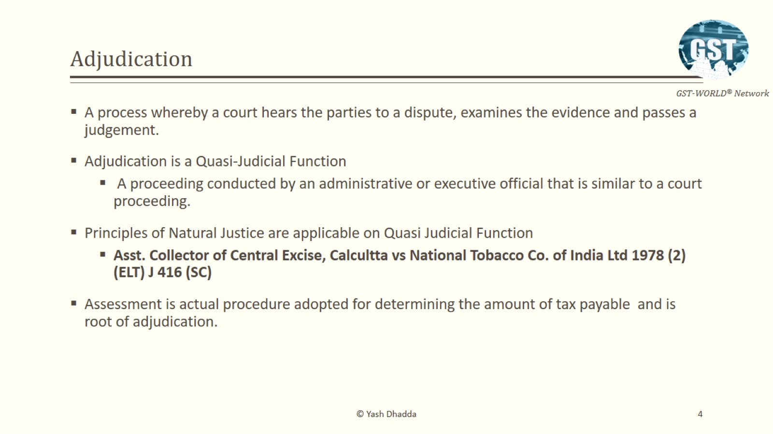
Principles of Adjudication

Slide 3
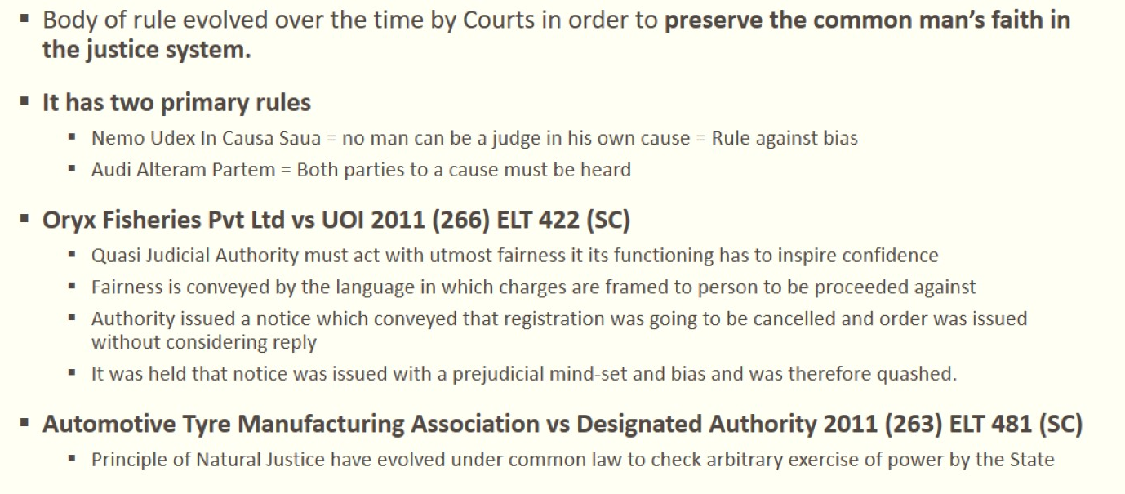
Principle of Natural Justice

Slide 4
Audit, Assessment & Investigation – Different powers
Assessment – Chapter XII
Self Assessment (S. 59)
Provisional Assessment (S. 60)
Scrutiny of Returns (S. 61)
Assessment of Non-filers of returns (S. 62)
Assessment of unregistered persons (S. 63)
Summary assessment in certain special cases (S. 64)
Audit – Chapter XIII
Audit by Tax Authorities (S. 65)
Special Audit (S. 66)
Investigation – Chapter XIV
Power of inspection, search & seizure (S. 67)
Inspection of goods in movement (S. 68)
Power of Arrest (S. 69)
Power to summon persons to give evidence and produce documents (S. 70)
Demands & Recovery – Chapter XV
Adjudication of taxes – Matters not involving fraud etc. (S. 73)
Adjudication of taxes – Matters involving fraud etc. (S. 74)

Slide 5
Service of Show Cause Notice
Where it appears to the Proper officer that,
  Tax has not been paid or
  Short paid or
  Erroneously refunded, or
  ITC has been wrongly availed or utilised
The expression “suppression” shall mean non-declaration of facts or information which a taxable person is required to declare in the return, statement, report or any other document furnished under this Act or the rules made thereunder, or failure to furnish any information on being asked for, in writing, by the proper officer.
S. 73 – For any reason
S. 74 – By reason of:
fraud, or
any wilful-misstatement or
suppression of facts to evade tax

Slide 6
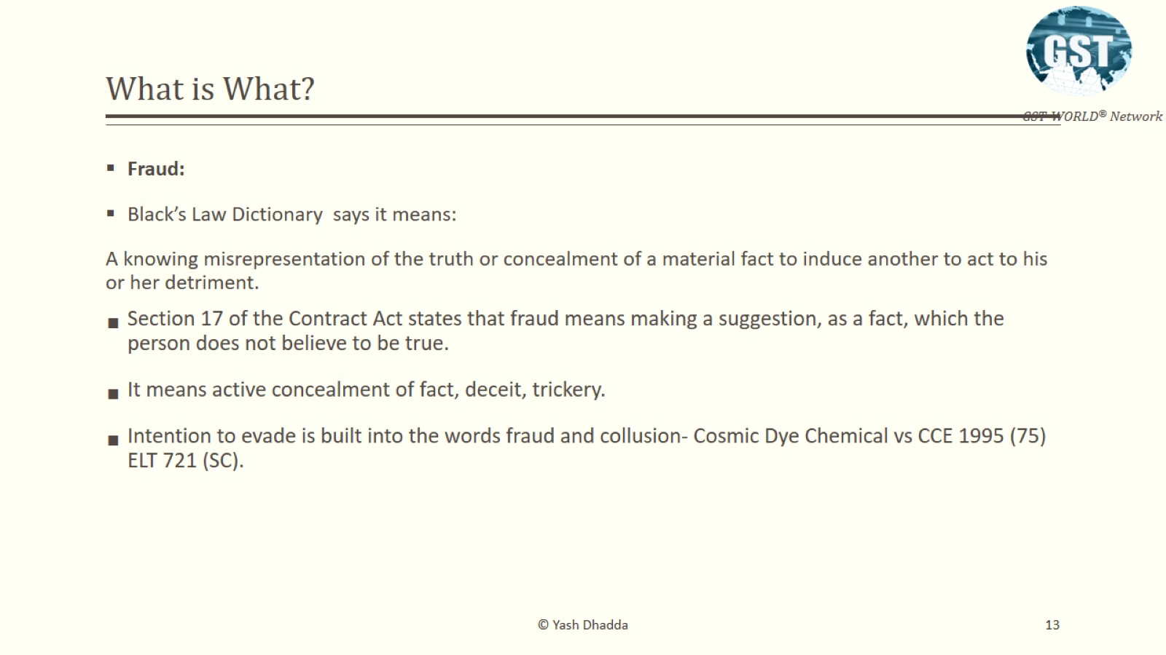
Fraud??

Slide 7
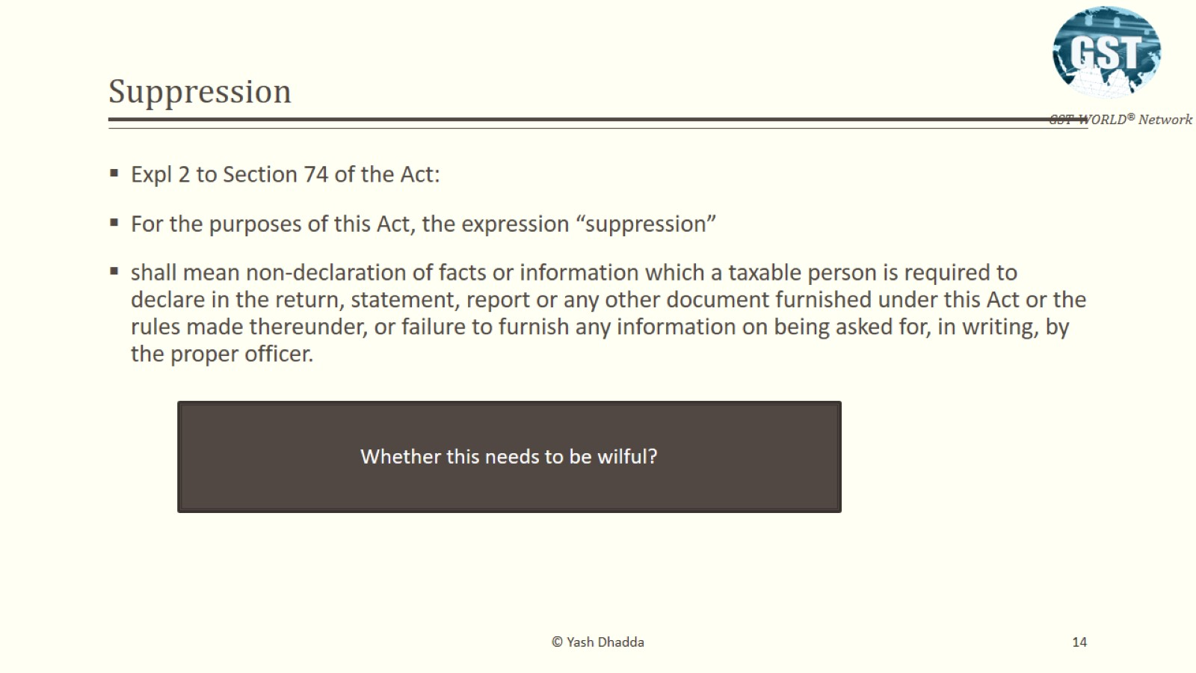
Suppression??

Slide 8
Applicability of Extended Period of limitation (S. 74)
Wilful would exclude casual, accidental, bonafide or unintentional acts:
Wilful would exclude casual, accidental, bonafide or unintentional acts or genuine inability. A wilful act would not encompass accidental, involuntary, or negligence in the act. It must be intentional, deliberate, calculated and conscious with full knowledge of legal consequences flowing there from – [Md. Illiyas AIR 2006 SC 258]
When the law requires an intention to evade payment of duty then it is not mere failure to pay duty. It must be something more. That is, the assessee must be aware that the duty was leviable and it must deliberately avoid paying it.
The word `evade’ in the context means defeating the provision of law of paying duty. It is made more stringent by use of the word `intent’. In other words the assessee must deliberately avoid payment of duty which is payable in accordance with law. [Tamil Nadu Housing Board vs. CCE –1991 (74) ELT 9 (SC)]

Slide 9
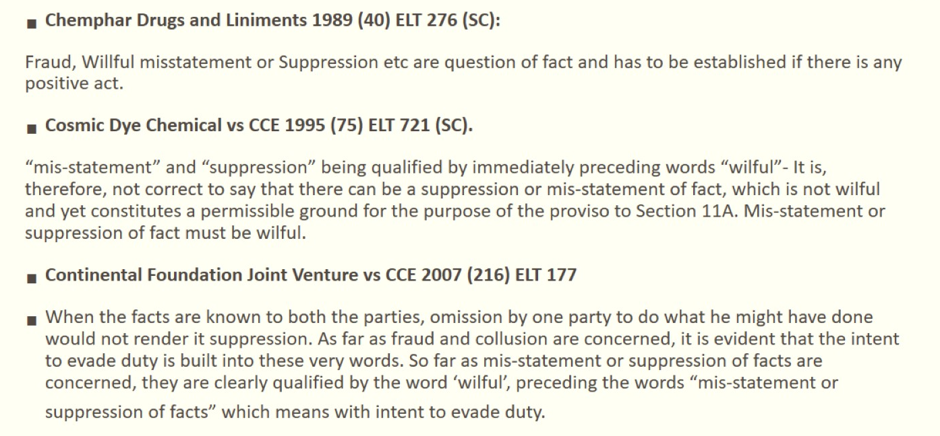
Wilful Mis-statement and Suppression??

Slide 10
Applicability of Extended Period of limitation (S. 74)
Mensrea’ as a necessary constituent of such an offence
It is well settled that when the statutes create an offence and an ingredient of the offence is a deliberate attempt to evade duty either by fraud or misrepresentation, the statute requires ‘mensrea’ as a necessary constituent of such an offence. But when factually no fraud or suppression or misstatement is alleged by the revenue against the respondent in the show cause notice the imposition of penalty under Section 11AC is wholly impermissible. [CCE vs. Pepsi Foods Ltd. –2010 (260) ELT 481 (SC)]

Slide 11
Burden of Proof
Initial burden to prove is on department”:
The initial burden is on the Department to prove that the situations visualized by the proviso existed. But once the Department is able to bring on record material to show that the appellant was guilty of any of those situations which are visualized by the section, the burden shifts and then the applicability of the proviso has to be construed liberally.
It is a cardinal postulate of law that the burden of proving any form of malafide lies on the shoulders of the one alleging it.
It cannot be overlooked that burden of establishing malafide is very heavy on the person who alleges it. The allegations of malafide are often more easily made than proved, and the very seriousness of such allegations demand proof of a high order of credibility. [Uniworth Textiles Ltd. vs. Commissioner of Central Excise, Raipur 2013 (288) ELT 161 (S.C.)]

Slide 12
Subsequent period SCN
Where a notice has been issued for any period under sub-section (1), the proper officer may serve a statement, containing the details of tax not paid or short paid or erroneously refunded or input tax credit wrongly availed or utilised. Sec. 73(3) & Sec. 74(3)
The service of statement under sub-section (3) shall be deemed to be service of notice under sub-section (1) of section 73, subject to the condition that the grounds relied upon in the said statement, except the ground of fraud, or any wilful misstatement or suppression of facts to evade tax, are the same as are mentioned in the earlier notice. Sec. 74(4)

Slide 13

Penalty Settlement Scheme
Section
Tax, Interest and Penalty
Action by the taxpayer
Action taken by the Authority
Voluntary payment before issuance of SCN
Under Section | Tax + Interest | Intimate the | The proper officer shall issue
73 |  | Department | an acknowledgement, accepting
 |  | about voluntary payment in Form DRC-03. | the payment made by the said person in FORM GST DRC–04, and if satisfied, no notice will be issued.
Under Section 74 | Tax + Interest + Penalty @ 15% of tax

Slide 14
Penalty Settlement Scheme
Section
Tax, Interest and Penalty
Action by the taxpayer
Action taken by the Authority
Payment within 30 days of issue of SCN
Under Section | Tax + Interest | Intimate the | If the Authority is satisfied with
73 |  | Department | the reply, it will drop the
 |  | about voluntary payment in Form DRC-03. | proceedings by the issue an order in Form DRC-05, or else Notice of a personal hearing will be issued.
Under Section 74 | Tax + Interest + Penalty @ 25% of tax

Slide 15

Penalty Settlement Scheme
Section
Tax, Interest and Penalty
Action by the Action taken by the Authority taxpayer
Payment after 30 days of issue of SCN but within the stipulated time mentioned in SCN
Under Section | Tax + Interest + | Reply to the SCN | If the Authority is satisfied with
73 | Penalty @ 10% of | in Form DRC-06 | the reply, it will drop the
 | tax or Rs. 10,000 | and submit | proceedings by the issue of
 | whichever is higher | documents. | Form DRC-05, or else Notice of
 |  |  | a personal hearing will be issued.
Under Section 74 | Tax + Interest + Penalty @ 50% of
 | tax

Slide 16
SCN and voluntary payment
Apart from the self-assessed tax, SCN is not warranted if the taxpayer voluntarily exercises the option u/s 73(5) or 74(5) to settle the dispute.
Amount paid under the stress of investigation cannot lead to self-assessment or self- ascertainment when the petitioner is fully geared up to take the matter forward. Hence the said amount paid is required to be returned. [Shri Nandhidhall Mills India Private Limited v. Senior Intelligence Officer (W.P. No. 5192 and 6135 of 2020) (Mad.)]

Slide 17
Time-limit for issuance of Show Cause Notice & Order
Section 73 – Normal Cases
Proper officer shall issue the notice at least 3 months prior to the time limit specified for issuance of order;
Proper officer shall issue order within:
  3 years from the due date for furnishing of annual return for the financial year to which the tax relates; or
  3 years from the date of erroneous refund.
Sec 74 – Cases involving fraud etc.
Proper officer shall issue the notice at least 6 months prior to the time limit specified for issuance of order;
Proper officer shall issue order within:
  5 years from the due date for furnishing of annual return for the financial year to which the tax relates; or
  5 years from the date of erroneous refund.
Section 73 – Normal Cases
Proper officer shall issue the notice at least 3 months prior to the time limit specified for issuance of order;
Proper officer shall issue order within:
  3 years from the due date for furnishing of annual return for the financial year to which the tax relates; or
  3 years from the date of erroneous refund.

Slide 18
Section 168A – Extending time limit mentioned u/s 73
Government may, on the recommendations of the Council, extend the time limit specified in this Act in respect of actions which cannot be completed or complied with due to force majeure.
Retrospective notifications can also be issued.
“force majeure” means a case of war, epidemic, flood, drought, fire, cyclone, earthquake or any other calamity caused by nature or otherwise affecting the implementation of any of the provisions of this Act. Till now, three notifications issued by taking cognizance of this Section –
Notification No. | Dated | Remarks
13/2022 | 05.07.2022 | Extended order issuance date to be 30.09.2023 for 17-18
09/2023 | 31.03.2023 | Extended order issuance for 17-18 to 19-20
56/2023 | 28.12.2023 | Extended order issuance for 18-19 by additional month

Slide 19
Section 168A – Extending time limit mentioned u/s 73
Extension by virtue of Section 168A has to be for special circumstances and having once extended period by virtue of notification dated 05.07.2022, no subsequent extension could be made. Notice issued to department - SRSS Agro (P.) Ltd. - [2023] 156 taxmann.com 656 (Gujarat)
It is observed that the petitioner shall file its reply to the impugned Show Cause Notice on or before 15.03.2024. It is further observed that till the returnable date, the proceedings initiated pursuant to the impugned Show Cause notice may proceed, but no final order in respect of the impugned Show Cause Notice shall be passed. - Indus Towers Ltd. - [2024] 160 taxmann.com 15 (Gauhati)
None of the eventuality mentioned in the explanation to section 168A of the Act existed when the impugned notification was issued by the Central Board of Indirect Taxes and Customs. Therefore, such extension is not sustainable in law and is contrary to the provision of Section 168A of the Act.

Slide 20
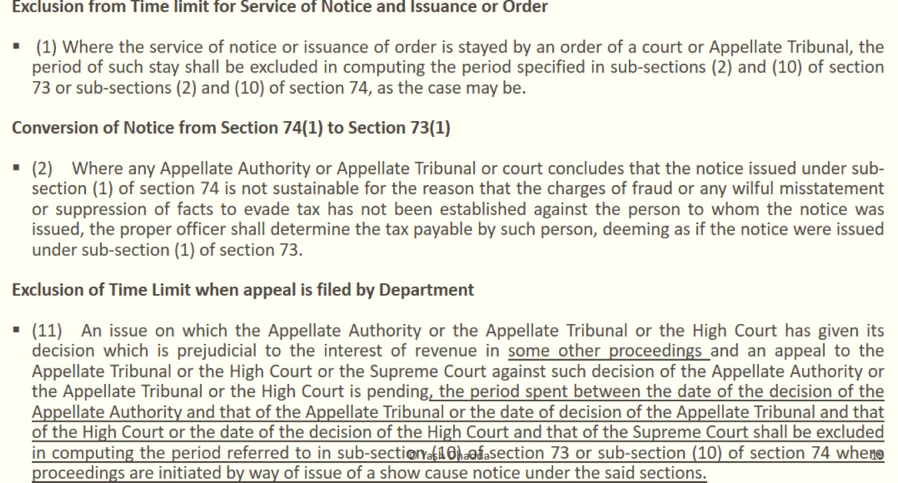
General Provisions u/s 75

Slide 21
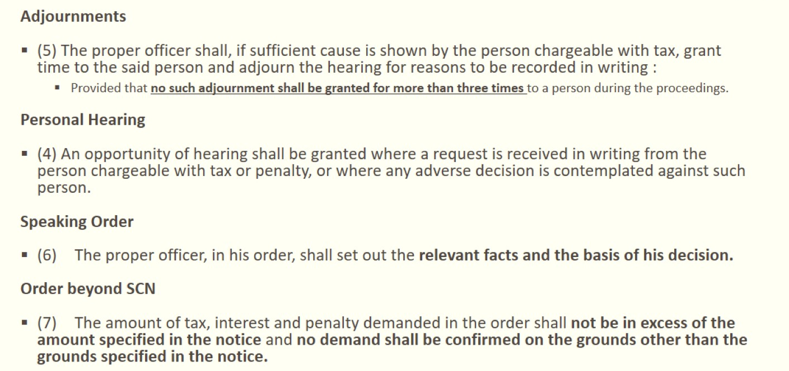
General Provisions u/s 75

Slide 22
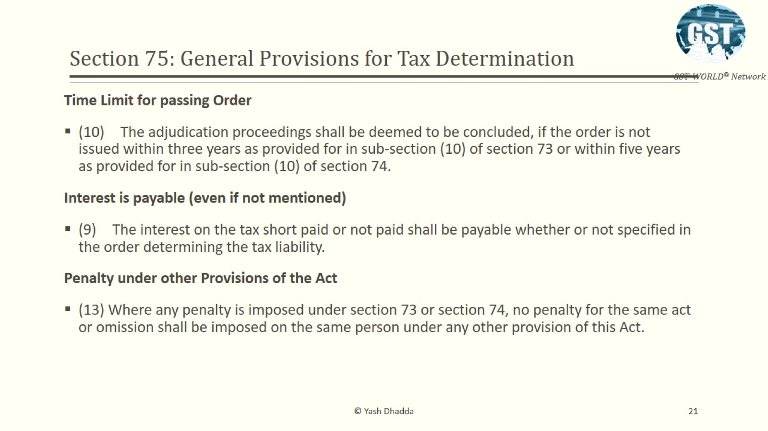
General Provisions u/s 75

Slide 23
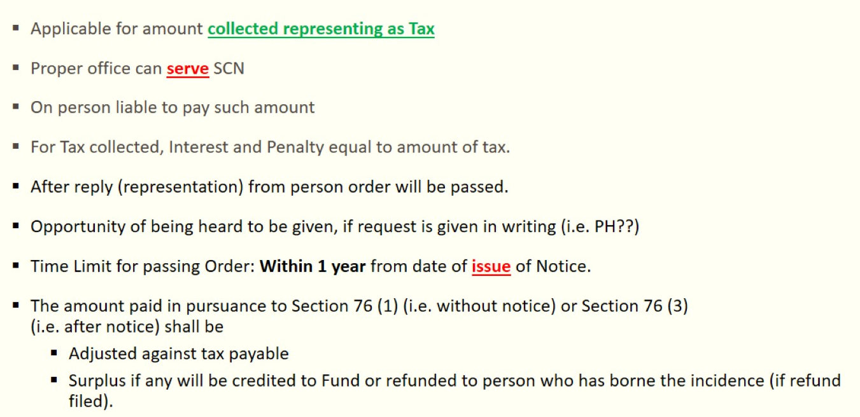
Tax collected but not paid u/s 76

Slide 24
Tax collected but not paid u/s 76
No time limit if any amount as representing the tax is collected but not paid - Sec 76 (1)
A show-cause notice issued a decade back should not be allowed to be adjudicated upon by the revenue merely because there is no period of limitation prescribed in the statute to complete such proceedings. The larger public interest requires that revenue should adjudicate the show-cause notice expeditiously and within a reasonable period – Parle International Limited 2020 (11) TMI 842 – (Bom HC)
No time limit provided in the law for replying to the show cause notice;
Delay in filing reply can affect the upper limit for issuance of orders.

Slide 25
Deemed conclusion of adjudication
The adjudication proceedings shall be deemed to be concluded if the order is not issued within three years as provided for in sub-section (10) of section 73 or within five years as provided for in sub-section (10) of section 74. [Sec. 75(10)] [Commissioner of Central Excise, Ahmedabad-I vs. M. Square Chemicals 2008 (231) ELT 194 (S.C.) – No demand can be made beyond 5 years.]

Slide 26
Other key Points to be noted
Direct recovery if self-assessed tax or interest as per return furnished u/s 39 remains unpaid, the same shall be recovered under the provisions of section 79 – Sec 75 (12);
The expression “self-assessed tax" shall include the tax payable in respect of details of outward supplies furnished u/s 37, but not included in the return furnished u/s 39 – Expln to Sec 75 (12);
No Time-limit provided in the law for replying to the show cause notice;
Delay in filing reply can affect the upper limit for issuance of orders.

Slide 27
Procedure to be followed for service or reply to SCN/Order
The proper officer shall serve along with the notice/ statement, a summary thereof electronically in FORM GST DRC-01 or DRC 02 respectively;
Proper officer may, before service of notice communicate the details of any tax, interest and penalty as ascertained by the said officer, in Part A of FORM GST DRC-01A.
Where the person has made partial payment of the amount communicated to him or desires to file any submissions against the proposed liability, he may make such submission in Part B of FORM GST DRC-01A.
Representation or the reply to any notice issued, whose summary has been uploaded electronically in FORM GST DRC-01 shall be furnished in FORM GST DRC-06.
A summary of the order issued shall be uploaded electronically in FORM GST DRC-07.
Where a rectification of the order has been passed or an order uploaded on the system has been withdrawn, a summary shall be uploaded electronically in FORM GST DRC-08.

Slide 28
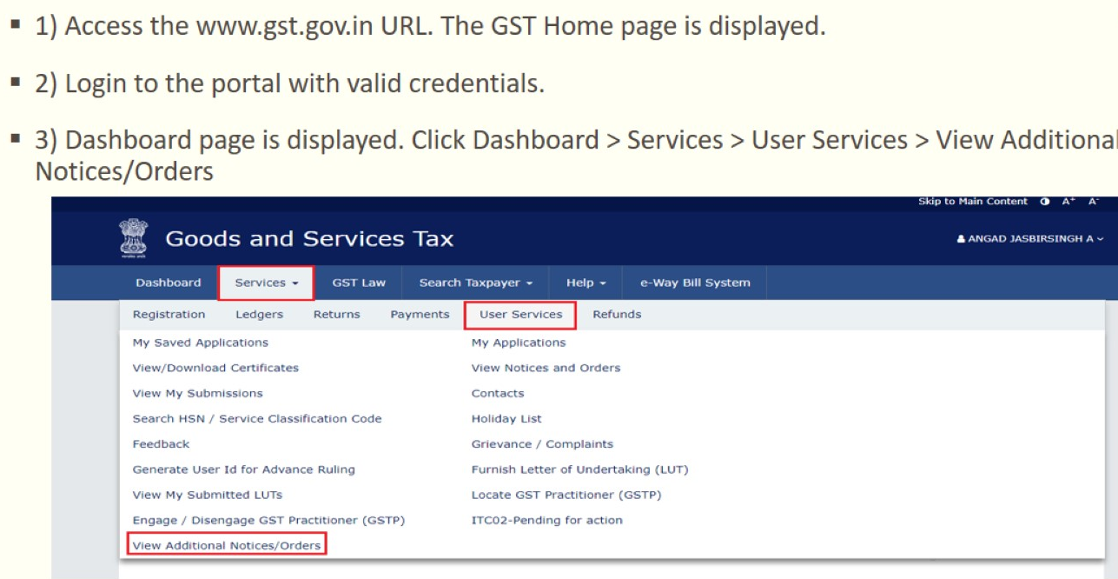
Reply on Portal

Slide 29
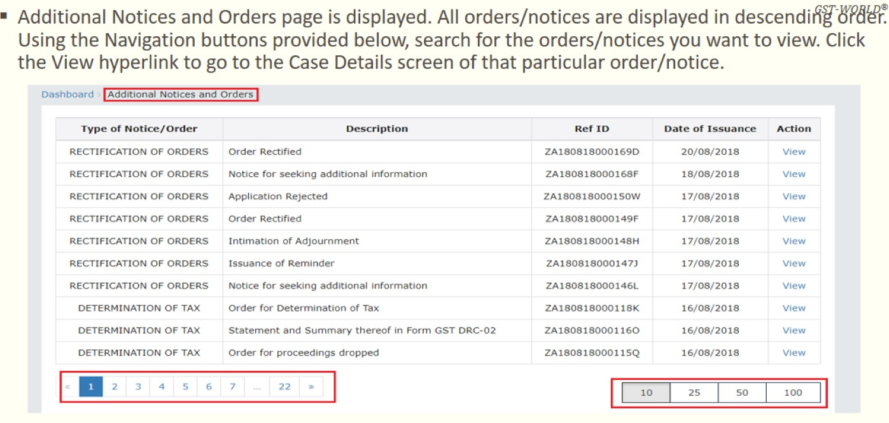
Reply on Portal

Slide 30
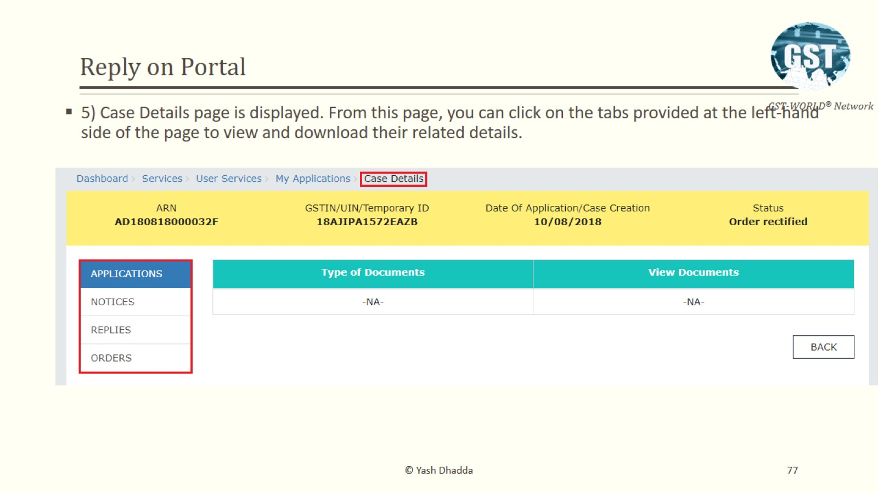
Reply on Portal

Slide 31
Automated Notices

Slide 32
Automated Notices
Form DRC-01B (rule 88C) Authorised by Sec 37 & 39
Form DRC-01C (rule 88D) Authorised by Sec 39
  Intimation will be issued based on approved risk-criteria. The Law Committee recommended on the difference of more than 20% as well as more than Rs. 25 lakhs for the purpose of intimation. [50th GST Council; item 3(viii) para 4.35 agreed]
You will receive the intimation via email and SMS
It will reflect in the GST portal under ‘Returns Compliance’ [path below]
To be responded to within 7 days.
To be filed with EVC/DSC.
Login
Services
Returns
Returns Compliance

Slide 33
Drafting effective reply to SCN

Slide 34
Areas to be focused in effectively replying to a SCN
Detailed study of a Show Cause Notice;
Understanding the complete facts and its collation;
Testing the validity and legality of the SCN and making appropriate submissions;
Framing grounds and replying them on merits;
Replying for demand of interest;
Replying for invocation of extended period of limitation & Penalties;
Prayer & verification;
Authorization for reply/ appearance;
Copy of SCN along with other supporting documents & Annexures.

Slide 35
Detailed study of a Show Cause Notice
SCN contains the following, each element must be read in detail:
  Introduction of the case;
  Legal framework;
  Factual statement and appreciation of evidences;
  Discussion, facts and legal framework;
  Discussion on Limitation;
  Discussion on penalties;
  Calculation of duty and other amounts due;
  Statement of charges;
  Authority issuing the SCN;
  Authority before matter to be adjudicated.
Framing various issues alleged in the notice along with its reasons and basis and identifying the Crux of the allegation;
SCN must be unbiased and not prejudiced - Nemo Judex in re Sua.

Slide 36
Understanding the complete facts and its collation
Copy of agreements, invoices, calculation sheets, mails/ letters and other relied upon documents must be obtained and the same must be analysed;
Understand & analyze the various submissions made in the past up to the receipt of SCN;
Understanding various oral submissions made – Opportunity to reduce it in writing;
Plotting the sequence of complete events with the date of its occurrence;
Detailed discussion with the client – Factory visit, Business understanding, Product understanding;
Facts gathered to be corroborated with the facts mentioned in the SCN – Missing/ incorrect facts.

Slide 37
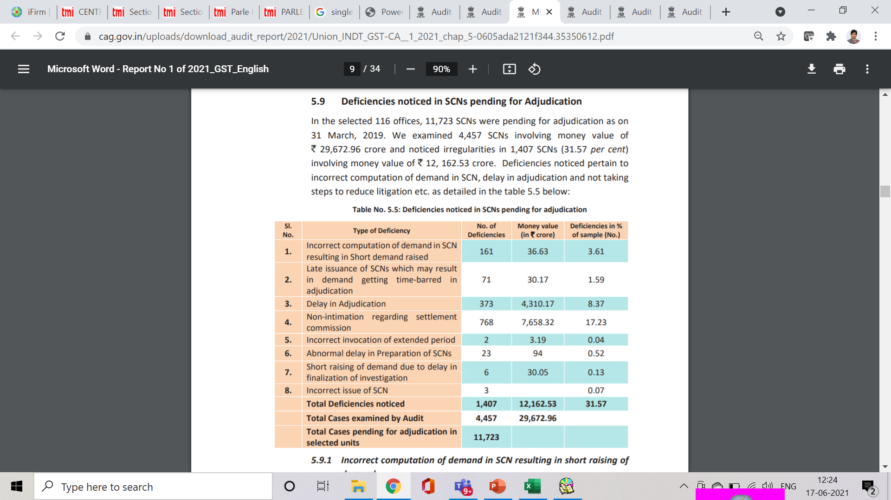
Findings in CAG (Report No. 1 of 2021) Dated 24.03.2021

Slide 38
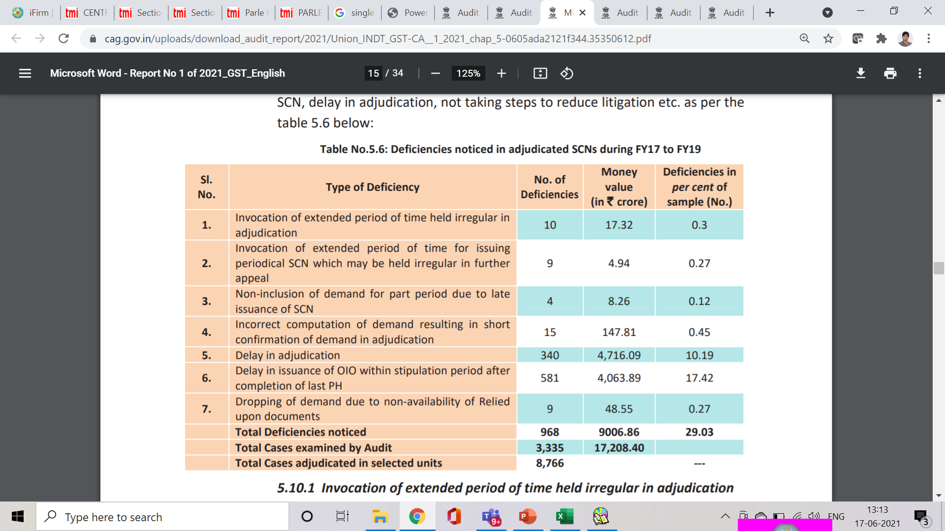
Findings in CAG (Report No. 1 of 2021) Dated 24.03.2021

Slide 39
Testing validity and legality of the SCN
SCN can only be issued electronically on the common portal - Shri Shyam Baba Edible Oils Vs CCE (MP High Court) 2020-TIOL-2016-HC-MP-GST
  It is trite principle of law that when a particular procedure is prescribed to perform a particular act then all other procedures/modes except the one prescribed are excluded - This principle becomes all the more stringent when statutorily prescribed.
DIN to be quoted on all communications (including emails): To be treated as invalid and deemed to have never been issued - Circular No. 122/ 2019 & Circular No. 128/ 2019;
Pre-communication of the demand under Rule 142 - Similar to Pre-SCN consultation under the erstwhile laws - Amadeus India Pvt. Ltd - Del HC & Back Office IT Solutions;

Slide 40
Testing validity and legality of the SCN
Proper officer for the purpose of the act - Jurisdiction of the officer issuing the notice:
Cross empowerment between Centre & State - Below 1.5 Crore (90% to the state) & Above 1.5 Crore (50% by both). Criteria to be followed for the division of taxpayer base between the Centre and the States to ensure single interface - Circular No. 1/ 2017 - F. No. 166, GST Council;
Proper officer to execute various functions entrusted under the provisions of the act and rules – Sec 2(91) read with Circular No. 3/3/2017;
Assignment of the territorial jurisdiction to the proper officers - Notification No.2/2017-Central Tax [Sayed Ali (2011) ELT 17 (SC) & Canon India 2021-TIOL-123-SC-CUS-LB];
Monetary limits for different levels of officers of central tax - Circular No. 31/05/2018 – GST;
The central tax officers of Audit Commissionerate's and Directorate General of Goods and Services Tax Intelligence (hereinafter referred to as “DGGSTI”) shall exercise the powers only to issue show cause notices. A show cause notice issued by them shall be adjudicated by the competent central tax officer of the Executive Commissionerate in whose jurisdiction the noticee is registered - Circular No. 31/05/2018 – GST.

Slide 41
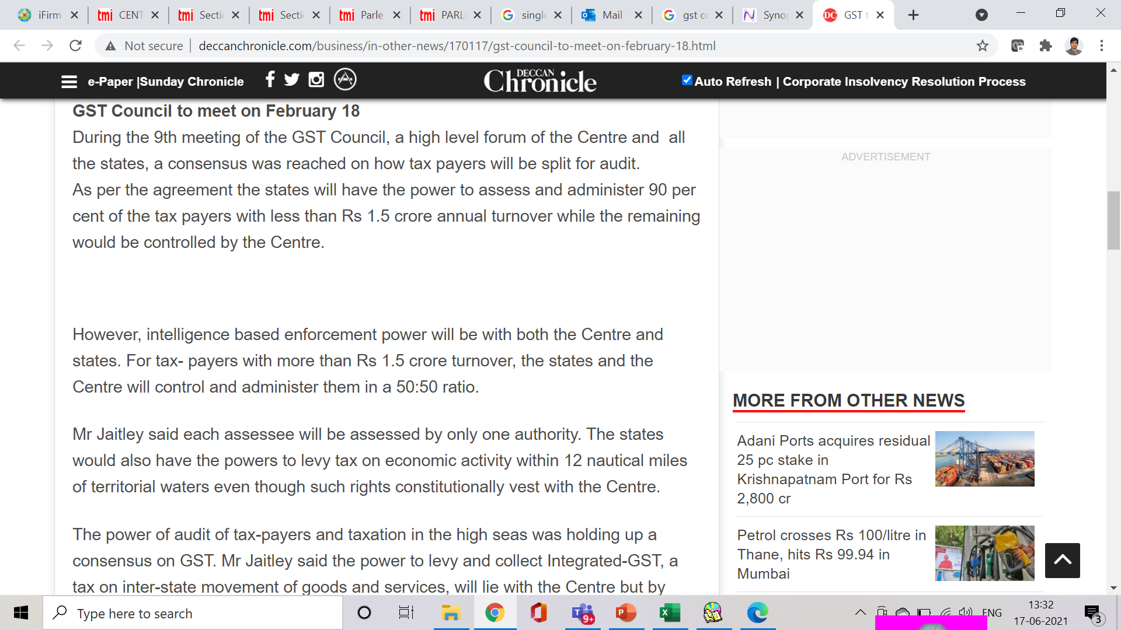
Parallel proceedings/ Duplicate proceedings

Slide 42
Parallel proceedings/ Duplicate proceedings
In case show cause notices have been issued on similar issues to a noticee(s) and made answerable to different levels of adjudicating authorities within a Commissionerate, such show cause notices should be adjudicated by the adjudicating authority competent to decide the case involving the highest amount of central tax and/or integrated tax (including cess) - Circular No. 31/05/2018 - GST
Where a proper officer under the State Goods and Services Tax Act or the Union Territory Goods and Services Tax Act has initiated any proceedings on a subject matter, no proceedings shall be initiated by the proper officer under this Act on the same subject matter - Sec 6(2)(b);
No one can be a judge in his own cause - Nemo Judex in causa sua - Issues faced in the e-way bill matters;

Slide 43
Audit vs Investigation and parallel proceeding
Proceedings of investigation can be carried out independent of the Audit proceedings:
Can the proceedings of the investigation be challenged when already an audit is under progress.
Audit under section 65 is a routine procedure to be carried out by the Commissioner in such frequency and in such manner as prescribed in the rules; which is independent of an investigation under section 67.
Section 67 is a more onerous procedure which can be initiated only on the satisfaction of Joint Commissioner or above of, suppression of taxable transactions, excess claim of input tax credit, contravention of the provisions of the Act and Rules, keeping of goods and accounts in contravention of the provisions, escapement of tax, secreting of goods or material liable to confiscation or relevant or useful in any proceedings under the Act and any act leading to evasion of tax.
Investigation under section 67 is no routine procedure as is an audit under section 65.
No any infirmity in the audit and investigation proceeding being continued simultaneously.
This is also upheld by SC [Suresh Kumar P. P. – (2021) 125 taxmann.com 61 (SC)]

Slide 44
Parallel proceedings/ Duplicate proceedings
Parallel GST proceedings cannot be conducted by 3 wings of same department for same tax period:
  The learned Advocate for the appellants submitted that for two issues, the appellants had submitted their response to the notice and the matter has not been taken to the logical end. In the meantime, the other two wings of the department, viz. Anti Evasion wing as well as the Range Office have also proceeded against the appellants by issuing notices for the very same period for which audit proceedings under Section 65 of the Act has already commenced.
  It was held that since the audit proceedings under Section 65 of the Act has already commenced, it is but appropriate that the proceedings should be taken to the logical end. The proceedings initiated by the Anti Evasion and Range Office for the very same period shall not be proceeded with any further.
[R. P. Buildcon Private Limited (Calcutta HC) - [WPA 20025 OF 2022 dated September 30, 2022]

Slide 45
Parallel proceedings/ Duplicate proceedings
One authority to adjudicate between Centre and State on the same issue:
  The appellants are aggrieved by the show cause notice issued by the respondent herein dated 29thDecember, 2022 on the ground that the very same issue is now subject matter of consideration by the Assistant Commissioner, State Tax, Bureau of Investigation, South Bengal (HQ), who has issued notice dated 7th November, 2022. In our considered view, if the subject issue is one and the same or if the subject is inter-related, it is always better that one authority adjudicates the matter. By directing the assessee to face multiple authorities may result in conflicting decisions. Therefore, not only in the interest of the assessee but in the interest of the revenue also, one authority should take the decision.
  [LGW Industries Ltd Vs Assistant Commissioner 2023 (3) TMI 826- Calcutta HC]

Slide 46
Parallel proceedings/ Duplicate proceedings
SCN cannot be issued on the same cause of action against which the favourable order is already passed by the Appellate Authority:
  Revenue cannot re-agitate and issue fresh show cause notices again for the same cause of action covering same period against which the Order passed by the first Appellate Authority has been accepted by the Respondents and same has attained finality.
  The actions of the Respondent No.2 and the Respondent No.3 is therefore bad in law and is without jurisdiction and is further hit by the principles of res judicata and is clearly not permissible under the law.
  As stated herein above, after passing of the 1st appellate order, only course available with the Respondents were to challenge the first Appellate Order before the Appellate Tribunal under Section 112 of the JGST Act, if at all aggrieved, and
  Therefore, the impugned Show Cause Notices are wholly without jurisdiction, without authority of law and also barred by principles of res-judicata.
  [Ambey Mining Pvt Ltd Vs Commissioner of State Tax 2023 (7) TMI 876- Jharkd HC]

Slide 47
Parallel proceedings/ Duplicate proceedings
Statutory bar on carrying out simultaneous parallel investigations by two different tax authorities is only applicable when subject matter of two investigations is same:
  The very purpose and object of Section 6(2)(b) of the Act is to ensure that on the same subject, the parallel proceedings are to be avoided. Once, on a particular subject, the State authority has initiated action under the State Goods and Services Tax Act, then alone, the proper officer under the Central Goods and Services Tax Act are restrained to wait till the finalization of the proceedings initiated by the State authorities. However, in all circumstances, and in respect of various other proceedings, the benefit cannot be claimed by the assessees. [para 11]
  It is to be established that subject matter is one and the same. Mere pendency of proceedings before the State authorities is not a ground to restrain the Central authorities from issuing summons and conduct investigation regarding certain allegations. Therefore, all these factors require an adjudication before the competent authority and if the summons are kept in abeyance at this stage, the same would paralyze the entire proceedings, which is not only desirable, but would cause prejudice to the interest of the Revenue in the present case. [para 12]
  [Kuppan Gounder P.G. Natarajan - 2021 (55) G.S.T.L. 420 (Mad.)]

Slide 48
Parallel proceedings/ Duplicate proceedings
  Authorities commencing the proceedings first would need to continue with the proceedings:
  Parallel proceedings by multiple authorities - State GST department, Preventive Wing of Central GST and DGGI initiated enquiries.
  DGGI could not raise a question about credibility and competence of State GST authorities
  The officers of DGGI do not enjoy any special power or privilege in comparison with officers of State GST authorities
  Proceedings on basis of search and seizure by State authorities, being prior in point of time and all proceedings being inter-related, State authorities were to continue with proceedings.
  Therefore, the Preventive Wing of CGST and DGGI Wing of CGST, would forward all their investigation carried to State authorities.
  [Vivek Narsaria - [2024] 158 taxmann.com 523 (Jharkhand)]

Slide 49
Parallel proceedings/ Duplicate proceedings
Plain reading of the provisions do not suggest any bar in exercise of audit under Section 65, if the assessee had faced any earlier proceedings under Section 74:
  Plain reading of the provisions do not suggest any bar in exercise of audit under Section 65, if the assessee had faced any earlier proceedings under Section 74 of the Act with respect to Input Tax Credit, excess claimed, there is no inherent legal infirmity shown to exist in the audit having been directed, keeping in mind the language of the statute.
  [Rising India - 2023 (5) TMI 589 - ALLAHABAD HIGH COURT]
  The different wings of the very same department should not issue notices and summons to the appellants without taking any of the earlier proceedings to the logical end.
  It is found that none of the proceedings initiated by the department has been shown to have been taken to the logical end. If, according to the respondent’s department, there is an irregularity in the availment of credit, then appropriate proceedings under the Act should be initiated and after due opportunity to the appellants, the matter should be taken to the logical end.
  [Ideal Unique Realtors (P.) Ltd. [2022] 145 taxmann.com 484]

Slide 50
Validity of service of notice
Whether the service of notice is valid?
Section 169(1) specifies the modes of communication for any decision, order, summons, notice or any other communication:
  by giving or tendering it directly or by a messenger including a courier,
  by registered post or speed post or courier with acknowledgement due;
  by sending a communication to his e-mail address;
  by making it available on the common portal.

Slide 51
Procedure to be followed for service or reply to SCN/ Order
The proper officer shall serve along with the notice/ statement, a summary thereof electronically in FORM GST DRC-01 or DRC-02 respectively;
Proper officer may, before service of notice communicate the details of any tax, interest and penalty as ascertained by the said officer, in Part A of FORM GST DRC-01A. ‘Shall” substituted for “may” vide Notification No. 79/2020-CT dated 15.10.2020. [Period between 09.10.2019 to 15.10.2020]
SCN can only be issued electronically on the common portal - Shri Shyam Baba Edible Oils Vs CCE (MP High Court) 2020-TIOL-2016-HC-MP-GST
  It is trite principle of law that when a particular procedure is prescribed to perform a particular act then all other procedures/modes except the one prescribed are excluded - This principle becomes all the more stringent when statutorily prescribed.
DIN to be quoted on all communications (including emails): To be treated as invalid and deemed to have never been issued - Circular No. 122/ 2019 & Circular No. 128/ 2019

Slide 52
Validity of service of notice
Whether Mere Uploading Notice on common portal amounts to Proper Service?
Section 169 of the respective GST enactments is a progressive provision intended to integrate technology with the assessment proceedings under the provisions of the respective GST Enactments - However, all men of commerce from the business community, particularly small traders, small service provider and small manufacturers may not be ready to receive and respond.
They may be technologically challenged which may impair them to respond autonomously to emails sent to them – It would be incumbent on the part of the department to serve at least another notice once through any of the other modes of service of notice prescribed under Section 169(1) of the respective GST Enactments so as to ensure there communication and there is no violation of principles of natural justice.
This will obviate recalcitrant and obstinate assessee's to scuttle the proceedings by stating that there is a violation of principles of natural justice.
There has to be some amount of flexibility - Rigidity in the administration of tax in such matters may not serve the purpose and can be counterproductive.
Sakthi Steel Trading - [2024] 159 taxmann.com 233 (Madras)

Slide 53
Validity of service of notice
Whether Mere Uploading Notice on common portal amounts to Proper Service?
Where assessee contended that, though impugned order was made available on portal as provided under section 169, but same did not amount to communication of order as stipulated in section 107 as an order can be said to be communicated only when person concerned comes to know about same; matter listed for consideration – Interim relief granted with condition of depositing 50% of the tax demanded. Baghel Trading Co. - [2023] 155 taxmann.com 95 (Allahabad)
Owing to the technical glitches, the taxpayer could not reply to the notice, therefore, till all problems are resolved on the technical side, the authority may simultaneously serve the notice both through registered post or speed post or courier with acknowledgment as is contemplated Section 169(1)(b) of the Act and through web portal. Order set aside. - Gyan Cement House - [2023] 153 taxmann.com 79 (Madhya Pradesh)

Slide 54
Testing legality of the SCN
Notice must be clear and specific, vague allegations without containing all the details cannot be a valid notice - Brindavan Beverages 2007 (213) E.L.T. 487 (S.C.)
  “The show cause notice is the foundation on which the department has to build up its case. If the allegations in the show cause notice are not specific and are on the contrary vague, lack details and/or unintelligible that is sufficient to hold that the noticee was not given proper opportunity to meet the allegations indicated in the show cause notice.”
SCN not to pre-judge the issue – Oryx Fisheries - 2011 (266) ELT 422 (SC)
  “If on a reasonable reading of a show-cause notice a person of ordinary prudence gets the feeling that his reply to the show cause notice will be an empty ceremony and he will merely knock his head against the impenetrable wall of prejudged opinion, such a show cause notice does not commence a fair procedure especially when it is issued in a quasi-judicial proceeding under a statutory regulation which promises to give the person proceeded against a reasonable opportunity of defence.”
Allegations must be based on evidence and proof and not on mere assumptions and presumption - Oudh Sugar - 1978 (2) E.L.T. (J 172) (S.C.)

Slide 55
Testing legality of the SCN
SCN issued under the incorrect section is invalid - N.B. Sanjana vs. The Elphinstone Spinning & Weaving Mills Co. Ltd - 1978 (2) E.L.T. (J 399) (S.C.);
Summary of demand in itself is not a show cause notice – Form DRC 01/ DRC 02;
Belated corrigendum to show cause notice for enlarging the scope of first notice is bad in law - Steel Authority of India Limited (2008) 225 ELT A 130 (SC);
Proper notice must contain the time, authority, place and nature of hearing – Circular No. 1053/2/2017-CX., dated 10-3-2017
Court in exercise of its jurisdiction under Art. 226 of the Constitution can interfere with the issuance of SCN if the same is issued without jurisdiction or having incurable infirmity, without clear disclosure of the offence alleged to be committed etc.

Slide 56
Testing legality of the SCN
Orders contrary to the allegations in SCN are not valid - Gas Authority of India Ltd (2008) 232 ELT 7 (SC);
Whether adjudicating authorities can step beyond the scope of allegations in the SCN – Section 75(7) & Bhor industries 2011 (267) E.L.T. A127 (S.C)
Order acted upon without jurisdiction can be challenged before the Writ court - Sanawarmal Purohit (1979) 4 ELT J 613 (SC)
Whether demand can be confirmed in a heading different from the one proposed in the SCN - Mahakoshal Beverages 2014 (33) S.T.R. 616 (Kar.);

Slide 57
Framing grounds and replying on merits of the case
Grounds must be framed based on the following assertions:
  Principles of natural justice not followed;
  Case built on incorrect factual position;
  Not in accordance with the provisions of the act or rules – Relied on Circulars etc.;
  Favorable judicial precedents – Higher Courts, Jurisdictional rulings, Final order to be relied, Reliance on international jurisprudence;
  Constitutional validity;
  Cardinal principles of interpretation & Legal Maxims;
  Incorrect quantification of demand;
  There can be multiple grounds for the same issue. Each ground can be without prejudice to the other – Bombay Tyres;
Each and every allegation must be precisely and clearly rebutted;
Benefit of Cum Tax can be claimed, if tax not collected;

Slide 58
Replying for demand of interest
Correctness of interest computations can be challenged;
Interest to be payable on Net Tax liability;
Applicability of interest on Input tax Credit availed and not utilised;
Interest on the tax short paid or not paid shall be payable whether or not specified in the order determining the tax liability. - Sec 75 (9);
Interest is compensatory in character and is imposed on an assessee who has withheld payment of any tax as and when it is due and payable - Levy of interest is geared to actual amount of tax withheld and the extent of the delay in paying the tax on the due date, thus essentially it is compensatory and different from penalty, which is penal in character. – Pratibha Processors - 1996 (88) E.L.T. 12 (S.C.)

Slide 59
Replying for extended period of limitation & Penalties
Fraud, willful-misstatement, suppression is a question of fact and has to be established if there is a positive act. Conscious or deliberate withholding of information necessary to invoke larger limitation - Chemphar Drugs 1989 (40) E.L.T. 276 (S.C.), Padmini Products 1989 (43) E.L.T. 195 (S.C.)
While issuing subsequent show cause notices, same/similar facts could not be taken as suppression of facts on part of assessee - Nizam Sugar Factory 2008 (9) S.T.R. 314 (S.C.)
Department already had the knowledge of the transaction - Monsanto manufacturers 2010 (260) E.L.T. 335 (S.C.)
Filing of returns on a regular basis and facts were known to the department - Pahwa Chemicals 2005 (189) ELT 257 (SC)
Can extended period be invoked in the cases involving revenue neutrality - Nirlon Ltd 2015 (320) E.L.T. 22 (S.C.)

Slide 60
Replying for extended period of limitation & Penalties
Matter involving interpretation - Issue pending with various courts - Nirmala Dyechem 2007 (207) E.L.T. 161 (S.C.)
Extended period cannot be invoked in case of retrospective amendment - JK Cotton Spinning and weaving mills 1998 (99) E.L.T. 8 (S.C.)
Initial Burden of proof lies on the department, once stated, then defence lies on the taxpayer - Tamilnadu Housing Board, Bajaj Auto & Marco Textiles;
SCN issued due to departmental audit - Dynamic Industries 2014 (307) E.L.T. 15 (Guj.)
Where penalties dropped, extended period cannot be invoked - Kapadia enterprises vs UOI
Where any penalty is imposed under section 73 or section 74, no penalty for the same act or omission shall be imposed on the same person under any other provision of this Act - Sec 75 (13)

Slide 61
Replying for extended period of limitation & Penalties
Mere non-declaration in the return cannot be labeled as suppression - Chemphar Drugs 1989 (40) E.L.T. 276 (S.C.)
Details declared in the books of accounts cannot be said to be suppressed - Super Industries - 2017 (348) E.L.T. A127 (S.C.)];
Intent to evade duty built into the expressions “fraud” and “collusion” but “mis-statement” and “suppression” being qualified by immediately preceding words “wilful” and “contravention of any of the provisions of this Act or rules” being qualified by the immediately following words “with intent to evade payment of duty – Cosmic Dye Chemicals 1995 (75) E.L.T. 721 (S.C.);
Willful would exclude casual, accidental, bonafide or unintentional acts or genuine inability. A willful act would not encompass accidental, involuntary, or negligence in the act. It must be intentional, deliberate, calculated and conscious with full knowledge of legal consequences flowing there from - Md. Illiyas AIR 2006 SC 258

Slide 62
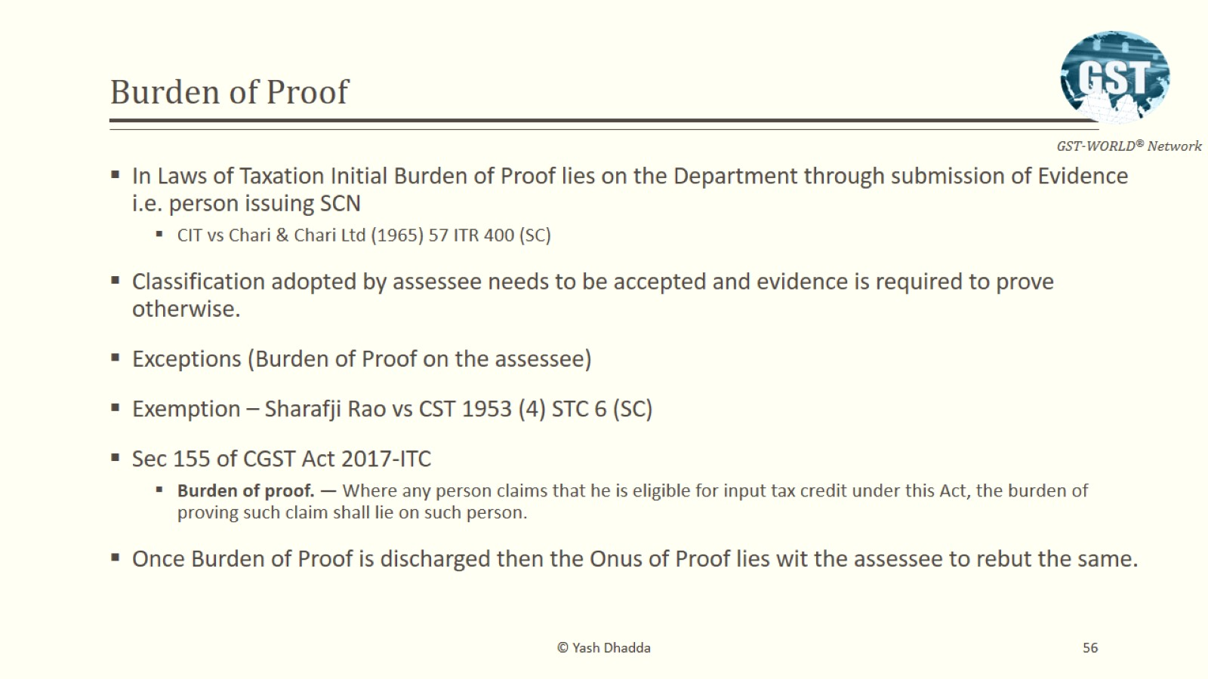
Burden of Proof

Slide 63
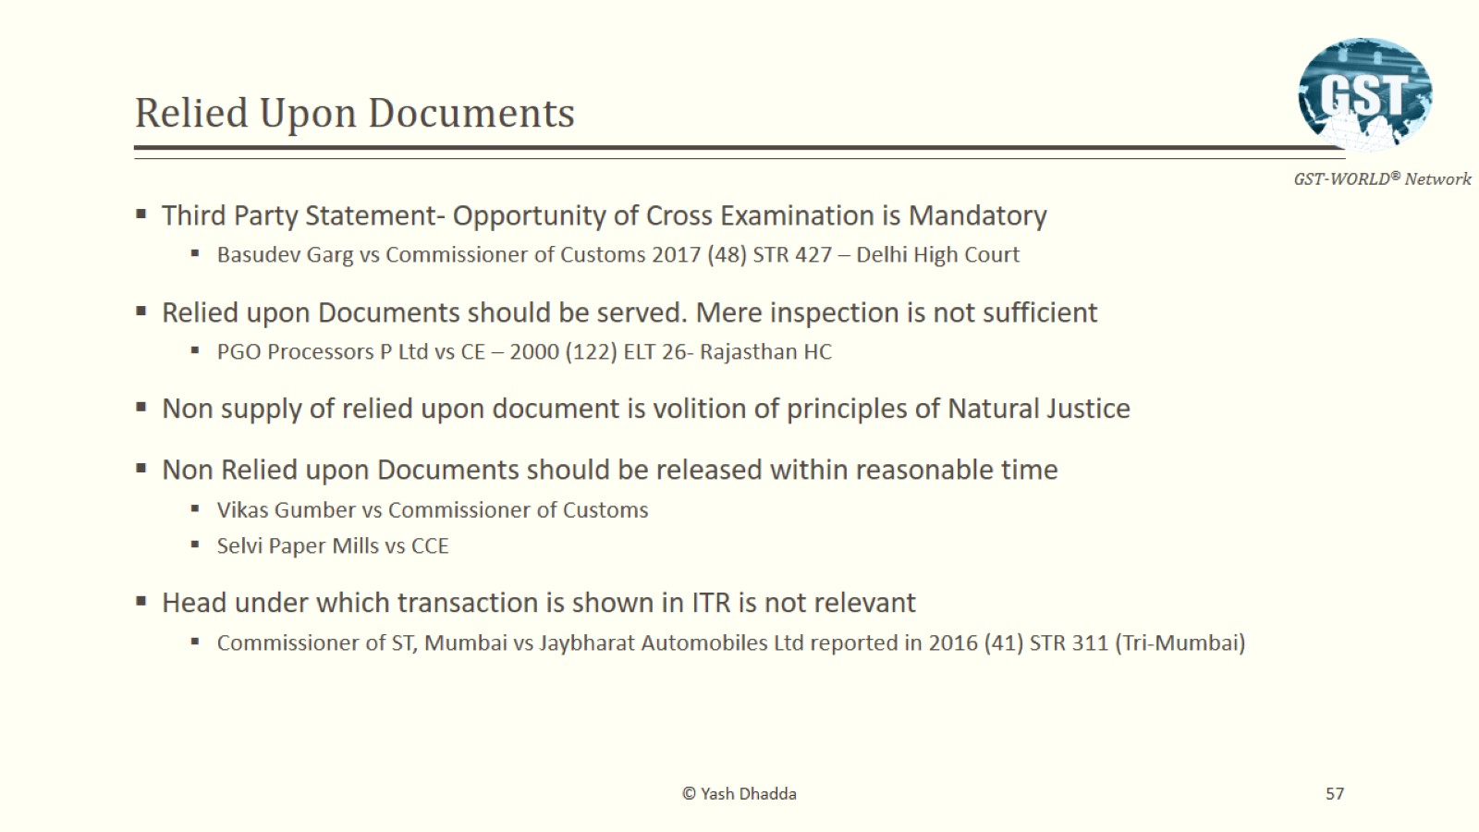
Relied Upon Documents

Slide 64
Other Important Aspects

Slide 65

Other Important Aspects
Cooperating with the officers and providing all the necessary information & documents called for;
Keeping the entire information in an organized manner ready prior to the visit by the audit party;
Seek adjournment if information/ documents not ready – MH Trade Circular;
Additional time to be requested if not clear/ not sure about any facts or law;
Professional can be involved as an authorized representative to handle the case and represent the taxpayer;

Slide 66
Other Important Aspects
Payment can be made under protest or under the right to contest - Areas of interpretation – Keeping the issue alive – waiting for the apex court judgment;
Proper officer may issue a SCN, if no SCN issued, then file a refund application;
If department asks for original documents – Make available on a sample basis backed by a CA certificate;
Unofficial demands by the aggressive officers in the course of audits – Payment must not be demanded under coercion/ harassment;
Oral directions for payment/ reversals - Suggested to keep everything in writing – Submit a letter stating the complete sequence of events with full facts & details;
Type of replies given during the initial phase would help – It will make the foundation strong for future litigation;

Slide 67
Other Important Aspects
1
2
3
Email
Telephone
Letters from the dept
Has got legal recognition – Registered email id, uploading on the portal – Sec. 169;
Not preferable mode of communication with the dept – Non-evidence means of correspondence;
the envelope cover should be retained as evidence for date of receipt.
4
5
6
7
Letters to dept
DIN to be quoted
Visits by depts
Visits to dept
All correspondences to the departmental officers be duly acknowledged and if not done, a copy to be sent by RPAD;
To be treated as invalid and deemed to have never been issued;
Visiting officers are required to record in the visit register with the purpose;
Departmental visits to be done on need basis

Slide 68
Other Important Aspects
Making Additional submissions upon new developments;
No Cut Paste from the existing drafted reply;
Reply along with annexures to be properly bound together;
Giving proper references, index, copies of the judgments relied upon;
Judgments relied upon must be read – Facts must be rechecked;
Independent study of judgments must be carried out – Both favorable & against;
Kernel must be prepared and vetted prior to the commencement of drafting to the SCN

Slide 69
Other Important Aspects
Quality review to be undertaken in case of non-repetitive/ complex matters;
Uploading all the departmental correspondences, client data, offer, research material in the common folder;
Discussion with the client is of paramount importance – factory/ site visit, understanding the nature of goods/ services;
Reading judgments – TIOL, TMI, Excus etc. can improve drafting – Keeping the language plain & simple;
Going deep, exploring your creative self – Think differently;
Reply to be to the point and crisp;

Slide 70

Thank you
ravikumar@hnaindia.com

