Slide 1
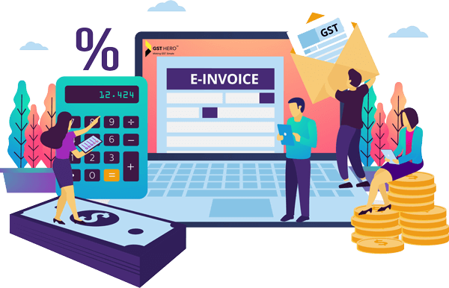
Goods and Service Tax
Topic:
Time, Place and Value of Supply
Presented by-
CA Chaitanya Sunil Vakharia
29th February 2024

Slide 2
Invoicing concept under GST
At What rate?
When?
As per HSN
Time of Supply
What to levy?
At What Value?
Supply
Goods / Services
IGST / CGST + SGST / UTGST
Place of Supply
Value of Supply

Slide 3
Time of Supply
Goods

Slide 4
Section 12 of CGST Act, 2017 (Goods)
(2) The time of supply of goods shall be the earlier of the following dates, namely:—
(a) the date of issue of invoice by the supplier or the last date on which he is required, under section 31, to issue the invoice with respect to the supply; or
(b)the date on which the supplier receives the payment with respect to the supply:
(Clause (b) exempted via Notification No. 66/2017 –Central Tax)

Slide 5
Section 31 of CGST Act, 2017
Tax Invoice for supply of Goods:
(1) A registered person supplying taxable goods shall, before or at the time of,—
(a) removal of goods for supply to the recipient, where the supply involves movement of goods; or
(b) delivery of goods or making available thereof to the recipient, in any other case,
issue a tax invoice showing the description, quantity and value of goods, the tax charged thereon and such other particulars as may be prescribed:

Slide 6
Illustration
Iron Man is a distributor of iPhone 15 in Maharashtra. Captain America is a retailer in Pune. Iron Man wishes to know the following:
When to raise invoice for sale of 15 iPhones to Captain America? Date of movement of goods 2nd March 2024
Can Iron Man raise invoice on Captain America before the delivery of iPhone on 1st March 2024?
Answer:
On or before 2nd March 2024
Yes, can raise on 1st March 2024

Slide 7
Section 12 of CGST Act, 2017 (RCM - Goods)
In case of supplies in respect of which tax is paid or liable to be paid on reverse charge basis, the time of supply shall be the earliest of the following dates, namely:—
(a) the date of the receipt of goods; or
(b) the date of payment as entered in the books of account of the recipient or the date on which the payment is debited in his bank account, whichever is earlier; or
(c) the date immediately following thirty days from the date of issue of invoice or any other document, by whatever name called, in lieu thereof by the supplier:
Provided that where it is not possible to determine the time of supply under clause (a) or clause (b) or clause (c), the time of supply shall be the date of entry in the books of account of the recipient of supply.

Slide 8
Section 12 of CGST Act, 2017 (Vouchers)
In case of supply of vouchers by a supplier, the time of supply shall be
a) the date of issue of voucher, if the supply is identifiable at that point; or
(b) the date of redemption of voucher, in all other cases.

Slide 9
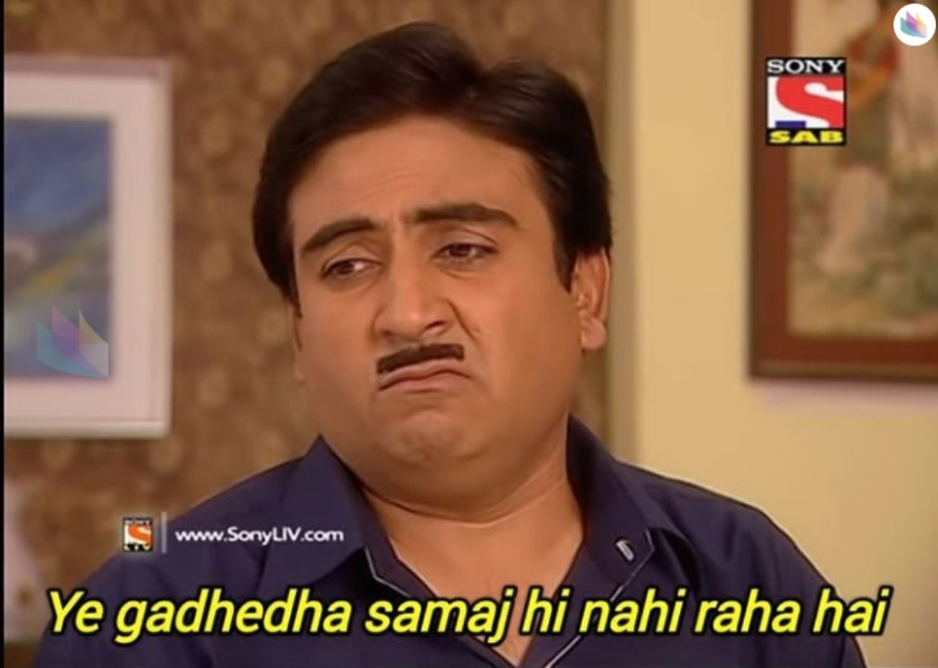
Illustration
Mr. Jethalal is a owner of Electronics shop namely Gada Electronics in Mumbai.
Mr. Iyer purchased gift voucher on 1st March 2024 from Gada Electronics amounting to Rs. 1,00,000/- which can be encashed against purchase of any item from Gada Electronics.
Mrs. Babita Iyer purchased Mobile phone on 14th April 2024.
What is the time of supply?
Answer:
Purchase item not known at the time of sale of voucher, Time of supply shall be 14th April 2024

Slide 10
Illustration
Mr. Iyer purchased gift voucher from Gada Electronics for purchase of mobile as anniversary gift to Mrs. Babita. Date of purchase of voucher - 3rd March 2024.
What will be the time of supply?
Answer:
Purchase item known at the time of sale of voucher, Time of supply shall be 3rd March 2024

Slide 11
Section 12 of CGST Act, 2017
Where it is not possible to determine the time of supply under the provisions of sub-section (2) or sub-section (3) or sub-section (4), the time of supply shall—
(a) in a case where a periodical return has to be filed, be the date on which such return is to be filed; or
(b) in any other case, be the date on which the tax is paid.

Slide 12
Section 12 of CGST Act, 2017
The time of supply to the extent it relates to an addition in the value of supply by way of interest, late fee or penalty for delayed payment of any consideration shall be the date on which the supplier receives such addition in value.

Slide 13
Time of Supply
Services

Slide 14
Section 13 of CGST Act, 2017 - Services
(2) The time of supply of services shall be the earliest of the following dates, namely:—
(a) the date of issue of invoice by the supplier, if the invoice is issued within the period prescribed under section 31 or the date of receipt of payment, whichever is earlier; or
(b) the date of provision of service, if the invoice is not issued within the period prescribed under section 31 or the date of receipt of payment, whichever is earlier; or
(c) the date on which the recipient shows the receipt of services in his books of account, in a case where the provisions of clause (a) or clause (b) do not apply:

Slide 15
Section 31 of CGST Act, 2017
Tax Invoice for supply of Services:
(2) A registered person supplying taxable services shall, before or after the provision of service but within a prescribed period, issue a tax invoice, showing the description, value, tax charged thereon and such other particulars as may be prescribed:
Rule 47: Invoice should be issued within a period of 30 days from the date of supply of service
Notes:
30 days from the provision of service

Slide 16
Illustration
Ganesh Gaitonde provided auditing services to Kuku and company for F.Y. 2022-23. The audit report was uploaded on 30th September 2023.
What is the time of supply in following scenarios:
Ganesh Gaitonde issues invoice on 1st October 2023
Advance payment is received in August 2023, however, no invoice is issued
Neither invoice is issued nor advance is received as on 29th February 2024
Answer:
October 2023
August 2023
September 2023

Slide 17
Section 13 of CGST Act, 2017 (RCM)
In case of supplies in respect of which tax is paid or liable to be paid on reverse charge basis, the time of supply shall be the earlier of the following dates, namely:—
(a) the date of payment as entered in the books of account of the recipient or the date on which the payment is debited in his bank account, whichever is earlier; or
the date immediately following sixty days from the date of issue of invoice or any other document, by whatever name called, in lieu thereof by the supplier:
Provided that where it is not possible to determine the time of supply under clause (a) or clause (b), the time of supply shall be the date of entry in the books of account of the recipient of supply:
Provided further that in case of supply by associated enterprises, where the supplier of service is located outside India, the time of supply shall be the date of entry in the books of account of the recipient of supply or the date of payment, whichever is earlier.
Notes:
Similar to goods

Slide 18
Section 13 of CGST Act, 2017 (Voucher)
In case of supply of vouchers by a supplier, the time of supply shall be—
(a) the date of issue of voucher, if the supply is identifiable at that point; or
(b) the date of redemption of voucher, in all other cases.
Notes:
Similar to goods

Slide 19
Section 13 of CGST Act, 2017
Where it is not possible to determine the time of supply under the provisions of sub-section (2) or sub-section (3) or sub-section (4), the time of supply shall—
(a) in a case where a periodical return has to be filed, be the date on which such return is to be filed; or
(b) in any other case, be the date on which the tax is paid.
Notes:
Similar to goods

Slide 20
Section 13 of CGST Act, 2017
The time of supply to the extent it relates to an addition in the value of supply by way of interest, late fee or penalty for delayed payment of any consideration shall be the date on which the supplier receives such addition in value.
Notes:
Similar to goods

Slide 21
Consequences for non issuance of invoice on time??
Interest leviable under Section 50 of the CGST Act, 2017.
Maximum – 18% p.a.
Notes:
Similar to goods

Slide 22
What to levy?
IGST or
CGST + SGST / UTGST

Slide 23
GST Levy Structure

Slide 24
Supply
GST Supply
Intra State Supply
Inter State Supply
Import
Goods and/or Services
SGST
CGST
Goods and/or Services
Basic Custom Duty
Services
Goods
IGST
IGST
IGST
Non GST Supply
E.g. Diesel

Slide 25
What is Inter-State Supply?
As per Sec 7 of the IGST Act, 2017:
Location of Supplier
Place of Supply
Two different State or Union Territory
Inter-State Supply

Slide 26
What is Intra-State Supply?
As per Sec 8 of the IGST Act, 2017:
Location of Supplier
Place of Supply
Same State or Union Territory
Intra-State Supply
Exceptions:
Supply to SEZ
Import of goods
Supplies made to tourist as per section 15

Slide 27
Place of Supply
Goods

Slide 28
Section 10 of IGST Act, 2017
10(1) The place of supply of goods, other than supply of goods imported into, or exported from India, shall be as under,—
(a) where the supply involves movement of goods, whether by the supplier or the recipient or by any other person, the place of supply of such goods shall be the location of the goods at the time at which the movement of goods terminates for delivery to the recipient;

Slide 29
Illustration: Involves Movement of Goods
Maharashtra
Gujarat
Supply to | GST Liability
Customer A | CGST+SGST
Customer B | IGST Payable
ABC Pune | No Tax Payable
ABC Surat | IGST Payable
ABC Depot | CGST+SGST
Customer A
Customer B
ABC Ahmednagar
ABC Pune
ABC Surat
Depots
Separate Registration
Notes:
Supply of iphone

Slide 30
Section 10 of IGST Act, 2017
10(1) The place of supply of goods, other than supply of goods imported into, or exported from India, shall be as under,—
(b) where the goods are delivered by the supplier to a recipient or any other person on the direction of a third person, whether acting as an agent or otherwise, before or during movement of goods, either by way of transfer of documents of title to the goods or otherwise, it shall be deemed that the said third person has received the goods and the place of supply of such goods shall be the principal place of business of such person;

Slide 31
Tax Invoice
IGST
Tax Invoice
IGST
PQR Surat
ABC Pune
XYZ Pune
Copy of Tax Invoice
+
Delivery Challan

Slide 32
Section 10 of IGST Act, 2017
10(1) The place of supply of goods, other than supply of goods imported into, or exported from India, shall be as under,—
(c) where the supply does not involve movement of goods, whether by the supplier or the recipient, the place of supply shall be the location of such goods at the time of the delivery to the recipient

Slide 33
Illustration: No Movement of Goods
Maharashtra
Gujarat
Supply to | GST Liability
Customer A | CGST+ SGST
Customer B | CGST + SGST
ABC Pune | No Tax Payable
ABC Surat | CGST + SGST
ABC Depot | CGST+SGST
Customer A
Customer B
ABC Ahmednagar
ABC Pune
ABC Surat
Depots
Separate Registration
Notes:
Sale of die / mould

Slide 34
Section 10 of IGST Act, 2017
10(1) The place of supply of goods, other than supply of goods imported into, or exported from India, shall be as under,—
(ca) where the supply of goods is made to a person other than a registered person, the place of supply shall, notwithstanding anything contrary contained in clause (a) or clause (c), be the location as per the address of the said person recorded in the invoice issued in respect of the said supply and the location of the supplier where the address of the said person is not recorded in the invoice.

Slide 35
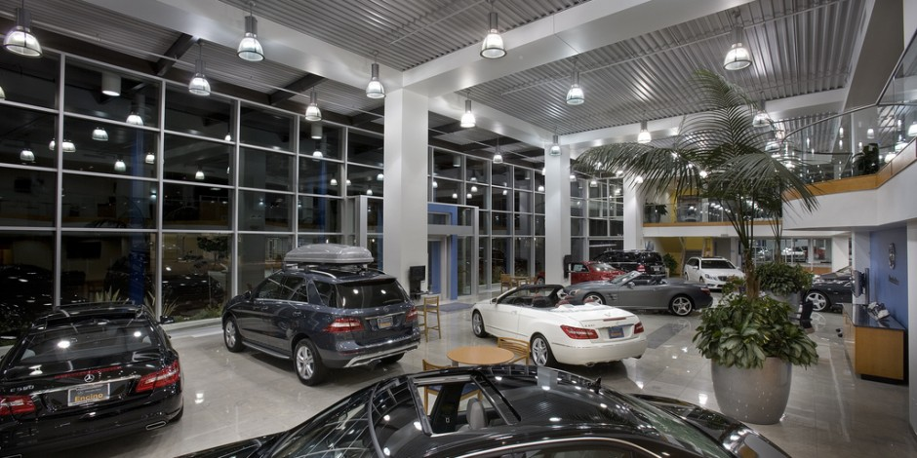
Illustration
Hulk is a Mercedes car dealer located in Pune.
Hulk sold Black Mercedes to Black Widow who is not registered under GST. However, Black Widow’s place of residence is Tamil Nadu.
Hulk has asked for your advice regarding chargeability of GST on above transaction.
Will your answer change if Black Widow asked for delivery at Tamil Nadu?
Answer:
CGST + SGST
In case of movement -charge IGST

Slide 36
Section 10 of IGST Act, 2017
10(1) The place of supply of goods, other than supply of goods imported into, or exported from India, shall be as under,—
(d) where the goods are assembled or installed at site, the place of supply shall be the place of such installation or assembly;

Slide 37
Section 10 of IGST Act, 2017
10(1) The place of supply of goods, other than supply of goods imported into, or exported from India, shall be as under,—
(e) where the goods are supplied on board a conveyance, including a vessel, an aircraft, a train or a motor vehicle, the place of supply shall be the location at which such goods are taken on board.
Notes:
Flight pre packed drinks – Canned juices example

Slide 38
Section 11 of IGST Act, 2017
(11) The place of supply of goods,—
(a) imported into India shall be the location of the importer;
(b) exported from India shall be the location outside India.

Slide 39
Place of Supply
Services

Slide 40
Location of Supplier and Recipient is in India

Slide 41
Section 12 of IGST Act, 2017
12(2) The place of supply of services, except the services specified in sub-sections (3) to (14),—
made to a registered person shall be the location of such person;
made to any person other than a registered person shall be,—
the location of the recipient where the address on record exists; and
the location of the supplier of services in other cases.
General Rule !

Slide 42
Section 12 of IGST Act, 2017
(3) The place of supply of services:
directly in relation to an immovable property, including services provided by architects, interior decorators, surveyors, engineers and other related experts or estate agents, any service provided by way of grant of rights to use immovable property or for carrying out or co-ordination of construction work; or
Shall be the location at which immovable property is located

Slide 43
Illustration
Ant Man is an Architect who is a registered person under GST is located in the state of Gujarat.
Thanos who is also registered under GST is located in the state of Maharashtra.
Thanos gave professional assignment to Ant Man of preparing construction plans for a site located in Vadodara, Gujarat.
Ant Man asks your advice for chargeability of GST for above transaction
Answer:
CGST + SGST (GJ)

Slide 44
Section 12 of IGST Act, 2017
(3) The place of supply of services:
(b) by way of lodging accommodation by a hotel, inn, guest house, home stay, club or campsite, by whatever name called, and including a house boat or any other vessel; or
shall be the location at which the immovable property or boat or vessel, as the case may be, is located or intended to be located:

Slide 45
Illustration
John Snow who knows nothing went on a trip to Rishikesh. John Snow is registered in the UT of Jammu & Kashmir.
John Snow booked a stay at Danaerys River Front Resort which is also registered under GST in Rishikesh, Uttarakhand.
Danaerys River Front Resort asks for your advice with regards to chargeability of GST
Answer:
CGST + SGST

Slide 46
Section 12 of IGST Act, 2017
(3) The place of supply of services:
(c) by way of accommodation in any immovable property for organising any marriage or reception or matters related thereto, official, social, cultural, religious or business function including services provided in relation to such function at such property; or
Shall be the location at which immovable property is located

Slide 47
Illustration
John Snow who is registered in the UT of Jammu & Kashmir booked a hall at Taj Mumbai for his marriage function with Danaerys
GST to be charged by Taj Mumbai?
Answer:
CGST + SGST

Slide 48
Section 12 of IGST Act, 2017
(3) The place of supply of services:
(d) any services ancillary to the services referred to in clauses (a), (b) and (c),
shall be the location at which the immovable property or boat or vessel, as the case may be, is located or intended to be located:

Slide 49
Section 12 of IGST Act, 2017
The place of supply of restaurant and catering services, personal grooming, fitness, beauty treatment, health service including cosmetic and plastic surgery shall be the location where the services are actually performed.

Slide 50
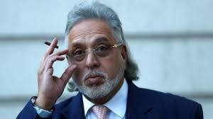
Illustration
Vijay Mallya who is a registered person in the state of Goa, threw a New Year Party at Talli & Co, Pune.
The restaurant Talli & Co wants your advice with regards to chargeability of GST on sale of food
Answer:
CGST + SGST (MH)

Slide 51
Section 12 of IGST Act, 2017
The place of supply of services in relation to training and performance appraisal to,—
(a) a registered person, shall be the location of such person;
(b) a person other than a registered person, shall be the location where the services are actually performed.

Slide 52
Illustration
Mr. Aman Gupta hosted an training event for start-up companies at Mumbai.
Lenskart who is registered at Banglore booked the entire event for its employees.
What is the chargeability?
Answer:
IGST

Slide 53
Illustration
Mr. Aman Gupta hosted an online training event for CA Students with regards to start-up.
Students from around the country joined the training session.
Aman Gupta is registered under GST at Mumbai and delivered online session from Mumbai.
Answer:
CGST + SGST (MH)

Slide 54
Section 12 of IGST Act, 2017
The place of supply of services provided by way of admission to a cultural, artistic, sporting, scientific, educational, entertainment event or amusement park or any other place and services ancillary thereto, shall be the place where the event is actually held or where the park or such other place is located.

Slide 55
Illustration
ICAI hosted National conference for its members at Jaipur
Admission fee for the Conference is charged by ICAI New Delhi
Member from Pune joined this conference and paid the admission fees
What is the chargeability?
Answer:
IGST
Notes:
Only admission fee. Other anciliary services are additionally charged

Slide 56
Section 12 of IGST Act, 2017
(7) The place of supply of services provided by way of,—
(a) organisation of a cultural, artistic, sporting, scientific, educational or entertainment event including supply of services in relation to a conference, fair, exhibition, celebration or similar events; or
(b) services ancillary to organisation of any of the events or services referred to in clause (a), or assigning of sponsorship to such events,—
(i) to a registered person, shall be the location of such person;
(ii) to a person other than a registered person, shall be the place where the event is actually held and if the event is held outside India, the place of supply shall be the location of the recipient.

Slide 57
Illustration
ICAI hosted National conference for its members at Jaipur
Entire Event Organizing fee for the Conference is charged by ICAI New Delhi
Member from Pune joined this conference and paid the admission fees
What is the chargeability?
In case Pune Member is registered under GST
In case Pune Member is not registered under GST
Answer:
IGST in both the cases
Notes:
Basically this is event management service. All inclusive package

Slide 58
Section 12 of IGST Act, 2017
(8) The place of supply of services by way of transportation of goods, including by mail or courier to,—
(a) a registered person, shall be the location of such person;
(b) a person other than a registered person, shall be the location at which such goods are handed over for their transportation.

Slide 59
Illustration
Bruce Wayne located in Maharashtra wants to send a courier package to Robin Hood who is situated at New Delhi.
Gotham & Company a courier agency delivers the package to Robin. Gotham & Co. is registered under GST at Maharashtra.
What is the chargeability of GST for Gotham & Co.?
Answer:
CGST + SGST
Notes:
Destination is irrelevant

Slide 60
Section 12 of IGST Act, 2017
(9) The place of supply of passenger transportation service to,—
(a) a registered person, shall be the location of such person;
(b) a person other than a registered person, shall be the place where the passenger embarks on the conveyance for a continuous journey:

Slide 61
Section 12 of IGST Act, 2017
(10) The place of supply of services on board a conveyance, including a vessel, an aircraft, a train or a motor vehicle, shall be the location of the first scheduled point of departure of that conveyance for the journey.

Slide 62
Section 12 of IGST Act, 2017
The place of supply of telecommunication services including data transfer, broadcasting, cable and direct to home television services to any person shall,—

Slide 63
Section 12 of IGST Act, 2017
(12) The place of supply of banking and other financial services, including stock broking services to any person shall be the location of the recipient of services on the records of the supplier of services:
Provided that if the location of recipient of services is not on the records of the supplier, the place of supply shall be the location of the supplier of services.

Slide 64
Section 12 of IGST Act, 2017
(13) The place of supply of insurance services shall,—
(a) to a registered person, be the location of such person;
(b) to a person other than a registered person, be the location of the recipient of services on the records of the supplier of services.

Slide 65
Section 12 of IGST Act, 2017
(14) The place of supply of advertisement services to the Central Government, a State Government, a statutory body or a local authority meant for the States or Union territories identified in the contract or agreement shall be taken as being in each of such States or Union territories and the value of such supplies specific to each State or Union territory shall be in proportion to the amount attributable to services provided by way of dissemination in the respective States or Union territories as may be determined in terms of the contract or agreement entered into in this regard or, in the absence of such contract or agreement, on such other basis as may be prescribed.

Slide 66
Illustration
CA Chaitanya S Vakharia was hired as an GST consultant for Avengers Limited.
CA Chaitanya S Vakharia is registered under GST in the state of MH.
Avengers Limited is registered under GST at Tamil Nadu, Chennai.
Please guide for chargeability of GST consultancy fees by CA Chaitanya S Vakharia to Avengers Limited.
Answer:
IGST
General Rule

Slide 67
Location of Supplier or Recipient is outside India

Slide 68
Export of Services
2(6) “export of services” means the supply of any service when
(i) the supplier of service is located in India;
(ii) the recipient of service is located outside India;
(iii) the place of supply of service is outside India;
(iv) the payment for such service has been received by the supplier of service in convertible foreign exchange or in Indian rupees wherever permitted by Reserve Bank of India ; and
(v) the supplier of service and recipient of service are not merely establishments of a distinct person in accordance with explanation 1 of section 8;

Slide 69
Import of Services
2(11) “import of service” means the supply of any service, where
(i) the supplier of service is located outside India;
(ii) the recipient of service is located in India; and
(iii) the place of supply of service is in India;

Slide 70
Section 13 of IGST Act, 2017
(2) The place of supply of services except the services specified in sub-sections (3) to (13) shall be the location of the recipient of services:
Provided that where the location of the recipient of services is not available in the ordinary course of business, the place of supply shall be the location of the supplier of services.
General Rule !

Slide 71
Section 13 of IGST Act, 2017
The place of supply of the following services shall be the location where the services are actually performed, namely:—
(a) services supplied in respect of goods which are required to be made physically available by the recipient of services to the supplier of services, or to a person acting on behalf of the supplier of services in order to provide the services:
Provided that when such services are provided from a remote location by way of electronic means, the place of supply shall be the location where goods are situated at the time of supply of services:

Slide 72
Illustration
Mr. Shaktiman located at Mumbai.
Mr. Shaktiman called Mr. Black Panther to India and paid Rs. $1,00,000 for the repairs of Shield.
What is the chargeability of GST?
Answer:
Import of Service

Slide 73
Illustration
Mr. Shaktiman located at Mumbai sent a shield for repairs to Black Panther at Wakanda (Outside India).
Mr. Shaktiman paid Rs. $100000 for the repairs.
What is the chargeability of GST?
Answer:
No GST as import of service condition not satisfied

Slide 74
Section 13 of IGST Act, 2017
The place of supply of the following services shall be the location where the services are actually performed, namely:—
Provided further that nothing contained in this clause shall apply in the case of services supplied in respect of goods which are temporarily imported into India for repairs or for any other treatment or process and are exported after such repairs or treatment or process without being put to any use in India, other than that which is required for such repairs or treatment or process;
(b) services supplied to an individual, represented either as the recipient of services or a person acting on behalf of the recipient, which require the physical presence of the recipient or the person acting on his behalf, with the supplier for the supply of services.

Slide 75
Section 13 of IGST Act, 2017
(4) The place of supply of services supplied directly in relation to an immovable property, including services supplied in this regard by experts and estate agents, supply of accommodation by a hotel, inn, guest house, club or campsite, by whatever name called, grant of rights to use immovable property, services for carrying out or co-ordination of construction work, including that of architects or interior decorators, shall be the place where the immovable property is located or intended to be located.

Slide 76
Section 13 of IGST Act, 2017
(5) The place of supply of services supplied by way of admission to, or organisation of a cultural, artistic, sporting, scientific, educational or entertainment or a celebration, conference, fair, exhibition or similar events, and of services ancillary to such admission or organisation, shall be the place where the event is actually held.

Slide 77
Section 13 of IGST Act, 2017
The place of supply of the following services shall be the location of the supplier of services, namely:—
(a) services supplied by a banking company, or a financial institution, or a non-banking financial company, to account holders;
(b) intermediary services;
(c) services consisting of hiring of means of transport, including yachts but excluding aircrafts and vessels, up to a period of one month.

Slide 78
Intermediary Services
Intermediary services have been defined to mean a broker, an agent or any other person, by whatever name called, who arranges or facilitates the supply of goods or services or both, or securities, between two or more persons, but does not include a person who supplies such goods or services or both or securities on his own account
Notes:
In case of outbound services C + S and in case of inbound services – No GST as place of supply will be outside India

Slide 79
Section 13 of IGST Act, 2017
(10) The place of supply in respect of passenger transportation services shall be the place where the passenger embarks on the conveyance for a continuous journey.

Slide 80
Section 13 of IGST Act, 2017
(11) The place of supply of services provided on board a conveyance during the course of a passenger transport operation, including services intended to be wholly or substantially consumed while on board, shall be the first scheduled point of departure of that conveyance for the journey.

Slide 81
Section 13 of IGST Act, 2017
(12) The place of supply of online information and database access or retrieval services shall be the location of the recipient of services.

Slide 82
Value of Supply

Slide 83
Section 15 of CGST Act, 2017
(2) The value of supply shall include—
(a) any taxes, duties, cesses, fees and charges levied under any law for the time being in force other than this Act, the State Goods and Services Tax Act, the Union Territory Goods and Services Tax Act and the Goods and Services Tax (Compensation to States) Act, if charged separately by the supplier;
(b) any amount that the supplier is liable to pay in relation to such supply but which has been incurred by the recipient of the supply and not included in the price actually paid or payable for the goods or services or both;

Slide 84
Section 15 of CGST Act, 2017
(2) The value of supply shall include—
c) incidental expenses, including commission and packing, charged by the supplier to the recipient of a supply and any amount charged for anything done by the supplier in respect of the supply of goods or services or both at the time of, or before delivery of goods or supply of services;
(d) interest or late fee or penalty for delayed payment of any consideration for any supply; and
(e) subsidies directly linked to the price excluding subsidies provided by the Central Government and the State Governments.
Explanation.— For the purposes of this sub-section, the amount of subsidy shall be included in the value of supply of the supplier who receives the subsidy.
Notes:
Packing & forwarding charges to be considered

Slide 85
Section 15 of CGST Act, 2017
(3) The value of the supply shall not include any discount which is given—
(a) before or at the time of the supply if such discount has been duly recorded in the invoice issued in respect of such supply; and
(b) after the supply has been effected, if—
such discount is established in terms of an agreement entered into at or before the time of such supply and specifically linked to relevant invoices; and
input tax credit as is attributable to the discount on the basis of document issued by the supplier has been reversed by the recipient of the supply.
Notes:
Cash & Trade Discount

Slide 86
For further queries,
CA Chaitanya Sunil Vakharia
Partner
Email: vakharia.chaitanya@gmail.com

