Slide 1




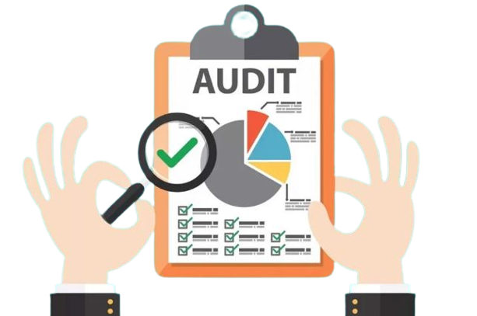
RERA-CERTIFICATIONS, IMP ORDERS & IMPACT
19.11.2023 By CA. ADITYA ZANTYE, FCA, DISA

Slide 2
DISCLAIMER:
The information contained in these PPT Slides is derived from public sources, which we believe to be reliable but which, without further investigation, cannot be warranted as to their accuracy, completeness or correctness and I am not obligated to update or amend the same. The information contained in these PPT Slides is not intended to be nor should be regarded as legal or professional advice and no one should act on such information without appropriate legal or professional advice. I do not accept any responsibility for any loss arising from any action taken or not taken by anyone using these slides.

Slide 3




TIMELY COMPLIANCES

Slide 4






1
2
2A
3
4
5

Slide 5

Sr. No. | Subject | Date | pdf
1. | MahaRERA General Regulations 2017 | 24/04/2017
2. | MahaRERA General (Amendment) Regulations 2017 | 11/10/2019
3. | MahaRERA General (Second Amendment) Regulations 2019 | 31/10/2019
4. | MahaRERA General (Amendment) Regulations 2021 | 22/12/2021

Slide 6

REGULATION 4

Slide 7
REGULATION 4
EARLIER
AMENDED
THE ANNUAL REPORT ON STATEMENT OF ACCOUNTS IN FORM 5 TO BE CERTIFIED AND SIGNED BY
THE ANNUAL REPORT ON STATEMENT OF ACCOUNTS IN FORM 5 TO BE CERTIFIED AND SIGNED BY
STATUTORY AUDITOR
ANNUAL AUDITOR

Slide 8
FORM 3-CA CERTIFICATE [REGISTRATION & WITHDRAWAL
SUBJECT CLAUSE CERTIFYING FINANCIAL PROGRESS OF WORK
ISSUED FOR RERA COMPLIANCE
SEVEN TABLES INTRODUCED
CERTIFYING DEPOSIT & UTILISATION FOR LAND & CONSTRUCTION OF PROJECT
COUNTER SIGNATURE OF PROMOTER

Slide 9
TABLE A- ESTIMATED COST OF THE PROJECT
SEPARATE TABLE FOR ESTIMATED COST
AT THE TIME OF REGISTRATION OF PROJECT SUBJECT TO CHANGE
ONLY ESTIMATED COST OF CONSTRUCTION BY ENGINEER TO BE MENTIONED
PROVISION FOR COST INCURRED FOR ADDITIONAL ITEMS AS PER TABLE A & B OF ENGINEER CERTIFICATE
PASS THROUGH CHARGES/INDIRECT TAXES EXCLUDED
CAN BE REVISED THROUGH CORRECTION APPLICATION
ABSORBED COST OF MACHINERIES &
EQUIPMENT

Slide 10
TABLE B- ACTUAL COST OF THE PROJECT
SEPARATE TABLE FOR ACTUAL COST
MINIMUM OF ACTUAL COST OF CONSTRUCTION BY ENGINEER OR CA TO BE MENTIONED
PROVISION FOR COST INCURRED FOR ADDITIONAL ITEMS AS PER TABLE A & B OF ENGINEER CERTIFICATE
PASS THROUGH CHARGES/INDIRECT TAXES EXCLUDED
ABSORBED COST OF MACHINERIES &
EQUIPMENT

Slide 11
TABLE C- STATEMENT FOR CALCULATION OF RECEIVABLES
STATEMENT FOR CALCULATION OF RECEIVABLES
SOLD INVENTORY
UNSOLD INVENTORY
PASS THROUGH CHARGES/INDIRECT TAXES EXCLUDED FROM UNIT CONSIDERATION

Slide 12
TABLE D- COMPARISON BETWEEN BALANCE COST & RECEIVABLES
ESTIMATED BALANCE COST TO COMPLETE
BALANCE AMOUNT OF RECEIVABLES-SOLD APARTMENTS
ESTIMATED UNSOLD SALES
TOTAL ESTIMATED RECEIVABLES
70%/ 100% CHECK ONLY FOR ONGOING PROJECTS
APPLICABLE TO ALL PROJECTS

Slide 13
TABLE E-DESIGNATED BANK ACCOUNT DETAILS
S. NO. | PARTICULARS | DESIGNATED BANK ACCOUNT DETAILS
 |  | ACTUAL AMOUNT TILL DATE [FROM START OF BANK ACCOUNT TO TILL DATE]
1. | OPENING BALANCE | NIL
2. | DEPOSITS
3. | WITHDRAWALS
4. | CLOSING BALANCE

Slide 14
TABLE F-MEANS OF FINANCE
S. NO. | PARTICULARS | ESTIMATED* (AT THE TIME OF REGISTRATION)(IN ₹) (PROPOSED & INDICATIVE) | PROPOSED/ ESTIMATED (AS ON THE DATE OF THE CERTIFICATE) (IN ₹) | ACTUAL (AS ON DATE OF CERTIFICATE) (IN ₹)
1. | OWN FUNDS | 25 | 25 | 15
2. | TOTAL BORROWED FUNDS (SECURED) -DRAWDOWN AVAILED TILL DATE | 50 | 50 | 25
3. | TOTAL BORROWED FUNDS (UNSECURED) -DRAWDOWN AVAILED TILL DATE | 25 | 25 | 15
4. | CUSTOMER RECEIPTS USED FOR PROJECT | 200 | 200 | 50
5. | TOTAL FUNDS FOR PROJECT | 300 | 300 | 105
6. | TOTAL ESTIMATED COST [AS PER TABLE A] | 275 | 275 | 125

Slide 15
TABLE G- ANY COMMENTS / OBSERVATIONS OF CA
ANY EXCEPTIONS IN LAND COST AND CONSTRUCTION COST
ANY DISCREPANCY IN BANK ACCOUNT OPERATIONS
SOLD & UNSOLD INVENTORY
PASS THROUGH CHARGES/INDIRECT TAXES INCLUDED IN UNIT CONSIDERATION
DEPOSIT & UTILISATION OF CUSTOMER RECEIPTS
OTHER EXCEPTIONS RELATED TO PROJECT

Slide 16
FORM 5-ANNUAL REPORT ON STATEMENT OF ACCOUNTS
SUBJECT CLAUSE CERTIFYING DEPOSIT, UTILIZATION & WITHDRAWAL
FOUR TABLES & 2 SUB-TABLES INTRODUCED
SHORTFALL DEPOSIT AMOUNT TO BE PROVIDED
DATE WISE DETAILS OF EXCESS WITHDRAWALS TO BE PROVIDED
DATE WISE DETAILS OF NON-UTILISATION FOR PROJECT COST TO BE PROVIDED
COUNTER SIGNATURE OF PROMOTER

Slide 17
TABLE A-DEPOSITS
S. NO. | PARTICULARS | FOR THIS FISCAL YEAR | TOTAL FOR THIS PROJECT TILL DATE
1. | TOTAL AMOUNT COLLECTED FROM ALLOTTEES | 50 | 100
2. | % OF AMOUNT TO BE DEPOSITED AS PER ACT | 70%/100% | 70%/100%
3. | AMOUNT TO BE DEPOSITED AS PER ACT (1*2) | 35 | 70
4. | TOTAL AMOUNT DEPOSITED IN THE DESIGNATED BANK ACCOUNT | 30 | 60
5. | % OF AMOUNT DEPOSITED IN DESIGNATED BANK ACCOUNT [(4)/(1)*100] | 60% | 60%
6. | SHORTFALL/(EXCESS) DEPOSIT (3-4) | 5 | 10

Slide 18

TABLE B-WITHDRAWALS
S. NO. | PARTICULARS | FOR THIS FISCAL YEAR | TOTAL FOR THIS PROJECT TILL DATE
1. | OPENING BALANCE OF DESIGNATED BANK ACCOUNT
2. | TOTAL DEPOSITS
3. | TOTAL AMOUNT WITHDRAWN
4. | CLOSING BALANCE

Slide 19
TABLE D- ANY COMMENTS / OBSERVATIONS OF CA
EXCEPTIONS RELATING TO DEPOSIT, UTILISATION & WITHDRAWALS
ANY DISCREPANCY IN FORM 1, 2 & 3
OTHER EXCEPTIONS RELATED TO PROJECT

Slide 20
FORM 1-ARCHITECT CERTIFICATE [REGISTRATION & WITHDRAWAL]
PLOT DETAILS, LATTITUDE & LONGITUDE, AREA, NEWS DELETED FROM SUBJECT CLAUSE
CERTIFICATE CAN BE ISSUED FOR THE ENTIRE LAYOUT
LIST OF TECHNICAL PROFESSIONALS DELETED
NUMBER OF BASEMENTS, PODIUMS, PLINTH & SLABS OF SUPER STRUCTURE DELETED
COUNTER SIGNATURE OF PROMOTER

Slide 21
FORM 2-ENGINEER CERTIFICATE [REGISTRATION & WITHDRAWAL]
PLOT DETAILS, LATTITUDE & LONGITUDE, AREA, NEWS DELETED FROM SUBJECT CLAUSE
CERTIFICATE CAN BE ISSUED FOR THE ENTIRE LAYOUT
LIST OF TECHNICAL PROFESSIONALS DELETED
ESTIMATED COST OF CIVIL, MEP, ALLIED WORKS, INTERNAL & EXTERNAL WORKS AS PER SPECIFICATIONS MENTIONED IN AGREEMENT OF SALE

Slide 22
FORM 2-ENGINEER CERTIFICATE [REGISTRATION & WITHDRAWAL]
ACTUAL COST INCURRED TO BE ON THE BASIS OF INPUT MATERIAL OR SERVICES USED & UNIT COST OF THESE ITEMS
COMPLETE PROJECT AS PER APPROVED DRAWINGS & SPECIFICATIONS MENTIONED IN AGREEMENT FOR SALE
AMENDMENT IN COST INCURRED OR TO BE INCURRED DUE TO DEVIATION IN QTY REQUIRED OR ESCALATION OF COST

Slide 23
FORM 2-ENGINEER CERTIFICATE [REGISTRATION & WITHDRAWAL]
DEVIATION IN MATERIAL USED TO BE REPORTED
LOCAL AUTHORITY LICENSE NO IF APPLICABLE
DELETED ITEMS TO BE MENTIONED IN TABLE C
COUNTER SIGNATURE OF PROMOTER

Slide 24
FORM 2A-QUALITY ASSURANCE
PLOT DETAILS, LATTITUDE & LONGITUDE, AREA, NEWS DELETED FROM SUBJECT CLAUSE
TO BE ISSUED YEARLY
MATERIAL WISE DETAILS DELETED
SPECIFICATIONS-AS PER ANNX F OF AGREEMENT FOR SALE
NO SPECIFICATIONS-AS PER INDUSTRY STANDARDS
COUNTER SIGNATURE OF PROMOTER

Slide 25
FORM 4-ARCHITECT CERTIFICATE [ON COMPLETION]
PLOT DETAILS, LATTITUDE & LONGITUDE, AREA, NEWS DELETED FROM SUBJECT CLAUSE
CERTIFICATE CAN BE ISSUED FOR THE ENTIRE PROJECT
LIST OF TECHNICAL PROFESSIONALS DELETED
ON THE BASIS OF INSPECTION & CERTIFICATE FROM STRUCTURAL ENGINEER
COMPLETE AS PER AGREEMENT OF SALE
COUNTER SIGNATURE OF PROMOTER

Slide 26
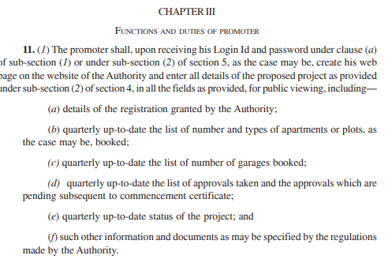
SECTION 11

Slide 27
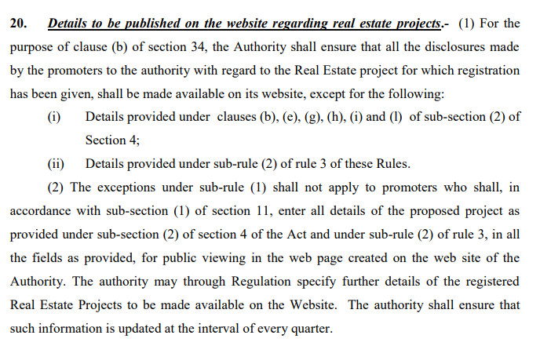
RULE 20

Slide 28
Order no. 33/2022 dated 05/07/2022
Order no. 18/2021 dated 28/07/2021

Slide 29

PROMOTER- COMPLIANCES

Slide 30

QUARTERLY UPDATES

Slide 31
FINANCIAL QUARTER BASED PROJECT PROGRESS REPORTING SYSTEM
FINANCIAL QUARTERS | DUE-DATE
APR-MAY-JUN | 20TH JUL
JUL-AUG-SEP | 20TH OCT
OCT-NOV-DEC | 20TH JAN
JAN-FEB-MAR | 20TH APR

Slide 32
FINANCIAL QUARTER BASED PROJECT PROGRESS REPORTING SYSTEM
BUILDING PLAN APPROVALS
PHYSICAL PROGRESS
BOOKING STATUS
PARKING
NO WITHDRAWAL-SELF DECLARATION
MENTION DEPOSIT IN DECLARATION

Slide 33
QUARTERLY-COVEYANCE REPORT?
QUARTERLY UP-TO-DATE STATUS REGARDING STEPS BY PROMOTER FOR CONVEYANCE DEED
ORDER NO 20/2021 DATED 28/07/2021

Slide 34

PROMOTER- COMPLIANCES

Slide 35
ANNUAL UPDATES
TYPE OF FORM | DUE-DATE
FORM 2A | 30TH JUN
FORM 5 | 30TH SEP

Slide 36
FORM 1,2,3 UPDATION
AT THE TIME OF REGISTRATION
PREVIOUS LIMIT FULLY UTILISED
INTERVAL OF 90 DAYS

Slide 37

STATUTE | CERTIFICATES TO BE SUBMITTED TO BANK?
RERA Act | YES
Maharera Rules & Regulations | YES
Circular No. 3/2017 dated 07th June 2017 | NO. ONLY SELF-DECLARATION TO BE SUBMITTED [DELETED]
FAQ No. 58 dated 23rd July 2019 | YES. ORIGINAL TO BE RETAINED & COPIES TO BE SUBMITTED TO BANK
Circular No. 39/2021 dated 28th Dec 2021 | YES. SUBMIT TO BANK AT THE TIME OF EVERY WITHDRAWAL & COPIES ONLINE TO MAHARERA
Circular No. 39A/2022 dated 17th Mar 2022 | YES. BUT IF WITHDRAWAL IN TRANCHES SAME CERTIFICATE & DECLARATION

Slide 38

PROMOTER- COMPLIANCES

Slide 39
REGULAR UPDATES
ENCUMBRANCE REPORT
CERSAI
PROJECT PROFESSIONALS
FORMATION OF SOCIETY
LITIGATION DETAILS

Slide 40

PROMOTER- COMPLIANCES

Slide 41

ON COMPLETION OF PROJECT
FORM 4
OC
DISCLOSURE BY PROMOTER & AOA ON CONVEYANCE

Slide 42
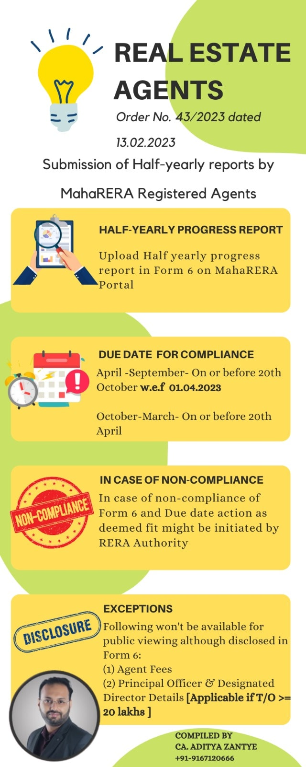

Slide 43
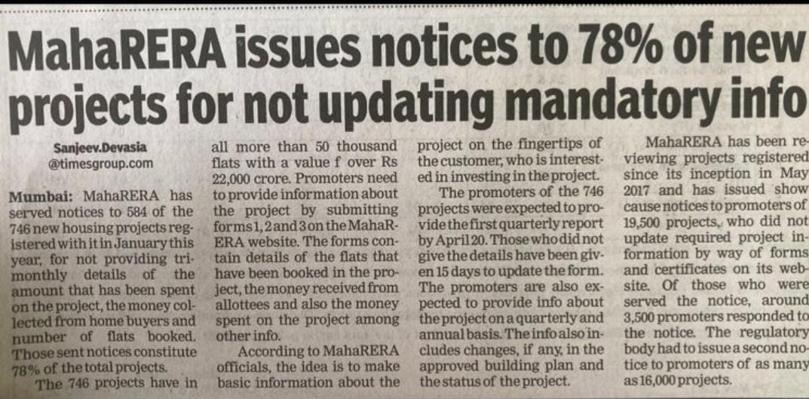

Slide 44
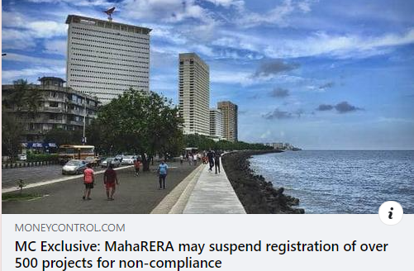

Slide 45
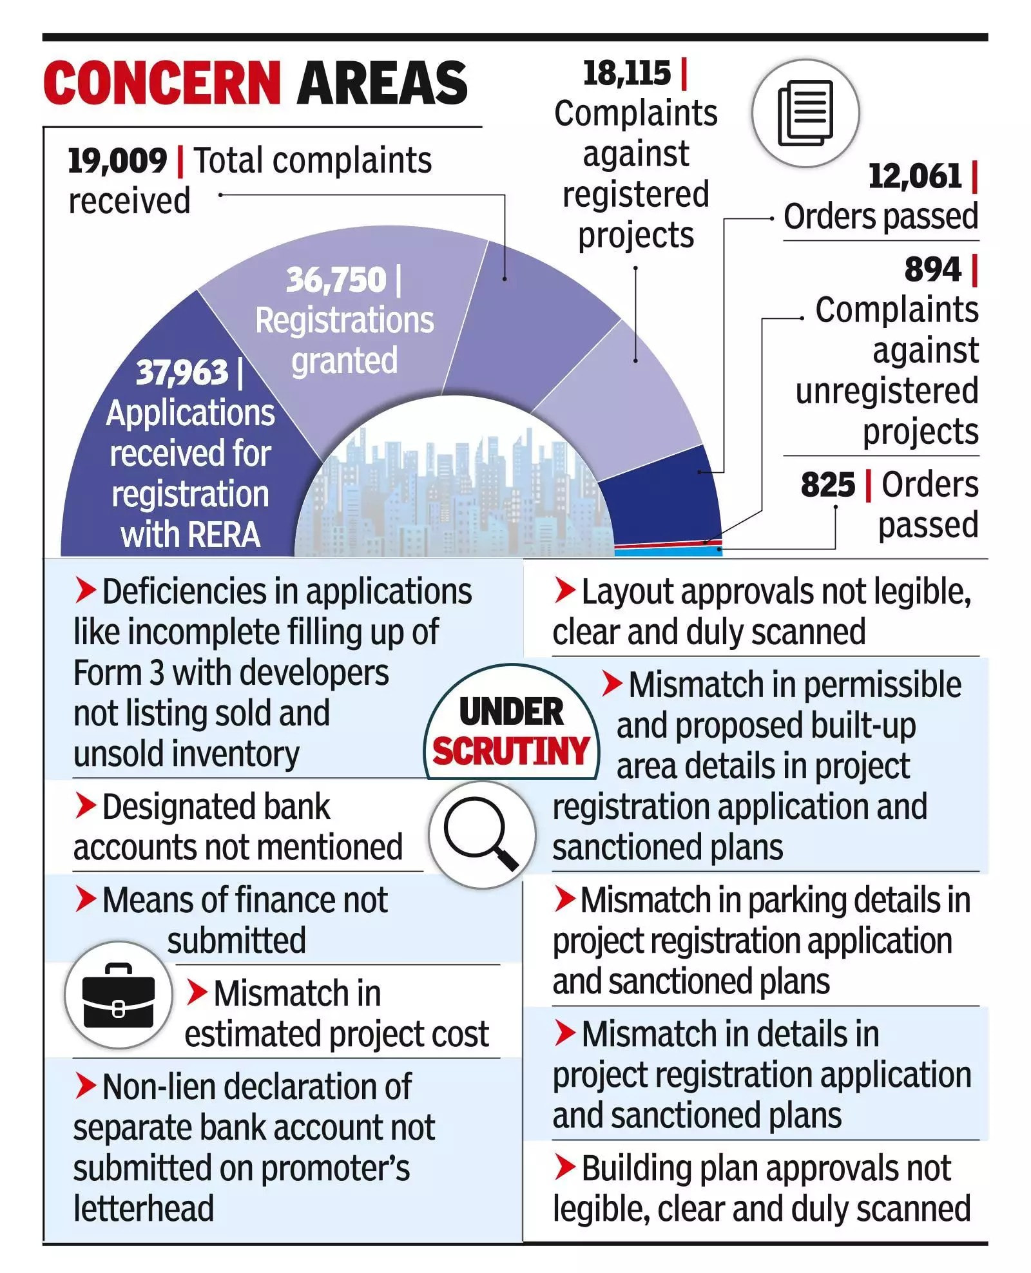

Slide 46
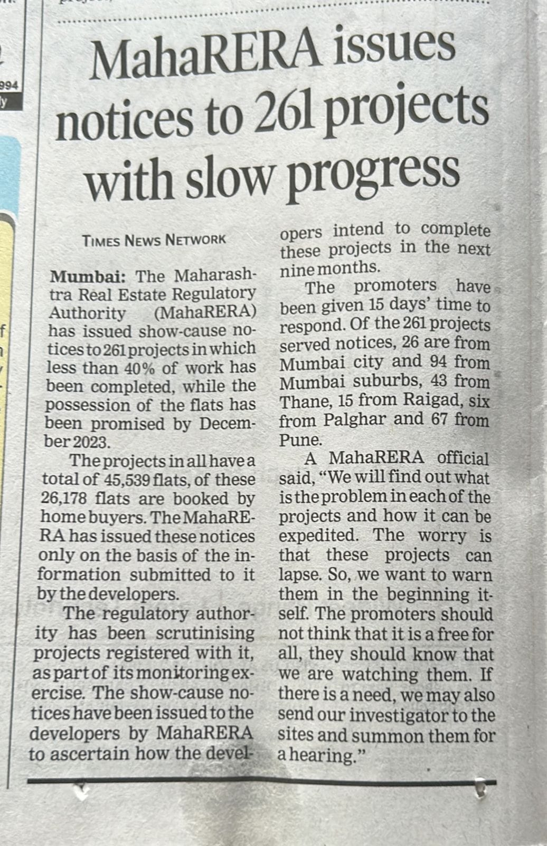

Slide 47
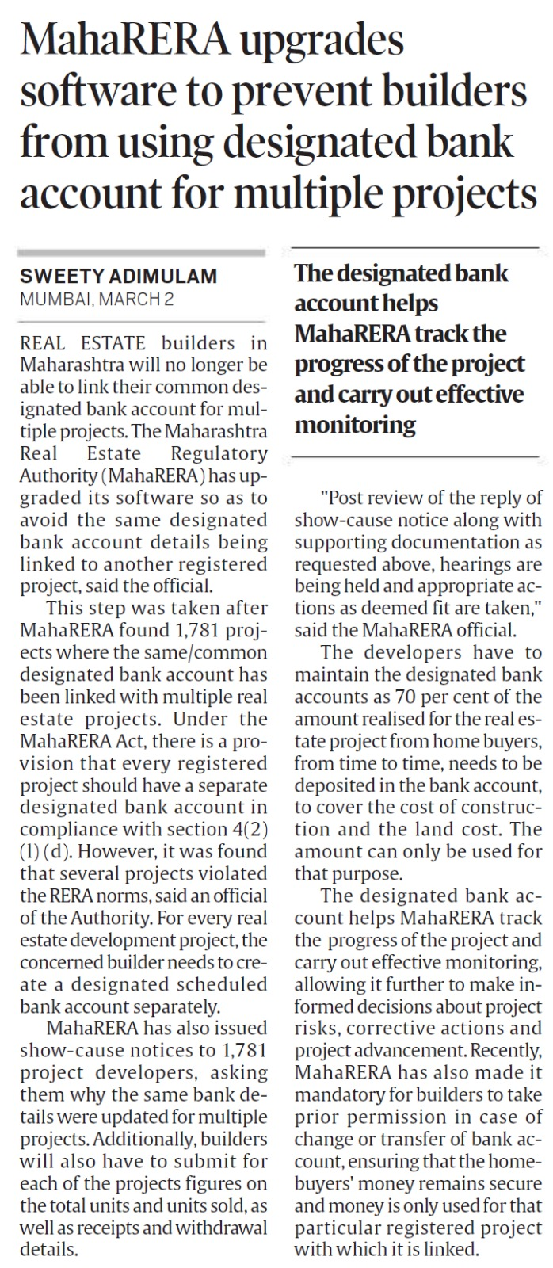
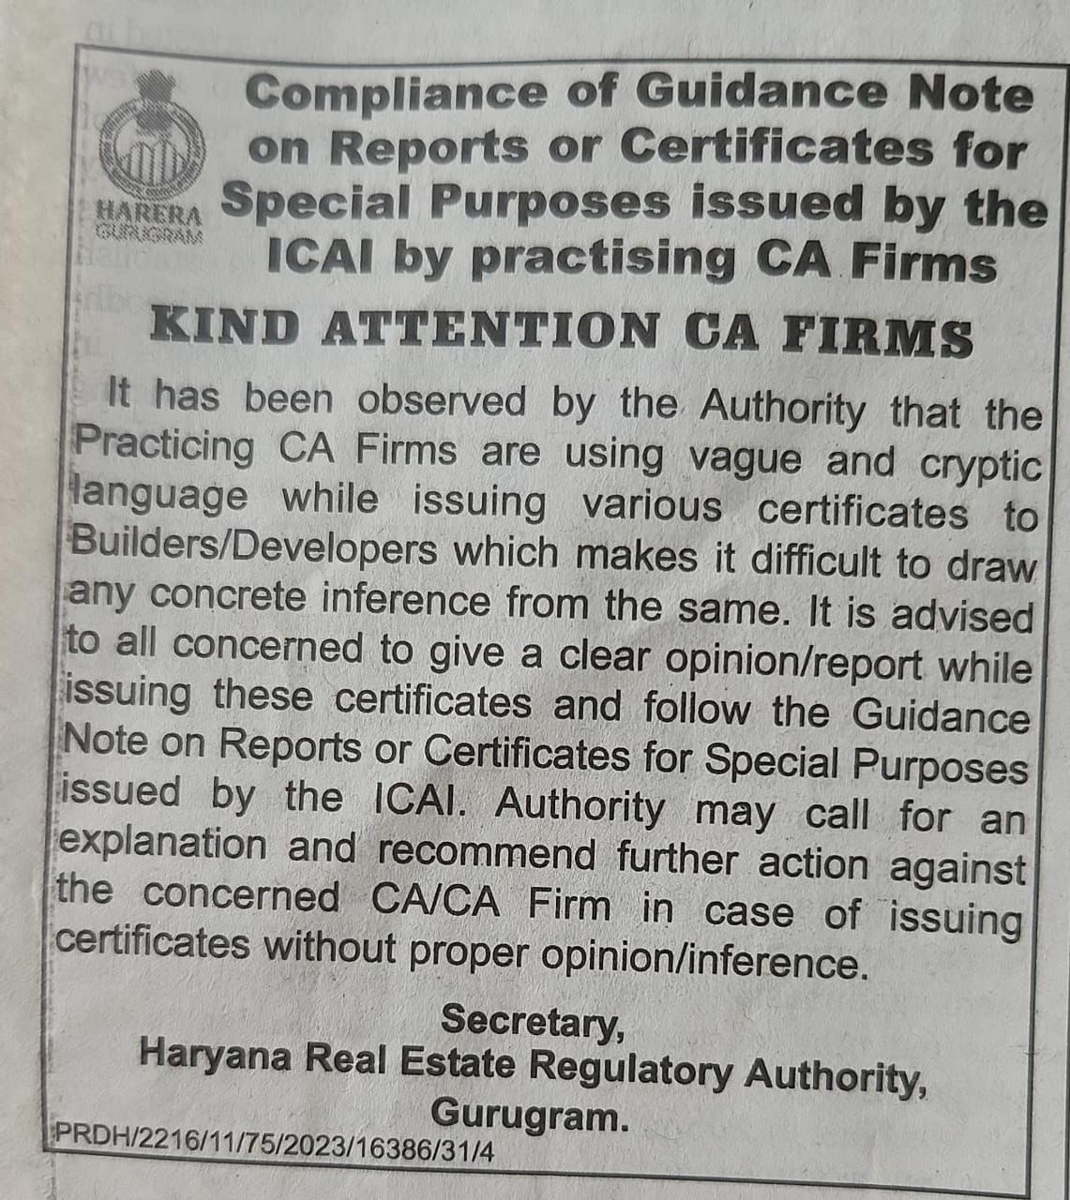

Slide 48
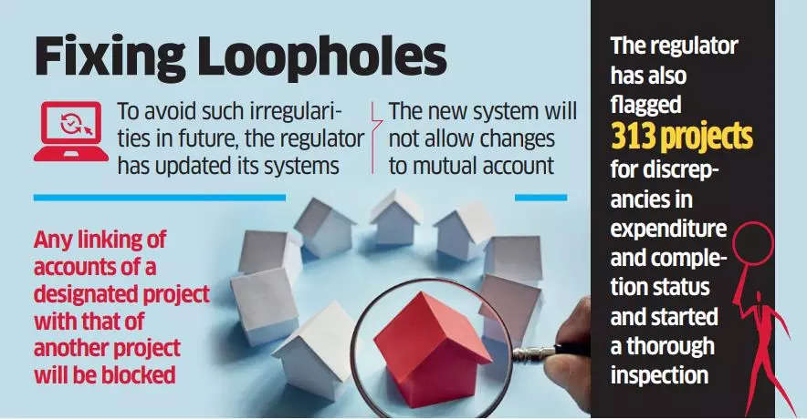

Slide 49


CA. Aditya Zantye
Partner
A K O R D & Co.
✉ aditya.zantye@gmail.com
📱 +91-9167120666

