Slide 1

Organized by : Pune Branch of WIRC of ICAI Jointly with Pune Branch of WICASA of ICAI.
Speaker CA Mohit Dhand +91 8956278566 camohitdhand@gmail.com
Seminar on Standard on Auditing Saturday -28th October 2023

Slide 2
Applicability – Ethical Principles
The Chartered Accountants Act. 1949
Code of Ethics
Companies Act, 2013
AGENDA
Framework on Engagement Standards
Standards on Auditing (SAs)
Standard on Review Engagements (SREs)
Standard on Assurance Engagements (SAEs)
Standard on Related Services (SRSs)
Standard on Quality Control ( SQC)
Key Standard for Discussion
Standard on Auditing – SA 240 Auditor's responsibility relating to fraud in an audit. - CA Mohit Dhand

Slide 3
Why Are Auditing Standards Important
PRINCIAPLE BASED STANDARDS – Applicable to all Practicing Chartered Accountants
Auditing Standards are mandatory to be by followed by practitioners under the direction issued by the Council of ICAI.
01
ICAI
Section 143(9) of the Companies Act, 2013 requires every auditor to comply with the Auditing Standards.
02
Companies Act
If not complied with Auditing Standards in performing Assurance Engagement, CA shall be held guilty of Professional misconduct under Schedule-II to the Chartered Accountants Act, 1949.
03
Ethics - ICAI

Slide 4
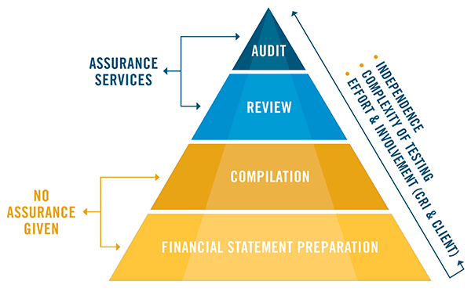
Framework – Nature of Services
Framework of auditing, assurance and other related services
 | Auditing | Review and Assurance | Related Services
Nature of services | Audit | Review | Agreed upon procedures | Compilation
Level of assurance | High assurance (not absolute) | Moderate assurance | No assurance | No assurance
Report provided | Positive assurance on assertion “In our opinion …..true and fair view | Negative assurance on assertion “Nothing has come to our attention” | Factual findings of procedures | Identification of information complied. Not attempt to verify

Slide 5
Structure of Standards issued by the Auditing and Assurance Standards Board (AASB)
Standards on Quality Control (SQC1)
Framework for Assurance Services
Framework for Related Services
Audits and Reviews of historical financial information
Assurance engagements other than audits or reviews of historical financial information
Standards on Auditing
(SA) 100 - 899
Standards on Review Engagements
(SREs) 2000 - 2699
Standards on Assurance Engagements
(SAEs) 3000 - 3699
Standards on Related Services
(SRSs) 4000 - 4699

Slide 6
Engagement and Quality Control Standards
Standards Issued till date
A - SQC 1 – ( 1 Issued)
“Quality Control for Firms that Perform Audit and Reviews of Historical Financial Information, and other Assurance and Related Services Engagements”
A - SQC
C. 2000-2699 Standards on Review Engagements (SREs) (2 Issued)
B - SA
B - Standard on Auditing ( 38 Issued)
100-199 Introductory Matters
200-299 General Principles and Responsibilities ( 9 Issued)
300-499 Risk Assessment and Response to Assessed Risks ( 6 Issued)
500-599 Audit Evidence (11 Issued)
600-699 Using Work of Others ( 3 issued)
700-799 Audit Conclusions and Reporting ( 6 Issued)
800-899 Specialized Areas ( 3 issued)
D. 3000-3699 Standards on Assurance Engagements (SAEs)
3000-3399 Applicable to All Assurance Engagements
3400-3699 Subject Specific Standards ( 3 issued)
C - SREs
D - SAEs
E. Related Services
4000-4699 Standards on Related Services (SRSs) ( 2 issued)
E - SRSs

Slide 7
Standards on Auditing (SA)
Audits of historical financial information
200-299 General Principles and Responsibilities
SA 200 - Overall Objectives of the Independent Auditor and the Conduct of an Audit in Accordance with Standards on Auditing
SA 210 - Agreeing the Terms of Audit Engagements
SA 220 - Quality Control for an Audit of Financial Statements
SA 230 - Audit Documentation
SA 240 - The Auditor’s Responsibilities Relating to Fraud in an Audit of Financial Statements
SA 250 - Consideration of Laws and Regulations in an Audit of Financial Statements
SA 260 - Communication with Those Charged with Governance
SA 265 – Communicating Deficiencies in Internal Control with those Charged with Governance and Management
SA 299 – Joint Audit of Financial Statements
300-499 Risk Assessment and Response to Assessed Risks
SA 300 - Planning an Audit of Financial Statements
SA 315 - Identifying and Assessing the Risks of Material Misstatement Through Understanding the Entity and Its Environment
SA 320 - Materiality in Planning and Performing an Audit
SA 330 - The Auditor’s Responses to Assessed Risks
SA 402 - Audit Considerations Relating to an Entity Using a Service Organisation
SA – 450 Evaluation of Misstatements Identified During the Audit

Slide 8
Standards on Auditing (SA)
500-599 Audit Evidence
SA 500 - Audit Evidence
SA 501 - Audit Evidence-Specific Considerations for Selected Items
SA 505 - External Confirmations
SA 510 - Initial Audit Engagements – Opening Balances
SA 520 - Analytical Procedures
SA 530 - Audit Sampling
SA 540 - Auditing Accounting Estimates, Including Fair Value Accounting Estimates, and Related Disclosures
SA 550 - Related Parties
SA 560 - Subsequent Events
SA 570 - Going Concern
SA 580 - Written Representations
600-699 Using work of others
SA 600 - Using the Work of Another Auditor
SA 610 - Using the Work of Internal Auditors
SA 620 - Using the Work of an Auditor’s Expert

Slide 9
Standards on Auditing (SA)
700-799 Audit Conclusions and Reporting
SA 700 - Forming an Opinion and Reporting on Financial Statements
SA 701 - Communicating Key Audit Matters in the Independent Auditor’s Report
SA 705 - Modifications to the Opinion in the Independent Auditor’s Report
SA 706 - Emphasis of Matter Paragraphs and Other Matter Paragraphs in the Independent Auditor’s Report
SA 710 - Comparative Information—Corresponding Figures and Comparative Financial Statements
SA 720 - The Auditor’s Responsibility Relating to Other Information in Documents
800-899 Specialized Areas
SA 800 - Special Considerations-Audits of Financial Statements Prepared in Accordance with Special Purpose Frameworks
SA 805 - Special Considerations-Audits of Single Financial Statements and Specific Elements, Accounts or Items of a Financial Statement
SA 810 - Engagements to Report on Summary Financial Statements

Slide 10
Standards on Review Engagement (SRE)
Reviews of historical financial information
2000-2699 Standards on Review Engagements (SREs)
SRE 2400 - Engagements to Review Historical Financial Statements
Example - Limited Review of Financial Statements carried out by a practitioner (other than statutory auditor of the company) at special request of management to take decision about prospective demerger.
SRE 2410 - Review of Interim Financial Information Performed by the Independent Auditor of the Entity
Example - Quarterly / Half yearly Limited Review performed by statutory auditor of the listed company to comply with the requirements laid down by SEBI

Slide 11
Standards on Assurance Engagement (SAE)
Assurance engagements other than audits and reviews of historical financial information
3000-3699 Standards on Assurance Engagements (SAEs)
3400-3699 Subject Specific Standards
SAE 3400 - The Examination of Prospective Financial Information
Example - Financial information examined by a practitioner for various purpose like Loan Finance, Valuation of Business, etc.
SAE 3402 - Assurance Reports on Controls At a Service Organisation
Example - Audit of a Knowledge Process Outsourcing (KPO) Organisation on behalf of an entity whose accounts are being maintained by KPO
SAE 3420 - Assurance Engagements to Report on the Compilation of Pro Forma Financial Information Included in a Prospectus
Example - Audit of Financial Information to be included in Prospectus with reference to Initial Public Offer of the company
3000-3399 Applicable to All Assurance Engagements

Slide 12
Standards on Related Services (SRS)
Engagements of related services such as agreed upon procedures, compilation engagements and other related services
4000-4699 Standards on Related Services (SRSs)
SRS 4400 - Engagements to Perform Agreed-upon Procedures Regarding Financial Information
Example - Report on Physical Inventory Verification for internal use of management
SRS - 4410 Compilation Engagements
Example - Report on Preparation of MIS for management’s internal reporting

Slide 13
Key Discussion
A. Standards on Quality Control (SQCs) - SQC 1, “Quality Control for Firms that Perform Audit and Reviews of Historical Financial Information, and other Assurance and Related Services Engagements”
B. Standards on Auditing (SAs) –
SA 230, Audit Documentation
SA 240, The Auditor’s Responsibilities Relating to Fraud in an Audit of Financial Statements
SA 500, Audit Evidence
SA 570, Going Concern
SA 700, Forming an Opinion and Reporting on Financial Statements

Slide 14
The firm’s system of quality control should include policies and procedures addressing each of the following elements:
SQC 1 and Elements of a System of Quality Control 1
Leadership responsibilities for quality within the firm
SQC 1 -It is a mother Standard for all other Standards and is all pervasive Standard in respect of quality control. As the name suggests, the SQC 1 contains extensive requirements in relation to establishment;
The firm should establish a system of quality control designed to provide it with reasonable assurance that the firm and its personnel comply with professional standards and regulatory and legal requirements, and that reports issued by the firm or engagement partner(s) are appropriate in the circumstances.
Ethical requirements
Acceptance and continuance of client relationships and specific engagements.
Human resources
Engagement performance and Monitoring

Slide 15
SA 240, The Auditor’s Responsibilities Relating to Fraud in an Audit of Financial Statements

Slide 16
SA 240, The Auditor’s Responsibilities Relating to Fraud in an Audit of Financial Statements
1) Scope :
This Standard on Auditing (SA) deals with the auditor’s responsibilities relating to fraud in an audit of financial statements. Specifically, it expands on how -SA 315, Identifying and Assessing the Risks of Material Misstatement Through Understanding the Entity and Its Environment and SA 330, The Auditor’s Responses to Assessed Risks
are to be applied in relation to risks of material misstatement due to fraud.
2) Effective date :
This SA is effective for audits of financial statements for periods beginning on or after April 1, 2009.
3) Objectives :
The objectives of the auditor are:
· To identify and assess the risk of material misstatement in the financial statements due to fraud;
· To obtain sufficient appropriate audit evidence about the assessed risk of material misstatement due to fraud, through designing and implementing appropriate responses;
· To respond appropriately to identified or suspected fraud

Slide 17
4) Definitions :
Fraud – An intentional act by one or more individuals among management, those charged with governance, employees, or third parties, involving the use of deception to obtain an unjust or illegal advantage.
Fraud risk factors – Events or conditions that indicate an incentive or pressure to commit fraud or provide an opportunity to commit fraud.

Slide 18
Types of Fraud – SA 240
Fraud takes place due to: 1-Incentives/Pressures, 2- Opportunities , 3- Attitudes/Rationalizations
Fraudulent Financial Reporting
Misappropriation
of
Assets
Manipulation, Falsification of accounting records/ supporting documents
Intentional omission of FS events/transactions
Misapplication of accounting principles, polices
Recording Fictitious journal entry, particularly at the end of period to manipulate operating results or achieving other objectives
Inappropriate adjusting assumptions/ Judgements
Embezzling Receipts
Stealing physical assets or intellectual property
Causing an entity to pay for goods/ services not received
Using entity’s assets for personal use

Slide 19
5. Requirements :
Professional Scepticism:
The auditor shall maintain professional skepticism throughout the audit, notwithstanding the auditor’s past experience
Unless the auditor has reason to believe the contrary, the auditor may accept records and documents as genuine. If conditions identified during the audit cause the auditor to believe that a document may not be authentic or that terms in a document have been modified but not disclosed to the auditor, the auditor shall investigate further.
Discussion Among the Engagement Team
SA 315 requires a discussion among the engagement team members and a determination by the engagement partner of matters which are to be communicated to those team members not involved in the discussion.
This discussion shall place particular emphasis on how and where the entity’s financial statements may be susceptible to material misstatement due to fraud, including how fraud might occur. The discussion shall occur notwithstanding the engagement team members’ beliefs that management and those charged with governance are honest and have integrity.

Slide 20
Audit Procedure – SA 240
Risk Assessment Procedures and Related Activities
Identification and Assessment of the Risks of Material Misstatement Due to Fraud
Responses to the Assessed Risks of Material Misstatement Due to Fraud
Reporting as per CARO para 3 clause X
Duty to Report
Fraud as per section 143 (12)
Inquiry of management & others within the entity
Inquiry of TCWG
Evaluate whether unexpected relationship identified in Analytical procedure
Evaluation of FRF
SA 315 – Identify & assess the Risk of Material Mismanagement at FS level & at assertion level
Obtain understanding of entity related controls
Responses as per SA 330 to address assessed RMM
Auditor should be–
  More professional scepticism
  More experienced staff
  More evaluation of A/c principles
  More control
1- Whether any fraud is committed by the employees / Management of the company? If yes, Report the nature and amount involved
2. Sec 143(12)- Report fraud to audit committee and if amount of fraud > 1Cr then report to CG immediately, maximum within 2 days.

Slide 21
Auditor Unable to Continue the Engagement
The auditor encounters exceptional circumstances that bring into question the auditor’s ability to continue performing the audit, the auditor shall:
Determine the professional and legal responsibilities applicable in the circumstances, including whether there is a requirement for the auditor to report to the person or persons who made the audit appointment or, in some cases, to regulatory authorities;
Consider whether it is appropriate to withdraw from the engagement, where withdrawal from the engagement is legally permitted; and
If the auditor withdraws:
  Discuss with the appropriate level of management and those charged with governance, the auditor’s withdrawal from the engagement and the reasons for the withdrawal; and
Determine whether there is a professional or legal requirement to report to the person or persons who made the audit appointment or, in some cases, to regulatory authorities, the auditor’s withdrawal from the engagement and the reasons for the withdrawal.

Slide 22
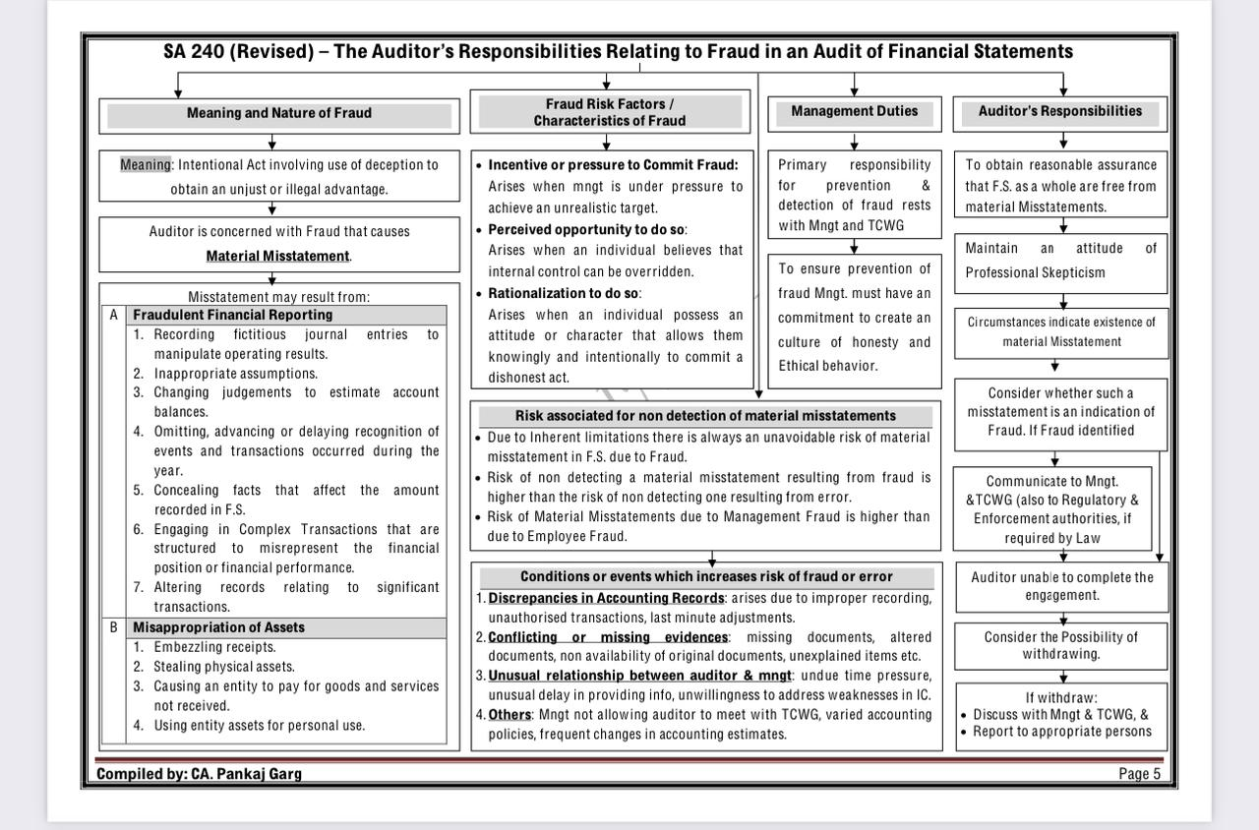

Slide 23
The National Financial Reporting Authority (NFRA) Recent circular to auditors of entities regulated by NFRA on 26.06.2023. : Observations and Circular Related to SA 240 (Ref IL & FS Case)
Auditors are not consistently fulfilling their statutory responsibilities related to reporting fraud as required by the Companies Act, 2013 (CA 2013), Companies (Auditor’s Report) Order (CARO), and Standards on Auditing (SAs).
Section 143(12) of CA 2013 mandates auditors to report fraud to the Central Government if they suspect fraud in a company.
Rule 13 of the Companies (Audit and Auditors) Rules 2014 outlines the steps to be followed by auditors in case of fraud involving or expected to involve an amount of one crore rupees or more. This includes reporting to the Board, Audit Committee, and the Central Government.
The consequences for auditors involved in fraudulent activities are significant, including action under section 447 of CA 2013 and potential removal and debarment for up to five years.
Standard on Auditing 240 (SA 240) outlines the auditor's responsibilities regarding fraud in financial statements.
Auditors are obligated to maintain professional skepticism and report fraud/suspected fraud, as per SA 200.
A recent Supreme Court judgment emphasized that resigning from an audit engagement doesn't absolve auditors of their reporting responsibilities and consequences under CA 2013.

Slide 24
Statutory auditors must report fraud if they observe suspicious activities, transactions, or circumstances indicating possible fraud, even if they are not the first to observe the fraud, they are not absolved of their duty to report fraud.
Reporting obligations include initiating the steps defined in Rule 13 and forwarding reports to the relevant authorities.
Resignation does not release auditors from their reporting responsibilities.
The Statutory Auditor shall exercise his/her own professional skepticism while evaluating fraud and need not be influenced by legal opinion provided by the Company or its Management.

Slide 25

Thank You
CA Mohit Dhand
+91 8956278566 camohitdhand@gmail.com

